Slide 1
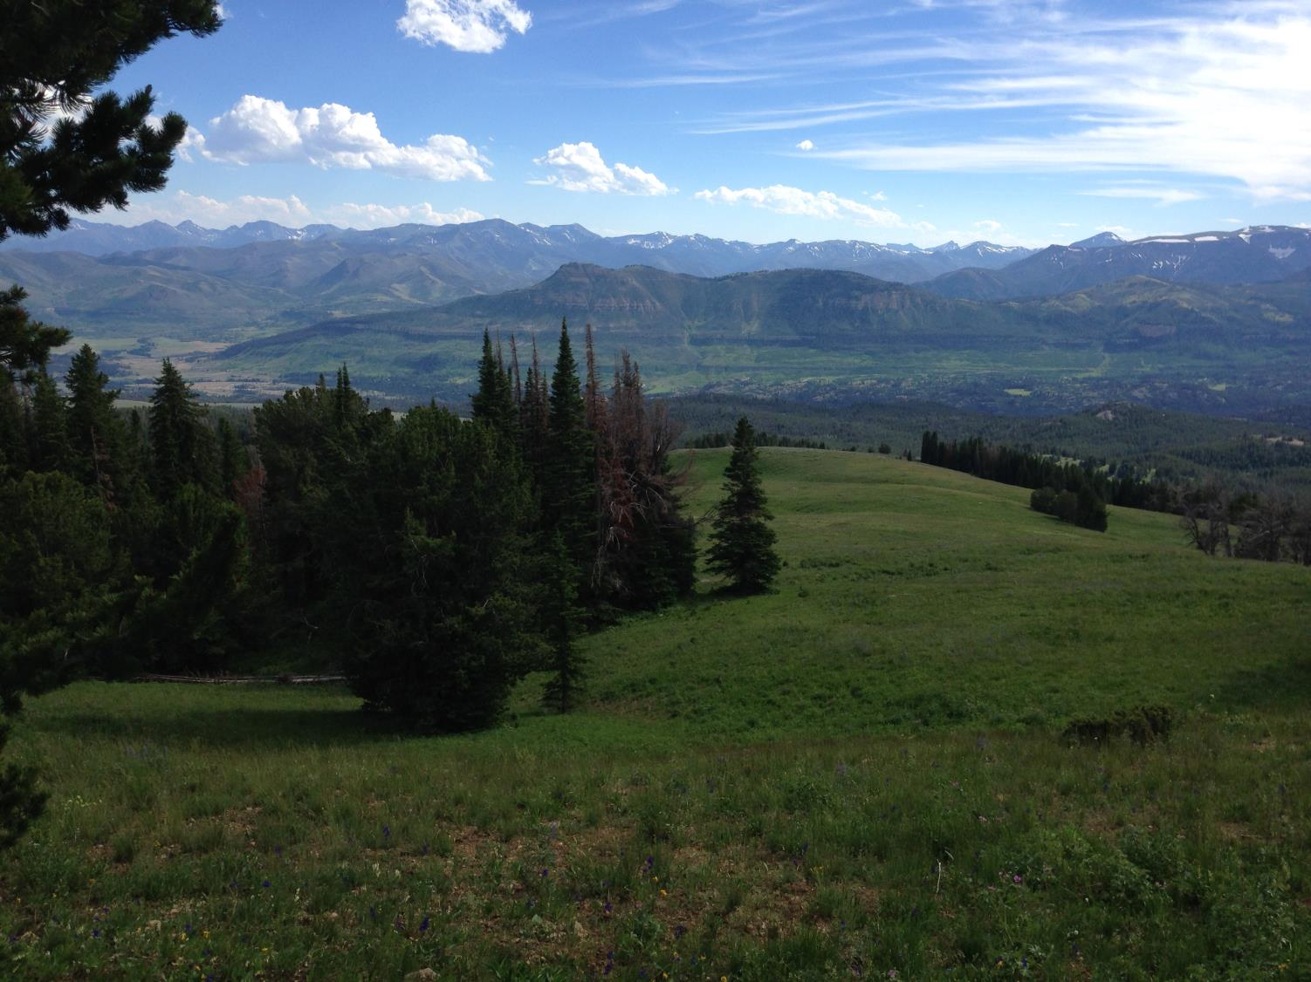
Dendrochronology and Forest History
3rd Biennial Shortleaf Pine Conference
Knoxville, Tennessee
22-24 September 2015
Henri D. Grissino-Mayer
Department of Geography
The University of Tennessee
Knoxville, Tennessee 37996

Slide 2
Basics of Dendrochronology
Dendrochronology: dendron = “tree” or “branch”; chronos = “time”; logos = “word” or “thought.”
Definition: The science that uses tree rings dated to their exact year of formation to analyze temporal and spatial patterns of processes in the physical and cultural sciences.
Disturbance Processes
Fire regimes: dominate the study types conducted in the U.S.
Insect dynamics: gaining traction in eastern U.S. with EAB and HWA
Tree health: effects of silvicultural management, various diseases and cankers, air/water pollution
Climate dynamics: short-term (drought), long-term (oscillations) in background
Stand Inventories
Tree establishment: single pulse, multiple pulses, evenly distributed over time?
Stand composition: transitioning of tree and shrub species over time
Stand structure: percentage of seedlings, saplings, mature trees in each species
Successional trajectory: what will be from what we had and have now

Slide 3
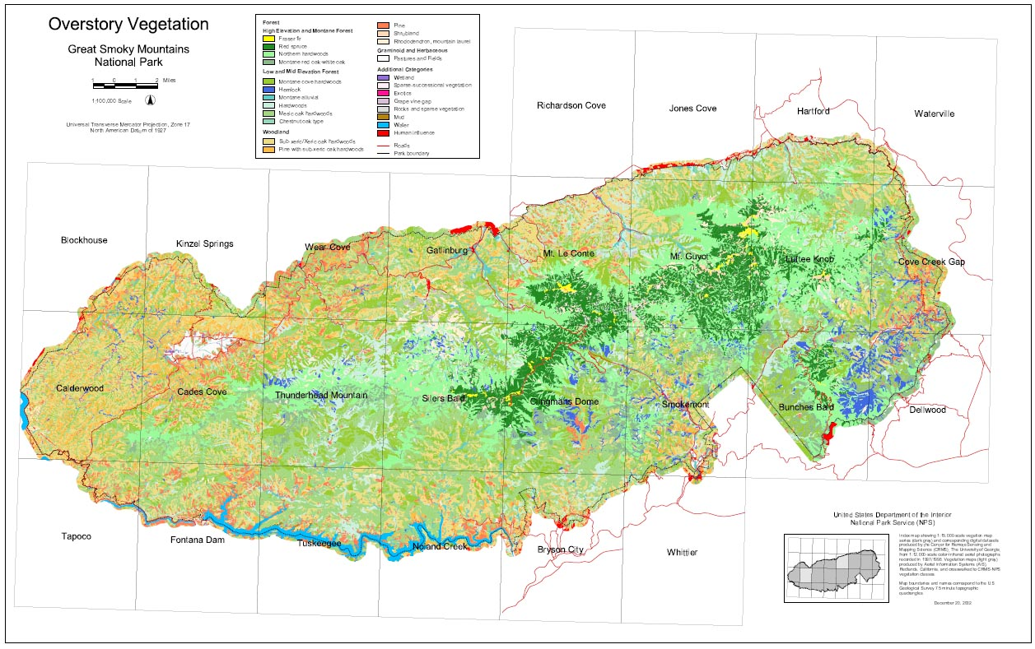
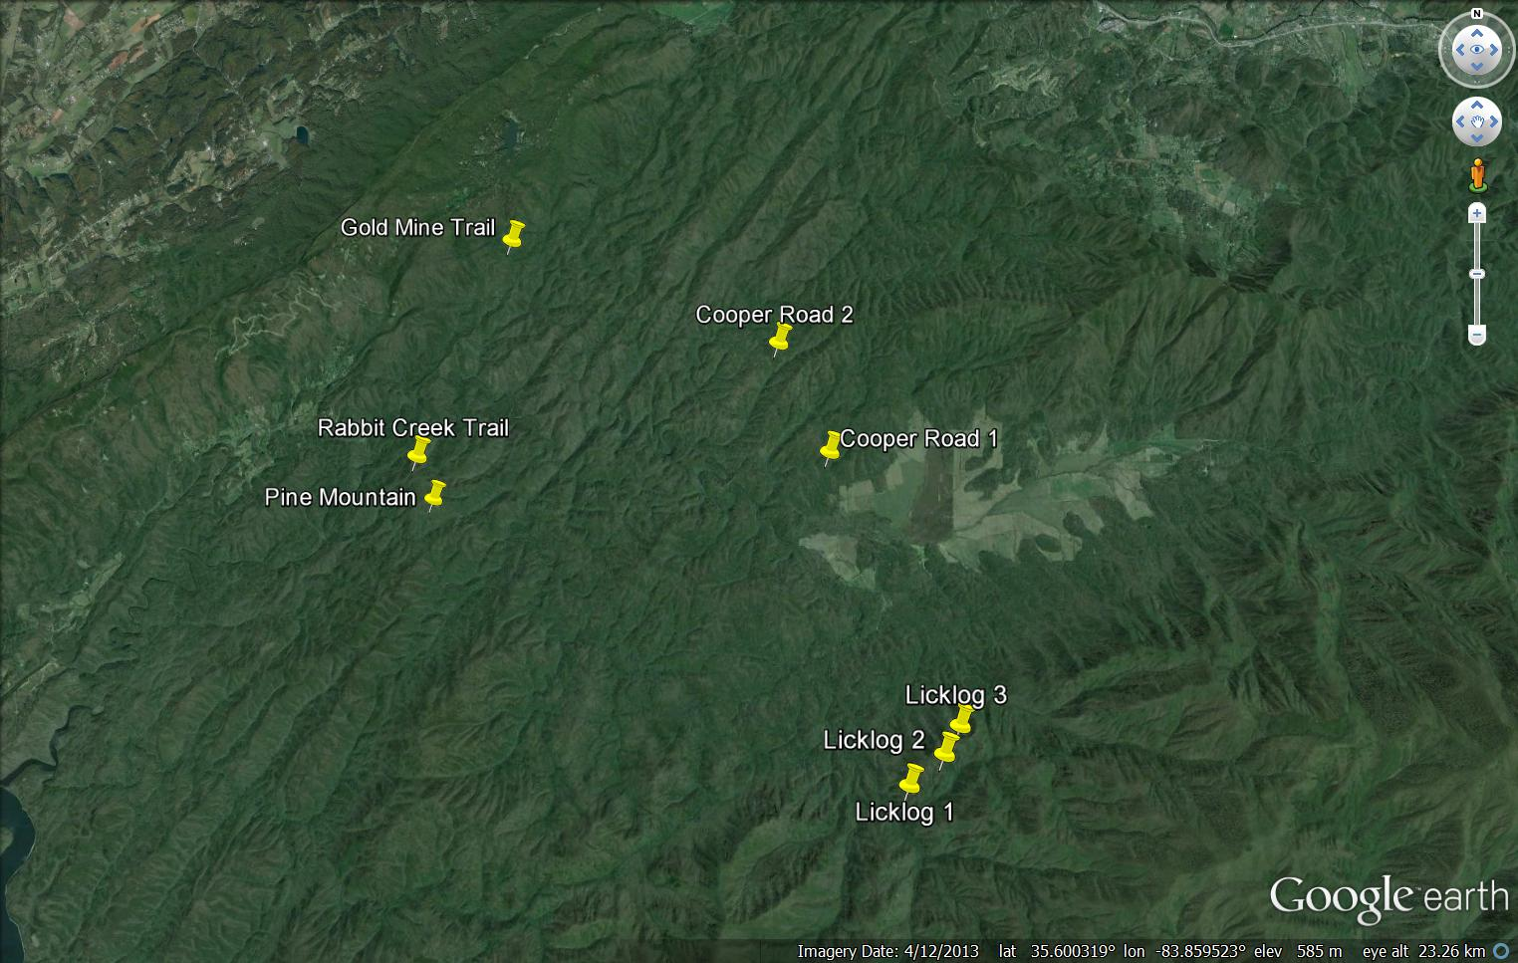
Fire History from Dendrochronology
Great Smoky Mountains National Park

Slide 4
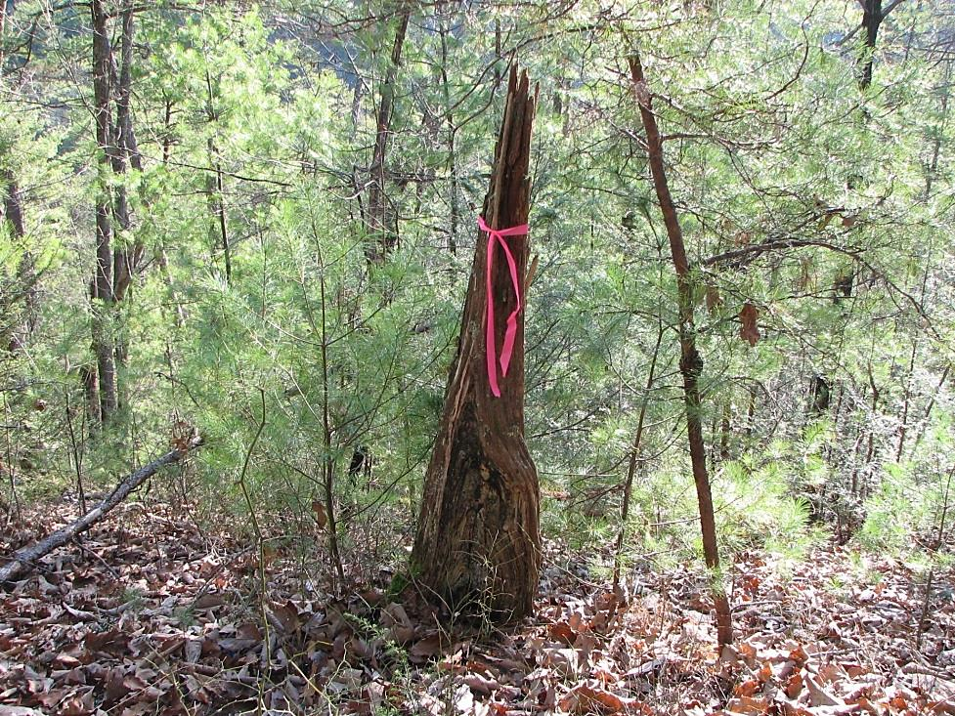
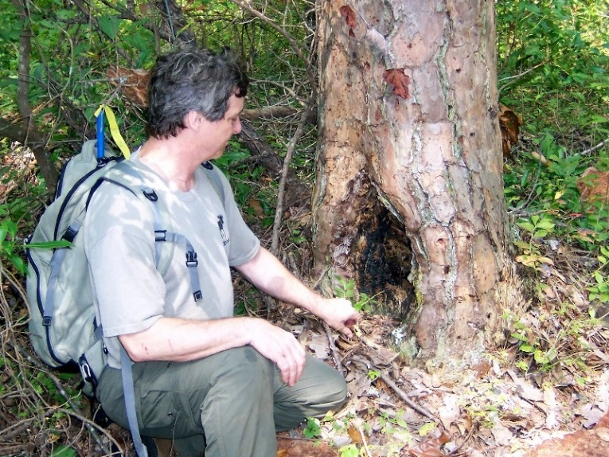
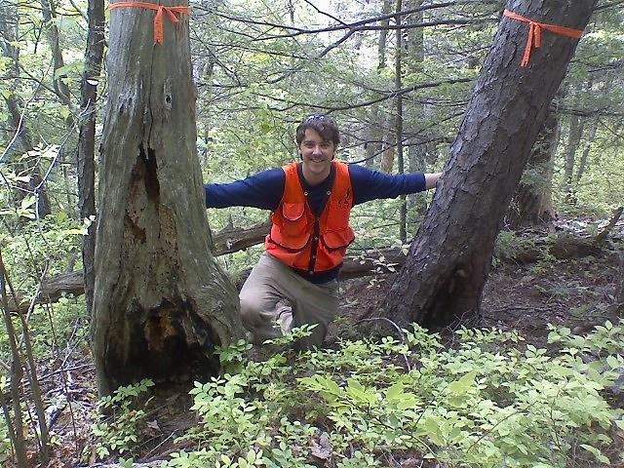
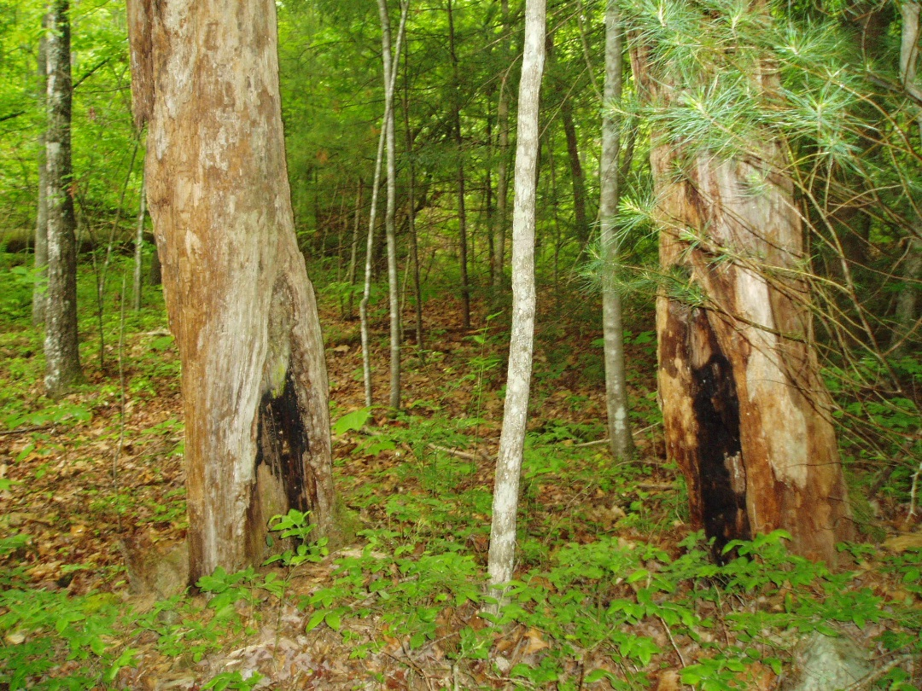

Slide 5
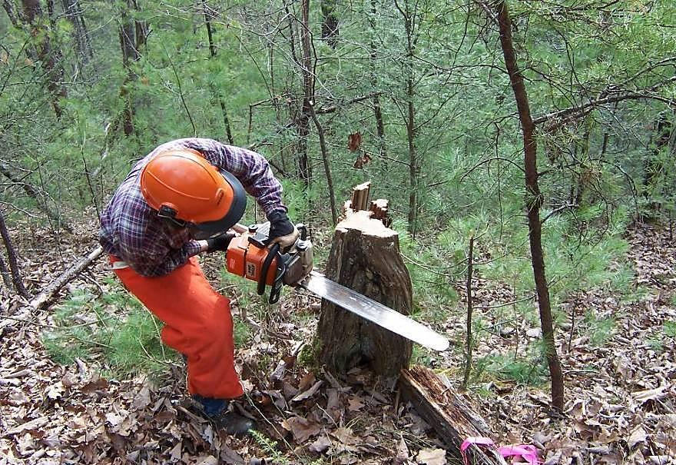
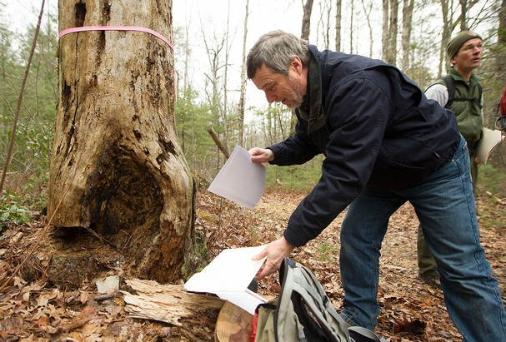
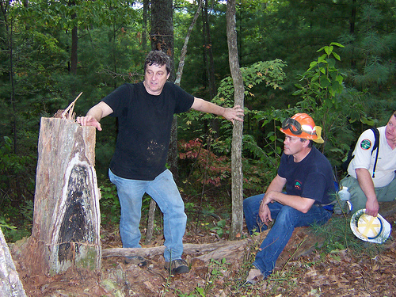
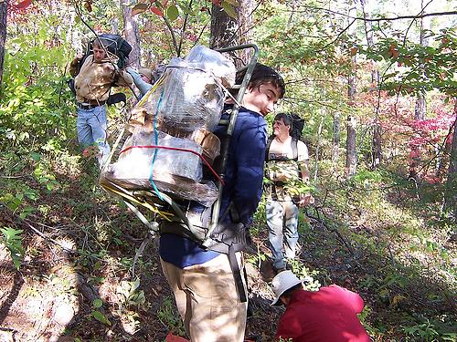

Slide 6
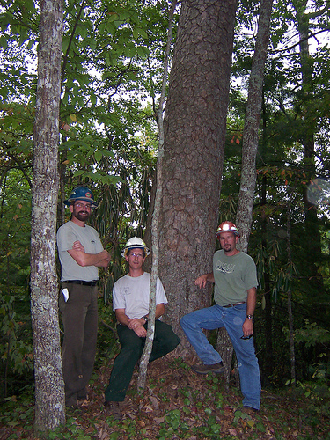
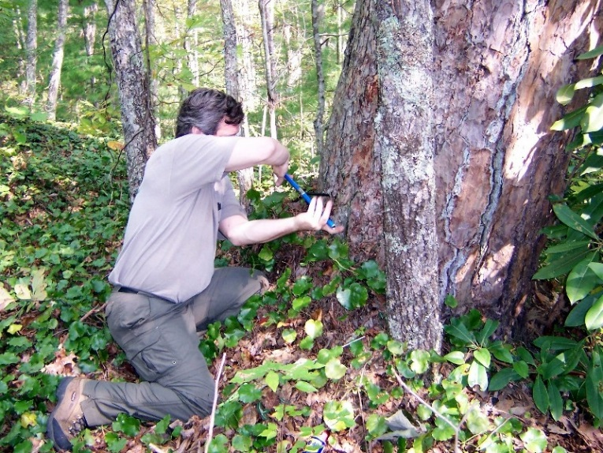
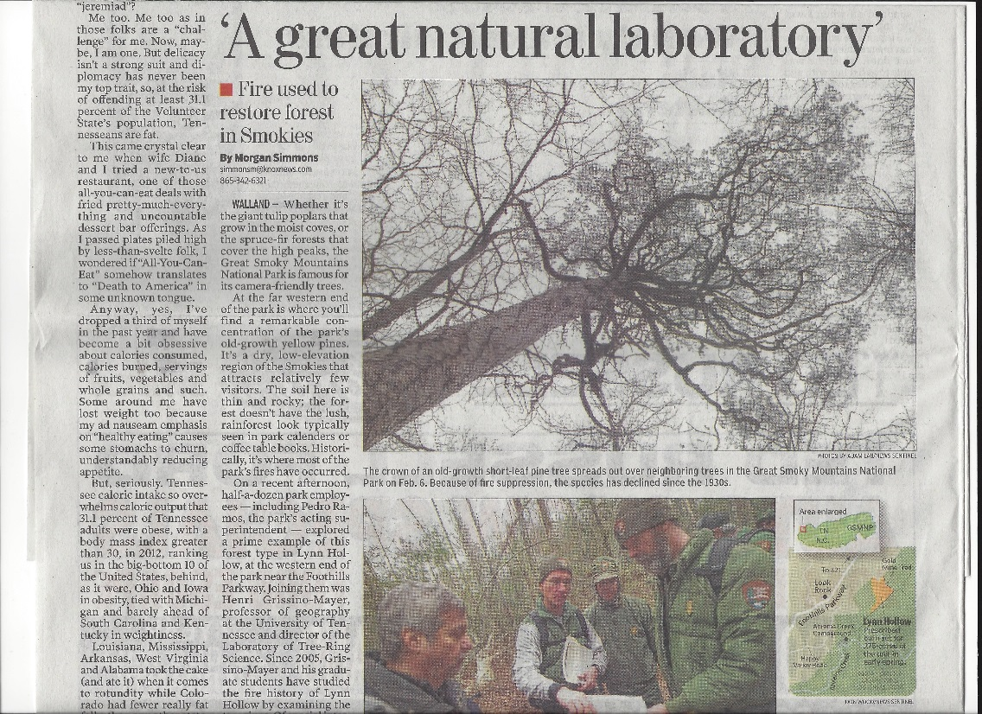

Slide 7
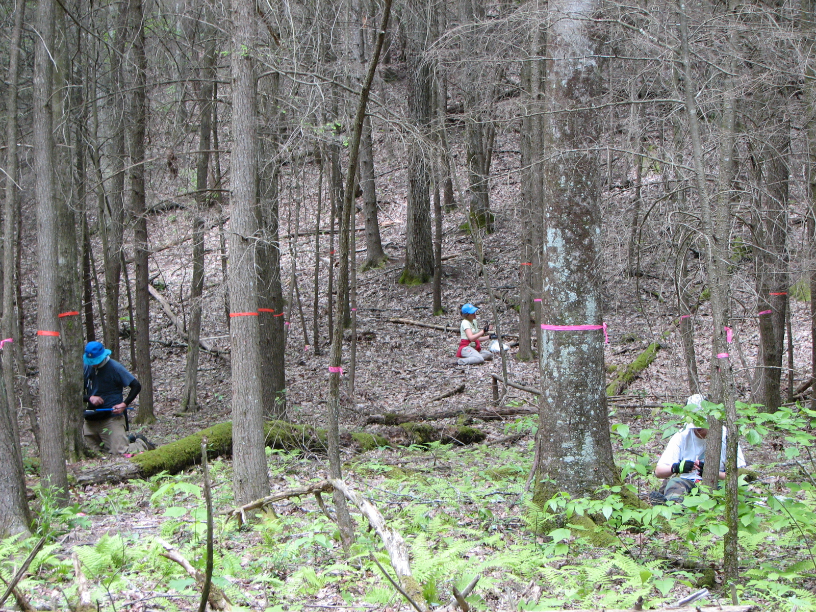

Slide 8
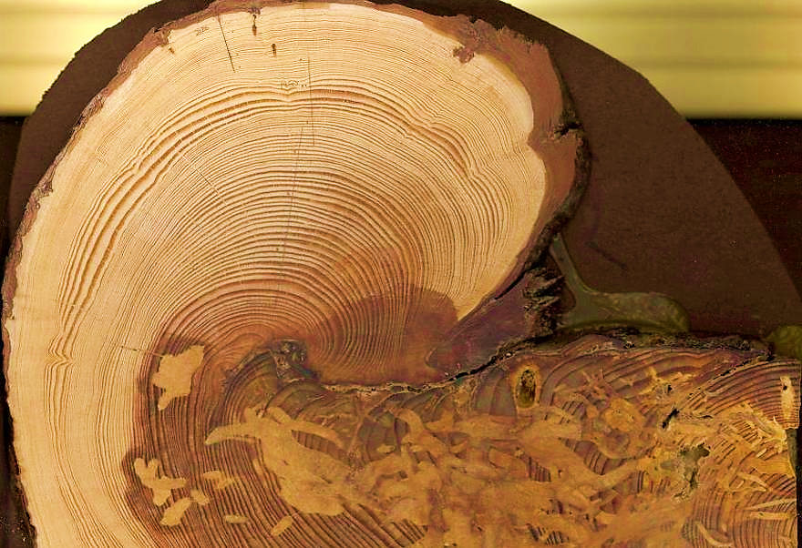
Fire History from Dendrochronology
Great Smoky Mountains National Park
Shortleaf pine, longest lived of the GSMNP yellow pines. Maximum age so far = 332 years.
1804

Slide 9
Fire History from Dendrochronology
Great Smoky Mountains National Park
Fire History from Dendrochronology
Great Smoky Mountains National Park
Each line is a tree
Each tic mark is a
dated fire scar
All Sites, 1825–1934
All fires:
MFI = 2 yrs, range 1 to 5 yrs
Widespread fires:
MFI = 7 yrs, range 2 to 17 yrs

Slide 10
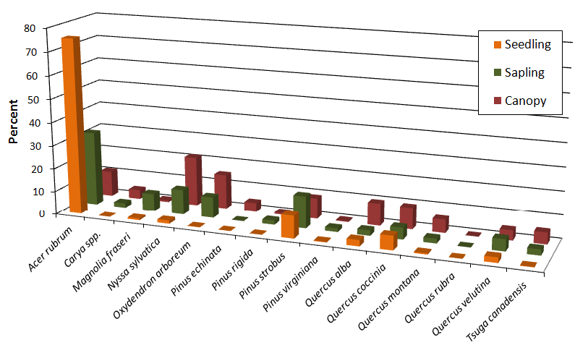
Fire History from Dendrochronology
Great Smoky Mountains National Park
Fire-intolerant tree species are becoming dominant:
Red maple
Eastern white pine
Black gum
Eastern hemlock
Biggest take-home message:
Our yellow pines are not regenerating.
Although “mesophication” is occurring, the proliferation of ericaceous shrubs is staggering such that any future wildfire could be catastrophic.
Clear shift from yellow pine/oak dominated fire tolerant stands to fire-intolerant, shade-tolerant hardwood and conifer species.
Fires are less common today, causing more fuels to build up, aided by southern pine beetle devastation, continuing the downward spiral, until some environmental threshold will be reached.
Restoration will be difficult to achieve. How do we remove an entire understory and dense ericaceous shrubs? Re-introduction of fire could be detrimental rather than beneficial.

Slide 11
The take-home message about fire in the Appalachians…
Fire was once a dominant disturbance process up until ca. 1925 to 1945.
Climate itself cannot have been the primary ignition source of fire post-1800, nor the primary cause of fire cessation post-1925.
If it was, then fires caused by lightning would be igniting today.
So, what’s different today?
Most fires found in the tree-ring record were likely caused by human ignitions.
Human ignitions were removed ca. 1925 to 1945 with establishment of national forests and national parks.
It’s possible that today’s forests in the pine/mixed hardwood stands of the southern Appalachians are simply reverting back to the original fire regime that existed before human ignitions became common.
Many eastern forests are thought to be undergoing “mesophication,” fire-intolerant tree species are becoming more common.
Soil charcoal study shows presence of mesic conifer charcoal in areas currently dominated by yellow pines, suggesting that “the current period of mesophication may not be unique in this ecosystem” (Underwood 2013).

Slide 12
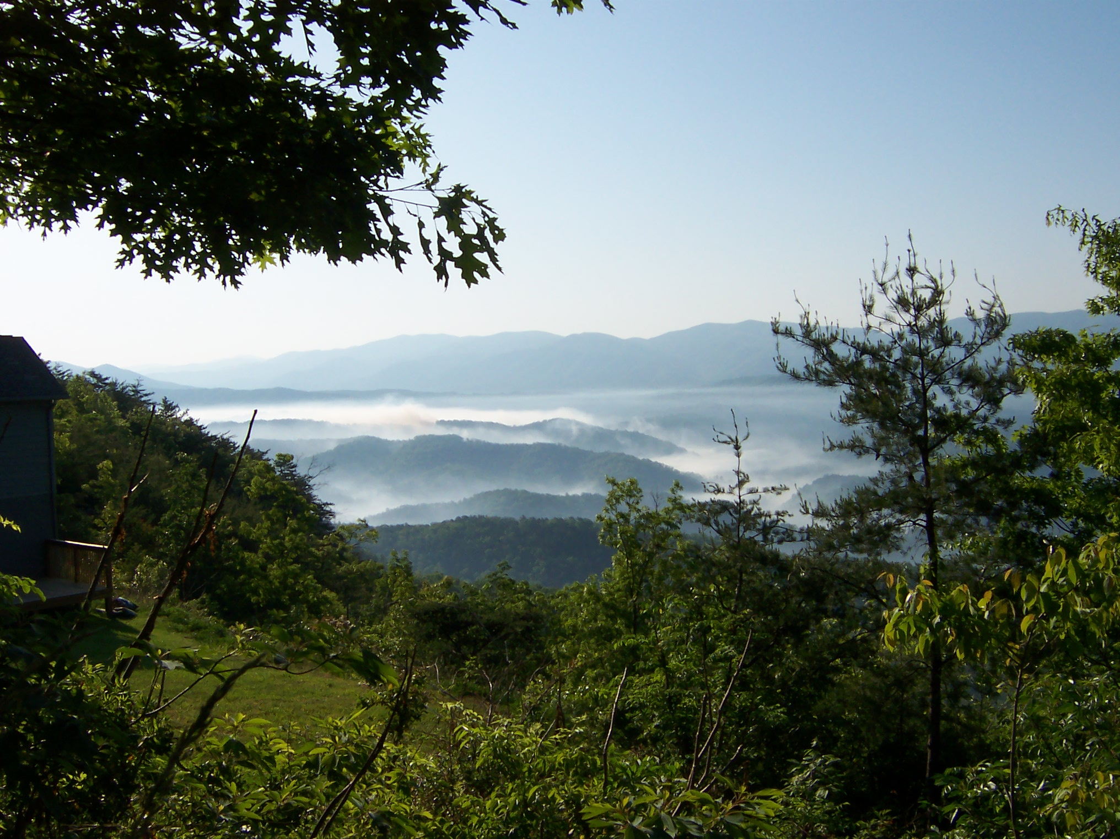
Thank you!

