Slide 1
Fire Exclusion is Causing an Increase in Hybrids Between Shortleaf and Loblolly Pine Rod Will, John Stewart, Jim Guldin, Barb Crane, Dana Nelson

Slide 2
Background
Since 1950, hybridization between shortleaf pine and loblolly pine has increased from 3% to 46% in shortleaf pine and 2% to 27% in loblolly pine stands (Stewart et al. 2012)

Slide 3
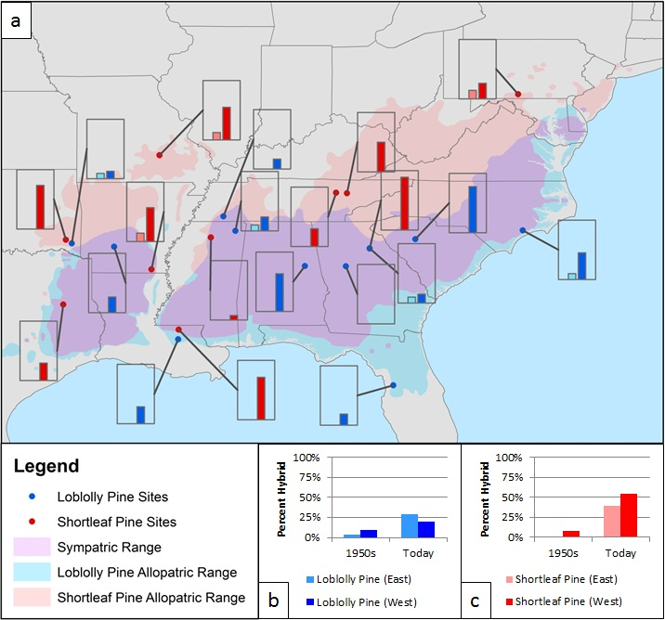
Tauer et al. 2012

Slide 4
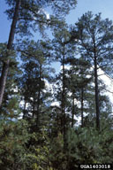
Risk of shortleaf pine extinction through introgression with loblolly pine

Slide 5
Why low previous hybridization?
Shortleaf and loblolly reproductively isolated by time of pollen shed (loblolly before shortleaf)
Shortleaf and loblolly isolated due to environmental preferences (loblolly = mesic, shortleaf = xeric)
Fire worked as a post reproduction selection pressure to reduce survival of hybrids and strengthen habitat preferences

Slide 6
What’s different now?
Increased cross fertilization
Climate change and increased variability in weather leading to overlap in pollen shed
Wide scale planting of loblolly pine and nonlocal seed sources
Habitat fragmentation
Removal of post-hybridization selection pressures against hybrids
Fire exclusion

Slide 7
Why do we care?
If loblolly, hybrids, and shortleaf all perform the same ecological function, does it matter?
If hybrids grow faster than shortleaf isn’t that a good thing?
Stuff happens

Slide 8
Why do we care?
Resilience!

Slide 9
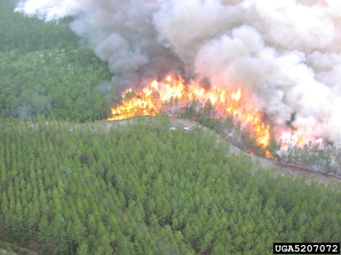
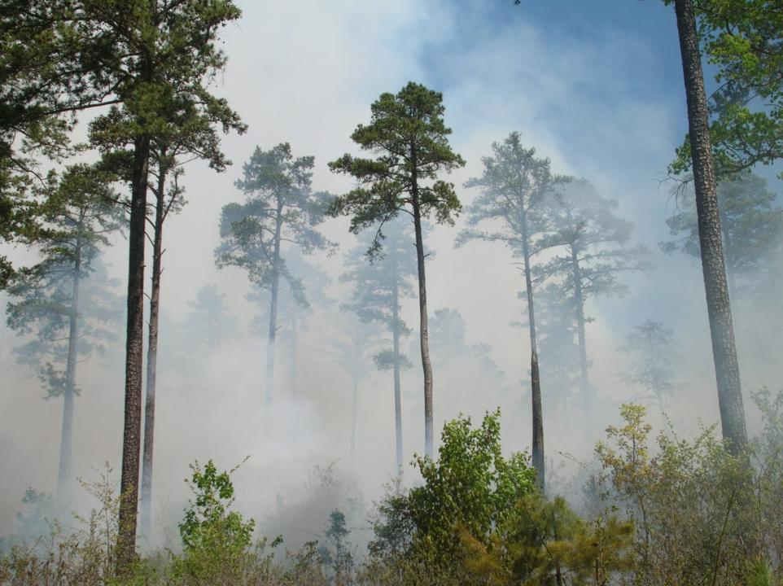
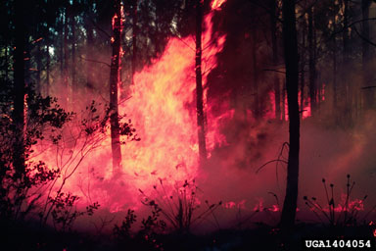
Shortleaf is more fire tolerant
Shortleaf pine
Loblolly pine

Slide 10
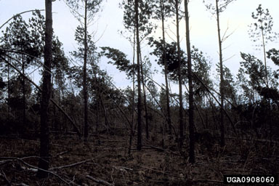
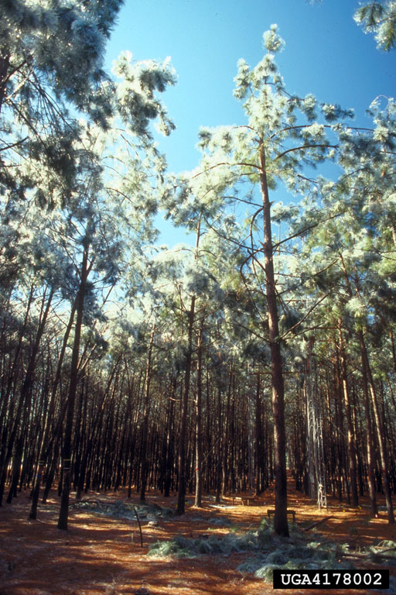
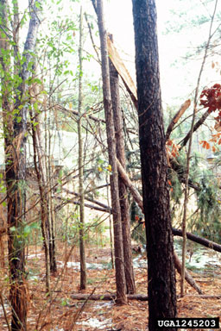
Shortleaf is more snow and ice tolerant
Shortleaf pine
Loblolly pine

Slide 11
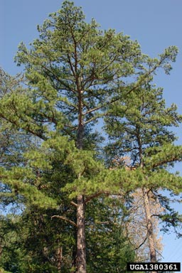
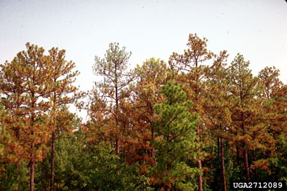
Shortleaf is more drought tolerant
Loblolly pine
Shortleaf pine

Slide 12
Why do we care?
Resilience - Shortleaf more drought, fire, cold, and ice tolerant
Sudden increase in hybridization indicates a perturbation
Once we cross the hybridization threshold, there may be no going back even if conditions change to favor pure shortleaf
Intrinsic value of biodiversity
I (we) like shortleaf pine

Slide 13
Objectives
To determine if there are morphological or physiological advantages that have allowed shortleaf pine x loblolly pine hybrids to increase over the last 60 years
To determine the role of fire exclusion

Slide 14
Associated Manuscripts
Stewart, J.S., Tauer, C.G., and Nelson, C.D. 2012. Bidirectional introgression between loblolly pine (Pinus taeda L.) and shortleaf pine (P. echinata Mill.) has increased since the 1950s. Tree Genet. Genomes 8:725-735
Tauer, C.G., Stewart, J.F., Will, R., Lilly, C., Guldin, J., and Nelson, C.D. 2012. Hybridization leads to loss of genetic stability in shortleaf pine: Unexpected consequences of pine management and fire suppression. Journal of Forestry. 110:216-224
Lilly, C.G., Will, R.E., and Tauer, C.G. 2012. Physiological and morphological attributes of shortleaf x loblolly pine F1 hybrid seedlings: is there an advantage to being a hybrid? Canadian Journal of Forest Research 42:238-246.
Will, R.E., C.J. Lilly, J. Stewart, S. Huff and C.G. Tauer. 2013 Recovery from topkill of shortleaf pine X loblolly pine hybrids compared to their parent populations. Trees: Structure and Function. DOI 10.1007/s00468-013-0866-
Stewart, J.F., R.E. Will, K.M Roberston, C.D. Nelson. 2015. Frequent fire protects shortleaf pine from introgression by loblolly pine. Conservation Genetics
Bradley, J., R.E. Will, et al. In Preparation. Sprouting response of shortleaf x loblolly pine seedlings to fire.

Slide 15
Background
What we already know about hybrids:
Can grow as fast as loblolly
Have intermediate needle characteristics
Are resistant to fusiform rust like shortleaf
Have better cold resistance than loblolly
Have better form than loblolly
What we don’t know about hybrids:
Resprouting potential following topkill
Fire adaptations – basal crook

Slide 16
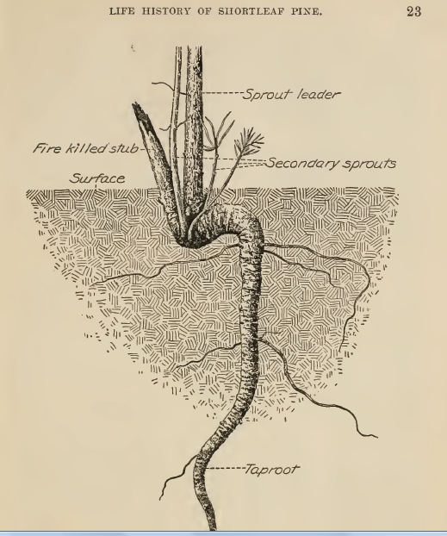
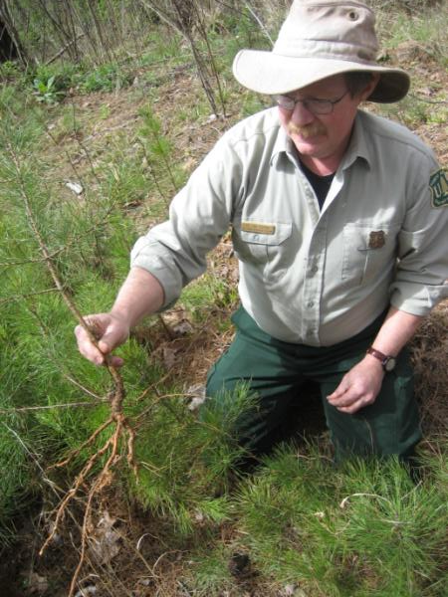
Picture from Mattoon 1915

Slide 17
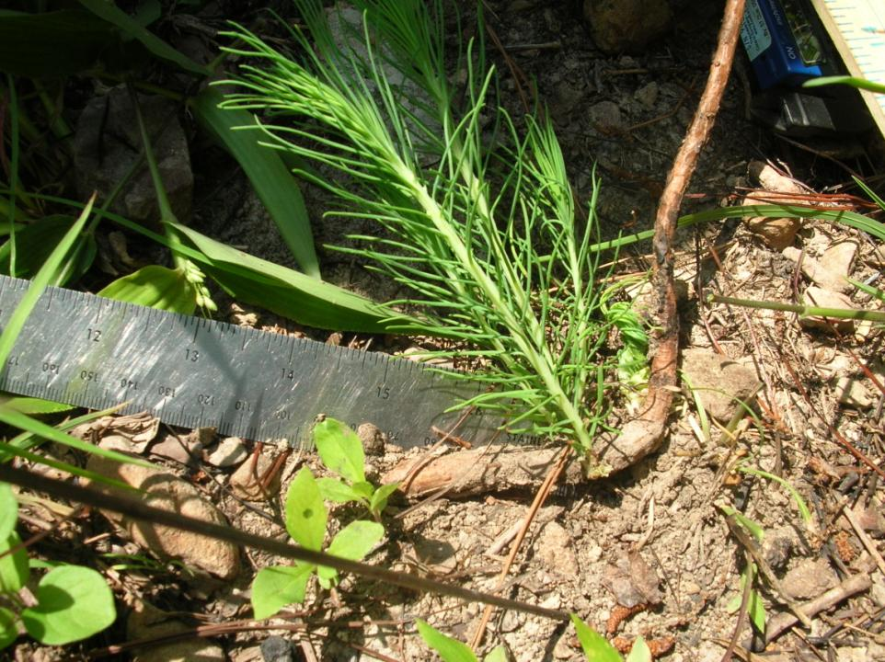

Slide 18
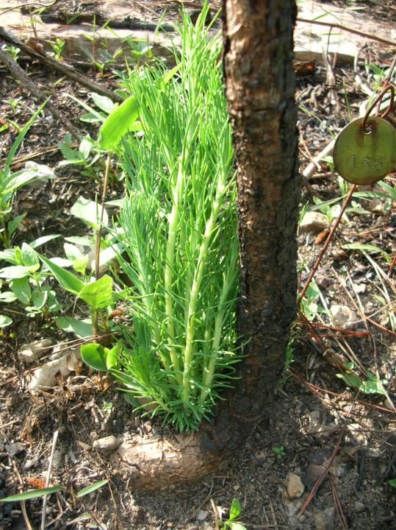

Slide 19
How do hybrids respond to topkill?
Nursery study using loblolly pine, shortleaf pine, and F1 hybrids
Topclipping

Slide 20
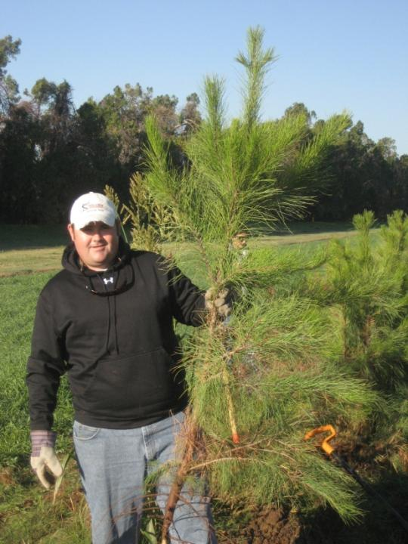
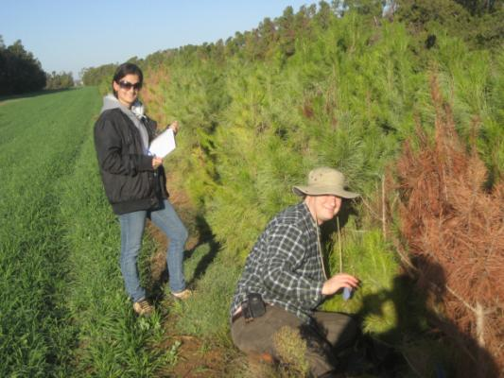
Seedling size end of year 3

Slide 21
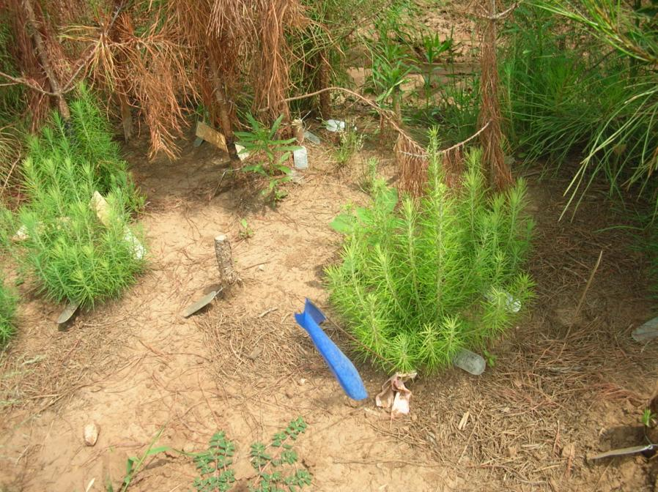

Slide 22
Seedling survival after topkill after 2
and into 3rd growing season

Slide 23
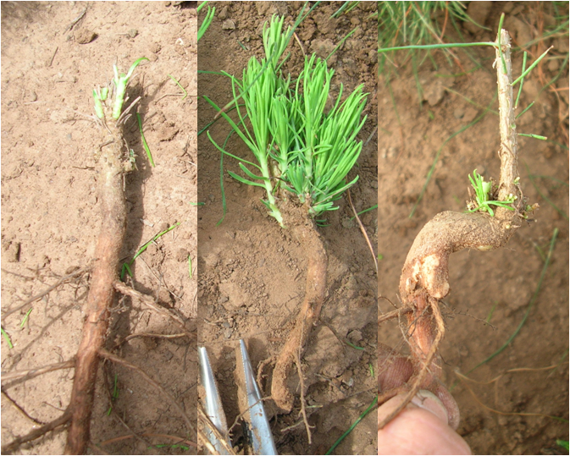
HYBRID
SHORTLEAF
LOBLOLLY

Slide 25
Height to first sprout
shortleaf pine = 3.5 ± 0.6 mm SE
hybrids = 7.7 ± 0.6 mm SE
loblolly pine = 21.3 ± 1.5 mm SE

Slide 26
Is the crook
important?
Char
Not Char

Slide 27
How does prescribed fire affect resprouting of hybrids?
Seeds of loblolly, shortleaf, and hybrid planted in Idabel, OK
Burned in spring after 1st growing season and in August of the 2nd growing season
Resprouting measured

Slide 28
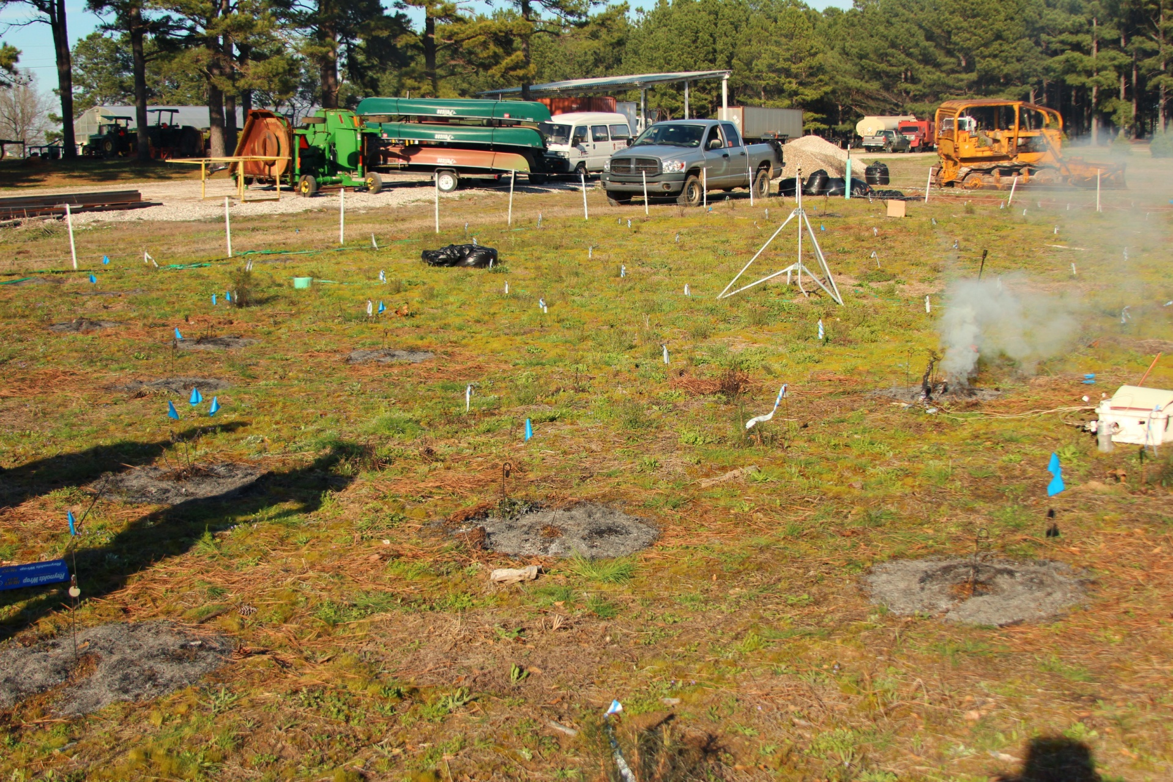

Slide 29
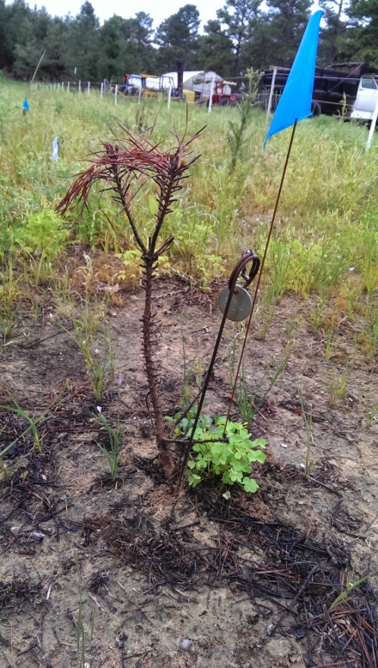
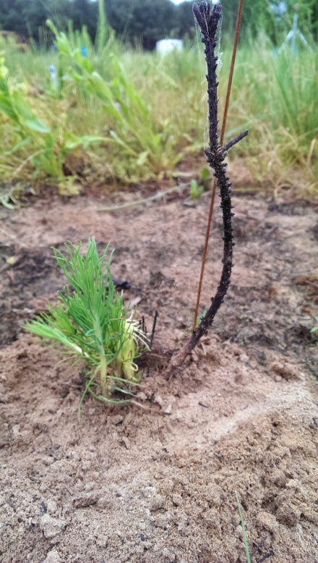
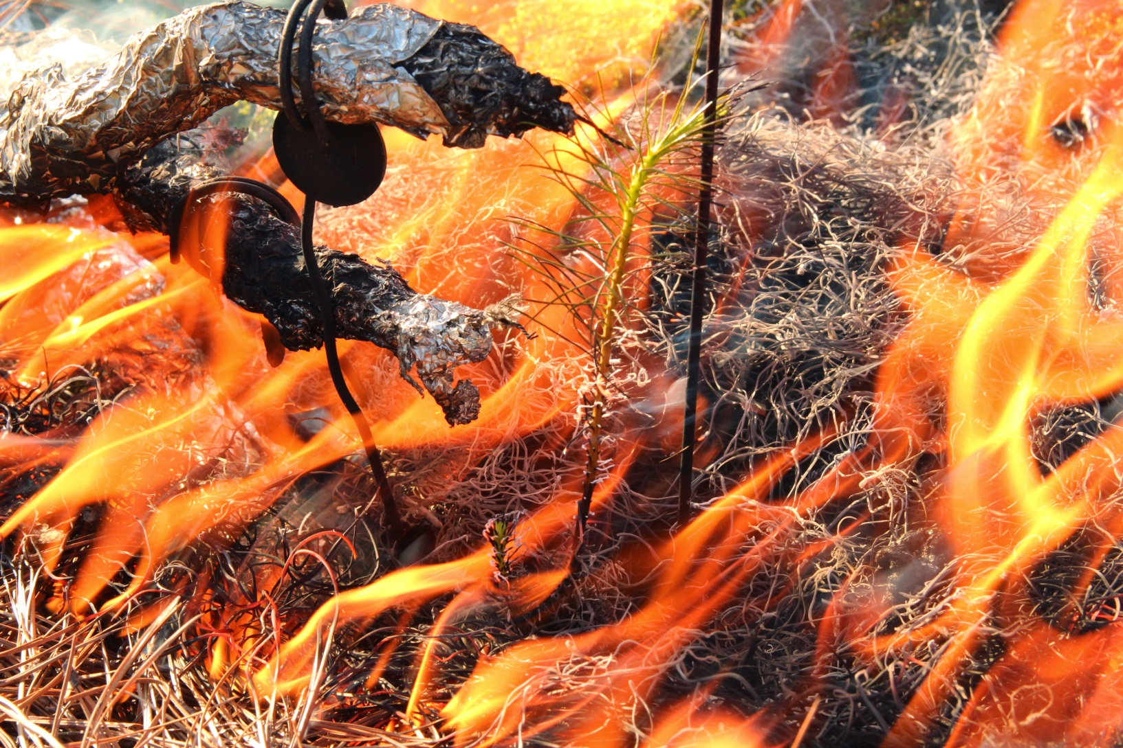
Spring burn seedlings alive in May
Species | Total | May Surviving | Percent
Loblolly | 35 | 0 | 0 %
Hybrid | 33 | 1 | 3 %
Shortleaf | 28 | 16 | 44 %

Slide 30
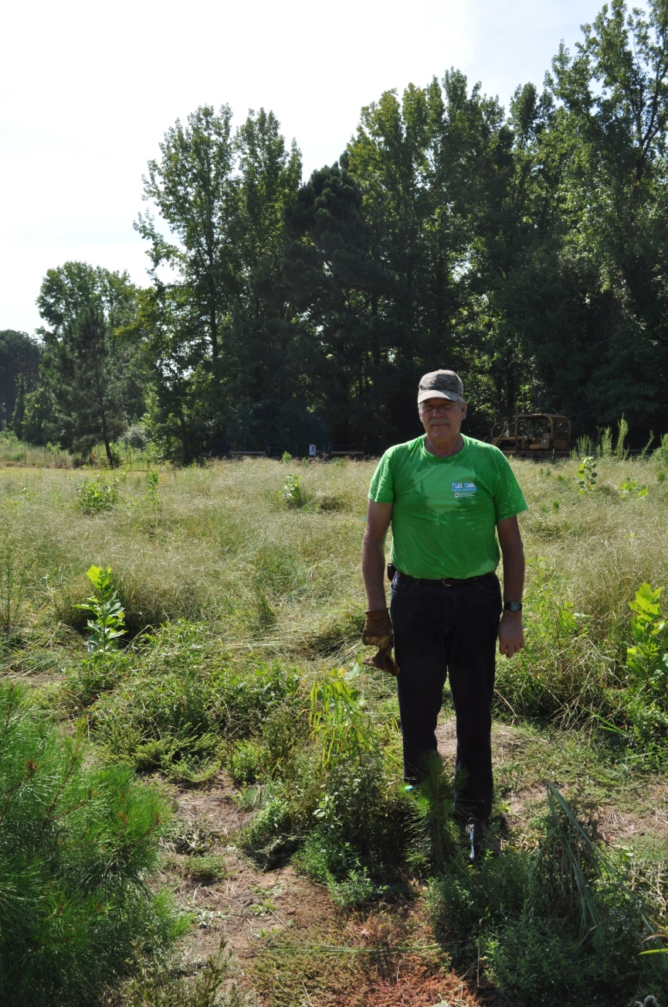
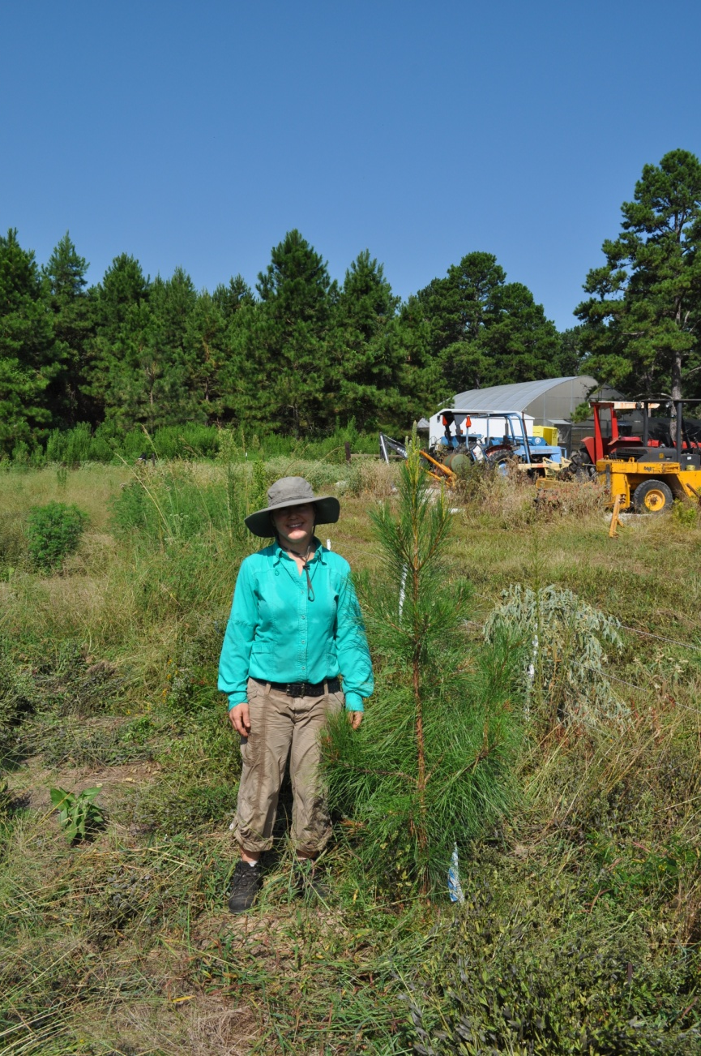

Slide 31
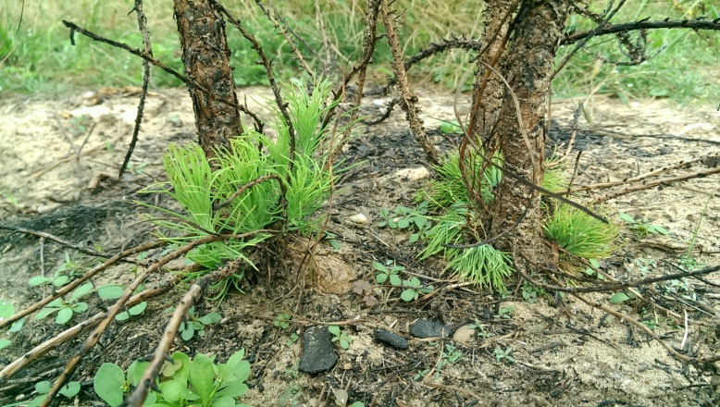
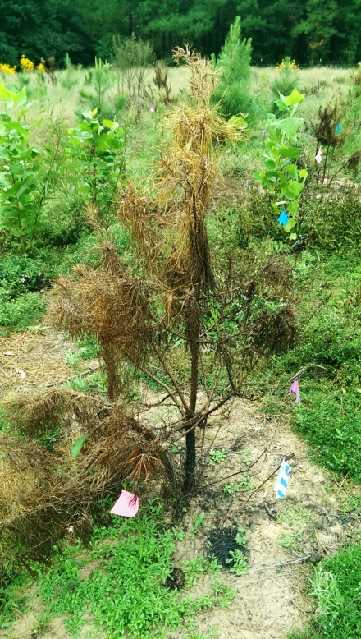
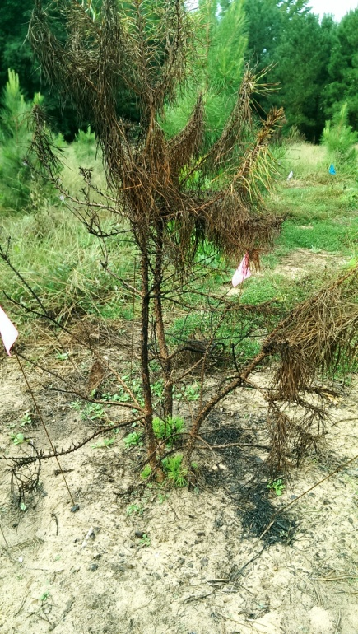
Summer burn seedlings alive in October
Species | Total | October Surviving | Percent
Loblolly | 26 | 0 | 0 %
Hybrid | 26 | 1 | 4 %
Shortleaf | 16 | 10 | 63 %

Slide 32
How does previous prescribed fire affect seedling populations?
Tall Timbers Research Station and Land Conservancy near Tallahassee, Florida
Mixed canopy of shortleaf and loblolly pine
Compared seedling and adult population
Not burned for 30+ years
Burned every 2 years

Slide 33
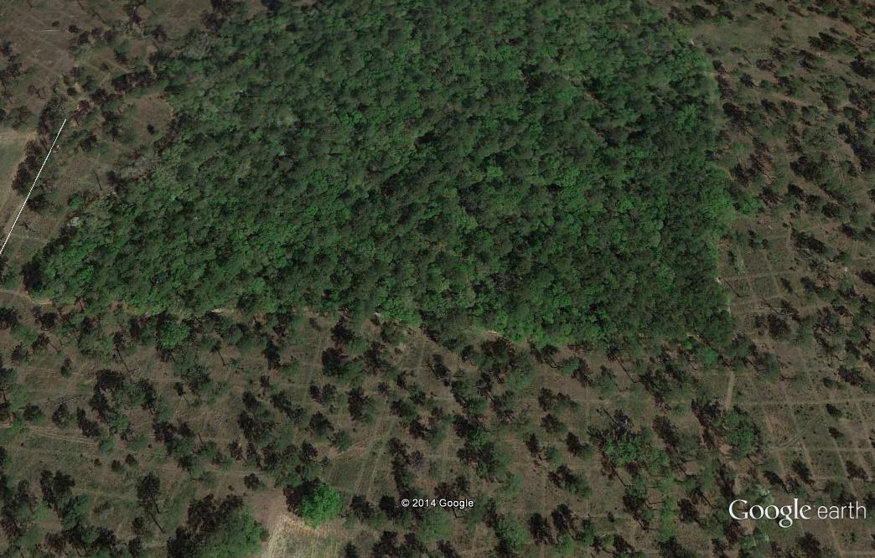

Slide 34
Fire eliminated loblolly and greatly reduced hybrids
Seedlings from nonburned areas
Loblolly = 45%
Hybrids = 30%
Shortleaf = 25%
Seedlings from burned areas
Loblolly = 0.0%
Hybrids = 15%
Shortleaf = 85%
-Of hybrids in burned areas, 10% of the 15% total were SLBC2
-None of the hybrids from the burned areas were LLBC

Slide 35
Conclusions
Hybrid pines have several competitive advantages over their parent species:
Growth rate; Hybrids = Loblolly > Shortleaf
Sprouting after damage; Shortleaf > Hybrids > Loblolly
Hybrids lack a strong basal crook that can serve as an adaptation to resprout following surface fire
Prescribed Fire kills hybrids
A regular burning regime shifts population to pure shortleaf

Slide 36
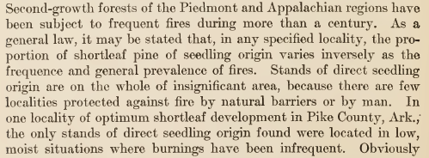
Shortleaf pine is a fire-adapted fire-dependent species
Quotes from Mattoon 1915

Slide 37
Management implications
Mechanical damage alone is not enough to eliminate hybrids (or loblolly pine) during the first couple of growing seasons
Prescribed fire will reduce or eliminate hybrids due to lack of strong basal crook
Seedling age and season of treatment matter
Emphasize restoration efforts where fire can be used in management, i.e., without including fire, it probably doesn’t matter

Slide 38
Implications for artificial regeneration
Remove hybrids from orchards
The crook is important - Sow at wider spacing in nursery to allow crook to develop or, plant deeper to protect dormant buds

Slide 39
Some shortleaf pine (Pinus echinata Mill.) seed orchard clones are hybrids with loblolly pine¹
John F. Stewart, Barbara S. Crane, Rodney E. Will, C. Dana Nelson
From 8 to 10% of U.S. Forest Service orchard clones from 0 to 10% of state agency orchard clones had hybrid character in the range of F1 or first backcrosses to shortleaf pine.
Hybrid frequencies in seedlings available for purchase were about the same as the parent population

Slide 40
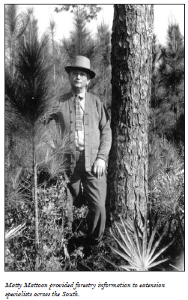
We need a modern day Matty Mattoon!

