Slide 1
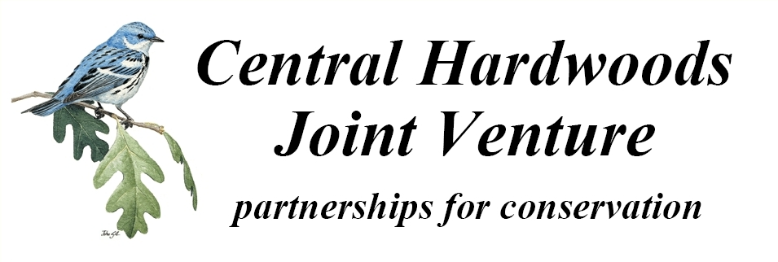
History and Composition of the Interior Highlands Shortleaf Pine Restoration Initiative
A presentation to the
3rd Biennial Shortleaf Pine Conference
22 September 2015
Jane A. Fitzgerald,
Central Hardwoods Joint Venture Coordinator

Slide 2
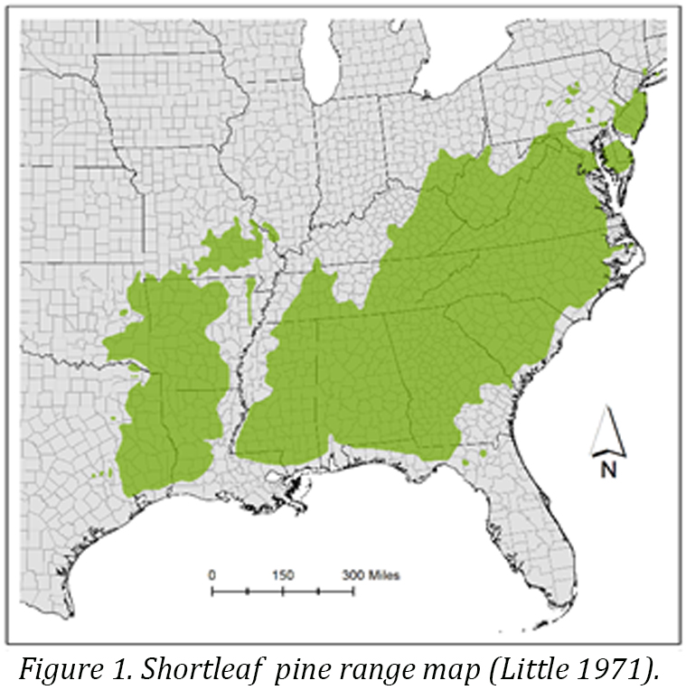
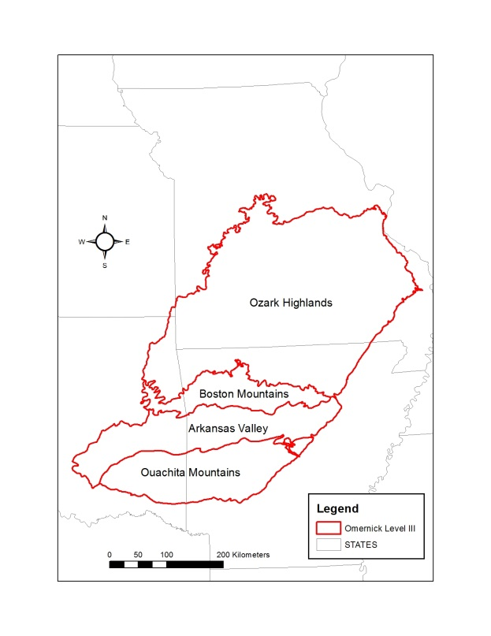
The “Interior Highlands”

Slide 3
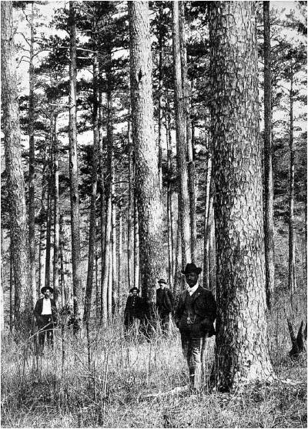
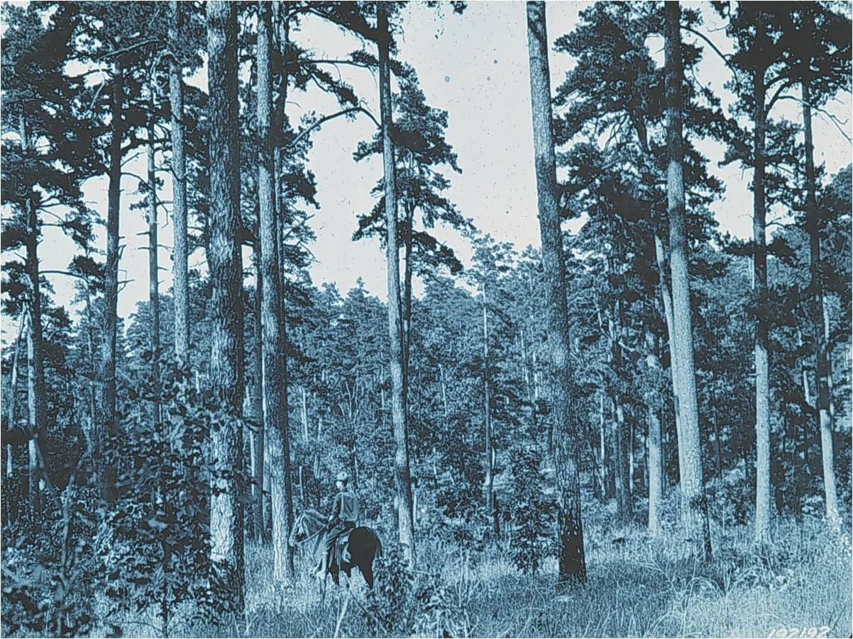

Slide 4
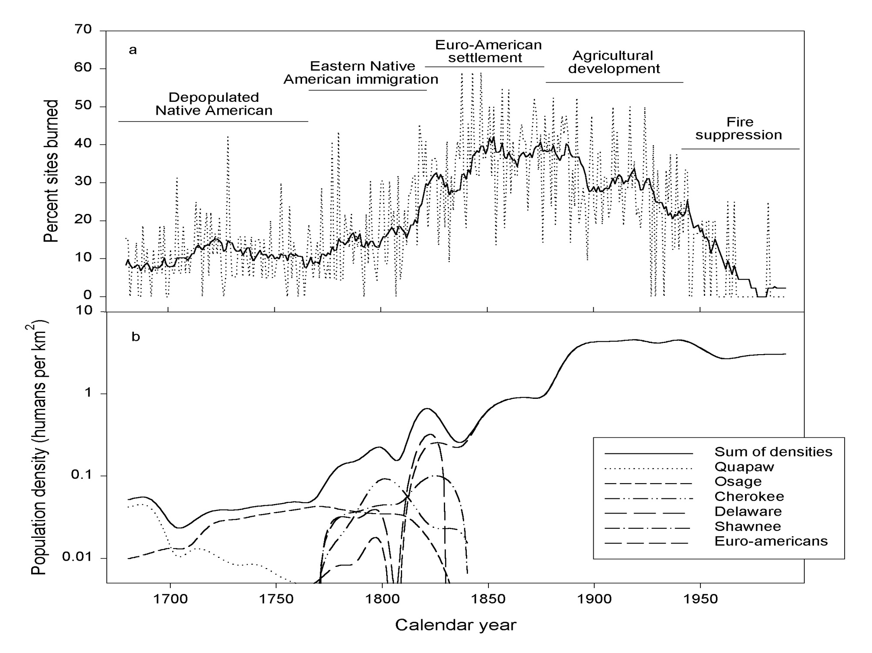
Guyette, R.P., Muzika, R.M., and D.C. Dey. 2002. Dynamics of an anthropogenic fire regime. Ecosystems, 5:472-486.

Slide 5
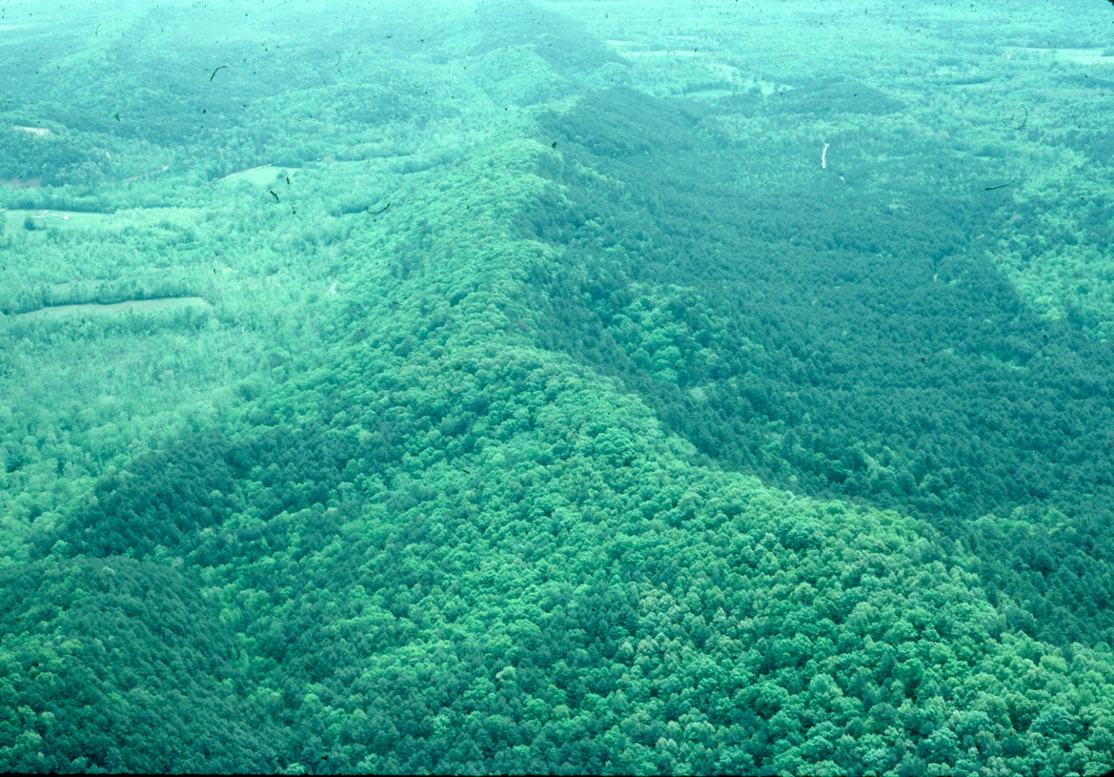
East/West trending ridges & valleys of the Ouachitas. Shortleaf pine dominates southern & western exposures Oaks/hickory dominates steep north slopes & streamsides.

Slide 6
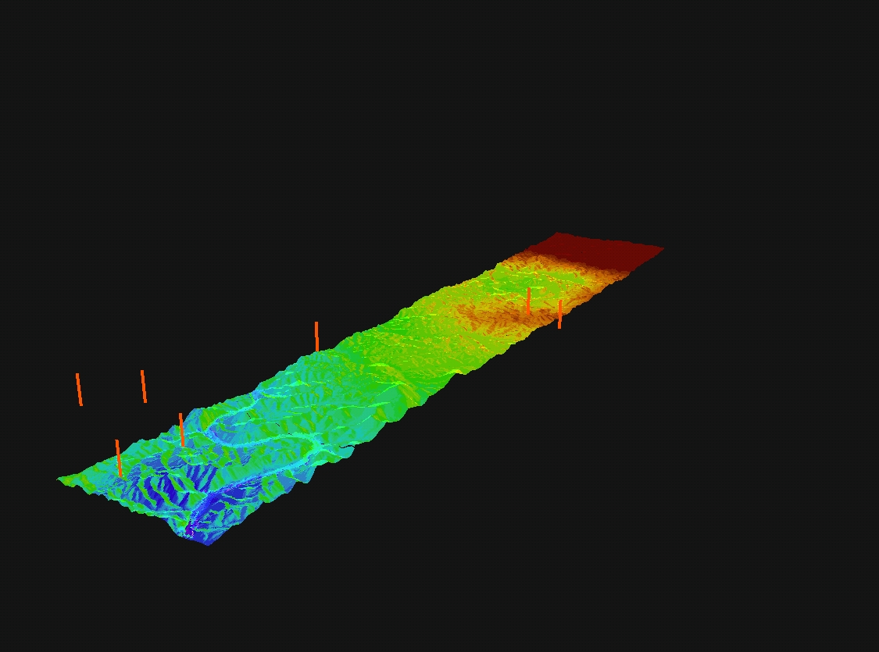
1
5
Mean Fire intervals (MFI)
9
10
45
55
15
N
70
Fire intervals over topography (elevation X3)
Notes:
Fires burned un-evenly across a landscape both in terms of time and scape. Topographic variation results in differences in relative moisture, with for example, south-facing typically slopes being drier and north-eastern slopes, especially in lower landscape positions being moister. Flat areas can burn more because they typically have few elements that stop the spread of the fire. Geology and soil types also have an influence (some soils hold more moisture and geo and soil also influence the plant communities, with some being more flammable than others)

Slide 7
General natural community distributions
Savannas and Prairies
Woodlands
8
7
9
4
3
N
Fire intervals over topography (elevation X3)
2
1
Dry-mesic forests
Mesic forests
Notes:
More frequent and intensive fires resulted in more open community types.

Slide 8
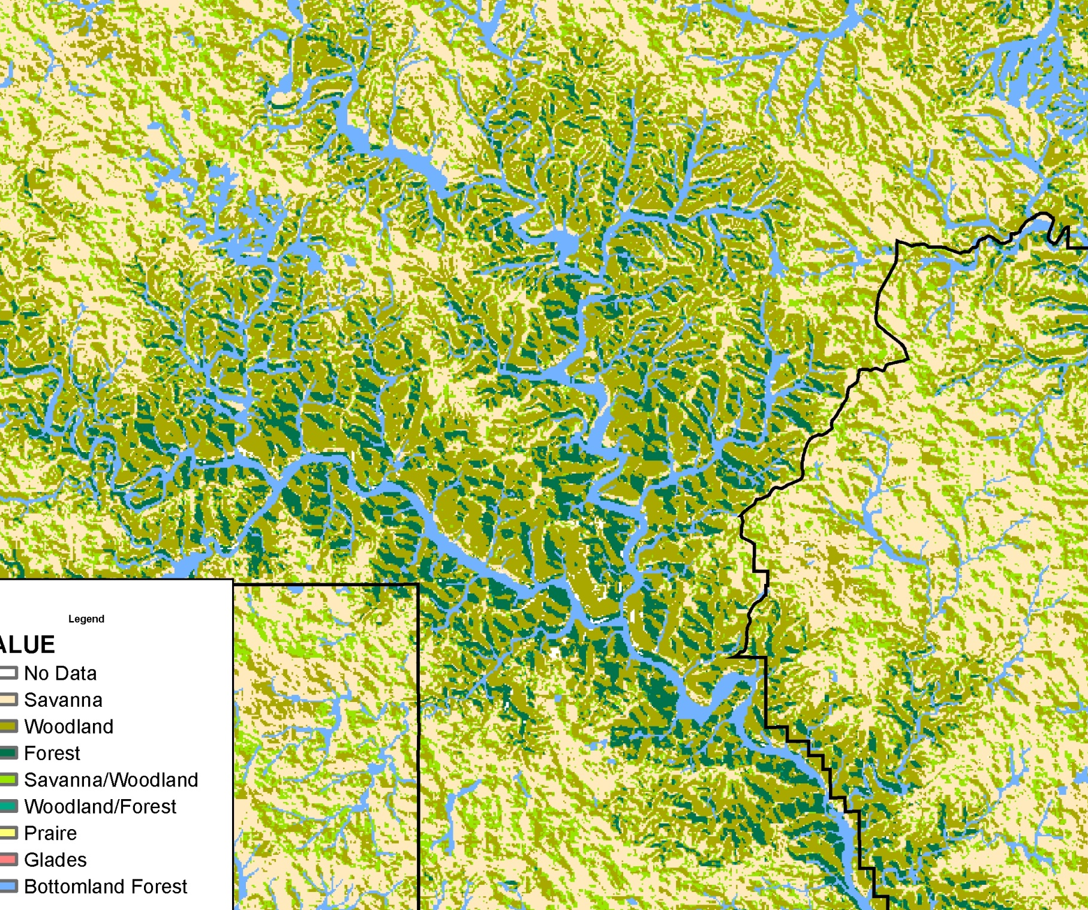

Notes:
But within a given landscape, different community types can intermingle…you can get a diversity of plants and wildlife in these landscapes as a result.

Slide 9
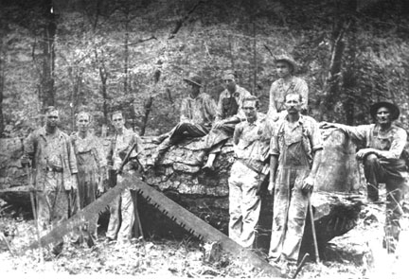
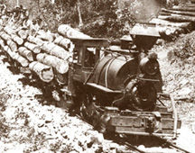
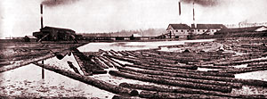
Notes:
So all that history is well and good, but around the early 1900s, things changed when the forests were almost completely cutover for building material, railroad ties, etc. AR ranked 5th in the nation for lumber production in 1909, mostly because of pine coming from the Ouachitas and, for example, a half-million white oak ties were shipped from Reeds Spring, MO in 1912 alone.

Slide 10
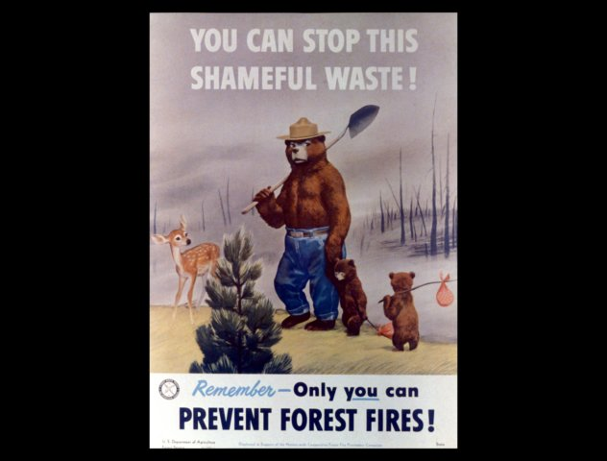

Slide 11
As a result of the great harvest, and later fire were suppression, the species and age composition of the forests are now very different than they were historically.
From: Regime Shifts and Weakened Environmental Gradients in Open Oak and Pine Ecosystems. Brice B. Hanberry, Dan C. Dey, Hong S. He; PLoS ONE 7(7): e41337. doi:10.1371/journal.pone.0041337
“A 160% increase in the Current River Hills subsection was due to replacement of shortleaf pine by black oak and scarlet oak followed initial logging and
burning of the pineries.”
“Oaks were the dominant genus throughout the Ozark Highlands and although they still are today, there has been a major reduction in their dominance and distribution since the historical surveys, along with loss of open oak ecosystems.”

Slide 12
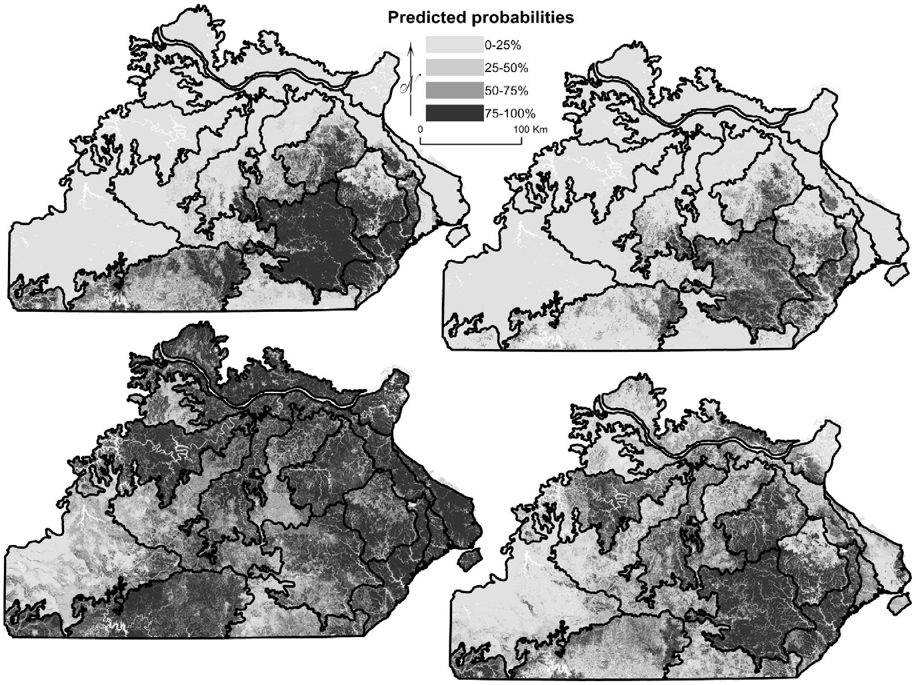
Figure 3. Predicted probabilities for species distributions of two fire-dependent species. Panels are (a) historical distribution of shortleaf
pine, (b) current distribution of shortleaf pine, (c) historical distribution of white oak, and (d) current distribution of white oak. In, Regime Shifts and Weakened Environmental Gradients in Open Oak and Pine Ecosystems. Brice B. Hanberry, Dan C. Dey, Hong S. He; PLoS ONE 7(7): e41337. doi:10.1371/journal.pone.0041337

Slide 13
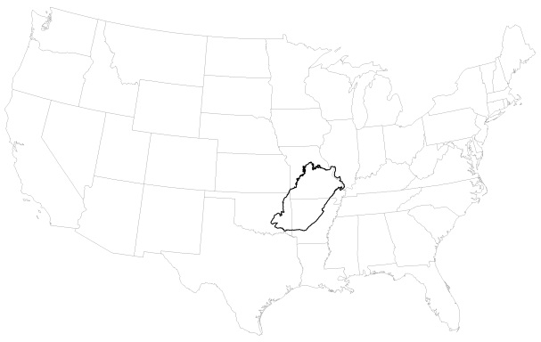
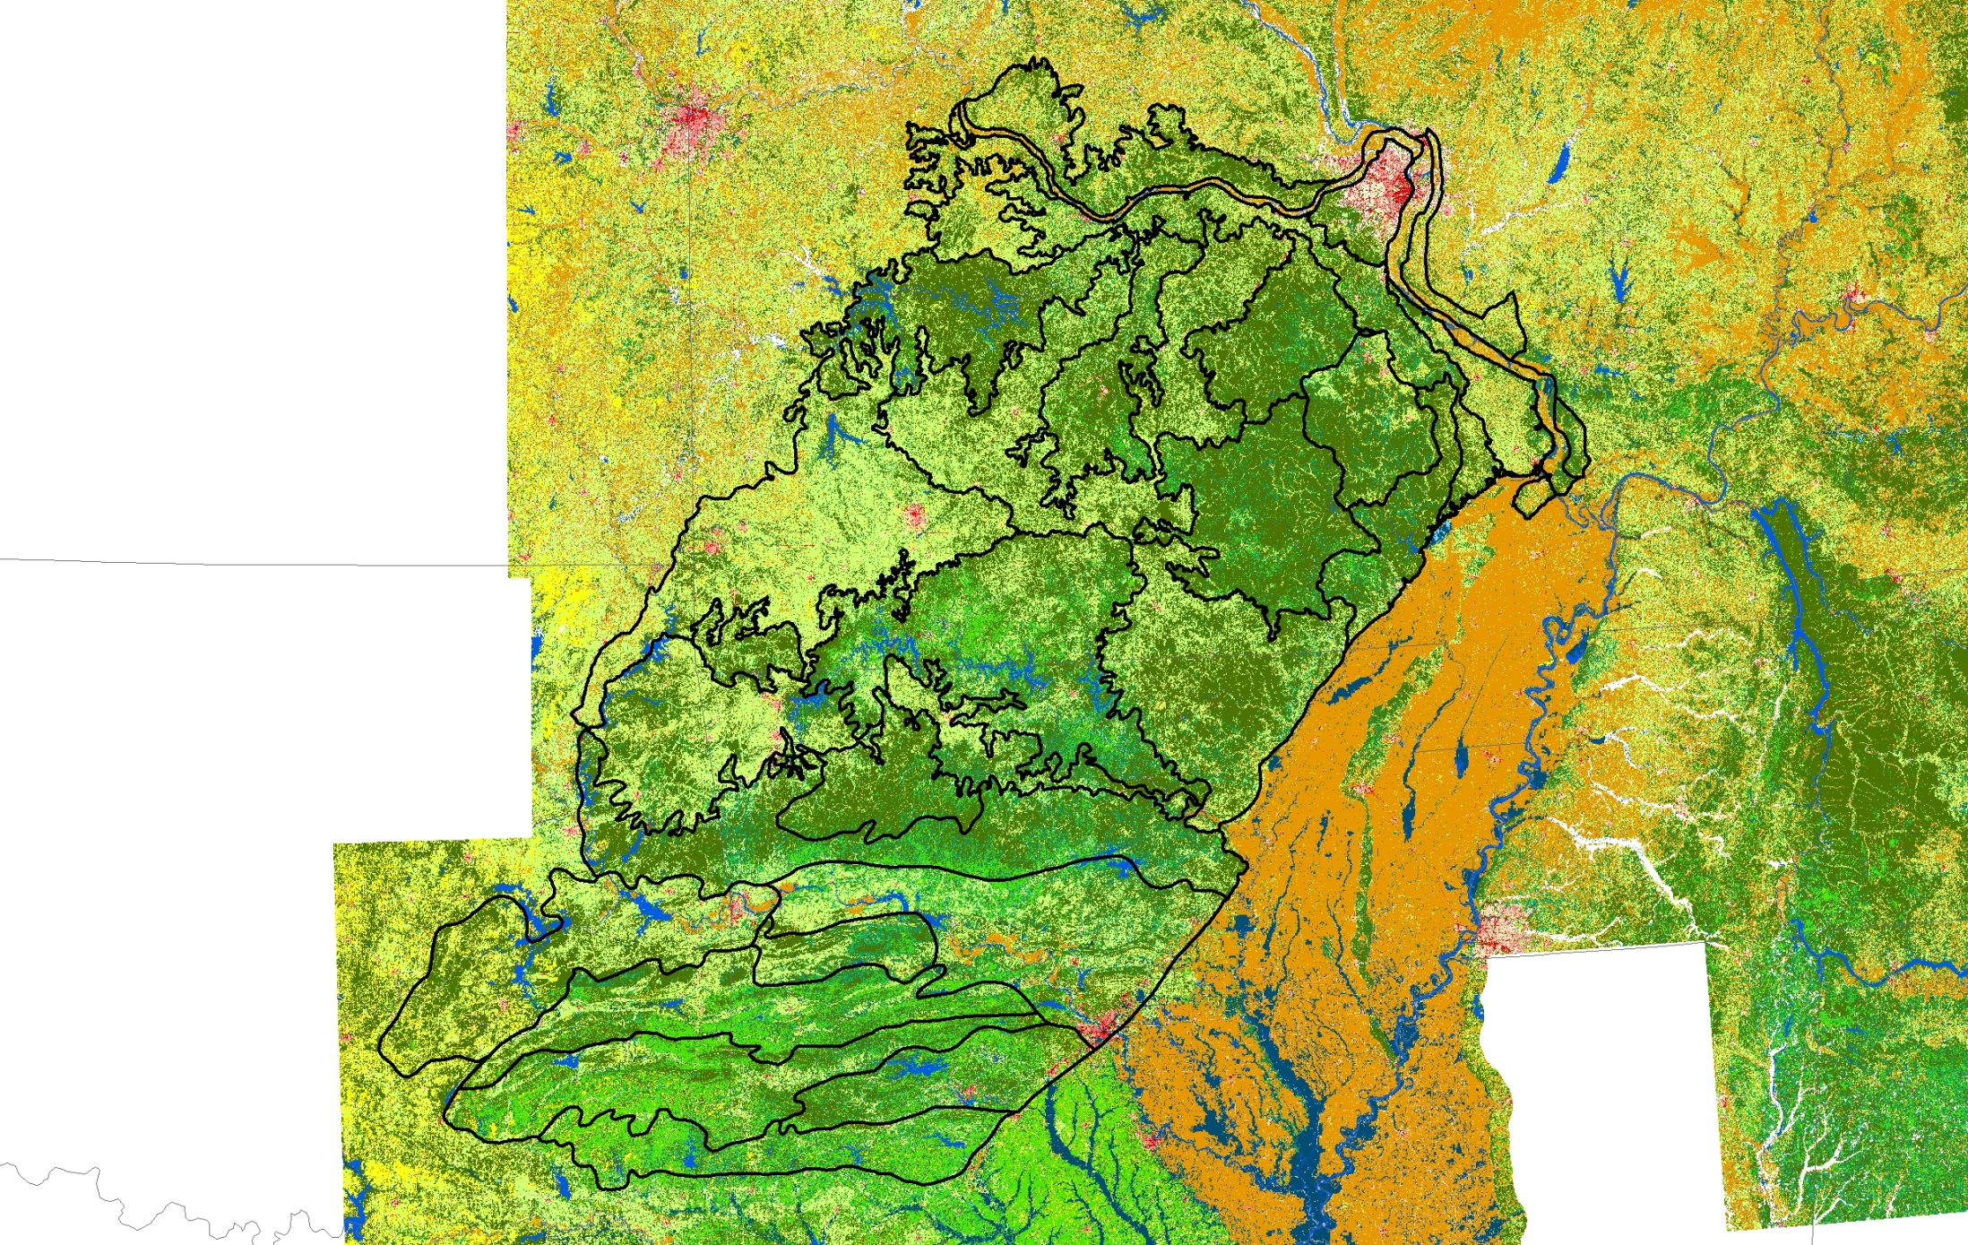
Notes:
Show that pine currently exists in great enough amounts to show up on NLCD and our region of interest now includes the Ouachitas. Light green is pine or mixed pine.

Slide 14
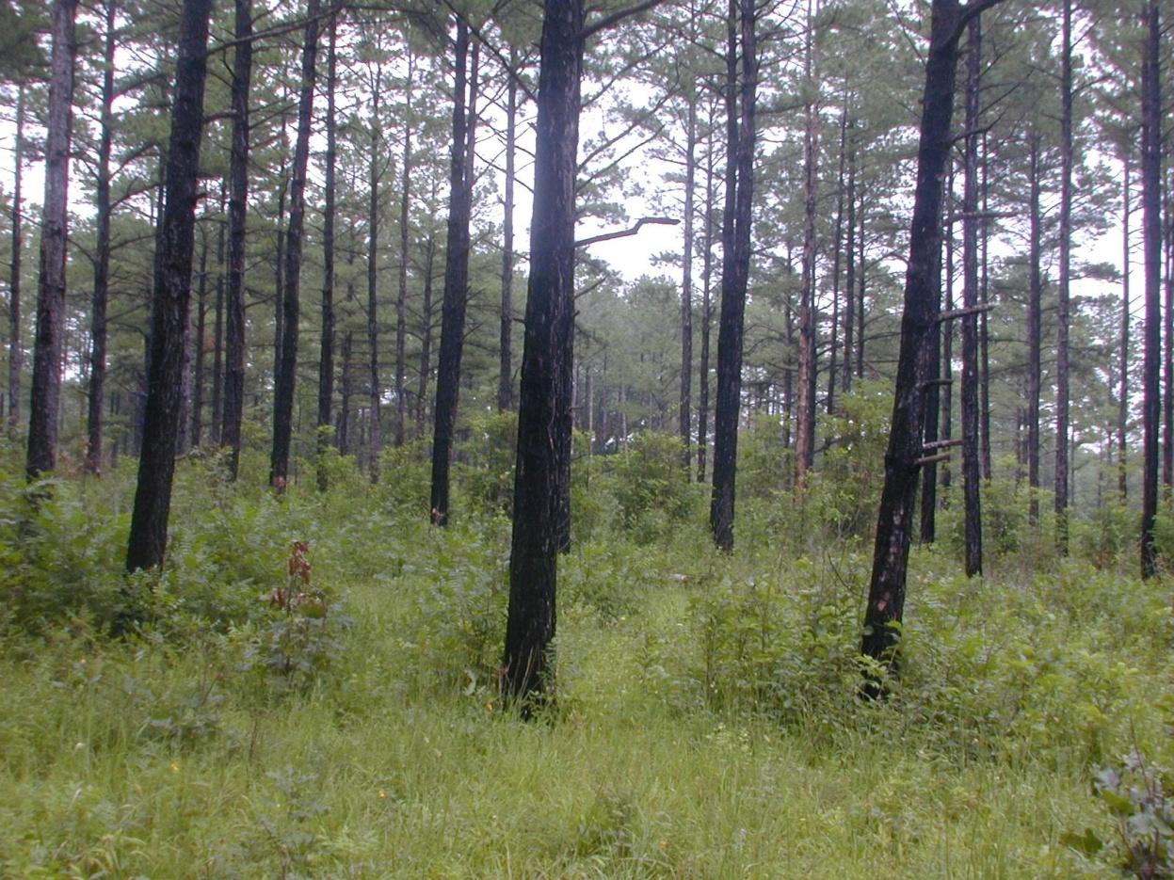
How do we get it back?

Slide 15
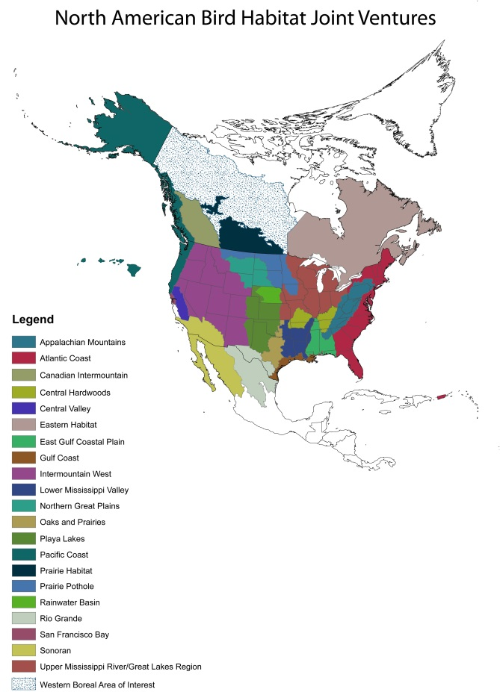
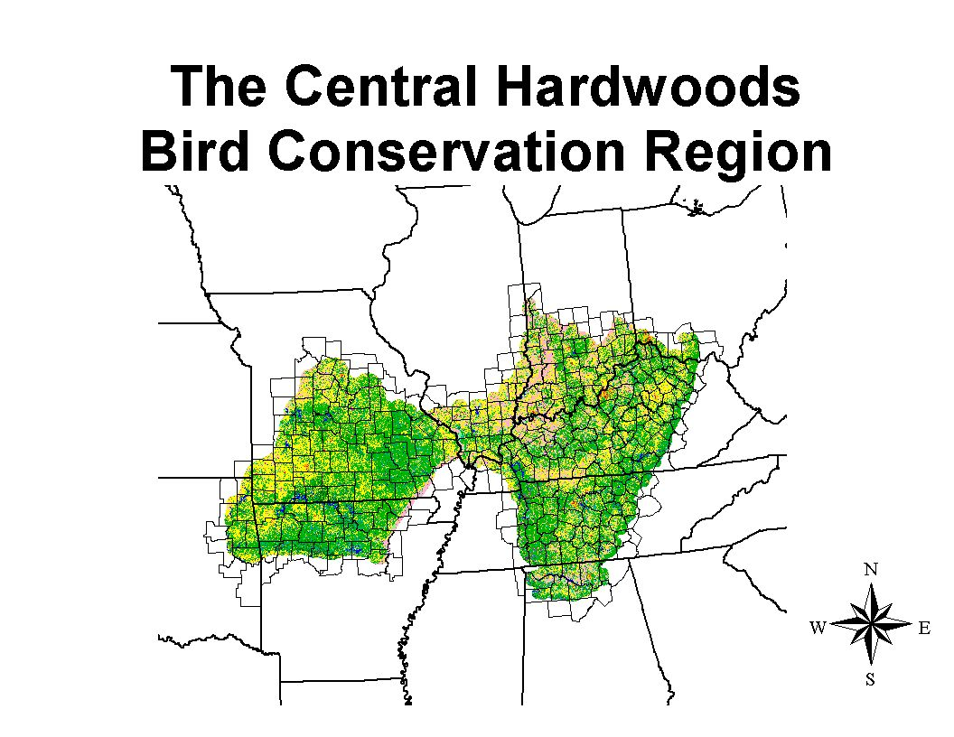
Notes:
Each JV has M. Board, a Coordinator, and usually a Science Coordinator. Some now have one or more Delivery Coordinators.

Slide 16
The Central Hardwoods Joint Venture Management Board
American Bird Conservancy
Arkansas Game and Fish Commission
Illinois Department of Natural Resources
Kentucky Department of Fish and Wildlife Resources
Missouri Department of Conservation
National Wild Turkey Federation
Northern Bobwhite Conservation Initiative
Oklahoma Department of Wildlife Conservation
Tennessee Wildlife Resources Agency
U.S.D.A. Forest Service
U.S. Fish and Wildlife Service
Notes:
Partnership formed in 2000, and I was hired as Coordinator in 2001.

Slide 17
RCW Recovery Success on the ONF
Shortleaf Pine-Bluestem Restoration
Notes:
There are 160 adults currently. Projected for 2012 are 3 new breeding colonies and possibly 12 new breeding colonies. Although this species doesn’t occur in the CHBCR, there are other pine-affiliates that do…

Slide 18
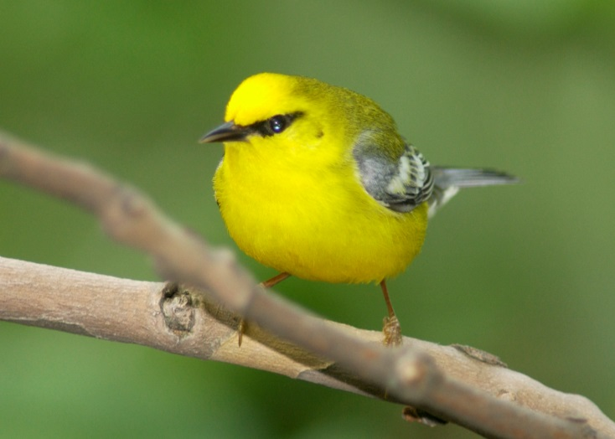
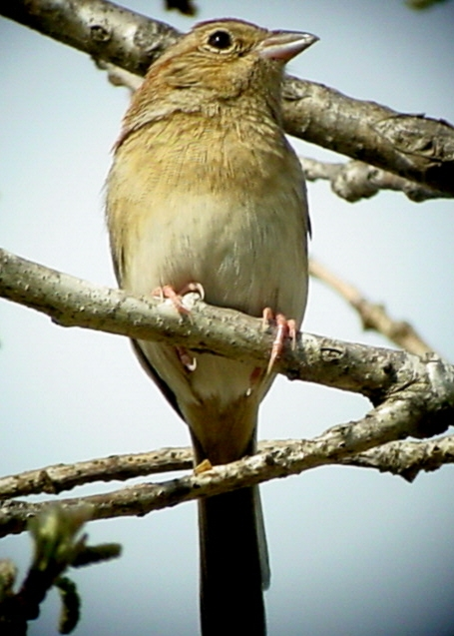
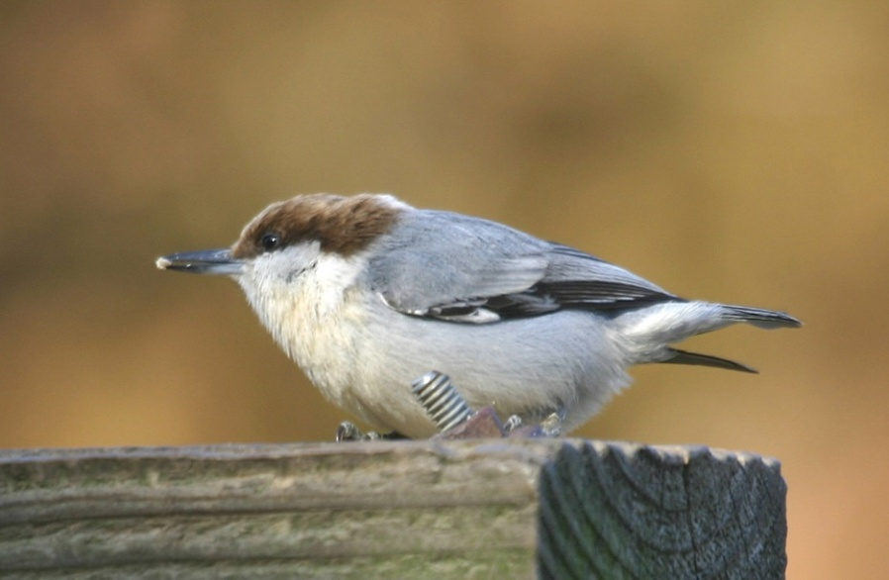
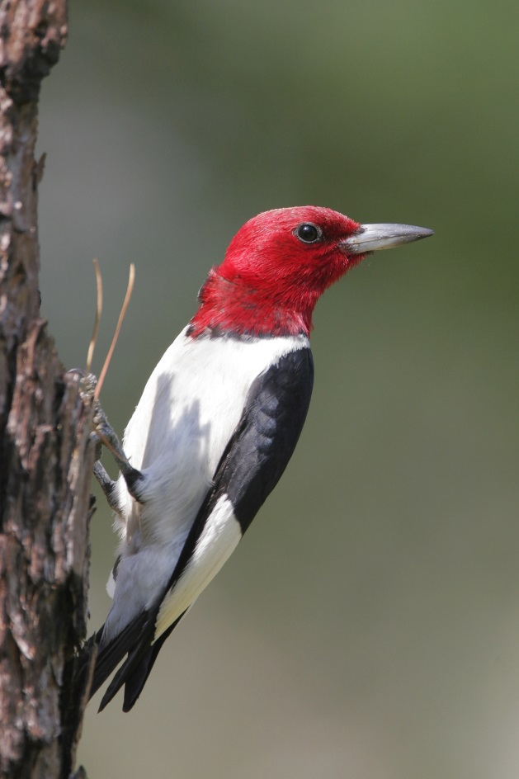
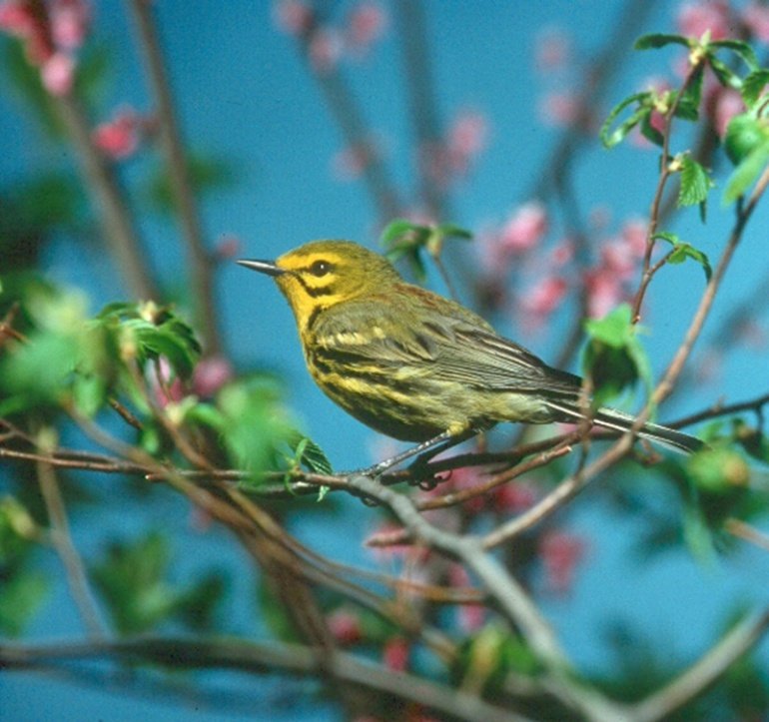
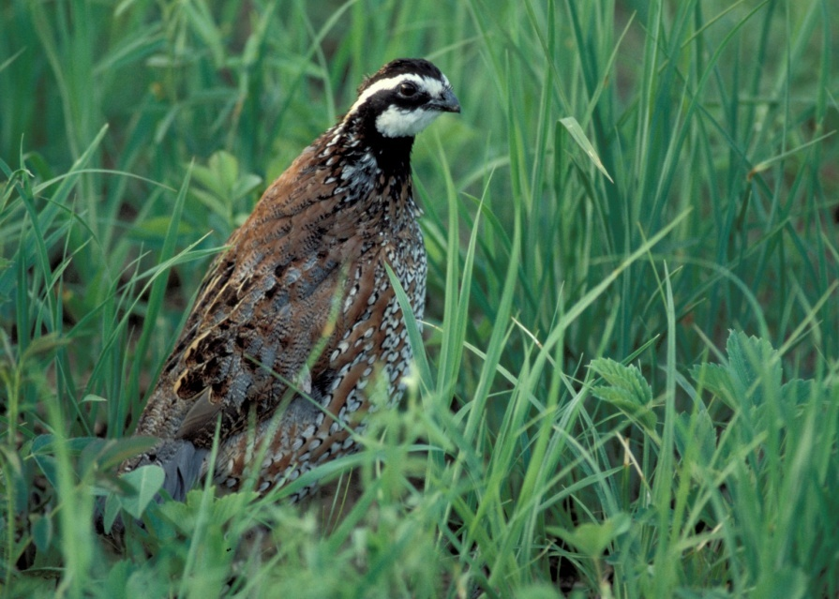
Notes:
Some CHJV priority birds affiliated with pine and pine-oak.

Slide 19
Percent annual decline of grass-shrub and open woodland species in Central Hardwoods 1966-2013
Bachman’s sp. -19.5
Bewick's Wren -4.9
Northern Bobwhite -4.2
Red-headed Woodpecker -2.3
Prairie Warbler -2.2
Field Sparrow -2.1
Yellow-breasted Chat -1.6
Eastern Towhee -1.4

Slide 20
Example: 2% annual decline

Slide 21
“Grass-shrubland” Breeding Bird Species Designated by Partners in Flight as in Need of Management Attention in the Central Hardwoods Bird Conservation Region
Increase 100%
Red-headed Woodpecker
Eastern Wood-Pewee
Eastern Kingbird
Blue-winged Warbler
Prairie Warbler
Field Sparrow
Bachman’s Sparrow
Increase 50%
Brown Thrasher
Maintain or Increase
Yellow-breasted Chat
White-eyed Vireo
Add 141,000 – 410,000 coveys
Northern Bobwhite
Notes:
Note which use trees, which use shrubs and which use the grass/forb understory or some combination.

Slide 22
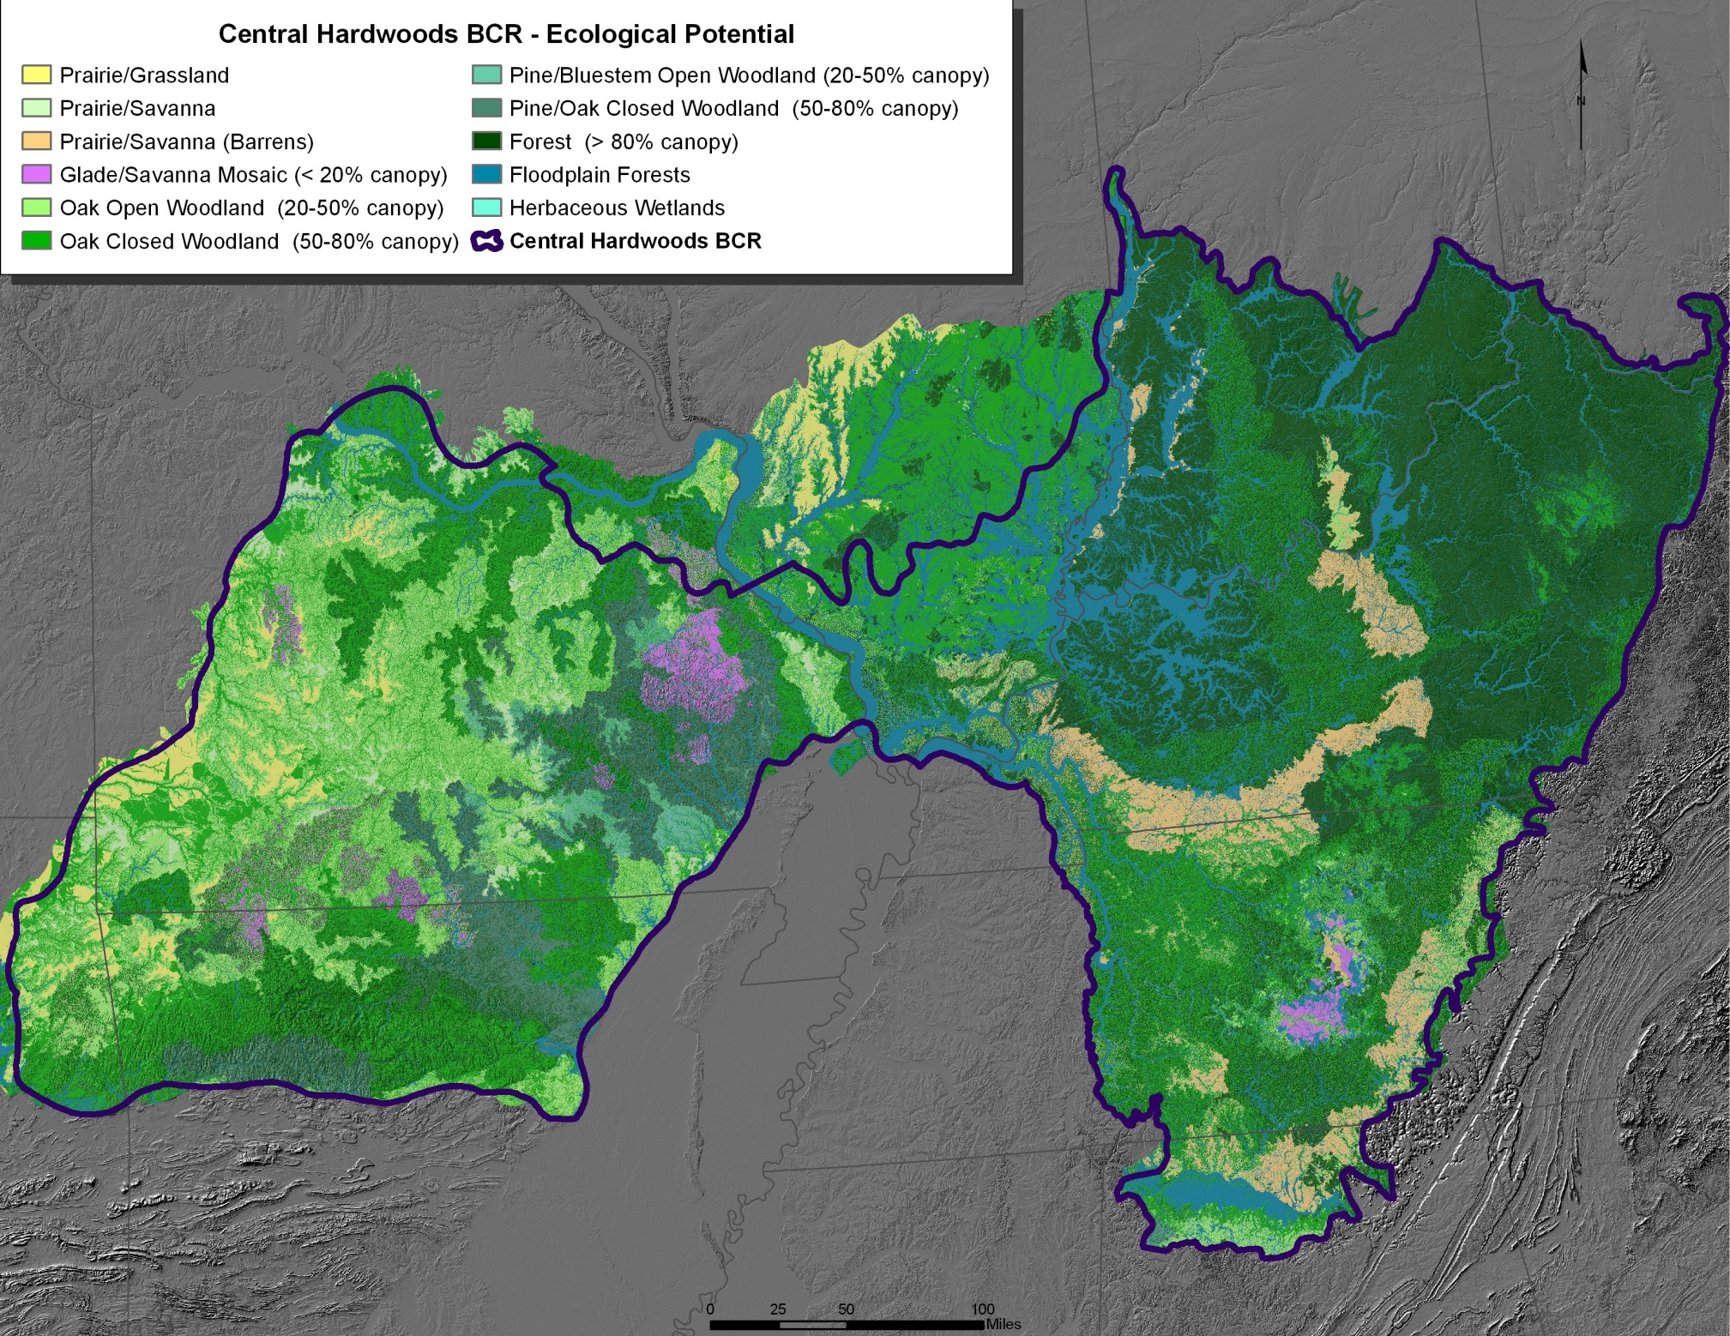
Notes:
This is what we think the vegetation types were prior to settlement, and we use this map to help managers determine which community types to emphasize in any given locale across the BCR. While I’m talking about grass-shrub species today, we also have priority species associated with open grasslands, forests and wetlands. Added Ouachitas for the pine partnership.

Slide 23
Interior Highlands Shortleaf Pine Restoration Initiative Participants
American Bird Conservancy
Arkansas Game and Fish
Arkansas Natural Heritage Commission
Central Hardwoods Joint Venture
L-A-D Foundation
Longleaf Alliance
Lower Mississippi Valley Joint Venture
Mark Twain National Forest
Missouri Department of Conservation
Missouri Department of Natural Resources
National Bobwhite Conservation Initiative
National Park Service
Natural Resources Conservation Service (MO and AR)
Oak Woodlands and Fire Consortium
Ouachita National Forest
Ozark-St. Francis National Forest
Shortleaf Pine Initiative
The Nature Conservancy
University of Missouri, Columbia
U.S.D.A. Forest Service Research
U.S. Fish and Wildlife Service
Notes:
We brought partners from around the Ozarks together in Jan 2011 to gauge interest; can see the wide array of groups and individuals that were interested in a pine restoration partnership. We have had two meetings of the initiative since then, which expanded to include the Ouachita Mountains. All of these same agencies and organizations from the region are still active participants, and we’ve added a few others.

Slide 24

Strength in Numbers
Different agency/groups and people have different reasons/motivation for participating…foresters, wildlifers, natural community ecologists all have different interests but have a better chance of getting what they want from working together.
Science and management experience both matter and it’s important to have practitioners of both working together…build confidence, reduce uncertainty.

Slide 25

Money?!?
Money might not be necessary to initiate
a partnership, but it does help motivate.
1st “formal” partnership came together in 2005 around a Doris Duke grant opportunity (pine-oak was the focus).
Most recent iteration in response to the Collaborative Forest Landscape Restoration Program funding (2009 Omnibus Budget) fostered partnerships around each forest; this expanded regionally in 2011 with Interior Highlands Shortleaf Pine Initiative.

Slide 26

Dedicated Coordinator
Takes responsibility for calling meetings, developing agendas, keeping notes, and generally keep things moving along…
Full Meetings:
Jan 2011; July 2013; May 2015
DFC meetings:
May 2011; December 2011; January 2012; February 2013

Slide 27
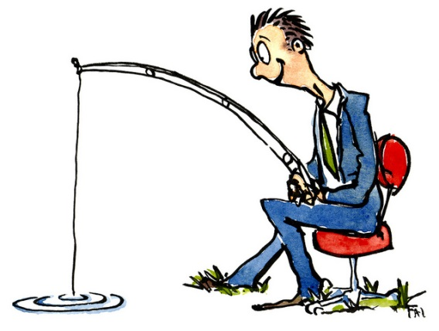
Patience!
Our current partnership is really built on a longer series of interactions among people in both states over the last 20 years or more;
Make time for people to express their viewpoints and opinions. Everyone has a right to have their voice heard and open communication provides a broader perspective that can lead to better ways of thinking about things.
Notes:
we didn’t start from “scratch” like many other regional groups might be and many of us already knew each other anyway so there were personal relationships and mutual respect and trust to build upon.

Slide 28
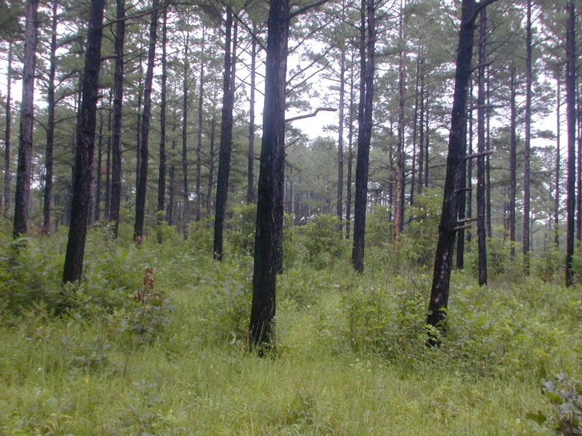
Questions???

Slide 29
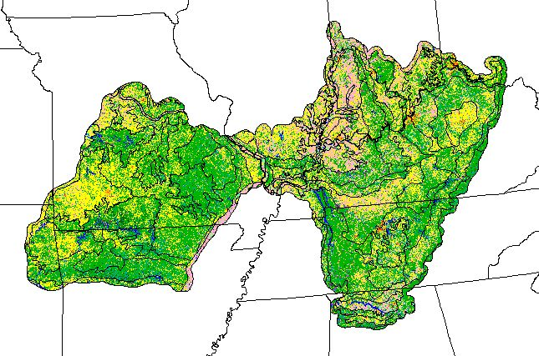
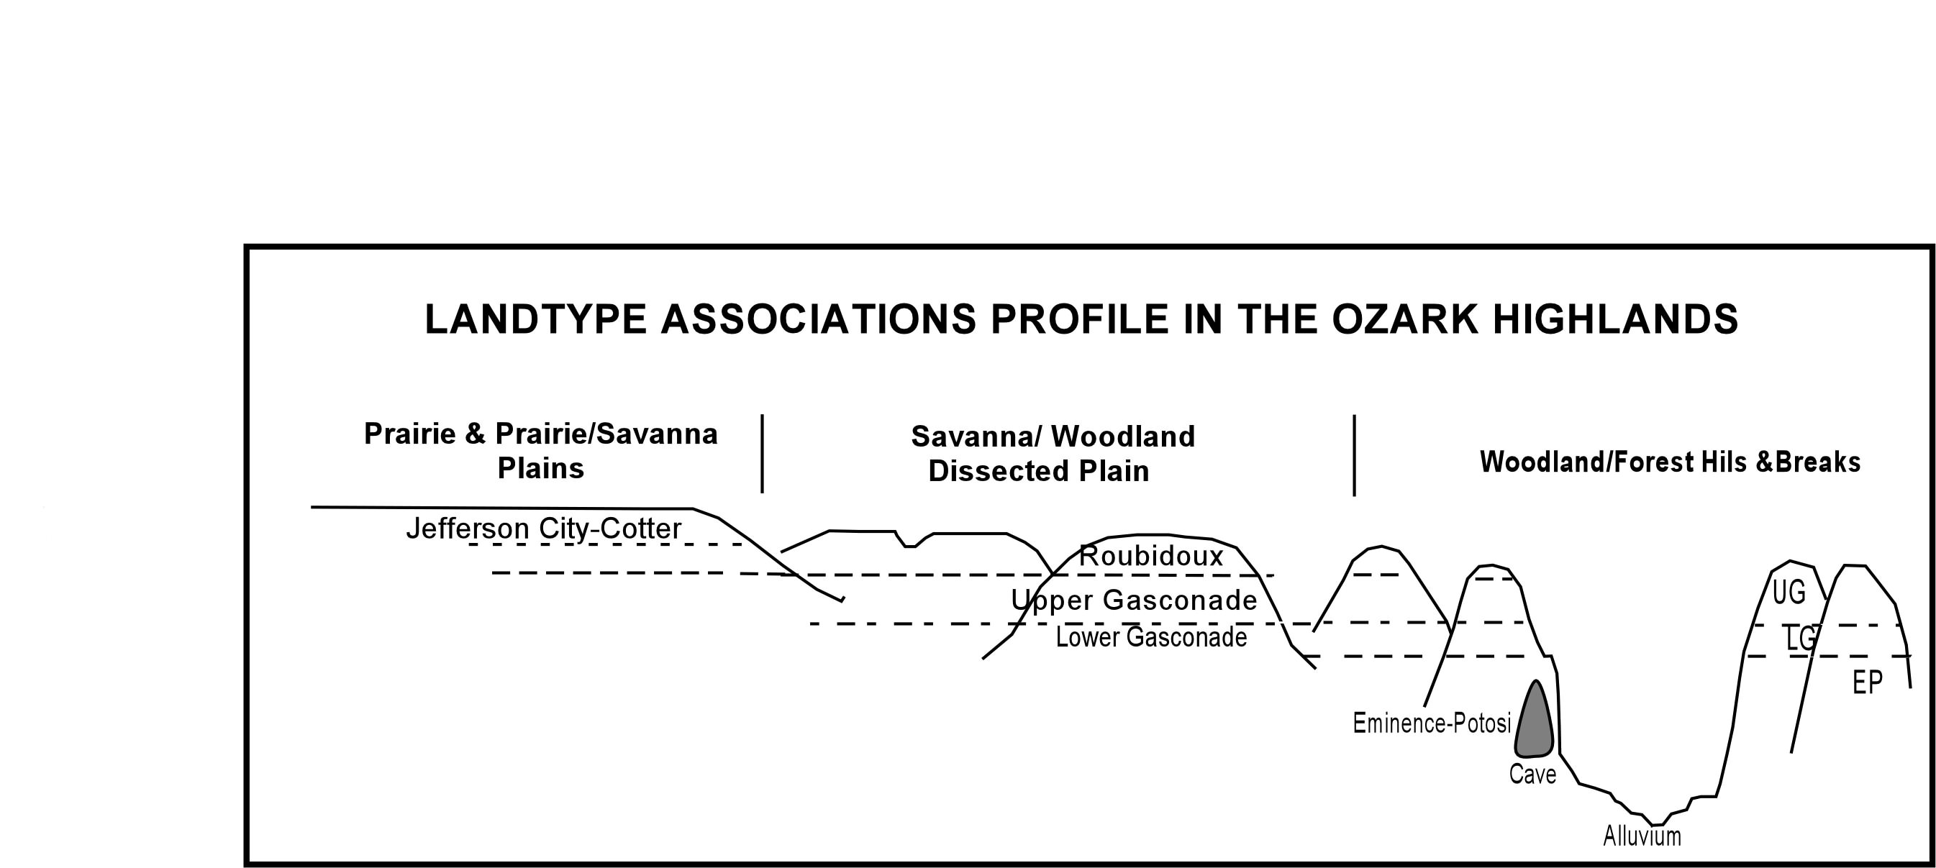
Landscapes and associated habitat types are largely a function of sun exposure, water accumulation and fire breaks and shadowing….
Notes:
Example of interplay of how geology/soils and topography influence communities at landscape scales…

Slide 30
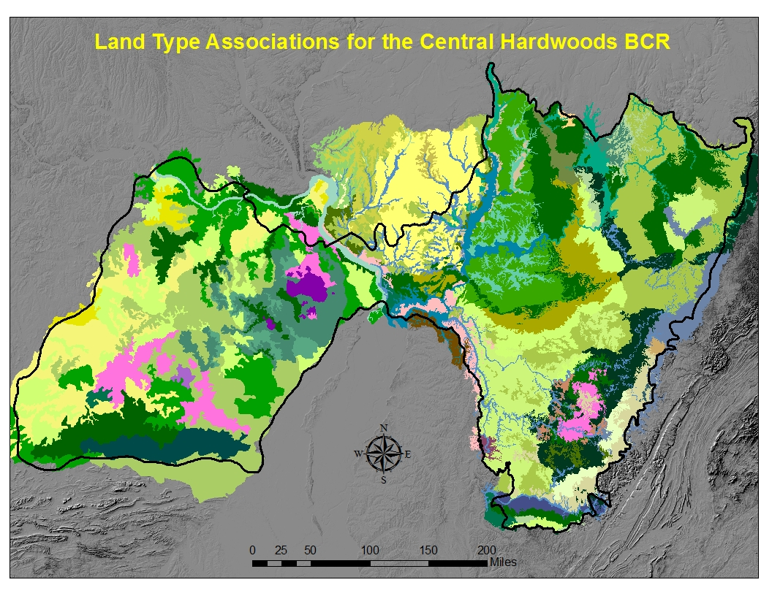

Slide 31
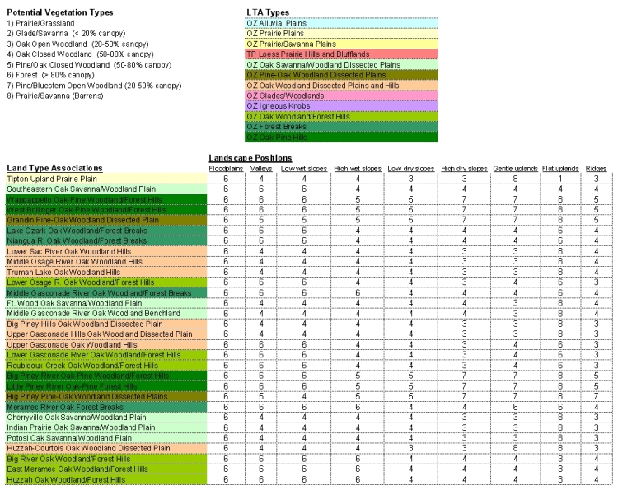

Slide 32
Notes:
This is what we think the vegetation types were prior to settlement, and we use this map to help managers determine which community types to emphasize in any given locale across the BCR. While I’m talking about grass-shrub species today, we also have priority species associated with open grasslands, forests and wetlands. Added Ouachitas for the pine partnership.

