Slide 1
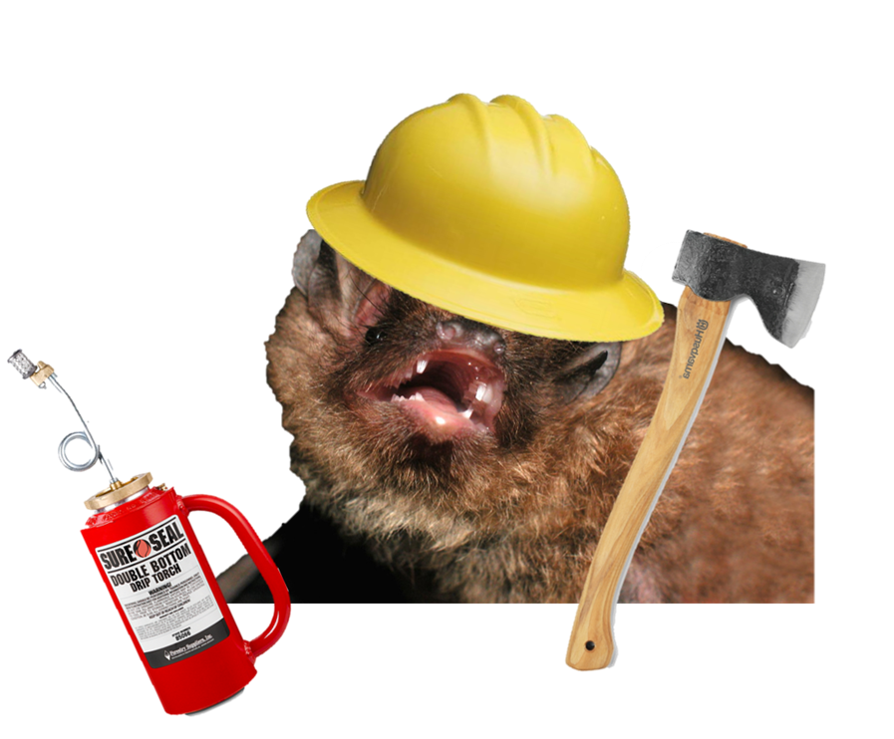


Prescribed Fire and Bat Conservation Joy O’Keefe Susan Loeb
Manager bat by S. Bergeson

Slide 2
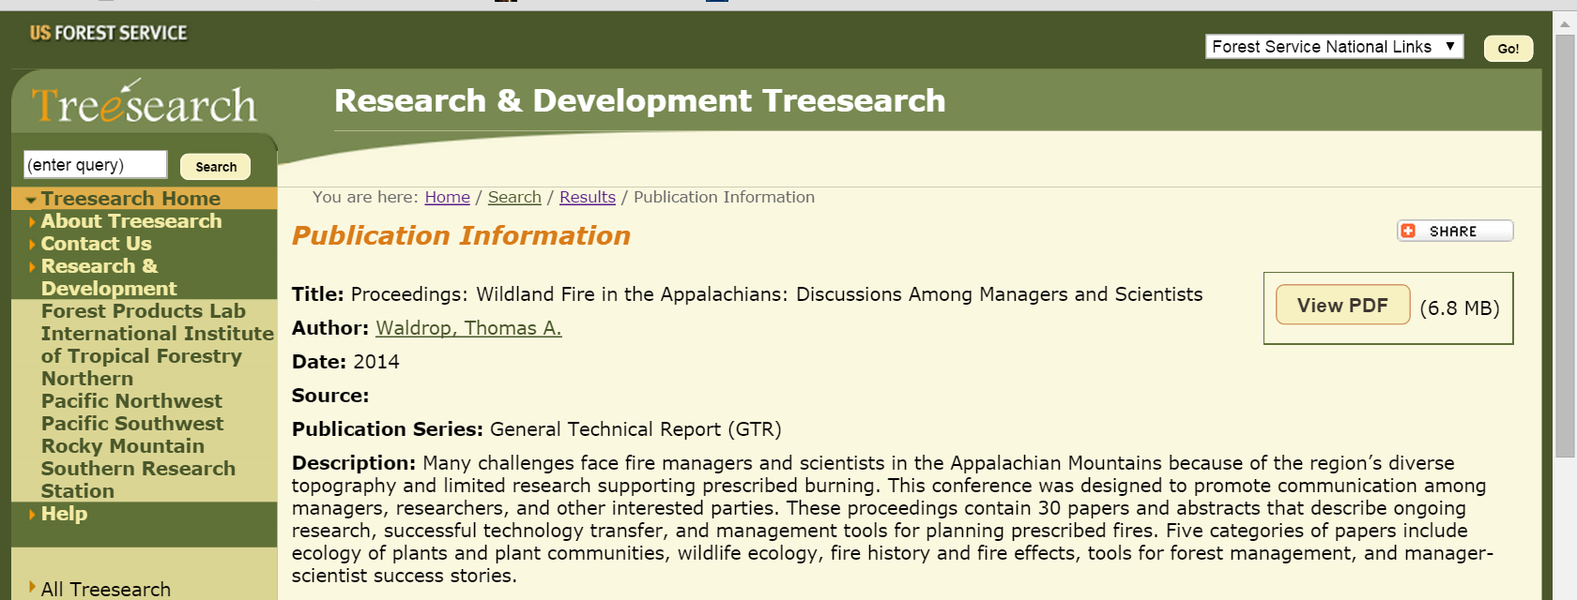
Refer to Loeb and O’Keefe 2014
Notes:
Go to treesearch webpage to find this publication. Housed within Waldrop 2014 Proceedings.

Slide 3
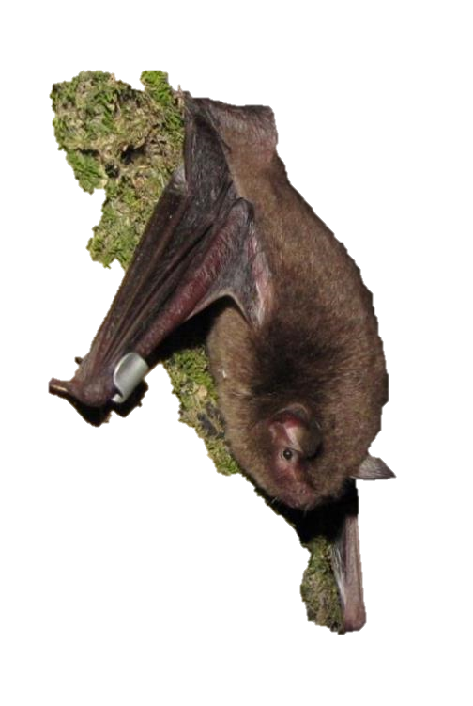
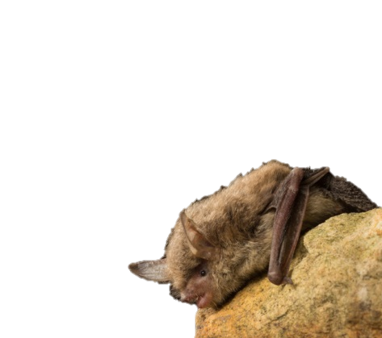
Six Grams of Grief?
Indiana bat (Myotis sodalis)
Northern long-eared bat (Myotis septentrionalis)
Notes:
Introduce the characters. Talk about distribution and overlap with SLP.

Slide 4
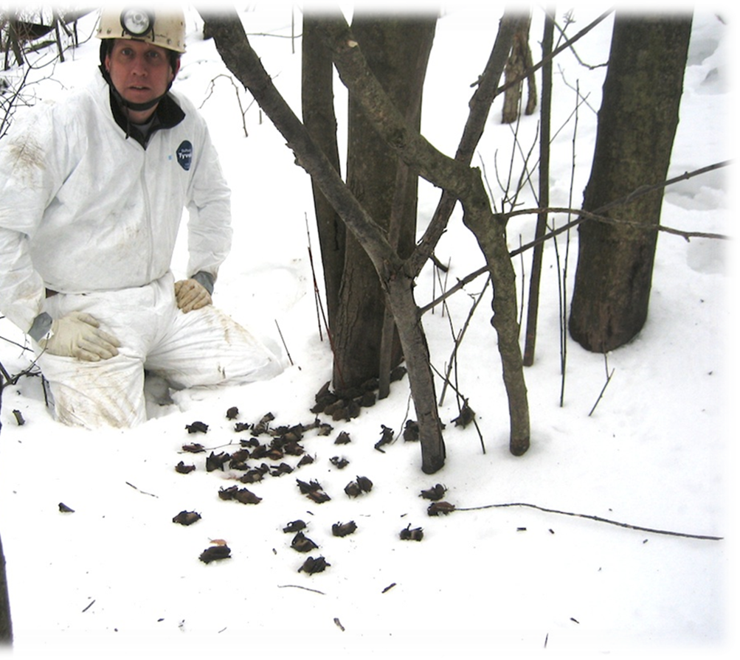
Bat Populations are Declining!
Catastrophic declines (>90% for Indiana bat and northern long-eared bat in some areas)
O’Keefe et al., in progress
Notes:
The first point has been demonstrated with both a 75% decline in the primary hibernacula in the Smokies in 2014 and 100% decline in captures of females and juveniles in summer 2014.

Slide 5
Myotis Declines in Smoky Mtns

Slide 6
Bat Populations are Declining!
Catastrophic declines in the Smokies (>90% for Indiana bat and northern long-eared bat)
Smaller “colony” sizes will translate to differences in roosting habits
Smaller roosts & different thermoregulatory strategies?
O’Keefe et al., in progress
Notes:
The first point has been demonstrated with both a 75% decline in the primary hibernacula in the Smokies in 2014 and 100% decline in captures of females and juveniles in summer 2014.

Slide 7
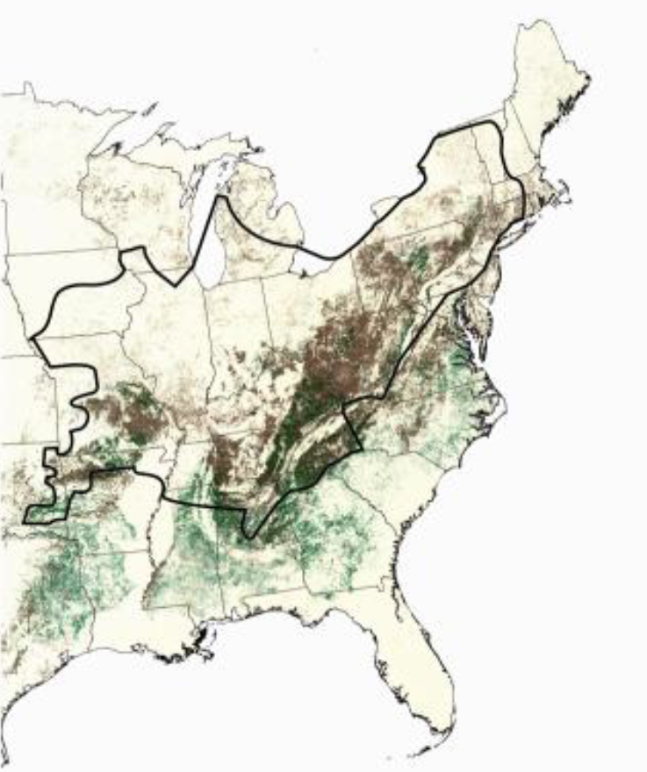
Endangered Myotis Overlap with Fire-Adapted Ecosystems
Indiana bat
Notes:
Species is distributed throughout much of the eastern U.S. and its range overlaps with the pine-oak forests that are dependent on fire. Indiana bats use pine and oaks as roosts in various parts of the species range. Oaks are used more in the Midwest, while pines are used in the southern portions.

Slide 8
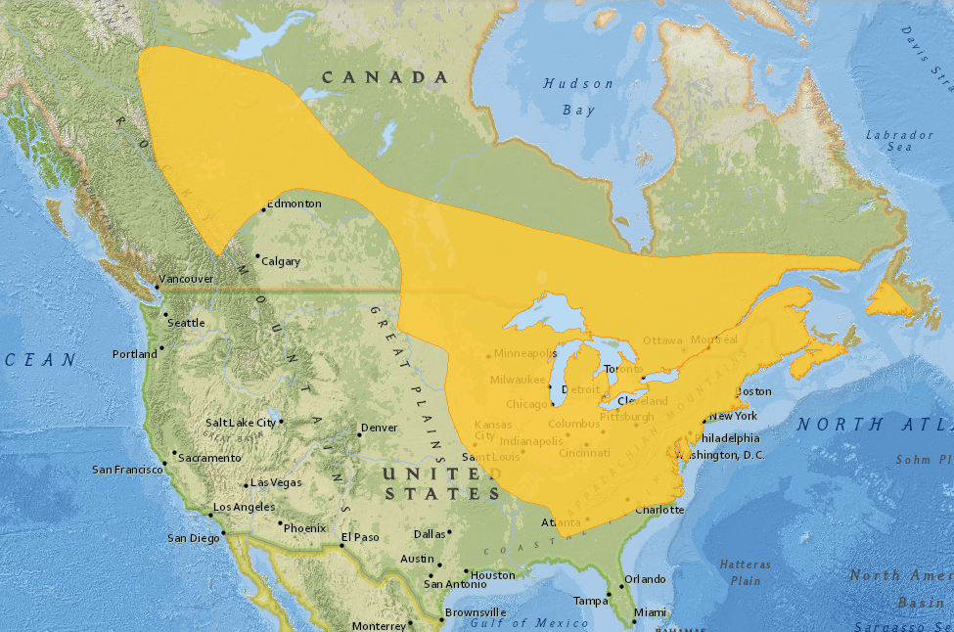
Endangered Myotis Overlap with Fire-Adapted Ecosystems
Northern long-eared bat

Slide 9

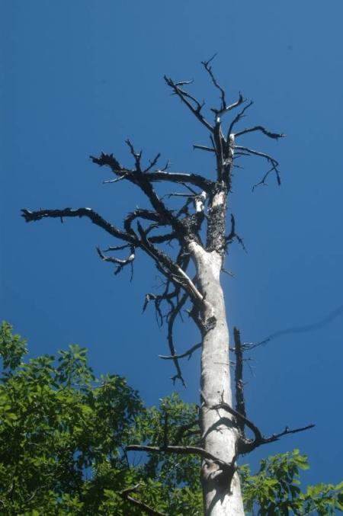
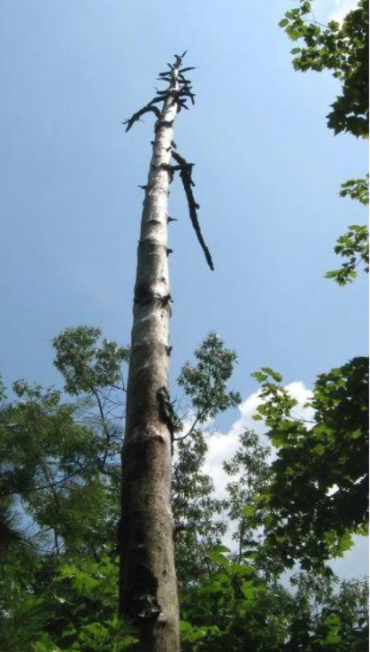
Pines are Important…
In east TN/western NC, 64% of Indiana bat roosts are in dead yellow pines (mainly shortleaf)
In Arkansas:
71% of Northern roosts are dead shortleaf pines
29% of male Indiana bat roosts are shortleaf pine (in fall)
Perry and Thill 2007
Perry, in review
O’Keefe and Loeb, in prep
Notes:
In the So Apps, Indiana bats are responding to a pulsed resource, which right now is dead yellow pines. Though they do key in on yellow pines, it seems they are selecting most heavily for the tree structure and a stand structure that facilitates switching. Tree height is important, which indicates that bats are keying in on trees that provide optimal solar conditions. Though yellow pines were the most dominant type of snag on the landscape during my 2009-2012 snag availability study, they are certainly declining because there are no new snags replacing them and most seem to be too decayed for roosting. Live yellow pines are a rarity in the southern Apps and perhaps not abundant enough to facilitate the approx. 30 year cycle of the southern pine beetle. It is possible that this natural cycle, plus naturally occurring fires, has always provided Indiana bats with optimal roost habitat in the southern Apps. However, the landscape is now dramatically different due to many years of fire suppression and it is possible this cycle is no longer possible. My lab has dendrochronology data that shows it can take over 200 years for a tree such as the SLP at right to develop. Other yellow pines, like the Table Mountain pine in the top right may be restricted to particular areas in the mountains and may also be slow growing.

Slide 10
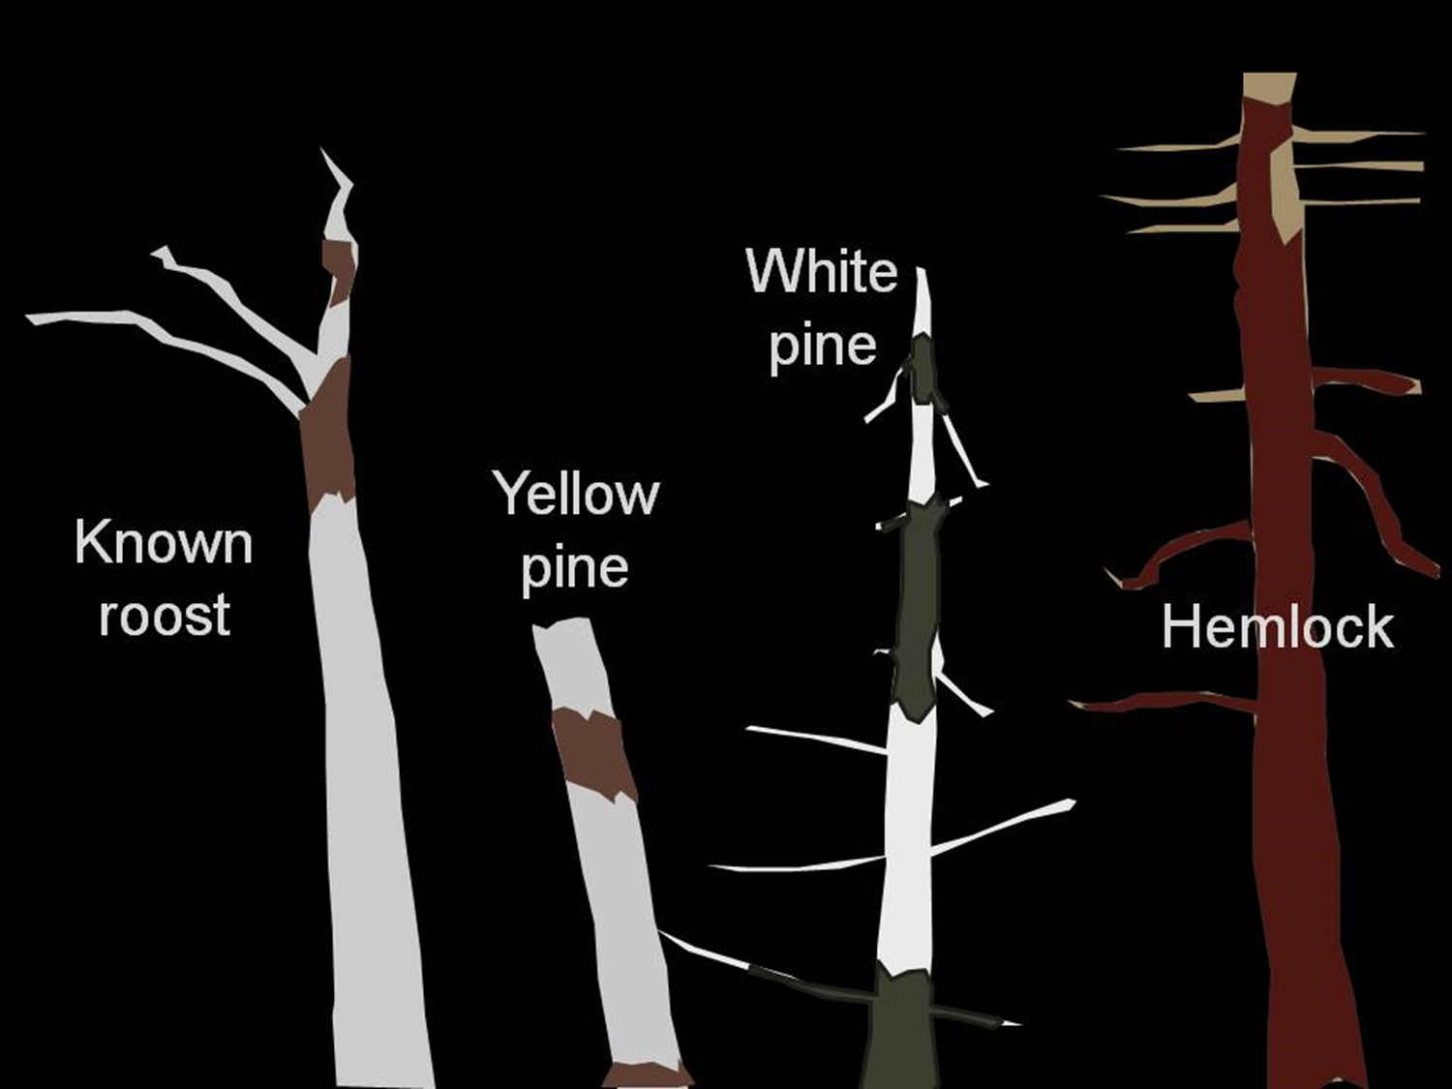
Suitable yellow pine snags less common
May take 200-300 years to grow large yellow pines
Bats will switch to alternate roost types

Slide 11
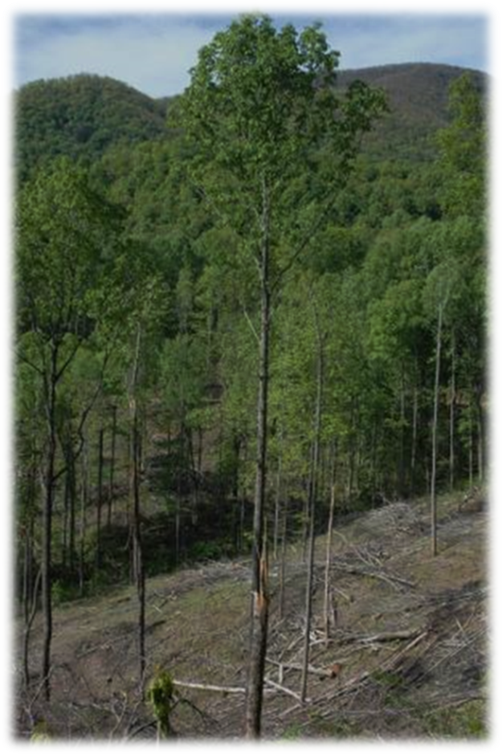
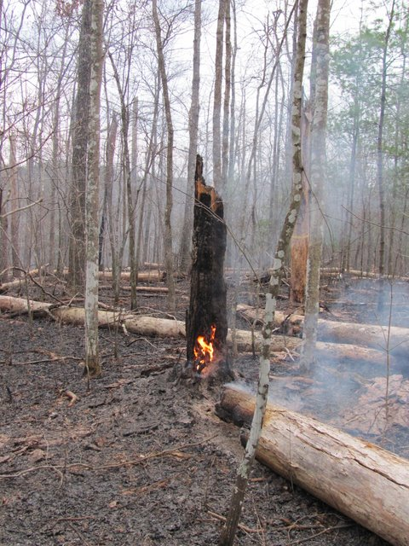
Concern about potential for “take” affects fire policy
“Take” = any action that may result in the harassment, harm, pursuit, wounding, or collection of an endangered species, where harm can include habitat modification
Potentially harmful management actions include timber harvest and fire
Notes:
Due to the legal status of Indiana bats, prescribed fires in areas where the bat occurs must be conducted to avoid take. It is well established that prescribed fire is likely to affect or adversely affect Indiana bats when the two overlap. USFWS will consult on proposed actions and will issue opinions about the likelihood for take and the ramifications of take (depends on effects).

Slide 12
Potential direct and indirect effects of fire on Indiana bats
Direct (short-term)
Kill bats at roost in caves or trees
Immediate loss of critical roosting habitat
Ear burns during intense fires
Waste energy reserves in response to fire
Predation risk from daytime flight to escape fire
Notes:
Because Rx fire may be critical for ensuring future habitat, managers and policymakers must balance the long-term needs for habitat restoration with the short and long-term negative impacts. I believe it is relatively easy to avoid the negative indirect effects, so we should focus more on the short-term effects in our planning. Direct effects are short-term effects that either result in harm or death. I feel like these are the more critical effects to consider when planning prescribed fires. Some of the effects are more likely during particular seasons. However, we still lack a lot of basic information needed to make decisions about how to avoid these direct effects.

Slide 13
Potential direct and indirect effects of fire on Indiana bats
Direct (short-term)
Indirect (long-term)
Kill bats at roost in caves or trees
Immediate loss of critical roosting habitat
Ear burns during intense fires
Waste energy reserves in response to fire
Predation risk from daytime flight to escape fire
Destroy roosting habitat, which is typically snags
Destroy foraging habitat, if fire is severe
Create roosting habitat
Pines & oaks
Large & small snags
Open conditons
Create foraging habitat
Open conditions
Insect pulses
Reduce wildfire risk
Notes:
Indirect effects can be positive or negative. Overall, indirect effects are likely to be neutral or even positive if Rx fire is planned with Indiana bats and their roosting and foraging habits in mind. This is where I can allude to the idea that bat boxes are not a panacea for all problems related to Indiana bats.

Slide 14
OK to burn if Indiana bats were present in summer;
requires consultation with USFWS
Fall
Winter
Spring
Summer
Notes:
Dates depend on the location and the biological opinions/incidental take permits that have been issued. But the basic idea is that activities are prohibited from April 1 to Sept 30 to avoid direct impacts and still regulated during the dormant season because of the potential for indirect effects.

Slide 15
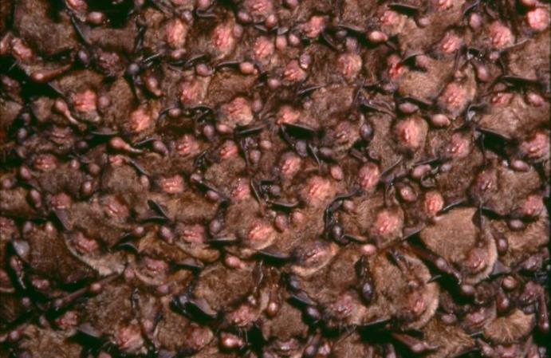
Annual Life Cycle of Myotis Bats
Four important phases:
Winter hibernation
Notes:
During the winter, Indiana bats are an obligate colonial roosting species, forming large clusters in hibernacula, which may be caves or mines. Population sizes in hibernacula range from 1->50,000 but 80% of the pop’n is in 16 hibernacula. During hibernation, bats drop their body temperatures to reduce energy use (deep torpor). Normally, bats would arouse about once every two weeks and then drop into torpor again. With WNS, bats are arousing more often (every few days) and, therefore, burning up energy reserves before the winter is over.

Slide 16
Fire Effects During Winter
Smoke effects
May be noxious
Or may cause additional arousals
Avoid burning when atmospheric conditions might draw smoke into caves
Mammoth Cave NP has successfully burned very near Indiana bat hibernacula
Dickinson et al. 2009
Caviness 2003
Notes:
The most likely effects of fire during hibernation are smoke effects for bats inside the cave. Even if smoke is not noxious, it still may cause additional arousals, which could be a problem for bats with low energy reserves. There may be advisories about suitable burn weather to reduce the chances for drawing smoke into caves.

Slide 17
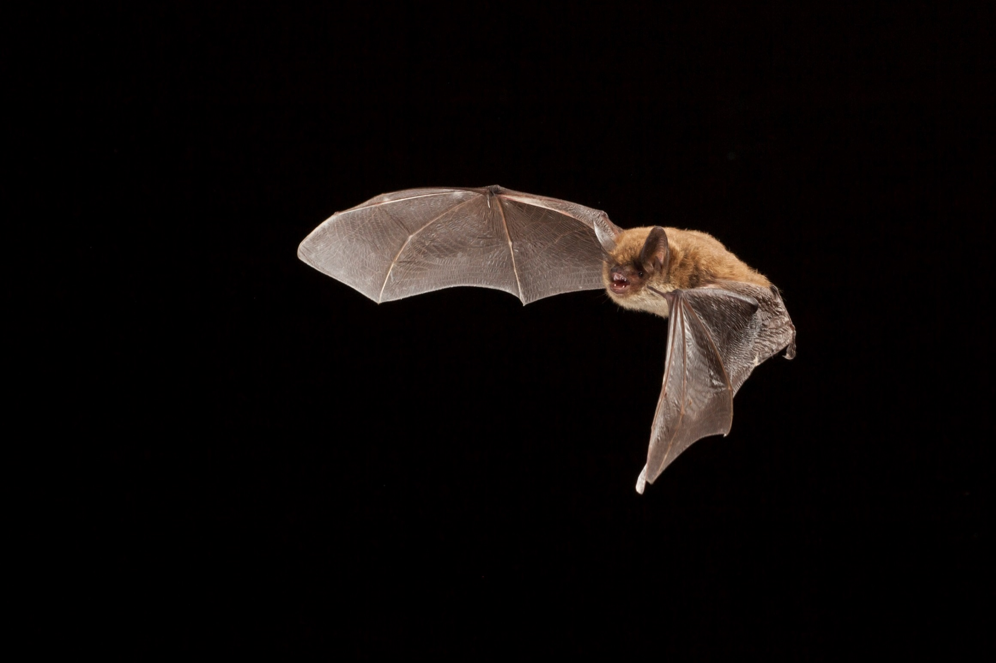
Annual Life Cycle of Myotis Bats
Four important phases:
Winter hibernation
Spring emergence & migration
Britzke et al. 2006
Gumbert 2001
Willis et al. 2006
Winhold & Kurta 2006
Dourson
(northern long-eared bat)
Notes:
This is a critical period. In WNS-affected areas, the two weeks following emergence from hibernacula have been shown to be critical to individual survival (healing from WNS). Emergence occurs from mid-March to the beginning of May (depends on outside temperatures). Upon emergence, bats must restore their fat reserves and, thus, they may remain near the hibernaculum for a short time, either roosting in trees or near the entrance to the cave. Female Indiana bats can fly as far as 575 km from their hibernacula to their maternity range (e.g., Mammoth Cave, Kentucky to lower Michigan). During the cold and stormy parts of spring, bats may use deep torpor to conserve energy while at roost in trees and, thus, may not arouse quickly during a spring burn. In spring, bats tend to use live trees (e.g., white oaks and shagbark hickories), which may provide more shelter from storms. However, we actually have very few data on the roosting habits of Indiana bats during spring. We also know nothing about foraging habits during spring. More on that later.

Slide 18
Fire Effects in Spring
May harass, harm, or wound bats at roost
May affect roosting or foraging habitat
Effects could be positive, negative, or neutral
Burning on warm days or in late afternoon may enable quick response by bats
Northern bats left roost in 10 min when fire lit at ~16:45 in KY
Dourson
Dickinson et al. 2009
Layne 2009
Notes:
Because bats are more likely to enter deep torpor on cool and stormy days in spring, it is possible that they will be injured by prescribed fire during this period. With regards to roosting and foraging habitat, we know very little about the ecology of Indiana bats during this period and, thus, we can only guess that effects might be positive, negative, or neutral. If fires create open areas, then the effects are likely positive. Indiana bats often roost in small groups during this period, so roost habitat may not be limiting. To increase the likelihood that bats will awaken to escape Rx fires, consider burning only on warm spring days or during warm periods of the day.

Slide 19
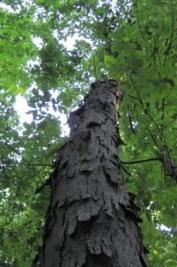
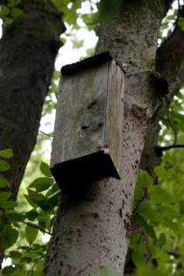
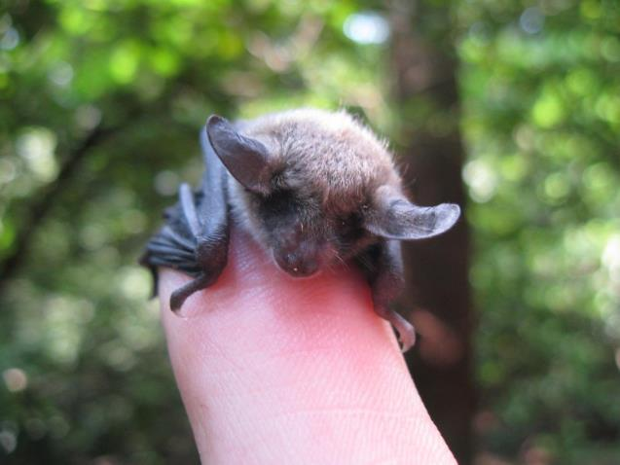
Annual Life Cycle of Myotis Bats
Four important phases:
Winter hibernation
Spring emergence & migration
Summer maternity period
USFWS 2007
Hammond 2013
Notes:
Once on the summer range, females form colonies of 30-200 or more bats. Primary roosts are those that hold a large proportion of the colony and may be used repeatedly over a season or across years. Alternate roosts are smaller or hold fewer bats and bats are less faithful to these trees. Indiana bats typically roost under the bark of a dead tree. In the southern Appalachians, 75% of roosts were large diameter yellow pine snags. White pine snags were also used. In other parts of the species range, oaks, hickories, ash, and elm snags are primary roost trees. Live trees such as white oaks and shagbark hickories are used as alternate roosts in some parts of the species’ range, but these trees cannot hold a lot of bats. When suitable roosts are lacking, Indiana bats will use bat boxes as primary and alternate roosts. We first observed this with the Indy Airport population and it has recently been tested somewhat experimentally by Copperhead Consulting. The summer is broken up into pregnancy, lactation, and post-lactation periods. Bats’ requirements may vary by period and also with the weather. Bats do use daily torpor, but it is not likely to be deep torpor like we might see in spring or fall when daytime temps are cooler. Indiana bats forage by hawking insects from the air. Primary foods are moths, flies, and beetles. Indiana bats are capable of exploiting interior forest, but they may select open areas when available.

Slide 20
Fire Effects in Summer
Growing season burns often prohibited
Indirect effects from burns outside growing season
Loss of large snags in some burns
May create new snags over longer term
Could promote optimal forest types
Oak and pine woodlands
Could create open conditions good for roosting & foraging
Oak and pine savannahs?
Bagne et al. 2008
Gumbert 2001
Johnson et al. 2010
O’Keefe, in prep.
Notes:
Growing season burns are usually restricted in areas containing maternity habitat over concerns of direct take. However, burns conducted during other seasons may have impacts – both positive and negative.
Major concern is that more snags are lost than are created during burns. I have data from the So. Apps to support this. However, intense fires that consume snags are also likely to create snags. For example, during a fire in Yellow Creek NC in 2010, we had almost complete loss of pine snags during the fire, but an increase in oak snags two years post-burn.
With sufficient intensity and frequency, prescribed fire could promote optimal forest types for Indiana bats – oak and pine woodlands. However, as I understand it, this is very difficult to achieve and policies designed to protect bats actually hinder the proper use of fire to achieve these goals.
Frequent fire could create open conditions good for roosting AND foraging. Fires that create snags will create canopy gaps and may promote open under and midstory conditions that are optimal for forest specialists like Indiana bats. Fire effects on nightflying insects are equivocoal – this needs more study (and this is being done in Mammoth Cave by Luke Dodd).

Slide 21
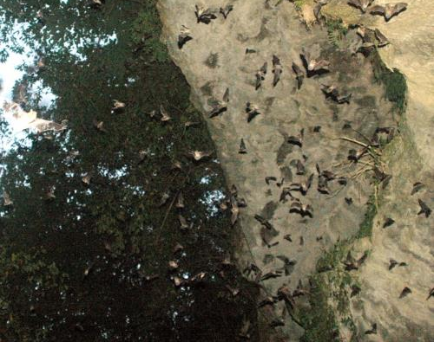
Annual Life Cycle of Myotis Bats
Four important phases:
Winter hibernation
Spring emergence & migration
Summer maternity period
Fall migration & swarming
Brack 2006
Gumbert 2001
O’Keefe, unpubl. data
Dourson
Notes:
Beginning in mid-August, bats migrate to their swarming and hibernation sites. Swarming is done to familiarize juveniles with the location of hibernacula and for males and females to mate. During this period, bats still roost in trees near hibernacula. These may be live or dead trees, but live trees are often used in Kentucky. In Indiana, we see bats on the summer range into the middle of October, so the migration period may be quite long. Females are likely to enter the hibernaculum once they have mated and gained sufficient fat stores, whereas males may roost outside the hibernaculum in trees and swarm for several nights to increase mating opportunities. Bats may enter the hibernaculum where they swarm or move to another hibernaculum.

Slide 22
Fire Effects in Fall
May harass, harm, or wound bats at roost
May affect roosting or foraging habitat
Effects could be positive, negative, or neutral
Burning during warm periods may enable quick response by bats
But fire behavior may vary in fall vs. spring
Dickinson et al. 2009
Layne 2009
R. Klein, pers. comm.
Dourson
Notes:
Just as in spring, bats are more likely to enter deep torpor on cool days in fall. With regards to roosting and foraging habitat, we know very little about the ecology of Indiana bats during this period and, thus, we can only guess that effects might be positive, negative, or neutral. If fires create open areas, then the effects are likely positive. Indiana bats often roost in small groups during this period, so roost habitat may not be limiting. The same admonitions apply as in spring – consider burning only during warm periods. However, it is important to consider that fire behavior may be much different in fall, as fuels may be at their driest and, thus, fire intensity may be greater.

Slide 23
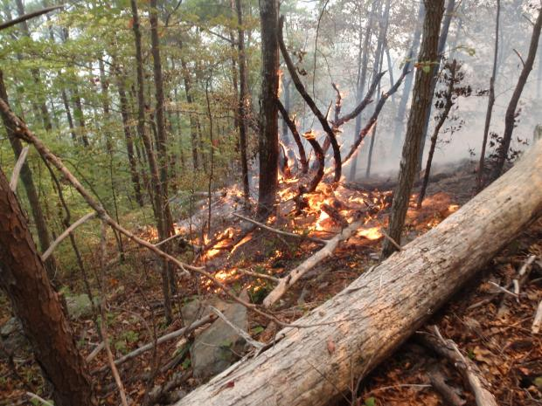
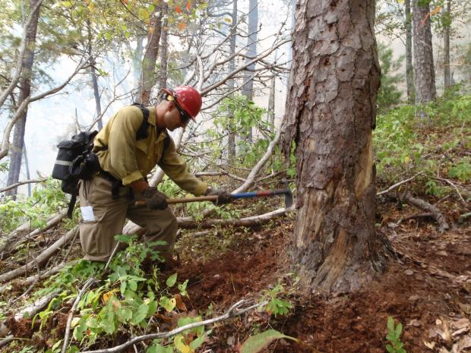
Potential Effects of NOT Burning
Increased wildfire risk
Loss of pine and oak woodlands
More cluttered forests
Cohen et al. 2007
Armitage & Ober 2012
Lafon et al. 2007
Notes:
Problem of fuels in the absence of Rx fires
Let it burn policy in the Park (Klein et al, right?)
Without Rx fire, we may lose pine and oak woodlands (see Lafon, right?)
Rx fire reduces forest clutter, so the logical conclusion is that w/o fire we will have more clutter.

Slide 24
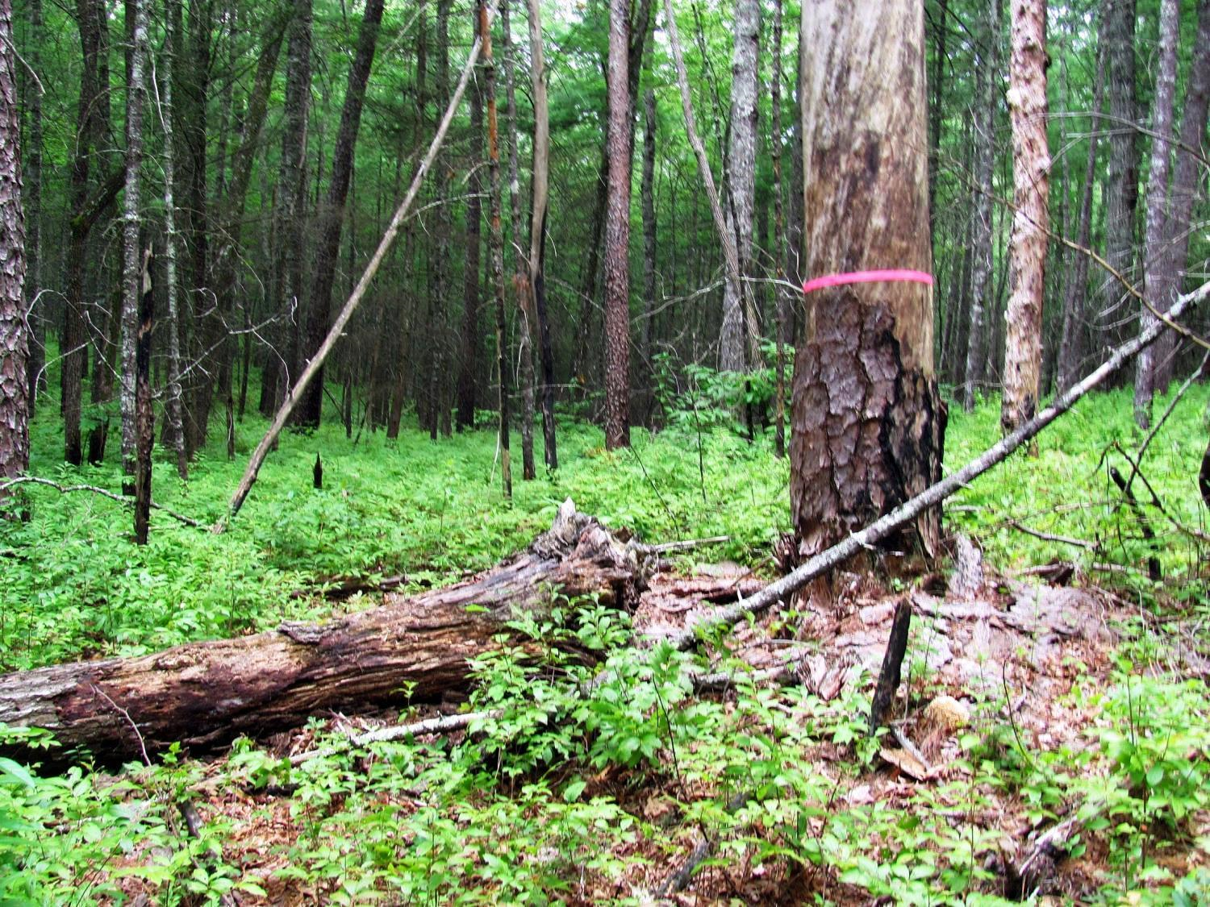
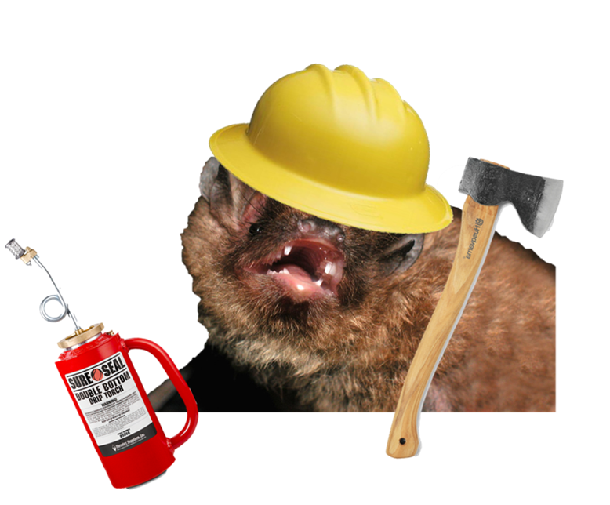
Is it possible to find harmony between forest management and bat conservation?

Slide 25
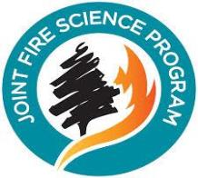



Thanks to funding sources and research assistants!
Notes:
Thanks for listening to my talk and thanks to all those who have gone the extra mile for this project.

Slide 26
