Slide 1
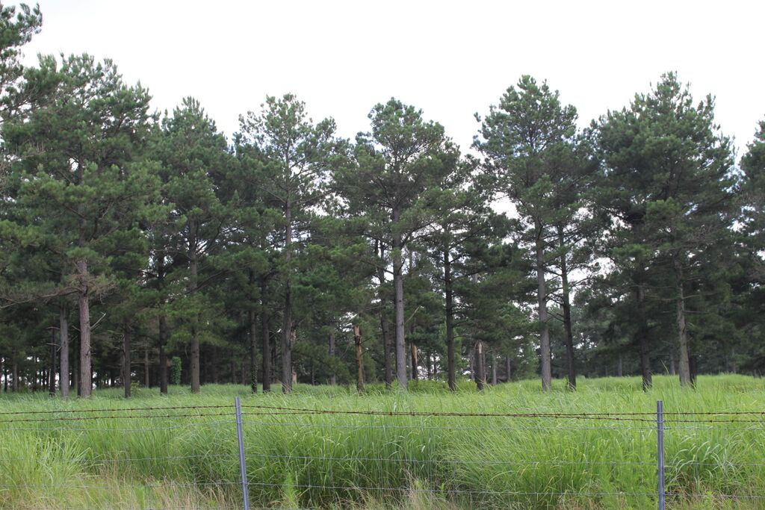
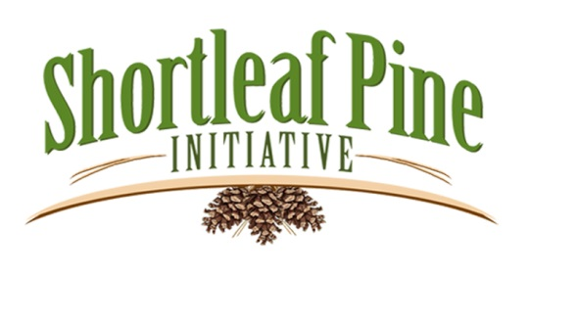
Shortleaf Pine Demonstration Areas Assist
In
Promoting Restoration
George Hernández
3rd Biennial Conference
Knoxville, TN

Slide 2
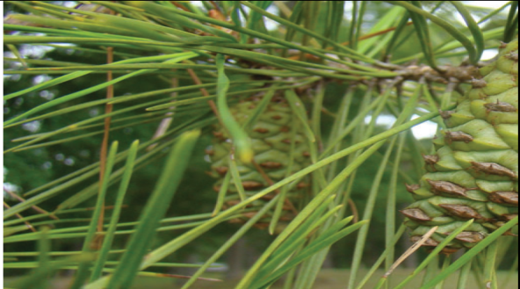
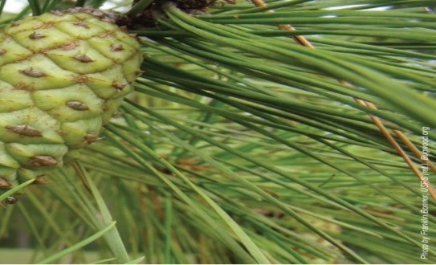
Objectives & Key Actions Developed During
Regional Stakeholder Workshops
During four regional workshops attended by a wide range of
natural resources management professionals and other
interested partners, issues, opportunities, and challenges for
conserving and restoring shortleaf pine ecosystems were
identified.
The workshop participants then proposed objectives and key
actions to address the issues, opportunities, and challenges
they had identified.

Slide 3
Objective: Maintain the range-wide partnership
that will facilitate the implementation of the plan
going forward.
Key action: Maintain the biennial shortleaf pine conference
and workshop.
Objective: Support the creation and development of
ecoregional or state-wide shortleaf pine restoration teams.
Key Action: Develop regional shortleaf pine networks that
share best practices, challenges, and provide a forum
for training workshops.
Key Action: Promote the development of accessible shortleaf
pine demonstration sites on public and private lands
that serve as locations for public outreach, training, and
demonstrating best practices.

Slide 4
Objective: Demonstrate the restoration of diverse
herbaceous understory vegetation, regeneration
of overstory species, and sustainability of desired
ecological conditions.
Key Action: Identify restoration/demonstration areas with the
most “intact” herbaceous layer.
Key Action: Demonstrate restoration that includes the variation
of shortleaf pine communities, seral stages, and overstory
density and composition.

Slide 5
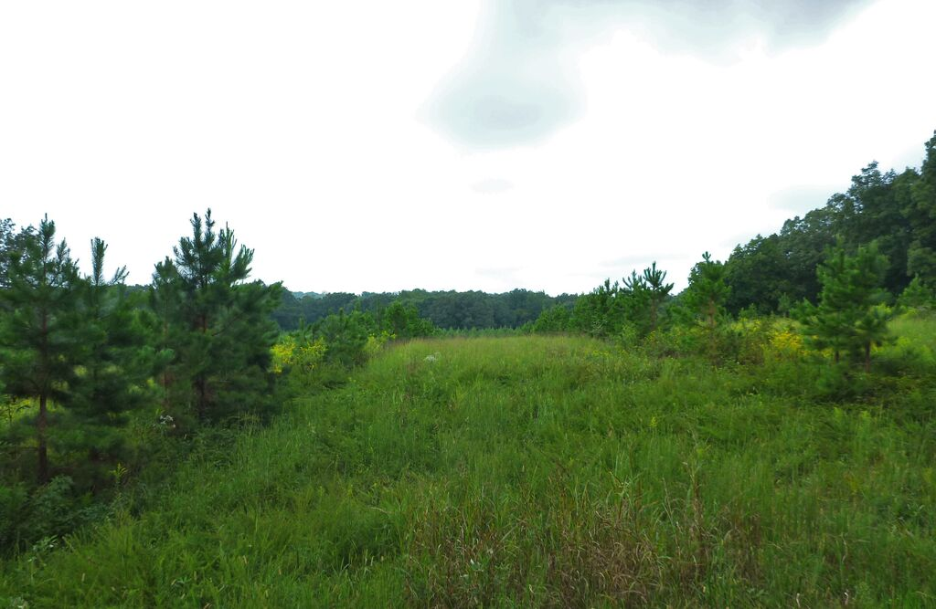
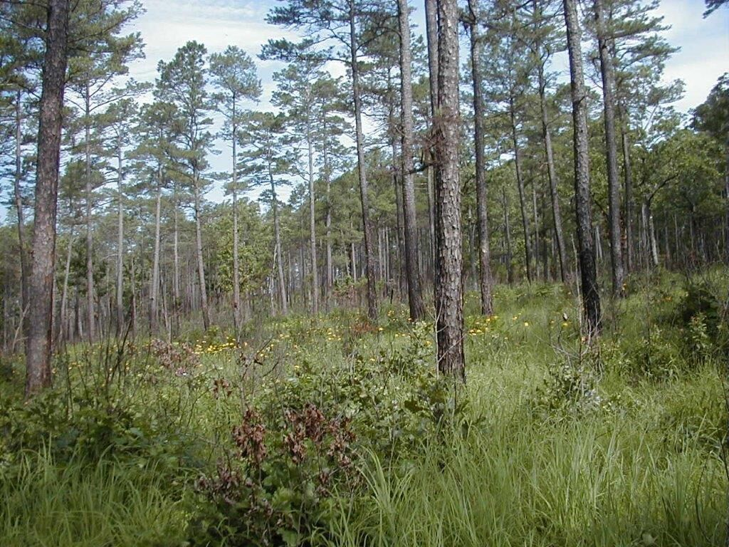
Objective: Establish Shortleaf Pine Ecosystem
Restoration Areas.
Key Action: Develop protocols for forests ecosystems where shortleaf pine is a component.
Key Action: Complete and implement restoration plans for areas identified for restoration.
Key Action: Designate accessible demonstration areas for
use in outreach.

Slide 6
Designate accessible demonstration areas for use in outreach.
Promote the development of accessible shortleaf pine demonstration sites on public and private lands that serve as locations for public outreach, training, and demonstrating best practices.
Identify restoration/demonstration areas with the most “intact”
herbaceous layer.
Demonstrate restoration that includes the variation of shortleaf pine communities, seral stages, and overstory density and composition.
Develop regional shortleaf pine networks that share best practices, challenges, and provide a forum for training workshops.

Slide 7
Key Elements of Demonstration Sites
Easily accessed
On public and private lands
Include areas with the most “intact” herbaceous layer where possible.
Contain all variations of shortleaf pine communities including:
seral stages,
overstory densities,
and overstory species compositions.
Become a regional network for demonstrating best practices.
Provide a forum for training workshops

Slide 8
Develop a regional network for demonstrating best practices.
Current Listed Sites on State and Private Lands
Catoosa WMA, TN Wildlife Resources. TN
Hill Farm, LSU Ag Center, LA
Jordan Lake Experimental Forest, NC
Moody Forest, The Nature Conservancy, GA
Picture Creek, NC Heritage Program, NC
Pushmataha WMA, OK Dept of Wildlife, OK
Stockton College Experimental Forest, NJ
Tall Timbers, Research Station and Land Conservancy, FL

Slide 9
Current Listed Sites on Federal Lands
Bankhead National Forest, USDA Forest Service, AL
Daniel Boone National Forest, USDA Forest Service, AR
Great Smokey Mountain National Park, US Park Service, TN
Hoosier National Forest, USDA Forest Service, IN
Mark Twain National Forest, USDA Forest Service, MO
Ouachita National Forest, USDA Forest Service, AR
Piedmont National Wildlife Refuge, US Fish & Wildlife Service, GA
Redstone Arsenal, Department of Defense, AL
Uwharrie National Forest, USDA Forest Service, NC

Slide 10
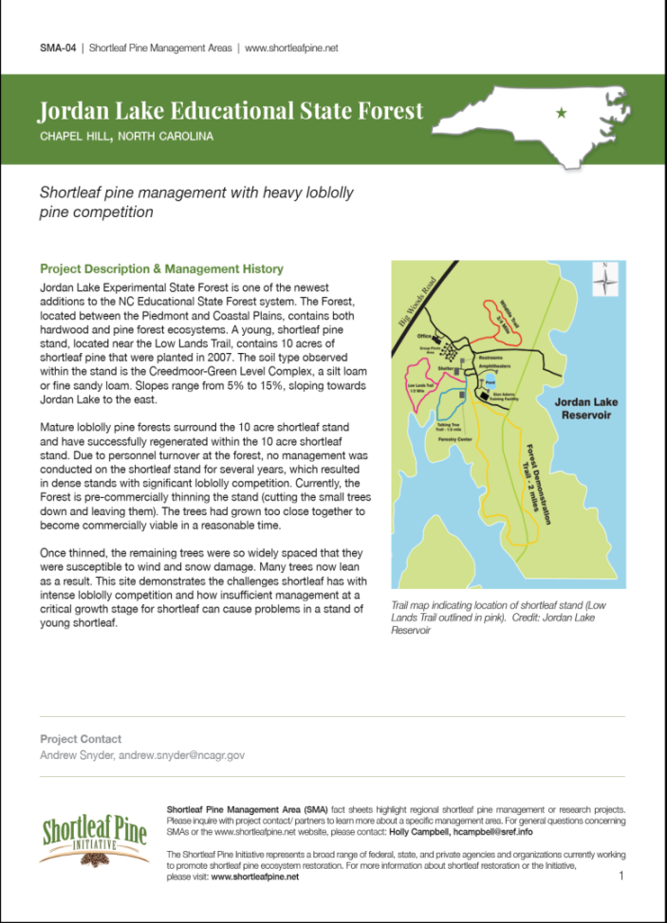
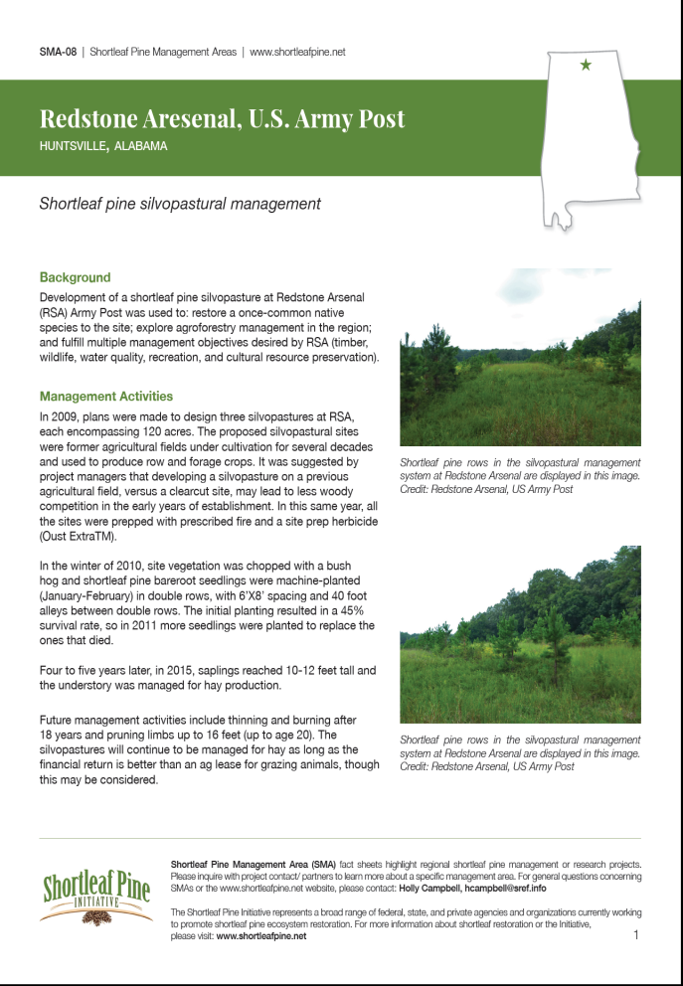
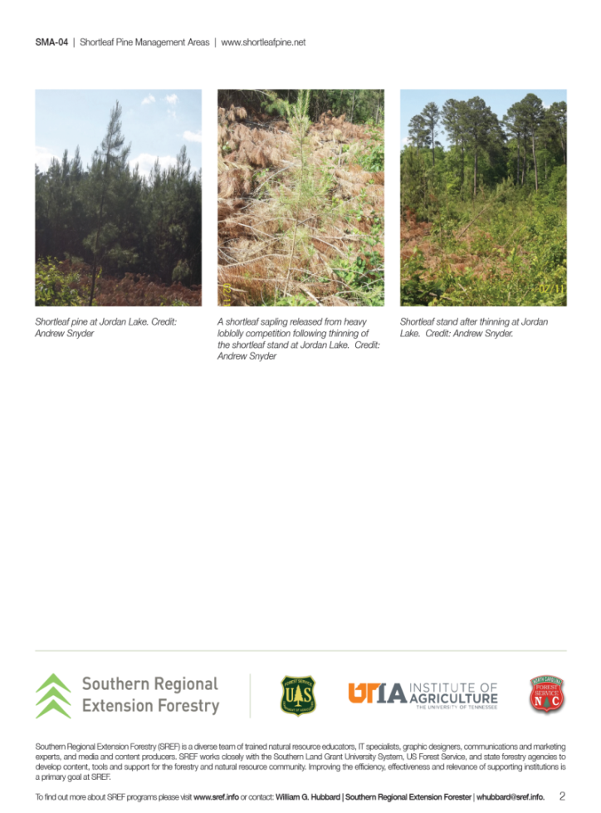
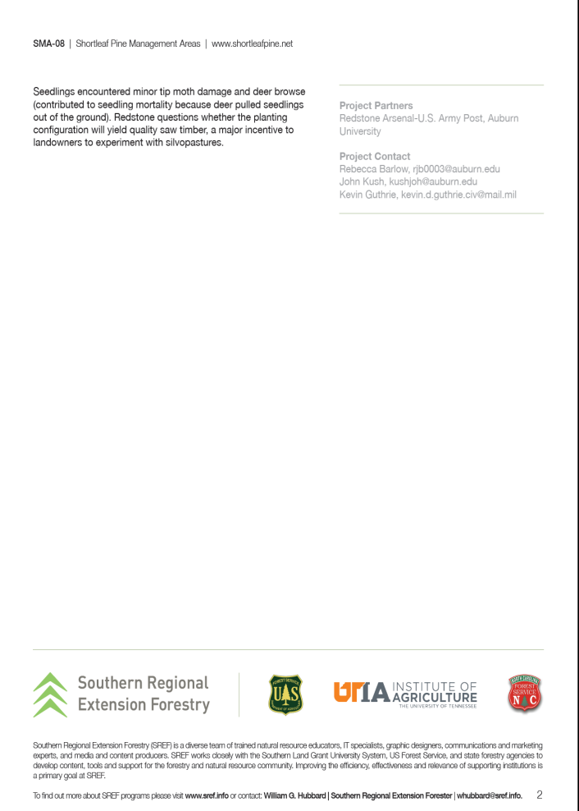
www.shortleafpine.info –
Tools & Resources –
Management in Action

Slide 11
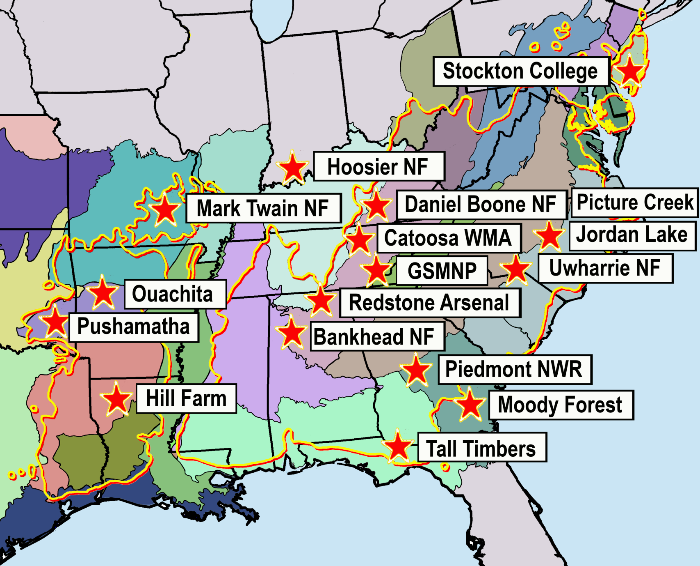
Current Best Practice Demonstration Sites
Listed in the Regional Network

Slide 12
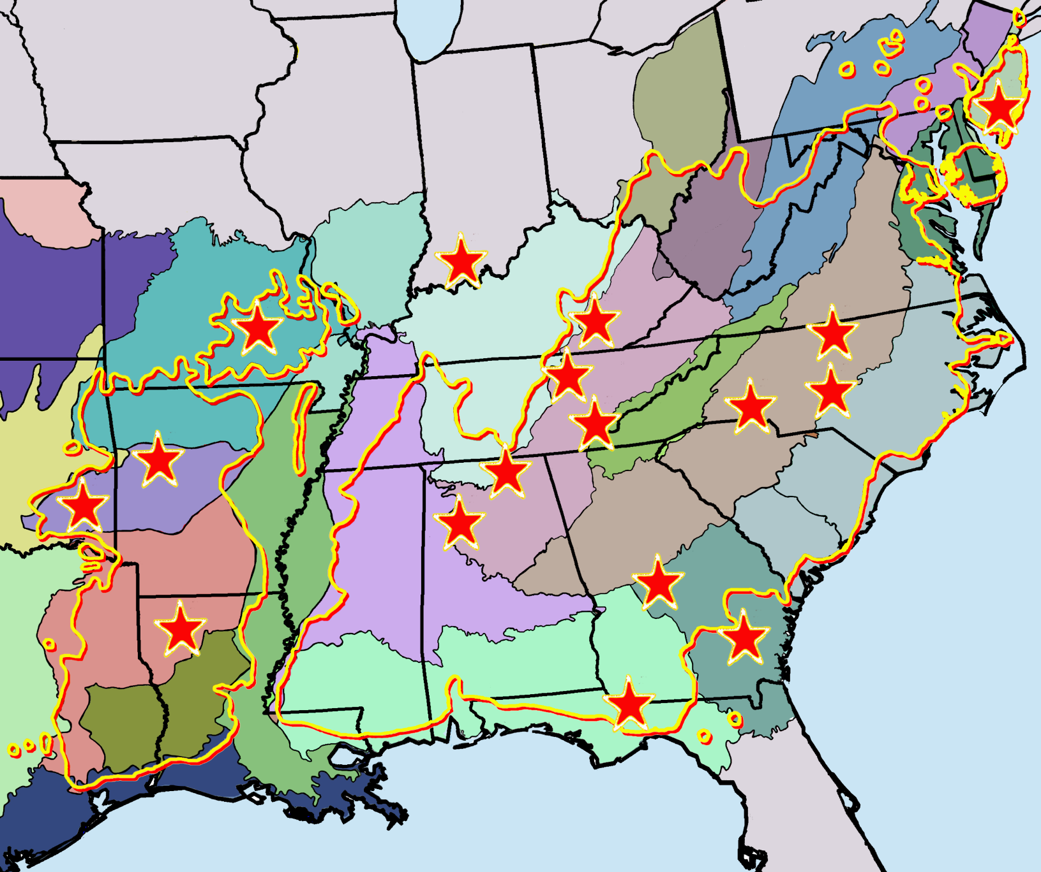
Location of Current Best Practice Demonstration Sites
Listed in the Regional Network

Slide 13
Current Status of Demonstration Sites On All Variations of Shortleaf Pine Communities
Stands Representing:
Seral stages: Not Complete
Overstory Densities: Not Complete
Overstory Species Compositions and,
Ecotypes: Not Complete
How Best to Determine How Many Ecotypes to Include?
Seral stages: Consensus Found in the Literature
Overstory Densities: Consensus Found in the Literature
Overstory Composition: Consensus Found in the Literature
Ecotypes: No Consensus in the Literature

Slide 14
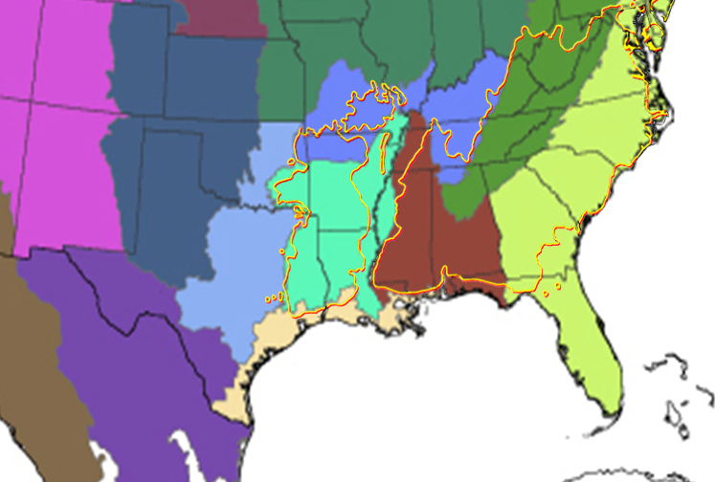
7 Joint Ventures

Slide 15
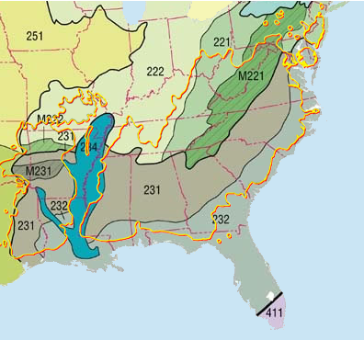
Ecoregions of the United States
Provinces
10 Provinces

Slide 16
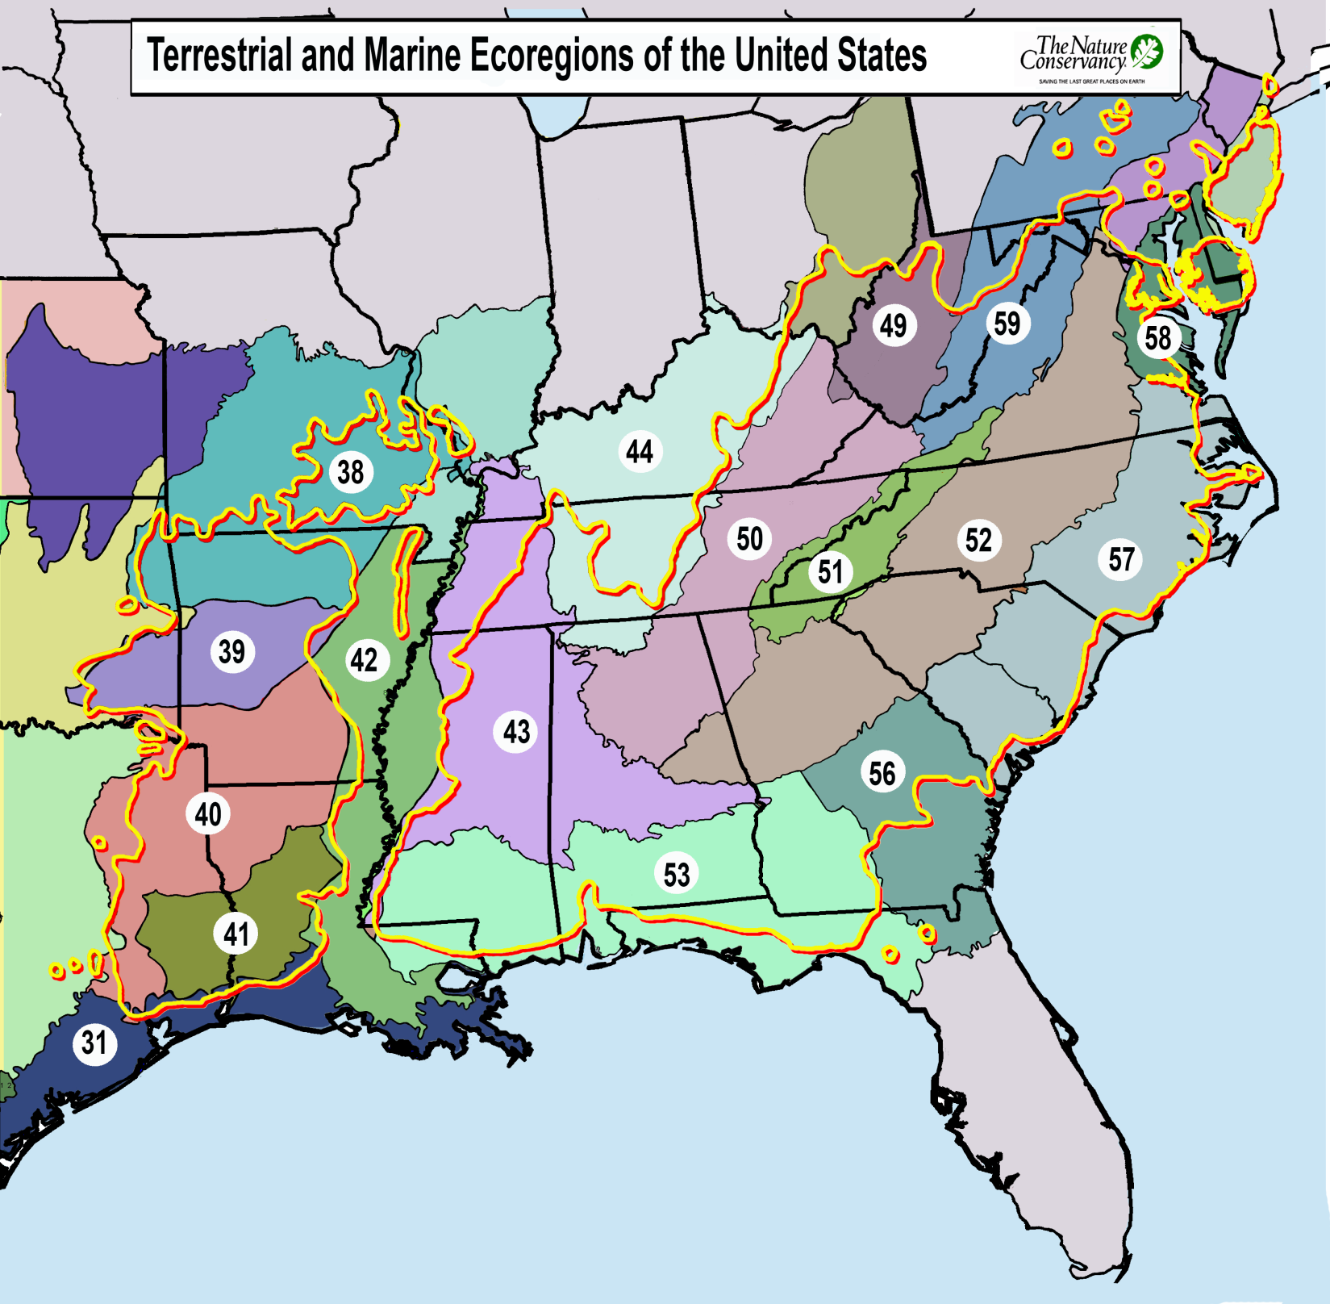
17 Ecoregions

Slide 17
Only 9 out of the 17 TNC Ecotypes Are Currently Listed

Slide 18
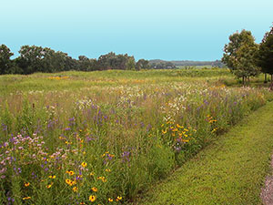
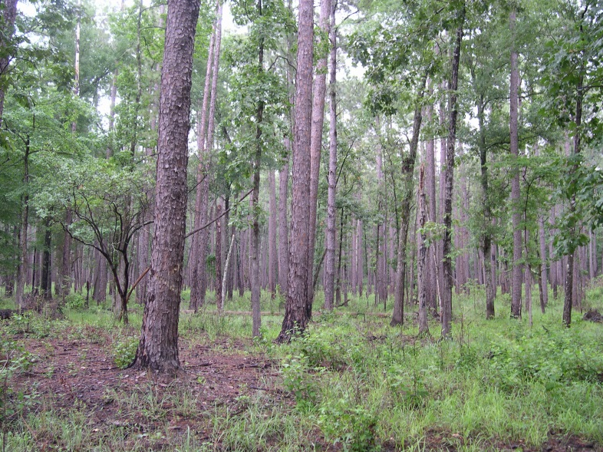
Funding Opportunities for Establishing
Demonstration Sites
USDA Forest Service
Stewardship Contracting

Slide 19
Stewardship contracting helps achieve land management goals while meeting local and rural community needs
It focuses on the “end result” ecosystem benefits and outcomes,
rather than on what’s removed from the land.
Stewardship contracting combines restoration activities on
National Forest System lands into contract or agreement
packages.
Forest Service staff collaborate to build community partnership
with cooperating Federal, State and local government agencies;
tribal governments; nongovernmental organizations; and any
interested groups or individuals to develop projects.
Examples of interested groups or individuals include resource
advisory committees, fire safe councils, resource conservation
districts, conservation groups, and watershed councils.

Slide 20
Ability to bundle several contracts into one and treat at a larger landscape scale.
Ability to trade goods for services.
Contract terms of up to 10 years.
Project proposals can be initiated from external sources as well as from within the agency.
There are organizations interested in completing restoration treatments through an agreement.
The partner would have to provide at least a 20% match, with direct and indirect costs counting towards the match.

Slide 21
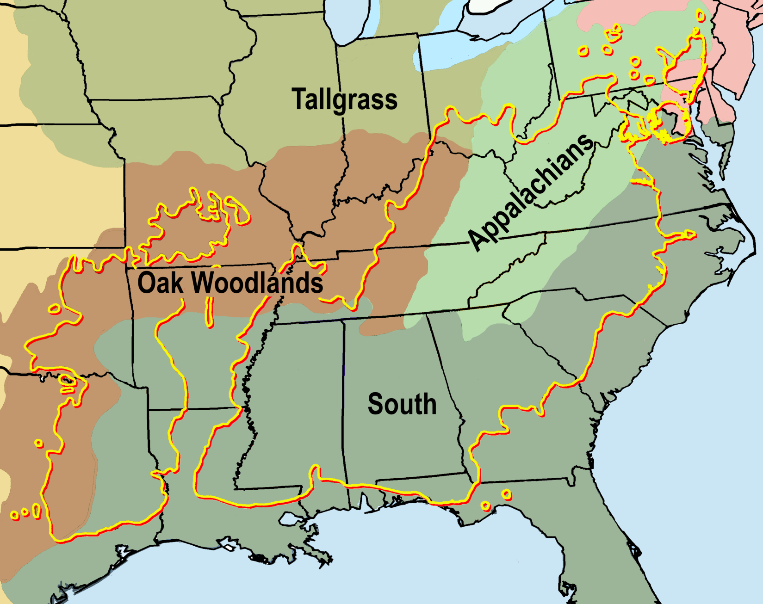

Slide 22
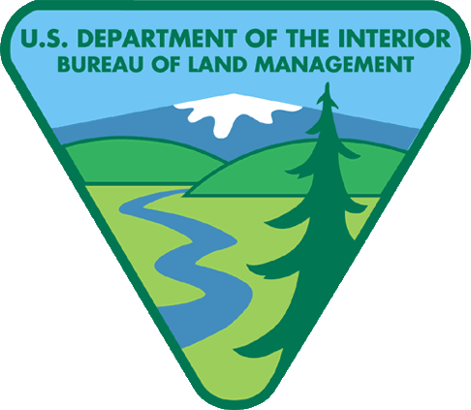
Funding Opportunities for Establishing
Demonstration Sites
Grants Issued Through Funding Opportunity Notices (FONs)

Slide 23
16-3-01 New Science Initiative –
Ecological and social dimensions of resilient landscapes
The Joint Fire Science Program (JFSP) is interested in sponsoring projects that explore and better define the concept of resilient landscapes, especially considering changing climates.
New approaches to stimulate new and creative thinking regarding the concept, definition, management, and measurement of resilient landscapes. Investigators are encouraged to work in collaborative cross-disciplinary teams, including both ecological and social scientists.
Primary Goals:
Restore and maintain landscapes across all jurisdictions to be resilient to fire-related disturbances in accordance with management objectives.
Actively manage the land to make it more resilient to disturbance, in accordance with management objectives. "

Slide 24
