Slide 1
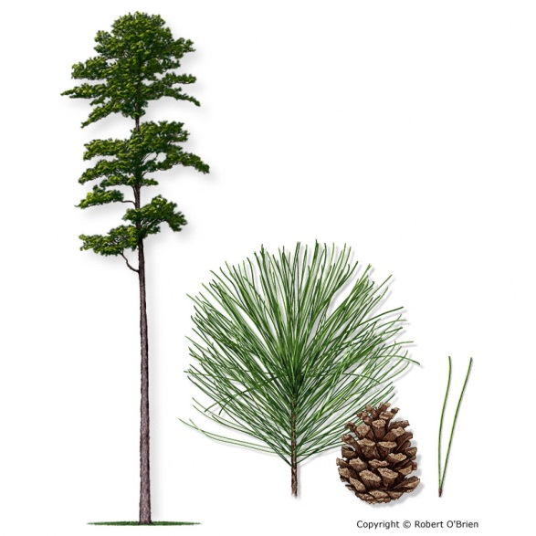
Shortleaf Pine Genetic Resources
Supporting Reforestation & Restoration
in the Southern Region
Robin Taylor, Barbara Crane, Ben Rowland, Mike McGregor,
Bobby Joe Ray, USDA Forest Service Genetics Program,
and Clyde Leggins, NC Forest Service
Third Biennial Shortleaf Conference
Shortleaf Initiative, September 2015

Slide 2
Talking Points
Background
Southwide Shortleaf Genetic Resources Survey
Forest Service shortleaf genetic resources (seed bank, seed orchards, progeny tests, seed production areas)
Forest Service Shortleaf reforestation & restoration activities
Current & future strategies
Partnerships

Slide 3
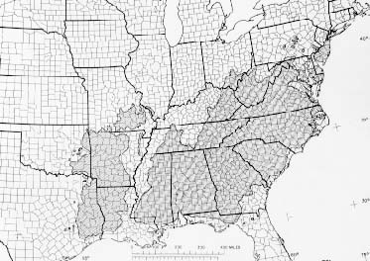
Shortleaf pine
Pinus echinata Mill.
Largest range of the 4 major commercial southern pines
Across 22 states
Fire adapted ecosystem, stem crook (re-sprouts after fire)
Cone crop every ~ 5-7 years
Seed shelf life ~15 years

Slide 4
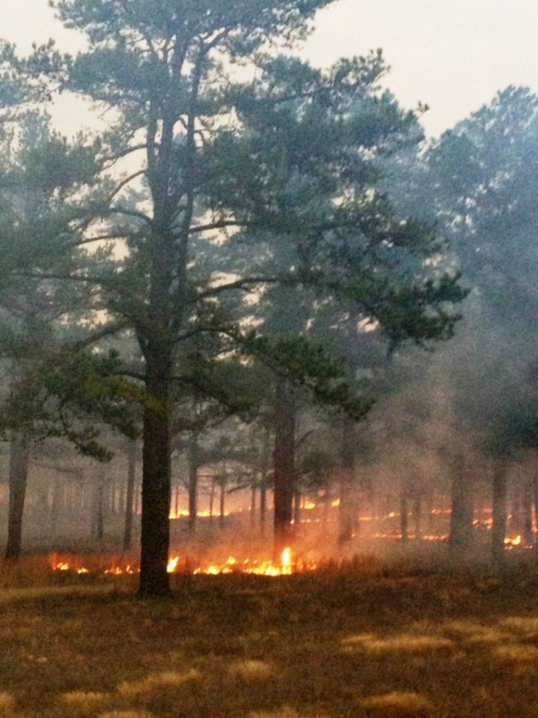
Shortleaf ecosystem
Imperiled ecosystem, 50% lost over the past 40 years
Due to pine beetle outbreaks, lack of fire, changes in forest management practices, changes in land uses
Hybridization occurrences increasing
Restoration plan written by FS
current version being updated by partners
Efforts at increased restoration
artificial & natural regeneration

Slide 5
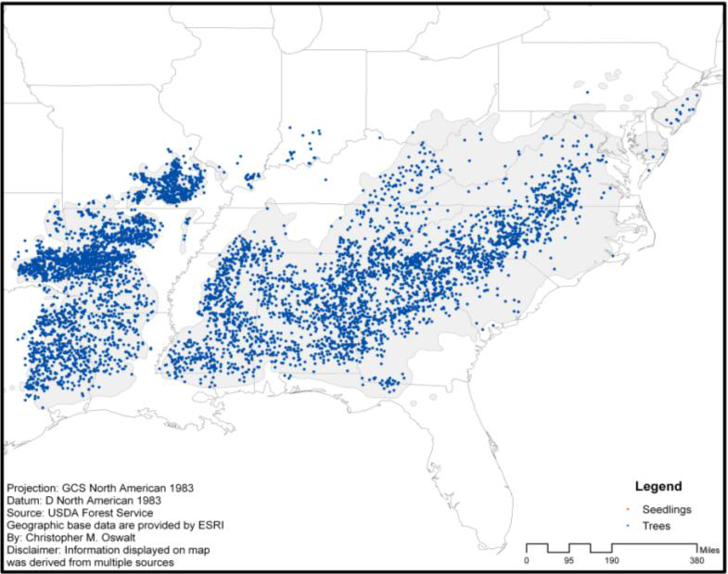
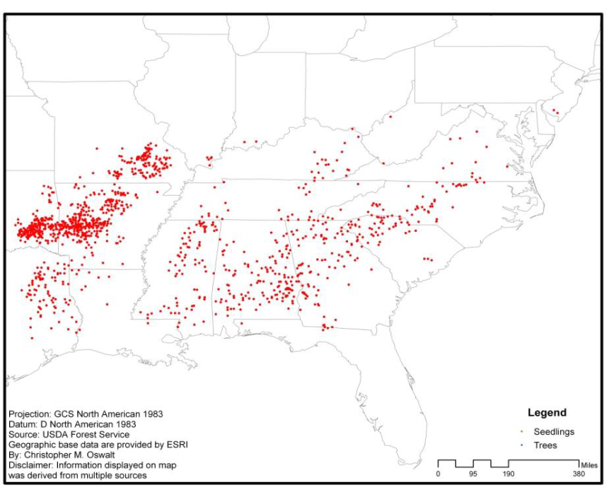
FIA – decline of
Shortleaf pine
Oswalt, 2013
1980
2012

Slide 6
Shortleaf Survey, circulated in 2012 & 2015
Will be posted on Shortleaf Initiative website
Statement | Answer
Seed Orchard Resources ACRES
First Generation
Second Generation
Advanced Generation
Seed Production Areas
Current Orchard Management YES NO
Original orchards retained, not managed, no seed collected
Orchards retained, not managed, some seed collected
Orchards retained, limited management, seed collected
Orchards retained, actively managed, seed collected
Orchards retained, actively managed, seed collected, additional genetics work underway or planned
Orchards removed
New orchards recently established on ______ acres
Never had shortleaf orchards
Seed Inventory POUNDS/ 1st or 2nd GEN SEED?
Approximate annual seed collection (averaged for last five years)
Approximate pounds of seed in storage
Seed Age
Program Intentions Next Five Years YES NO
Maintain status quo
Increase management intensity and seed collection activity
Discontinue shortleaf efforts, remove orchards
Mothball orchards for the time being
Kiln Facility (Write in YES or NO and LOCATION)
Geographic sources for shortleaf in your program: ___________________________________ _______________________________________________________________________________________ Geographic area where seed/seedlings are adapted for out-planting: ______________________ _________________________________________________________________________________ Additional Comments:
Seed orchard acres
Orchard management
Seed inventory
Program intentions
“Genetic Resource & Tree Improvement Capacity: This survey is to assess the shortleaf resources available to meet the current and projected demand for genetically improved shortleaf pine seed.“ THANK YOU for responding!

Slide 7
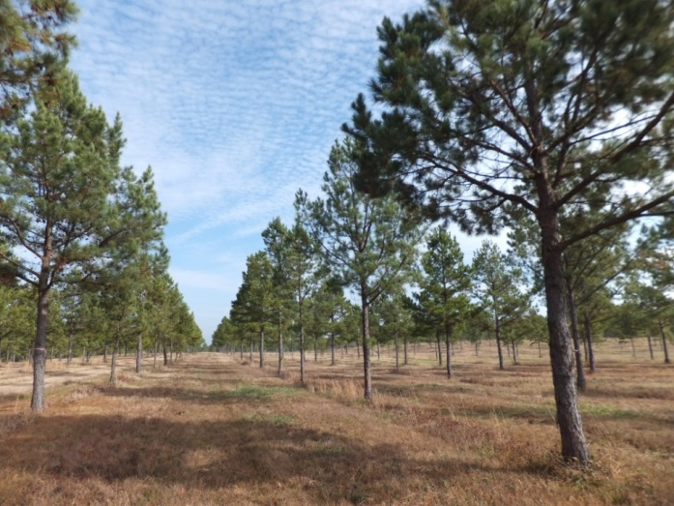
Shortleaf Survey Results
State agencies own ~ 9 % of orchard resources
Oklahoma DF ?
Tennessee DF 9 acres
Arkansas DF 14 acres
Kentucky DF 15 acres
Georgia FC 4 acres
NC Forest Service 18 ac
FS owns & manages 91% of all shortleaf resources
Industry – none (Plum Creek, Rayonier, Weyerhaeuser)
LA Forestry Seed Co., Southern Seed Company – seed only

Slide 8
Talking Points
Background
Southwide Shortleaf Genetic Resources Survey
State of Forest Service shortleaf genetic resources (seed bank, seed orchards, progeny tests, seed production areas)
Forest Service Shortleaf reforestation & restoration activities
Current & future strategies
Partnerships

Slide 9
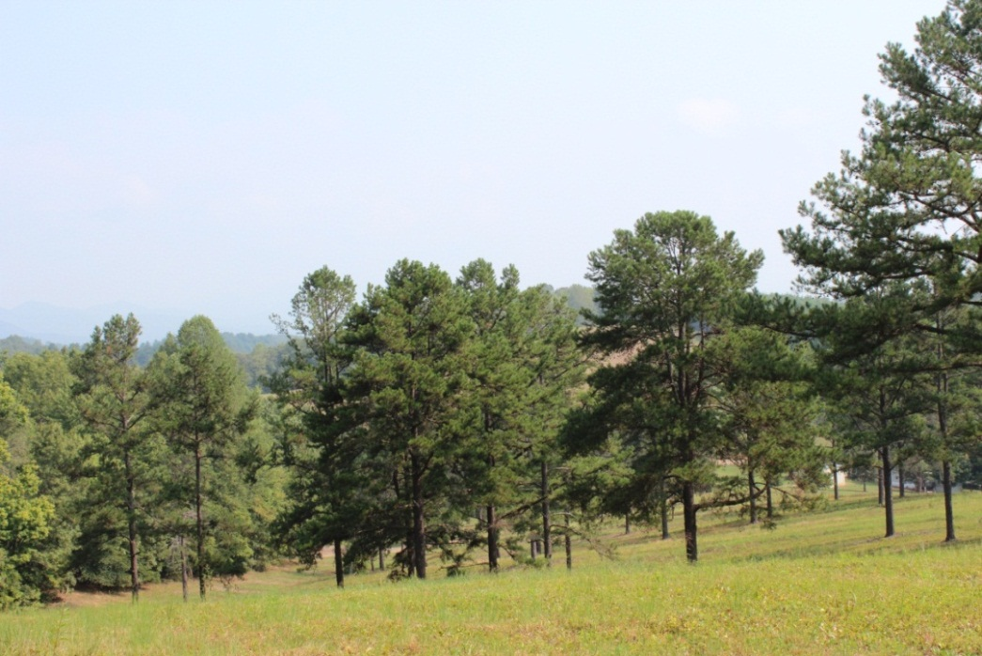
Forest Service Shortleaf genetic resources
Shortleaf seed orchards:
505 acres 1st Generation, planted in 1960’s
27 acres 2nd Generation, planted 1990’s
0 acres 3rd Generation
0 acres Seed Production Area

Slide 10
Shortleaf seed orchards in NC, MS, LA, ARK
Mt Ida
Beech Creek
Stuart
MS

Slide 11
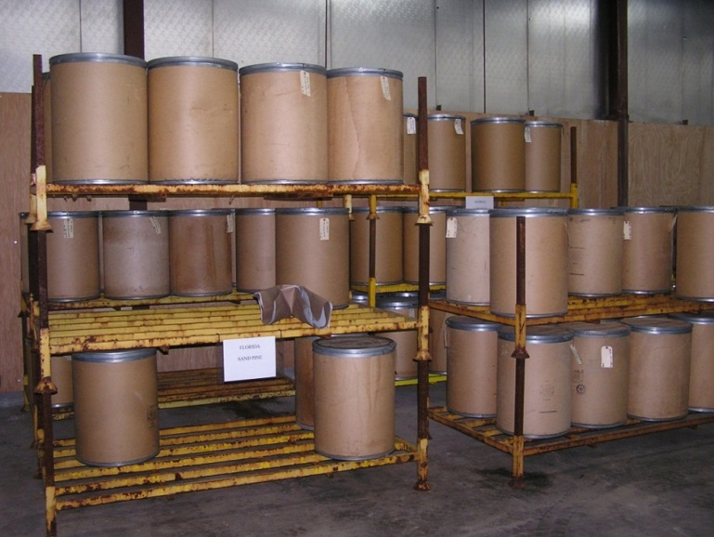
Forest Service Shortleaf progeny tests:
155, established 1982 - 1993, resurrected, documented, monumented, silviculture prescriptions written
Data collection for Appalachian seed zones – tentative FY17, funding dependent
FS Shortleaf
seed inventory:
4534 lbs. (90% ARK source)
Collected 1984 – 2014
Need Appalachian seed

Slide 12
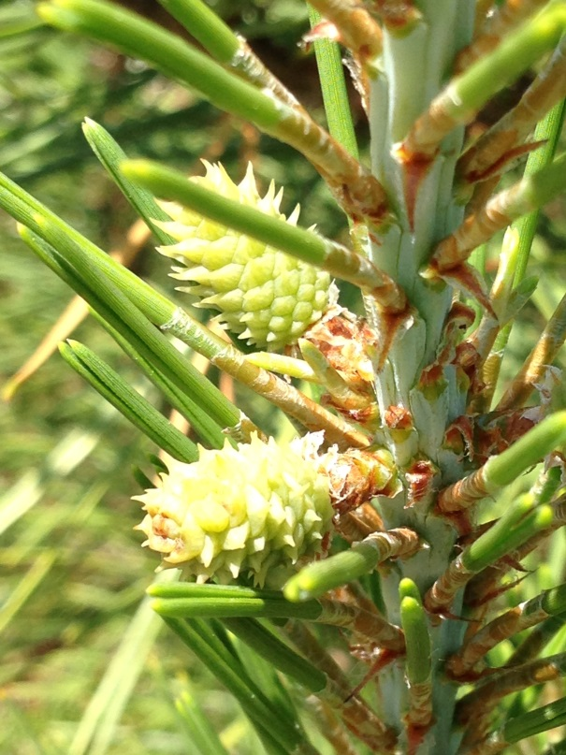
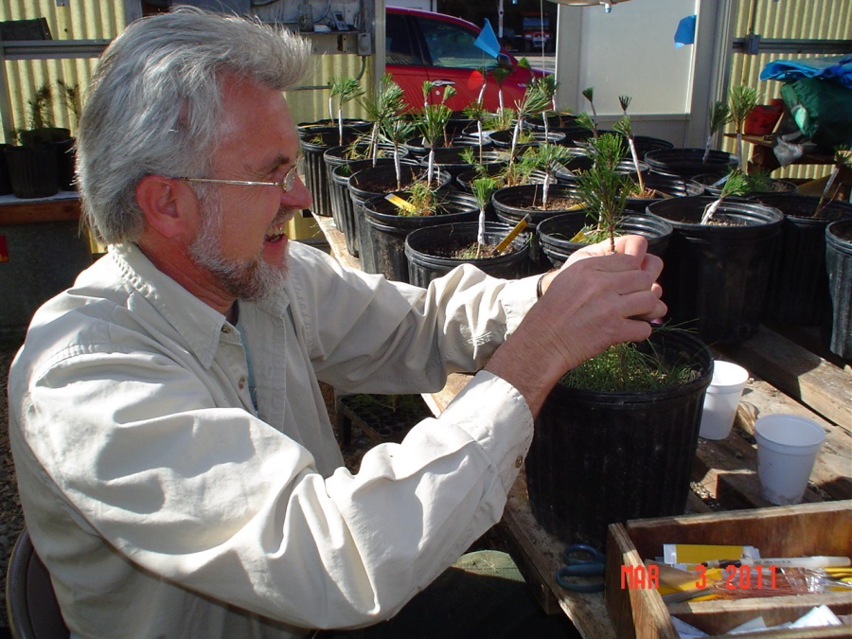
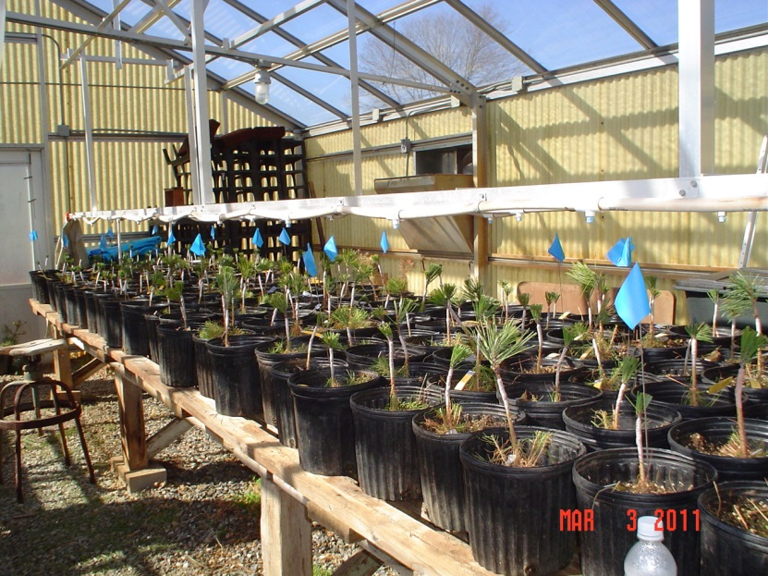
Working with NC Forest Service,
Building up 2nd gen orchards,
Using progeny test data,
Graft scion from selections
Anyone else interested?

Slide 13
Talking Points
Background
Southwide Shortleaf Genetic Resources Survey
State of Forest Service shortleaf genetic resources (seed, orchards, progeny tests, seed production areas)
Forest Service Shortleaf reforestation & restoration activities
Current & future strategies
Partnerships

Slide 14
START WITH
CRITICAL QUESTIONS:
What is the most appropriate genetic material to plant that will grow a healthy, diverse and sustainable forest?
50 - 100+ yr. rotations
Forests need to be resilient
Climate change variability's are occurring faster than some tree species ability to respond.
Is shortleaf a resilient species?
Is it a generalist or specialist?

Slide 15
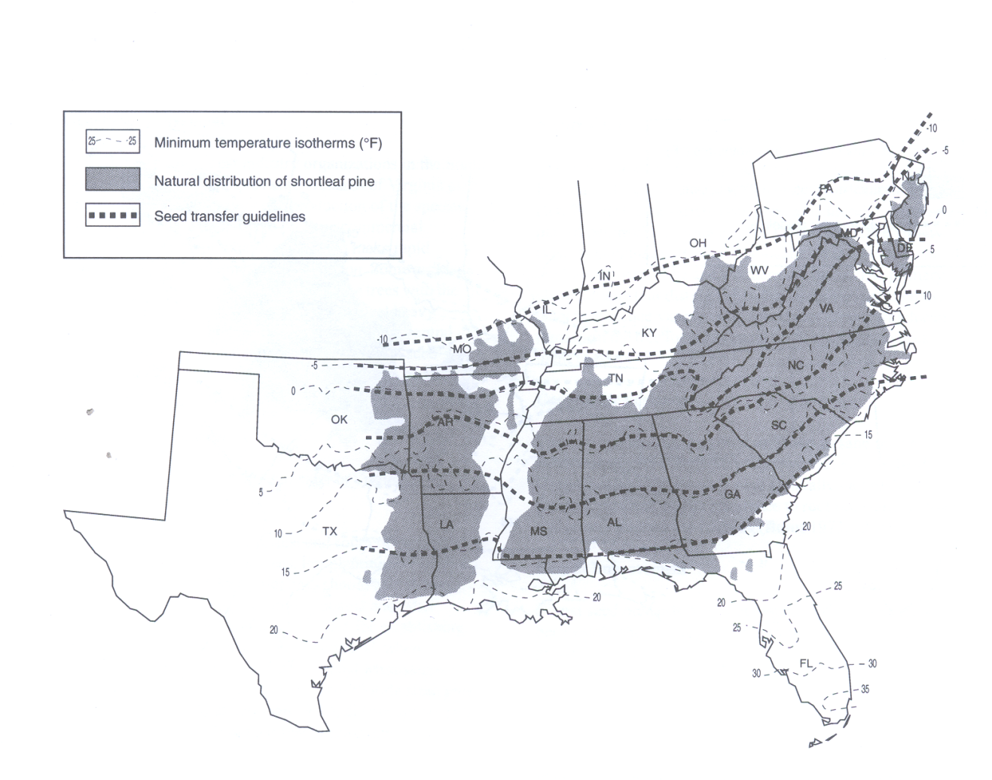
Shortleaf
Follow seed zone guidelines
100 year+ rotation

Slide 16
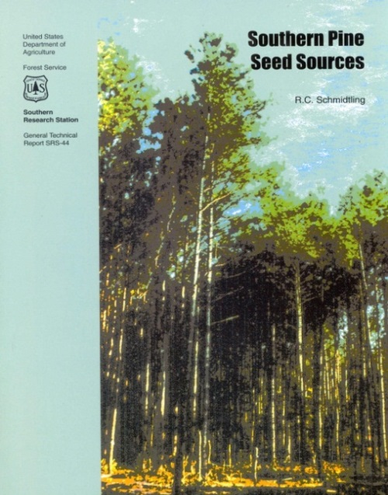
Time for an update?
Developed using past and current genetic information & climatic conditions to designate seed sources & seed zones.
HOWEVER will it be pertinent for future seedling
deployment? Under the threat of climate change?

Slide 17
Climate change

Slide 18
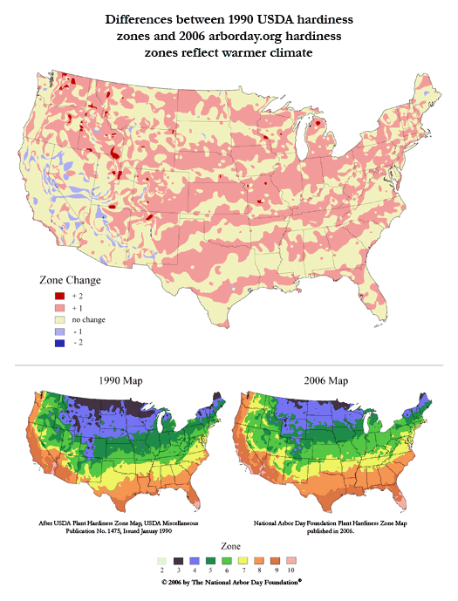
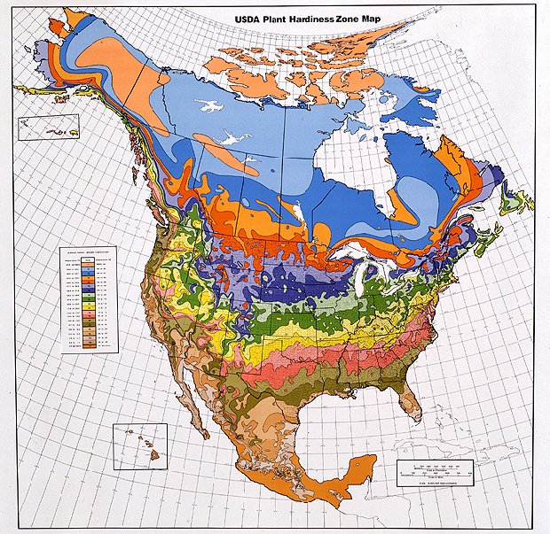
What should we do OR modify operationally to prepare our future forests to be resilient?
Seed zones are changing

Slide 19
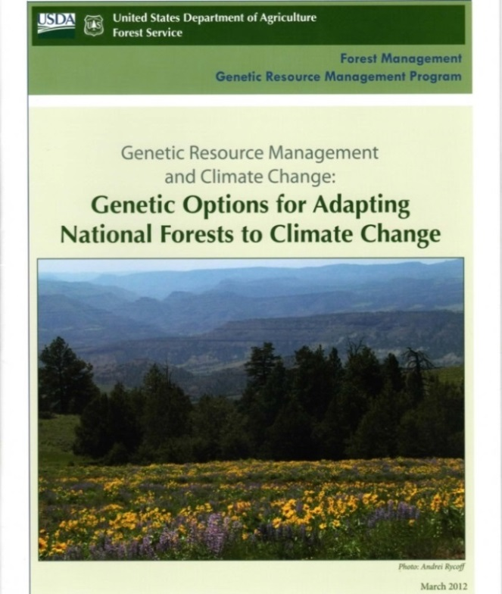
Forest Service
National Guidelines for National Forests
Goals, Principles and Recommendations
for Enhancing Forest Resiliency
2012

Slide 20
Planting in the right areas –
for now and for the future
New seed zone development & application
Mix seed lots from adjacent N/S seed zones, plant in N seed zones, e.g. mix zone 7 & 8 seed, plant in zone 8
Seed forecasting – is there enough seed?
Understanding tree physiology & seed biology
Genecology studies – to understand adaptation
Assisted migration studies

Slide 21
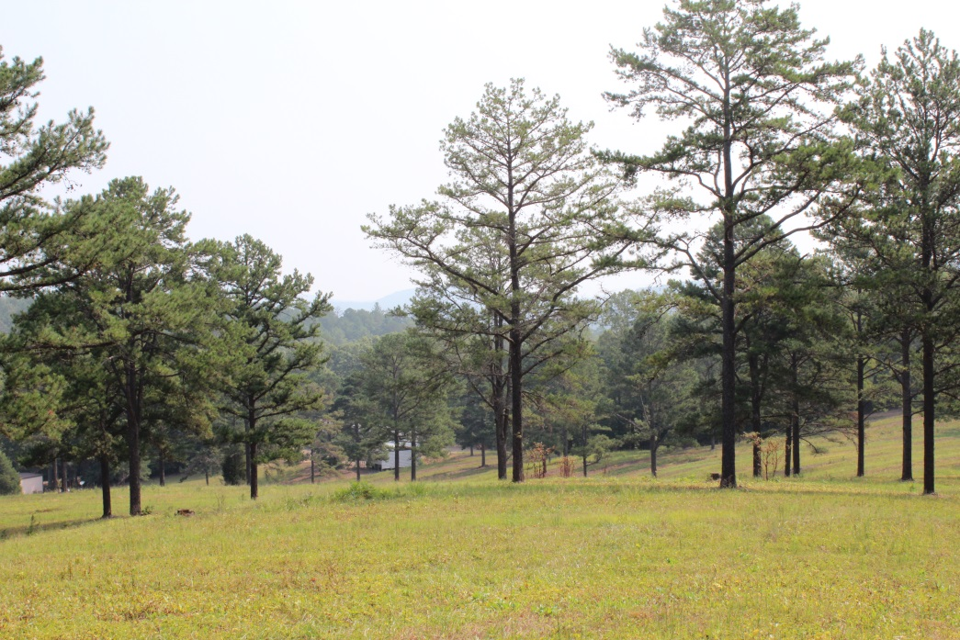
Shortleaf x loblolly hybridization
A serious concern:
SHL x LOB hybridization study, Oklahoma State U, Stuart & Will, FS provided funding
No adaptive crook to re-sprout after fire
What we are doing about it:
DNA fingerprinting Forest Service orchards to eliminate hybrids (National Genetics Lab “NFGEL”)
Cutting down loblolly around the orchard and within the orchard > minimize loblolly pollen cloud
Continue to do prescribed burns to
kill hybrids

Slide 22
Talking Points
Background
Southwide Shortleaf Genetic Resources Survey
State of Forest Service shortleaf genetic resources (seed, orchards, progeny tests, seed production areas)
Forest Service Shortleaf reforestation & restoration activities
Current & future strategies
Partnerships

Slide 23
Current Strategies
Seed Need Projections - on a 5-year cycle
based on reforestation needs
Forest | Species* | Projected acres | No.# seedlings | Seed | Lbs of Seed | Lbs of viable seed | # of yrs of stored seed
 |  | to plant per year | per year ** | per pound | needed per year | in inventory | meets planting targets
 |  |  |  |  |  |  | (# yrs worth in storage, collection yr)
Alabama NFs | coastal longleaf | 400 | 240,000 | 4,500 | 53 | 186 | 3 yrs, '00, '03, '06, '08
 | mtn longleaf | 500 | 300,000 | 4,900 | 61 | 967 | 16 yrs, '00, '03, '04, '06
 | shortleaf | 100 | 60,000 | 41,300 | 1
Cherokee, TN | shortleaf | 800 | 480,000 | 41,300 | 12 | 0 | 0 yrs, purge '82
 | pitch | 100 | 60,000 | 48,000 | 1 | 0 | 0 yrs, purge '90
 | table mtn pine |  |  | 28,600
 | Am. Chestnut
Chatto/Oconee, GA | shortleaf | 220 | 132,000 | 41,300 | 3
 | longleaf | 110 | 66,000 | 4,300 | 15
 | pitch | 100 | 60,000 | 45,100 | 1
 | table mtn pine | 125 | 75,000 | 34,000 | 2 | 1 | 1/2 yr '05
For example:
Plant 1+ million shortleaf seedling annually

Slide 24
Future Strategies
EFETAC
Eastern Forest Environmental Threat Assessment Center
Developing new tree range maps (FORECasts)
R8 will use for seedling deployment
R8 will be mixing seed sources in the new planting zones
Longleaf and Shortleaf – taking risks in small areas
“Determining Suitable Locations for Seed Transfer under Climate Change, Potter & Hargrove, 2014
http://www.forestthreats.org/research/projects/project-summaries/assessing-forest-tree-risk

Slide 25
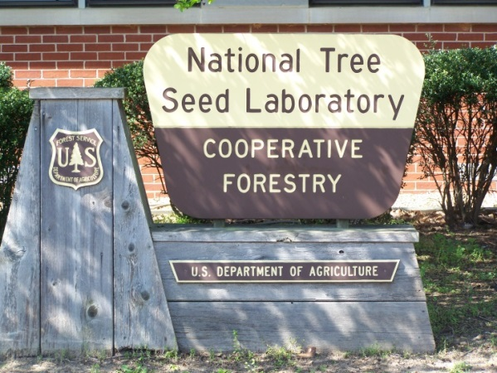
Partners - FS R&D, state agencies, universities, nurseries, Shortleaf Initiative group, etc.

Slide 26
Same Challenges continue…
LIMITED Resources (people, funding)
Scarcity of seed for the Appalachian areas
Need to establish additional 2nd gen. seed orchards for missing seed zones
Funding is needed
More partners involved
Need grafting expertise
Where to plant to ensure resiliency?
Data collection & analysis

Slide 27
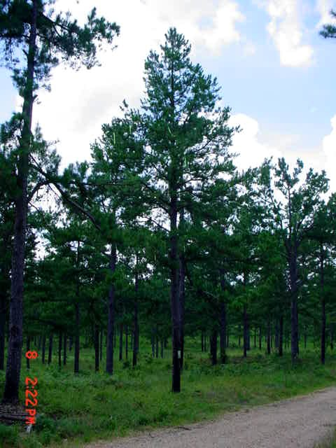
Thanks!
barbaracrane@fs.fed.us

