Slide 1
Shortleaf Pine Opportunities for Assistance
Shortleaf Pine Opportunities for Assistance
Tim Albritton
NRCS, State Staff forester
Auburn, AL

Slide 2
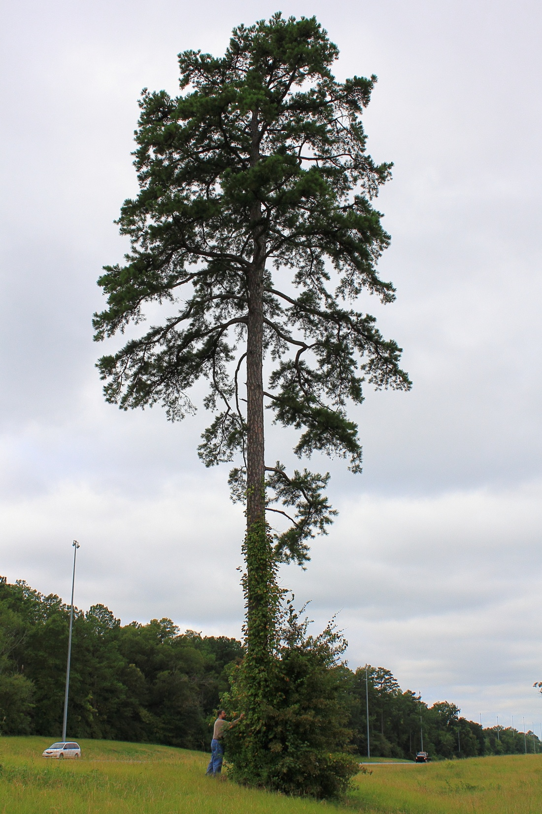
Shortleaf Pine’s range covers most of Alabama and can be found in most counties.
However, of the 23 million acres of timberland in Alabama only 175,768 acres are comprised of shortleaf pine stands (stands in which pine species comprise over 50% of the dominant and co-dominant trees AND shortleaf pine is the predominant pine species).
The majority of shortleaf pine stands are found in SE Alabama (Barbour, Bullock, Lee, Macon, and Russell Counties)
This shortleaf pine tree is in Montgomery in between the
I85 median.
Photo credit:
Hannah Albritton

Slide 3
Shortleaf Pine Facts
71% of all shortleaf pine stands are comprised predominantly of sawtimber-sized trees

Slide 4
More Shortleaf Pine Facts
The “loblolly pine” forest type comprises more acres than any other single forest type in Alabama (7.9 million acres). Within this forest type, there is more shortleaf pine volume than any other species except for loblolly pine and sweetgum. Therefore, despite the small number of acres that are considered to be shortleaf pine stands, shortleaf pine is a prominent species in Alabama

Slide 5
More Shortleaf Pine Facts
Despite the low number of timberland acres comprised of shortleaf pine stands, total shortleaf pine volume ranks 7th out of 130 species in Alabama
Species | Total Volume (Cu. Ft.)
Loblolly pine | 11,582,794,319
Sweetgum | 2,807,384,236
Water oak | 1,869,955,091
Yellow-poplar | 1,731,707,486
White oak | 1,353,789,347
Longleaf pine | 874,836,070
Shortleaf pine | 863,440,671

Slide 6
More Shortleaf Pine Facts
The current shortleaf pine “Champion Tree” is located in Madison County and its measurements are: circumference = 129”; height = 91’; average crown spread = 56’
Special Thanks to:
Brian Hendricks
Forest Inventory & Analysis (FIA) Coordinator
Alabama Forestry Commission

Slide 7
Shortleaf Pine (Pinus echinata)
In 2005 Shortleaf was added to the EQIP Tree Establishment species list.
We believed there was a need to promote a more diverse species list.

Slide 8
This accomplished nothing!

Slide 9
Where is assistance available?
Limited to north Alabama

Slide 10
Because of littleleaf disease problems in central and south Alabama, shortleaf pine planting is only eligible in the following counties: Blount, Cherokee, Cullman, DeKalb, Etowah, Jackson, Lawrence, Limestone, Madison, Marshall, Morgan, Walker, Winston, and those eastern portions of Colbert, Lauderdale, Fayette, Franklin, and Marion that are outside of the coastal plain soils.

Slide 11
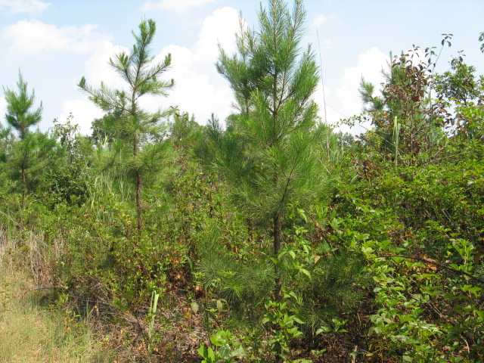
Shortleaf Pine Planting
Chemical site prep in fall of 2006
9’ x 12’ spacing with 403 trees per acre
Completed its 5th growing season

Slide 12
Photo credit: Jim Schrenkel

Slide 13
Photo credit: Jim Schrenkel

Slide 14
EQIP
612 Tree/Shrub Establishment
Shortleaf Pine Ecosystem
Program payments are limited to planting recommended species (containerized). Minimum spacing is 400 TPA and maximum is 684.
($16,017 limit per cont. Reg.; $19,221 HU – this includes all practices associated with the planting- 612, 490, 338, 394, etc.
Payment Rate per acre $160.17
HU Rate $192.21
Notes:
Examples of tree spacing would be: 9’ x 12’ = 403, and 8’ x 8’ =681

Slide 15
EQIP
490 Tree/Shrub Site Preparation
Aerial Chemical
Program payments are limited to site preparation on pasture, idle fields with a predominance of shrubby vegetation, or cut- over forest, using a chemical herbicide.
Payment Rate per acre $73.00
HU Rate $87.60

Slide 16
EQIP
338 Prescribed burn
A prescribed burn is usually recommended and is planned as a separate practice.
Payment Rate per acre $21.00
HU Rate $25.20

Slide 17
Forest Stand Improvement
Increasing shortleaf pine production can be achieved with release treatments in mixed pine/hardwood stands
Cain, Michael D. 1991a. Five-year response of natural loblolly and shortleaf pine regeneration to release treatments. Res. Pap. SO-265. New Orleans, LA: U.S. Department of Agriculture, Forest Service, Southern Forest Experiment Station. 13 p.

Slide 18
Other Practices Offered in EQIP
Understory Release in Mid-Rotation Stands
Hardwood Crop Tree Release
Precommercial Thinning
Prescribed Burning

Slide 19
AL EQIP Deadline
October 16, 2015

Slide 20
For More Information http://www.al.nrcs.usda.gov/
Click on “Programs”

Slide 21
Questions
Photo credit: Jim Schrenkel

