Slide 1
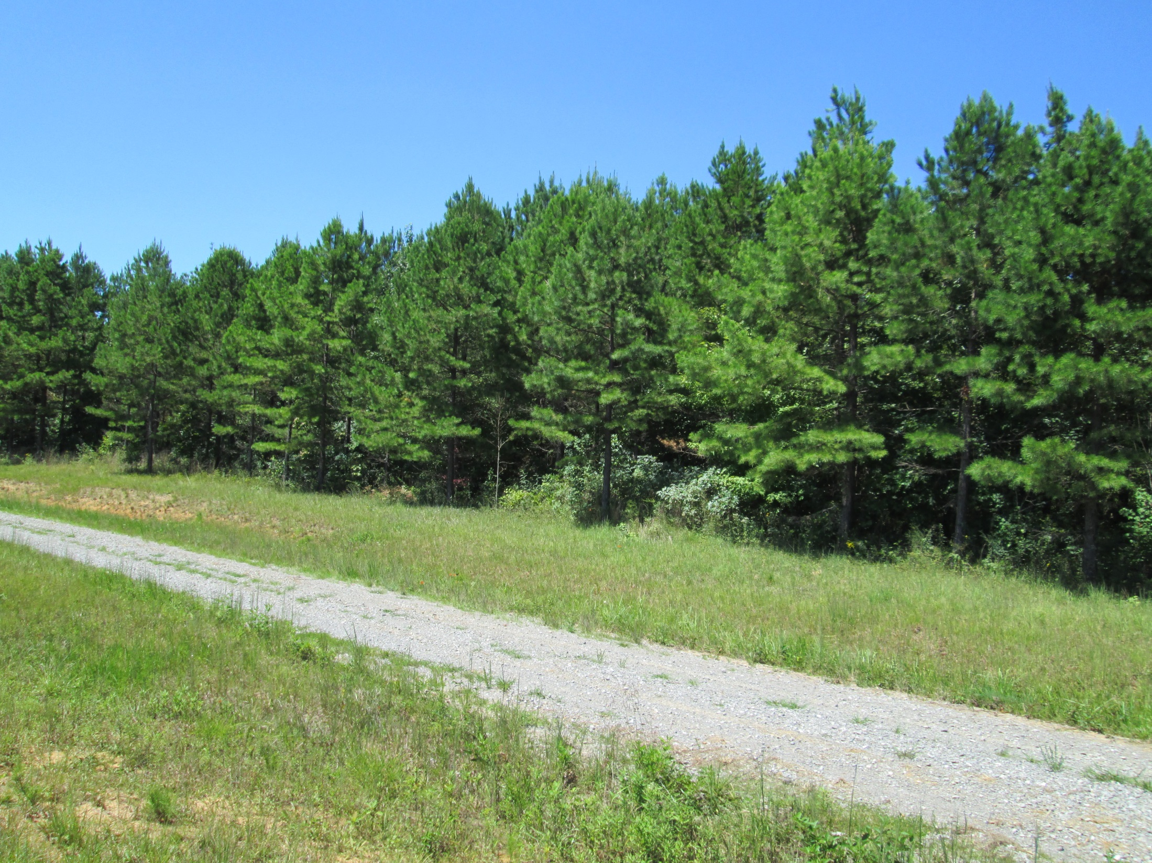
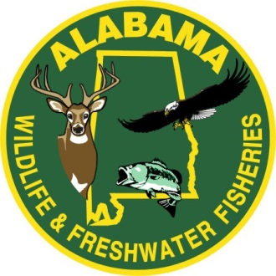
Shortleaf Pine Restoration on Alabama
Wildlife Management Areas
3rd Annual Shortleaf Pine Conference:
The Return of an American Forest Legacy
Daniel A. “Drew” Nix, RF
Alabama Wildlife and Freshwater Fisheries
9-24-2015
Notes:
Hello, I am Drew Nix with the Alabama Wildlife and Freshwater Fisheries Division. I am an Auburn graduate, and have worked in private industry, State forestry, private consulting, and with the Division for the past 20 years. I appreciate the opportunity to share with you attendees some of our past experiences with shortleaf today.

Slide 2
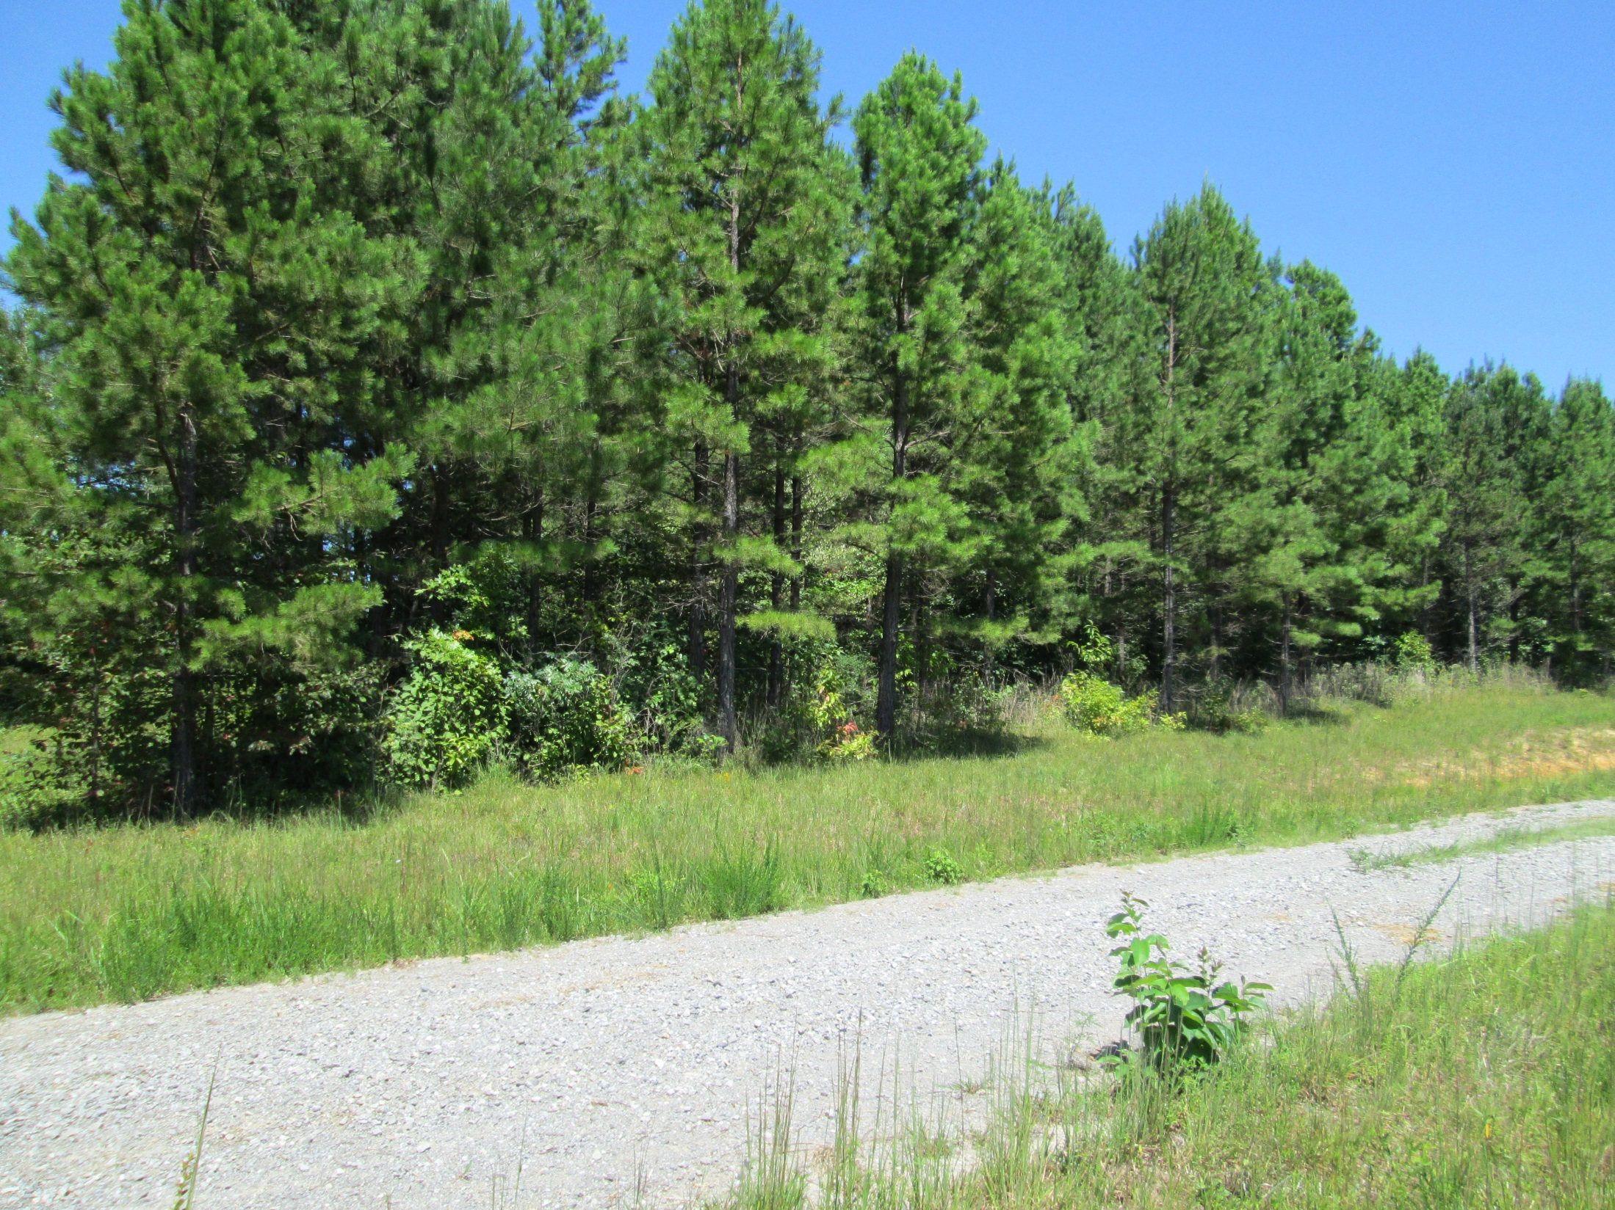
Skyline WMA Aug 2015
Notes:
WFF has acquired industrial timber lands in North Alabama from the 1970’s into the 2000’s. Much of these lands had loblolly plantation on them. Some of these lands had timber reservations and some did not. Our first foray into shortleaf planting was on the Skyline WMA, Jackson County, on the Cumberland Plateau, in extreme north east Alabama.
Some of the property WFF has in Skyline WMA was owned by Champion and had been aerially seeded to loblolly in the 60’s. WFF started thinning some of these sands in the mid 90’s, and the area in the pictures was a salvage clearcut from tornado damage. The area biologist and I were proud of the thinnings that we had done, realizing what the habitat potential was with continued management. Winter came that year, with a fairly good ice and snow storm, that devastated the recently thinned loblolly stands, breaking branches and tops, and laying trees over.
We decided at that point to try reforesting the tornado salvage area with shortleaf, with plans to manage this stand into an uneven aged stand over time as a hedge against ice and snow loading.
Some of the property WFF has in Skyline WMA was owned by Champion and had been aerially seeded to loblolly in the 60’s. WFF started thinning some of these sands in the mid 90’s, and the area in the pictures was a salvage clearcut from tornado damage. The area biologist and I were proud of the thinnings that we had done, realizing what the habitat potential was with continued management. Winter came that year, with a fairly good ice and snow storm, that devastated the recently thinned loblolly stands, breaking branches and tops, and laying trees over.
We decided at that point to try reforesting the tornado salvage area with shortleaf, with plans to manage this stand into an uneven aged stand over time as a hedge against ice and snow loading.

Slide 3
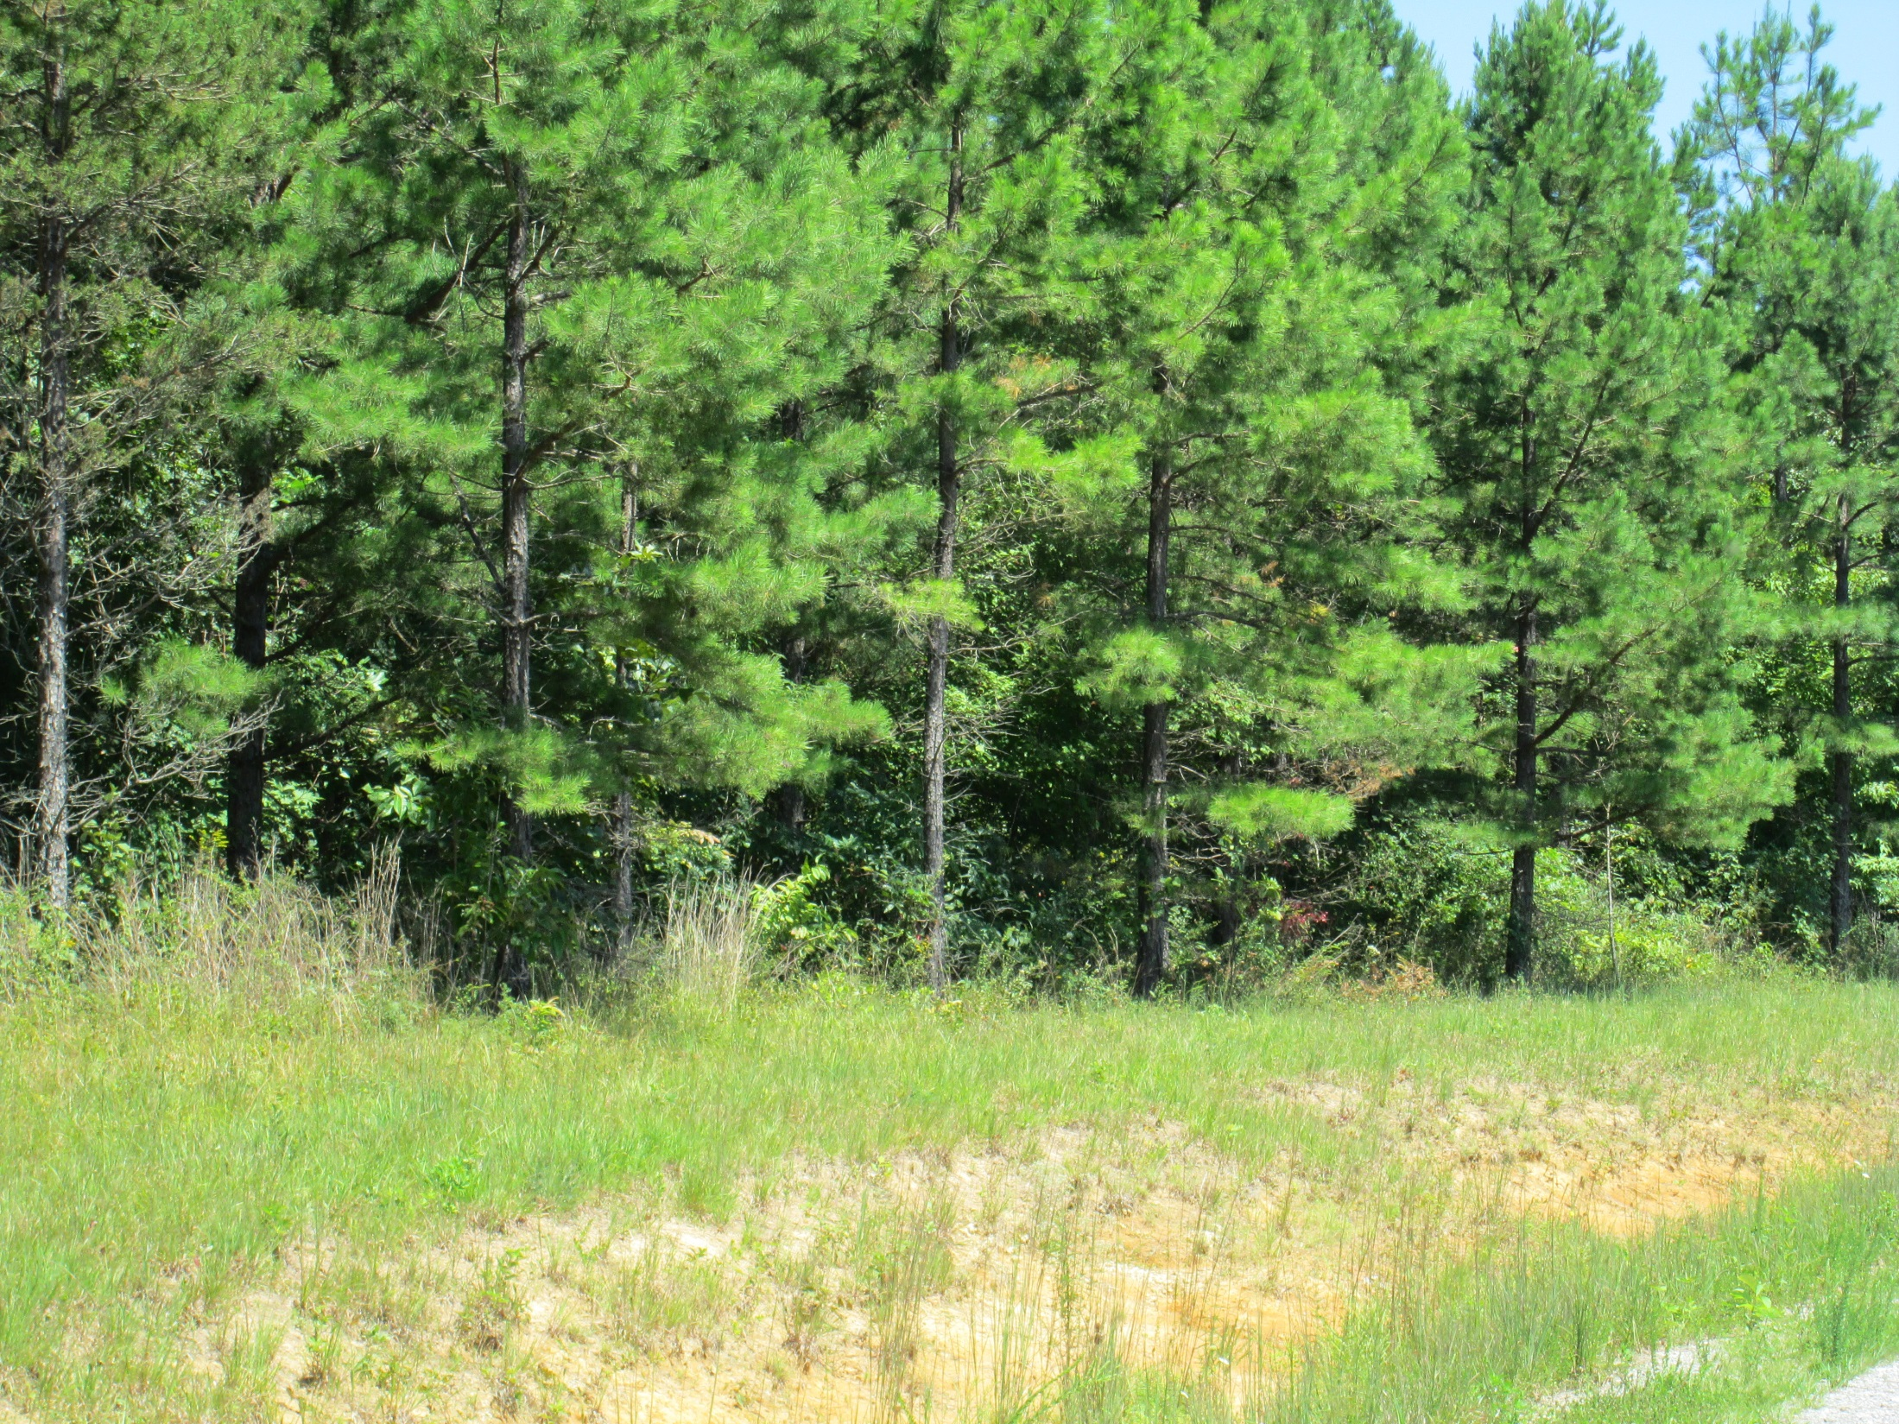
Skyline WMA Aug 2015
Notes:
We had chemical site prep consisting of imazapyr and glyphosate, followed with a prescribed burn. Seedlings were a large issue back in those days at least here in Alabama. States to north produced some bareroot seedlings for landowners, but would not sell out of state. We ended up sourcing some seed from Arkansas, and had container seedlings grown at Wallace State Community College, Hanceville Alabama. The seedlings were shallow plugs, and there were a lot of the production that had the basal crook 2” above the top of the plug. We did not know anything about shortleaf seedling production, and basically graded these seedlings as culls, but overall seedling production was so low we had to use them. That is one of the good things over the following years as interest has grown in shortleaf, that seedling production is better.
This stand is approaching 20 years old and will be scheduled for thinning in the next 2 to 3 years.

Slide 4
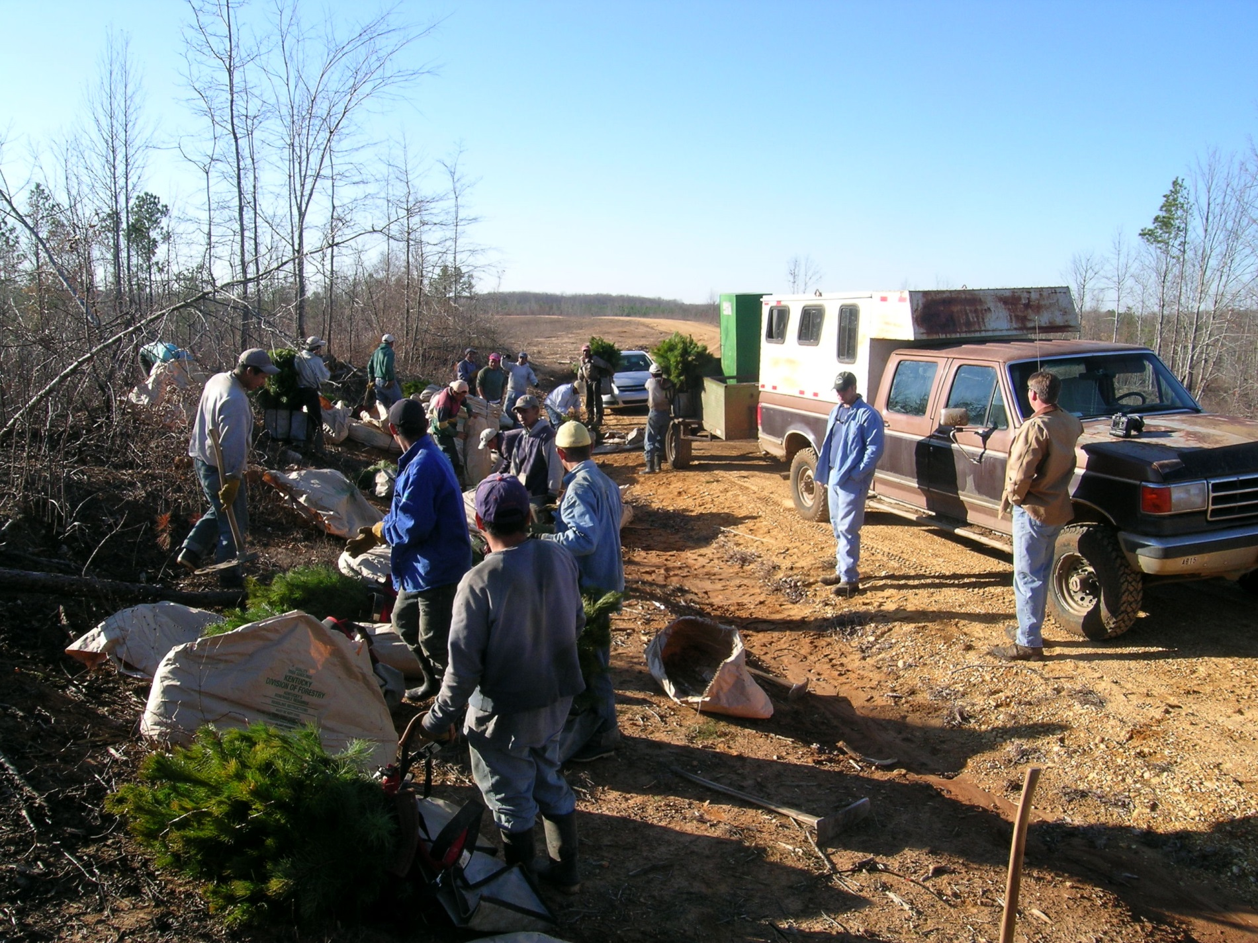
Freedom Hills WMA Dec 2006
Notes:
In 2001, The Alabama Forever Wild Land Trust purchased approximately 31,000 acres of industrial timberland in Colbert and Lauderdale Counties for public hunting in the Freedom Hills and Lauderdale Wildlife Management Areas. The majority of this land had a phased timber reservation lasting 19 years. Several stands a year were scheduled for harvesting, leaving 4 trees per acre. Most of these areas have been restored to shortleaf pine.

Slide 5
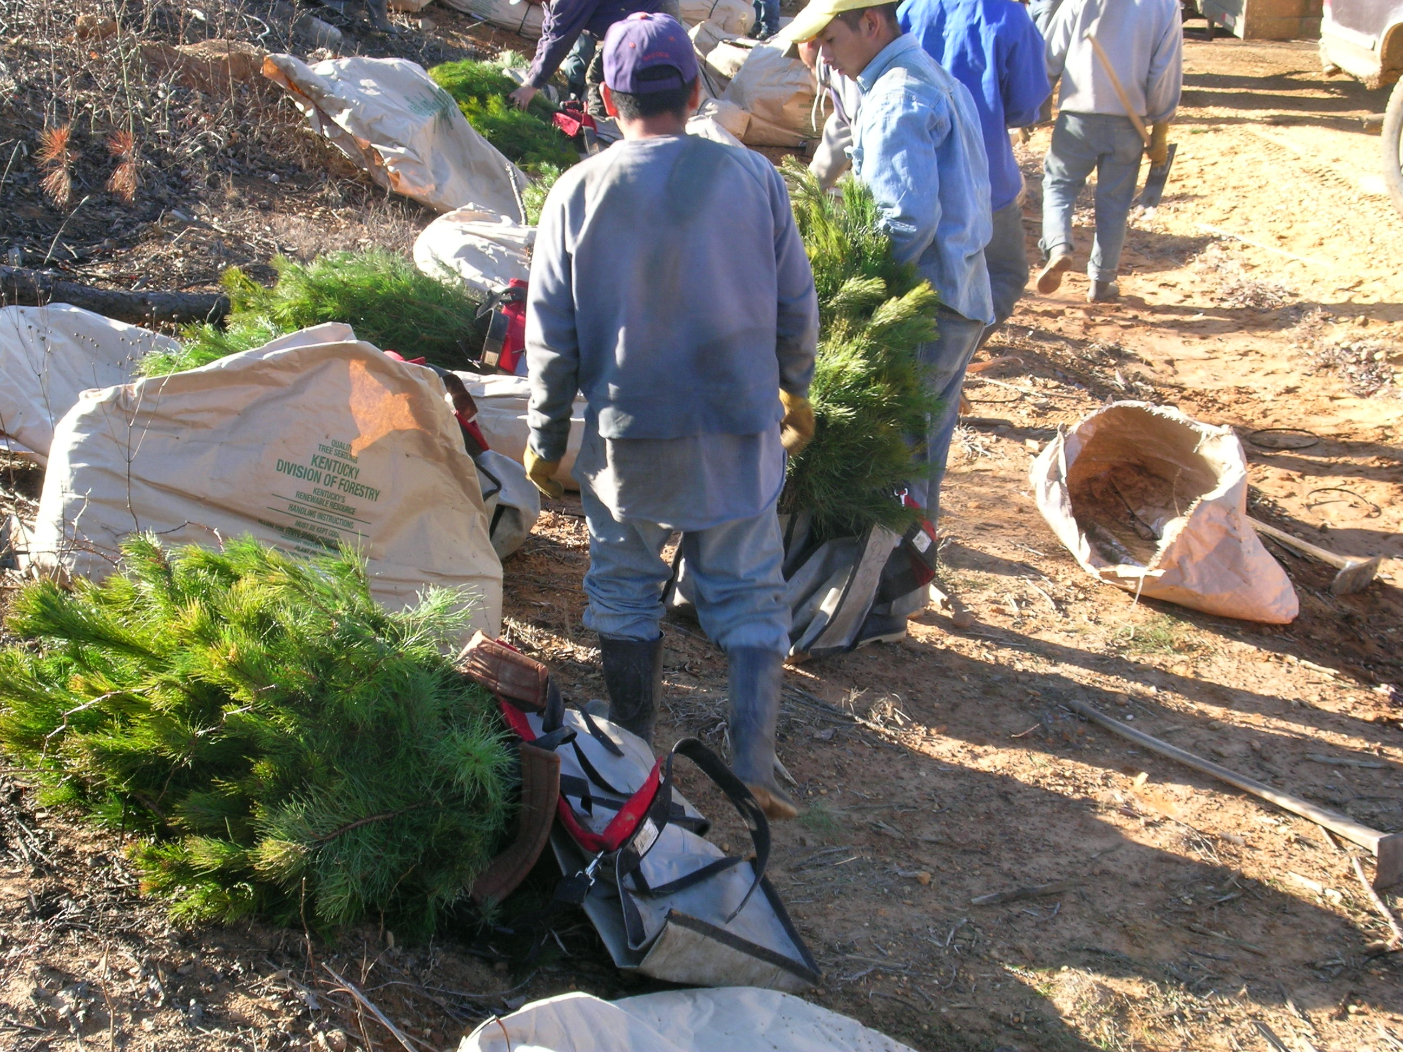
Freedom Hills WMA Dec 2006
Notes:
This process was jump started with the use of $300,000 of State Wildlife Grant money, Project T-3-2 “Shortleaf pine – Bluestem Habitat Restoration on Freedom Hills and Lauderdale WM A’s.” This 3 year project is the initial phase to restore approximately 2,000 acres of an identified 20,000 acres to a fire dependent, shortleaf pine, open canopy, blue stem ecosystem. SWG money was matched by FW Stewardship funds 2006 thru 2009. The project has been carried on annually since 2009 with FW Stewardship only.

Slide 6
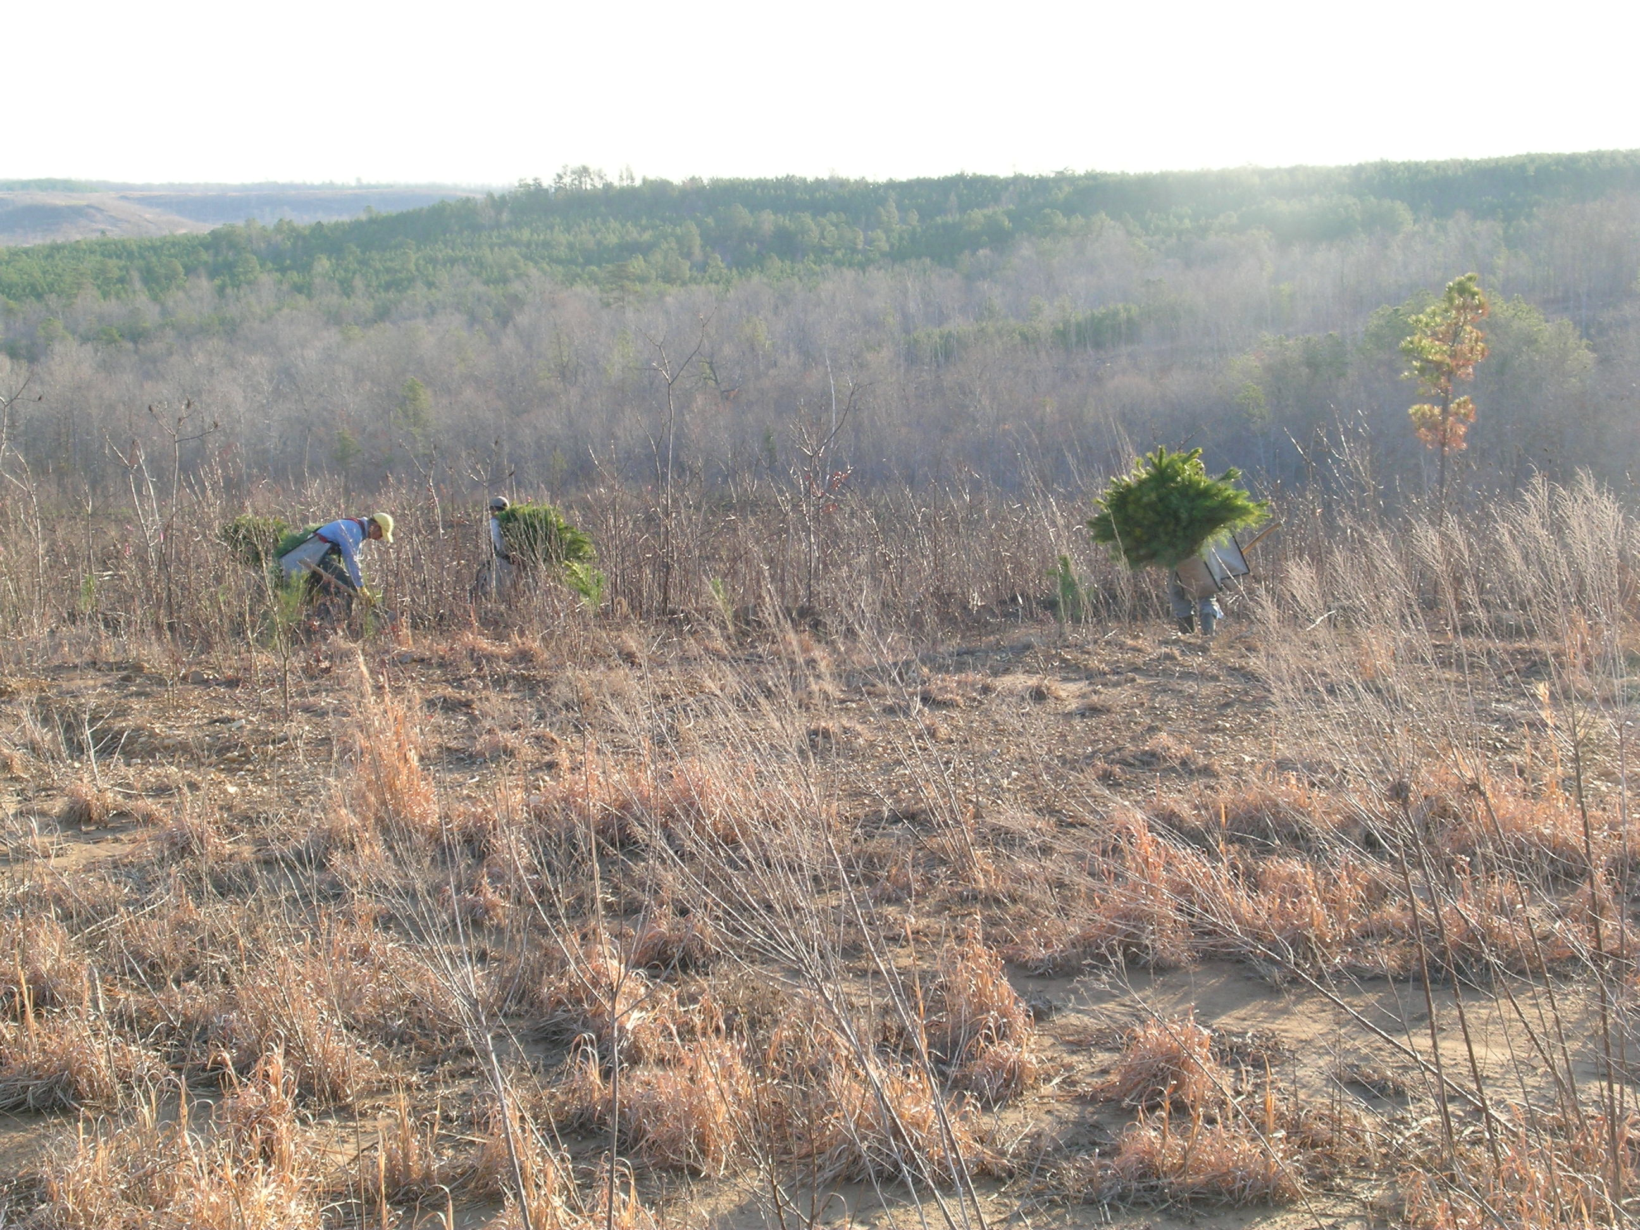
Freedom Hills WMA Dec 2006
Notes:
The first tract in 06-07 planting season was on Freedom Hills WMA and utilized bareroot planting stock. Site prep consisted of imazapyr and glyphosate, and a burn. First year survival was low due to drought and bareroot planting stock. 07-08 and 08-09 utilized container grown seedlings and success was much better.

Slide 7
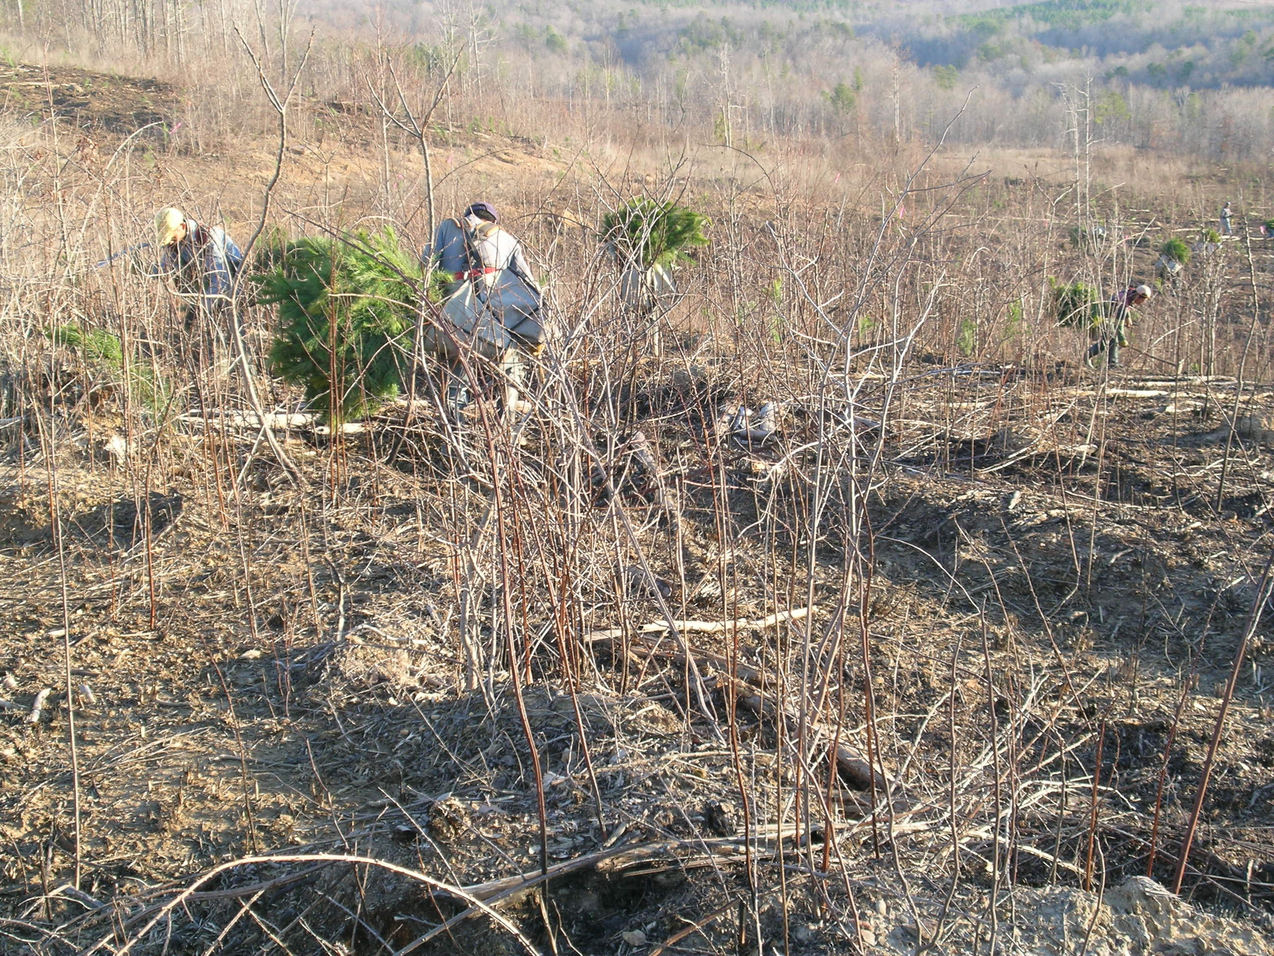
Freedom Hills WMA Dec 2006

Slide 8
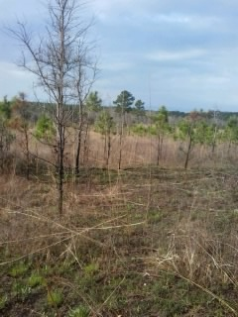
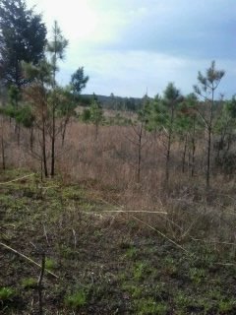
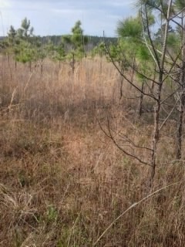
Burned January 2014 pic March 2015, FH WMA
Notes:
Prescribed fire has been introduced into the stands on various return intervals. Some areas have a more frequent return interval and have more grasses, forbs, and legumes. The longer return interval areas have more briers and hardwood brush.

Slide 9
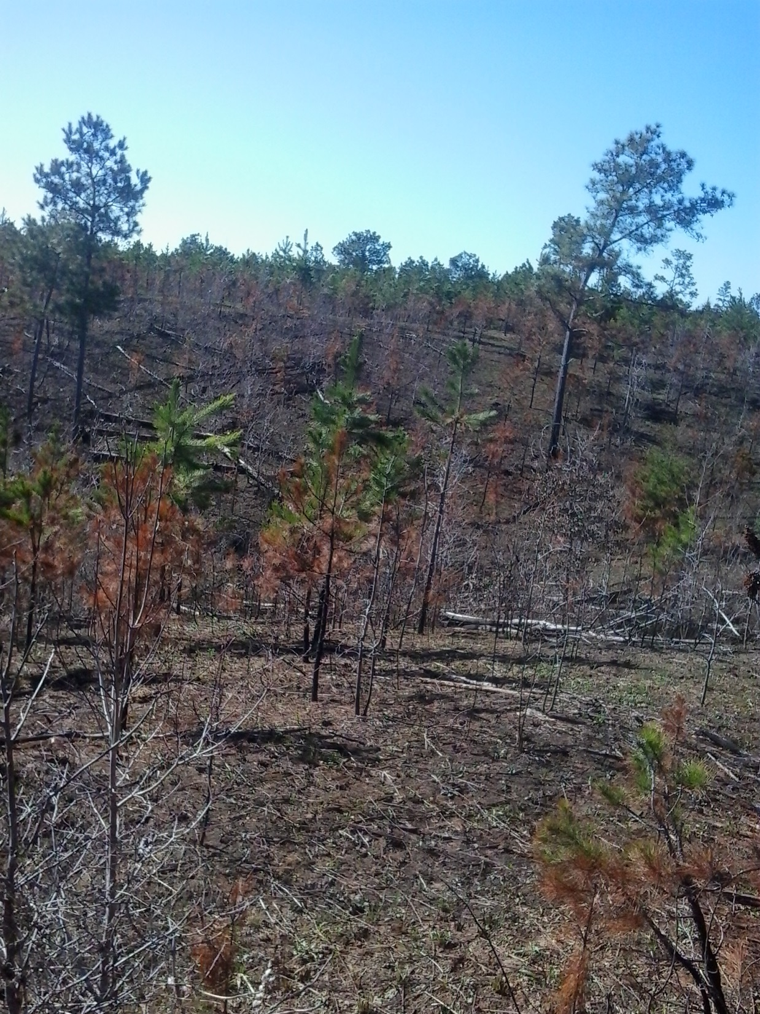
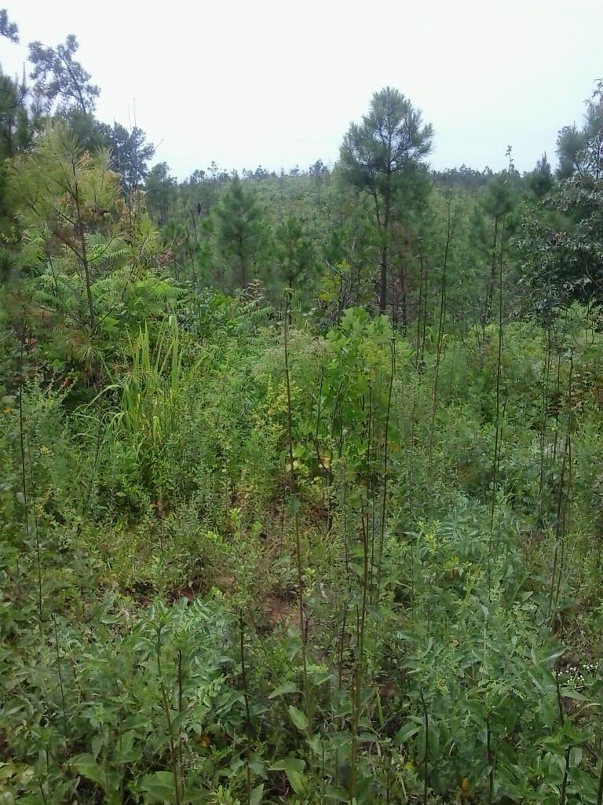
Burned January 2015 Pic June 2015

Slide 10
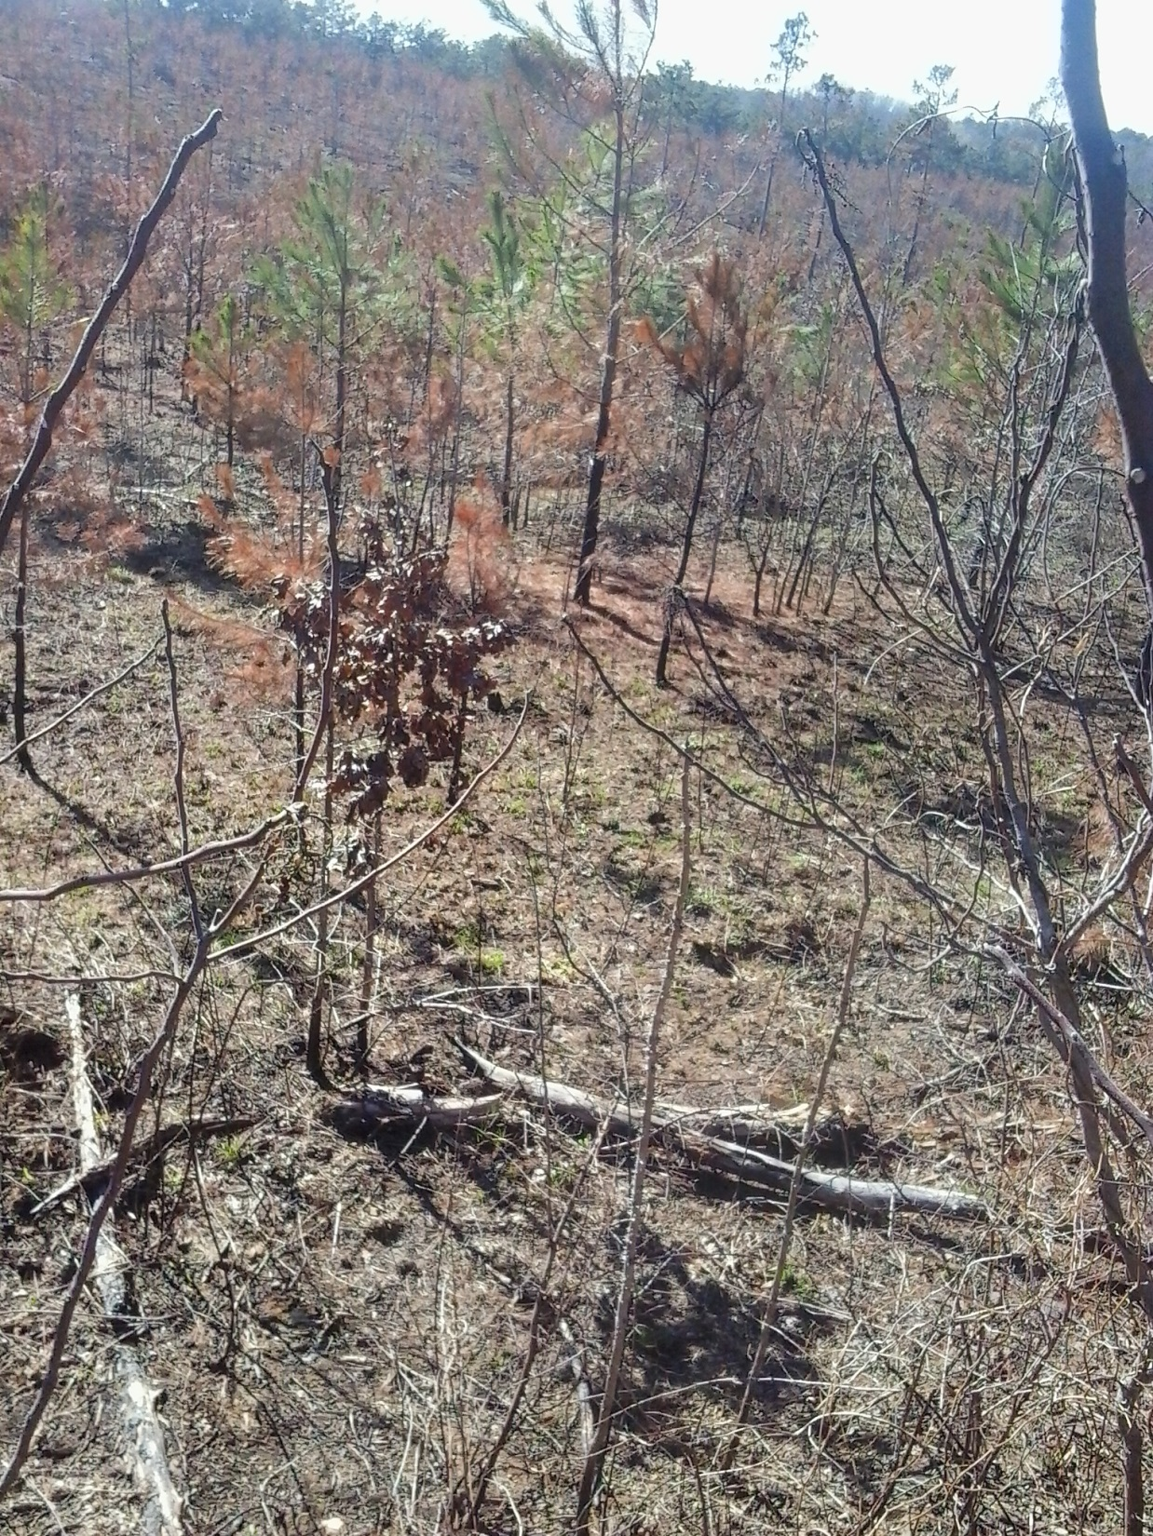
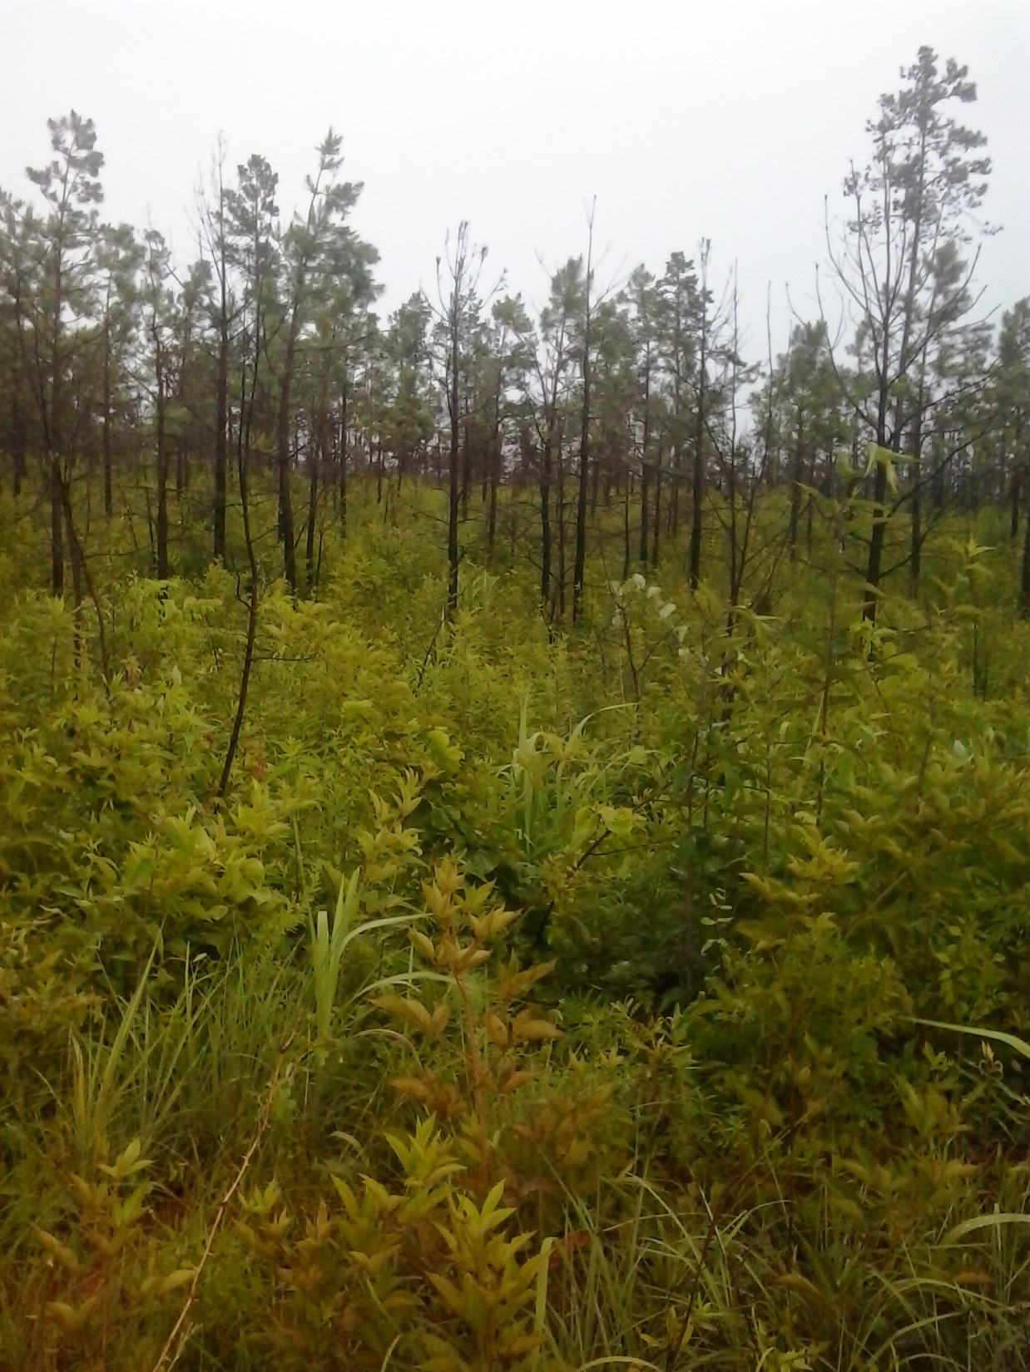
Burned January 2015 Shaw Hollow

Slide 11
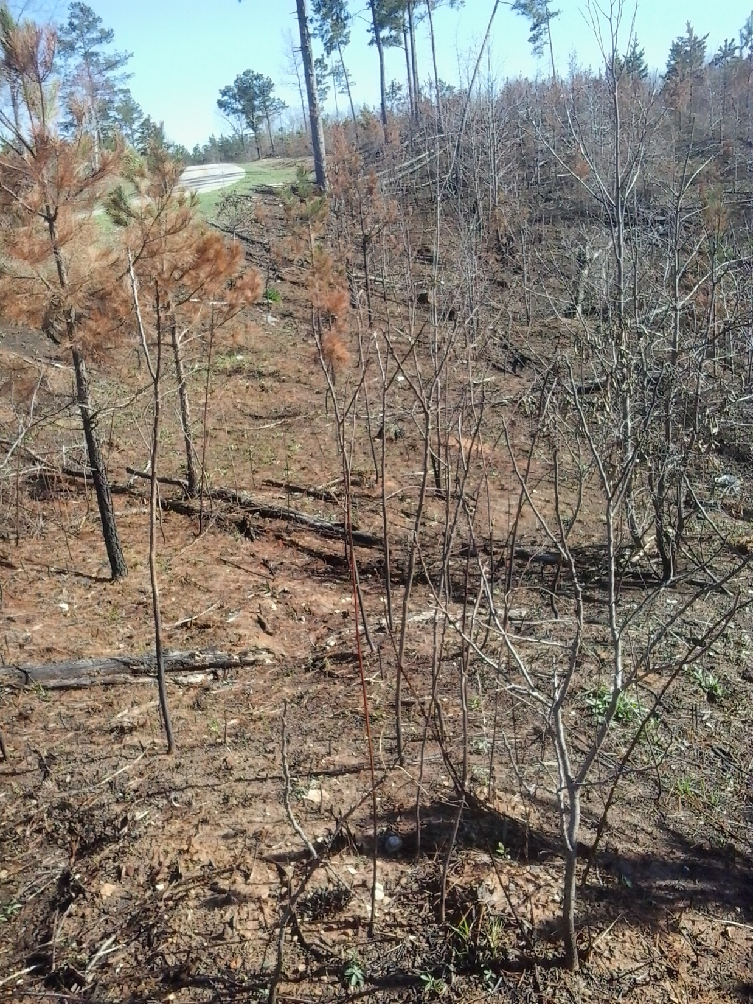
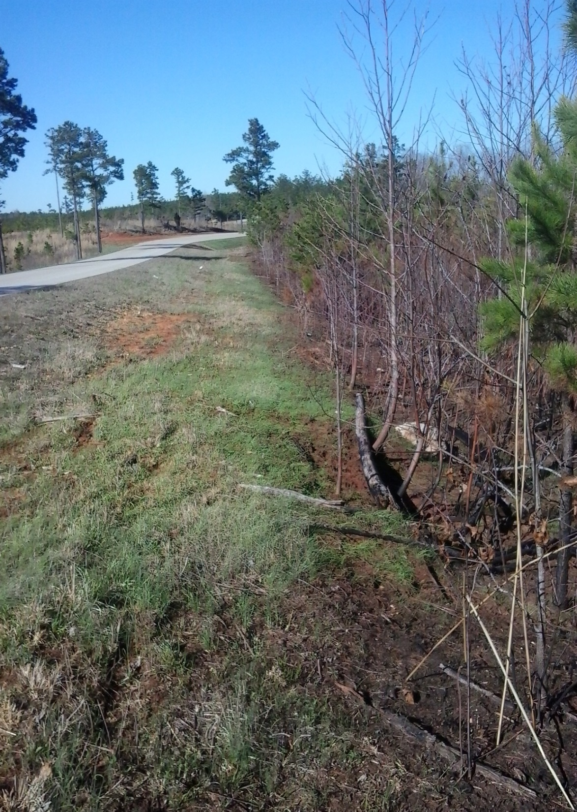
Burned January 2015 Pea Ridge

Slide 12
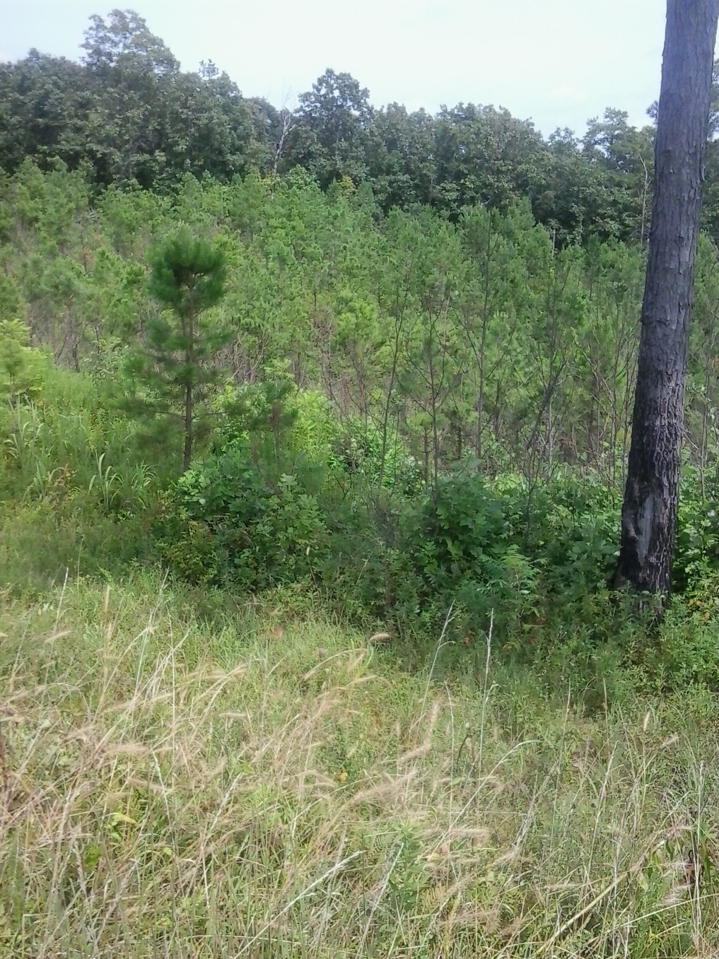
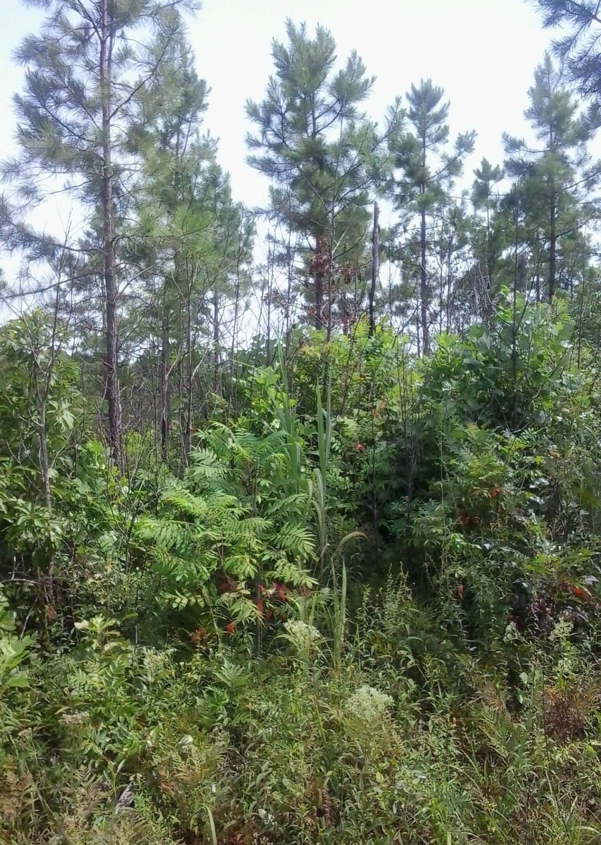
Burned January 2015 Pics July 2015

Slide 13
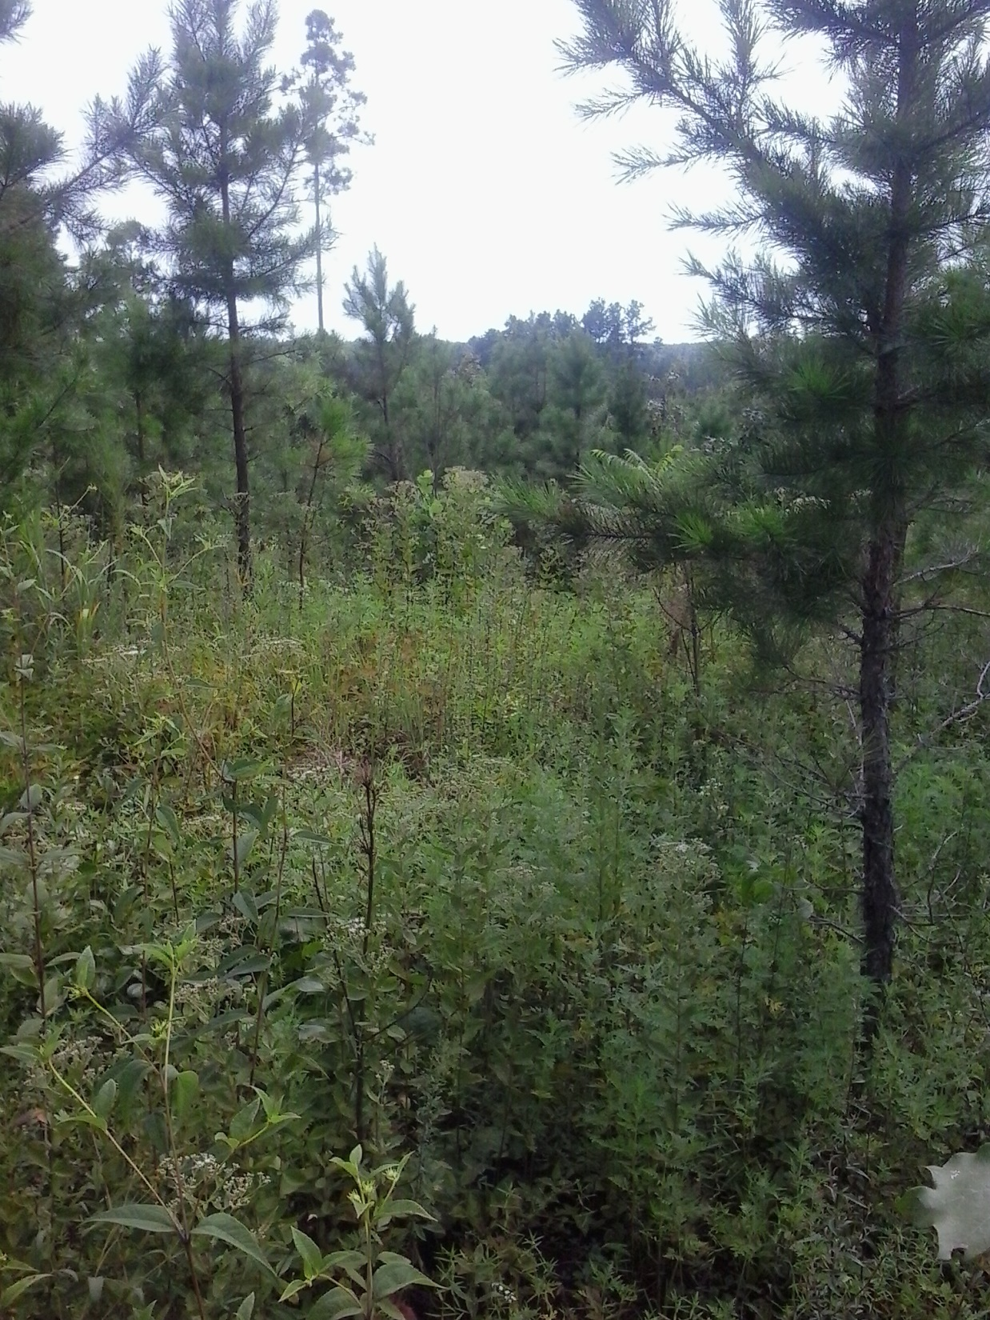
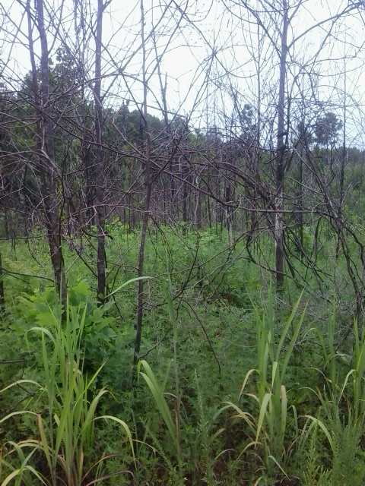
Burned January 2015 Pic June 2015

Slide 14
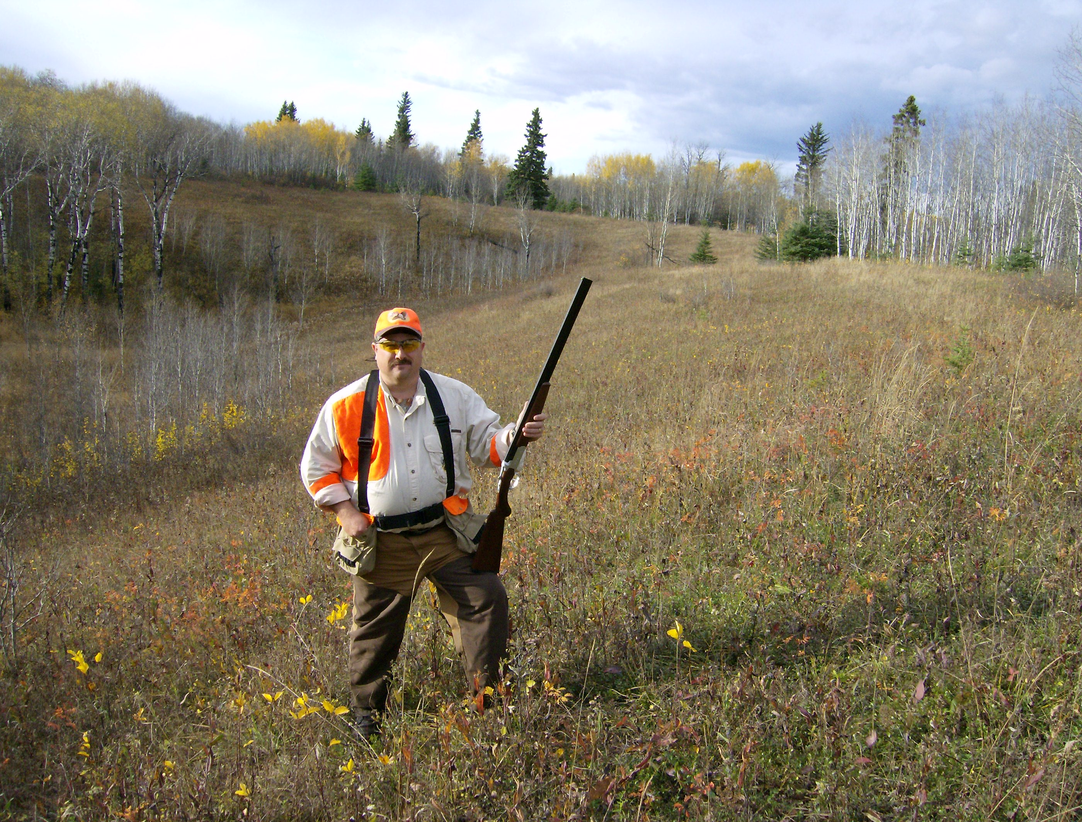
QUESTIONS?
Drew Nix
Andrew.Nix@dcnr.alabama.gov

