Slide 1
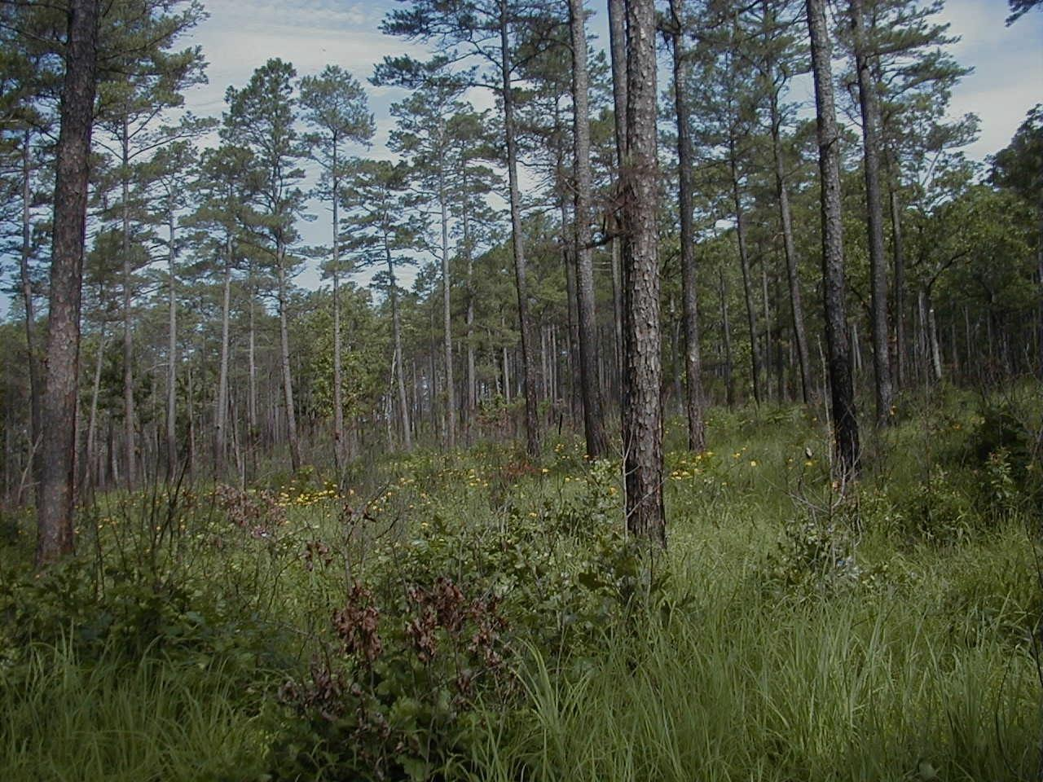
Shortleaf Pine Restoration:
Twenty Years of Science and Management in the Western Range
3rd Biennial Shortleaf Pine Conference
Pine-Oak Ecosystem Restoration Partnerships
Notes:
This morning, I would like to bring some positive perspective about what is possible when conservation partners utilize their combined resources towards mutual goals. I’ll do this by looking at examples of some of the landscape-level projects undertaken in the western range of shortleaf during the last twenty years and our mutual goals to change some landscapes back to ecological conditions. These conditions, primarily woodlands, savannas and glades, were once common but are now the rarest on our landscapes.
It is my intent to simply present our experiences in shortleaf pine restoration, which some of you are also doing, to hopefully encourage our larger attempt at a range-wide Initiative.

Slide 2
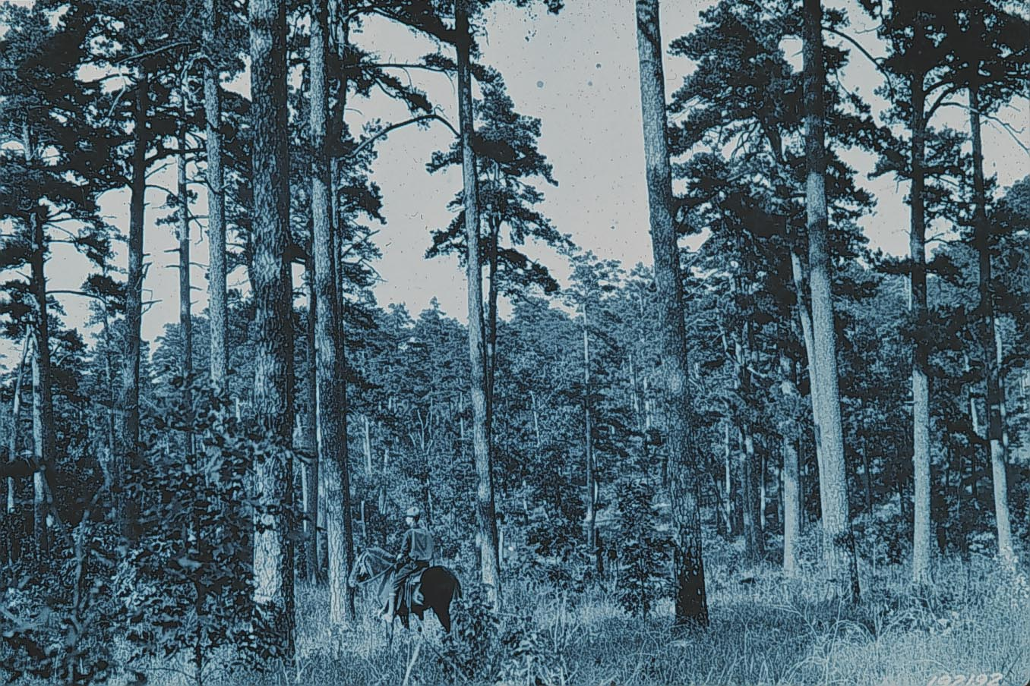
Notes:
We’ve learned quite a bit through investigating our historical records like fire scar histories, writings left behind, GLO survey notes and through research and monitoring our management efforts about what seems to work and what doesn’t.
I’ll share some of the research findings as to how restoration has affected flora and fauna, and provide some “lessons learned” during our attempts, as well as, some preliminary steps that should be considered before taking on a restoration project. And then I would like to provide a basic management recipe our agency and others undertake when our goal is ecological restoration.
Jane brought up the formation of the Interior Highlands Shortleaf Pine Restoration Initiative, one of our goals being to capture, in forest metrics, what we consider to be the Desired Conditions of restored communities. Therefore, I will go over those DFCs that have been included as an appendix in the overall Initiative’s plan.
I would like to then conclude with more recent efforts in providing outreach and opportunities to private landowners within the western range of shortleaf, both technical assistance and cost incentives to manage their forests.

Slide 3
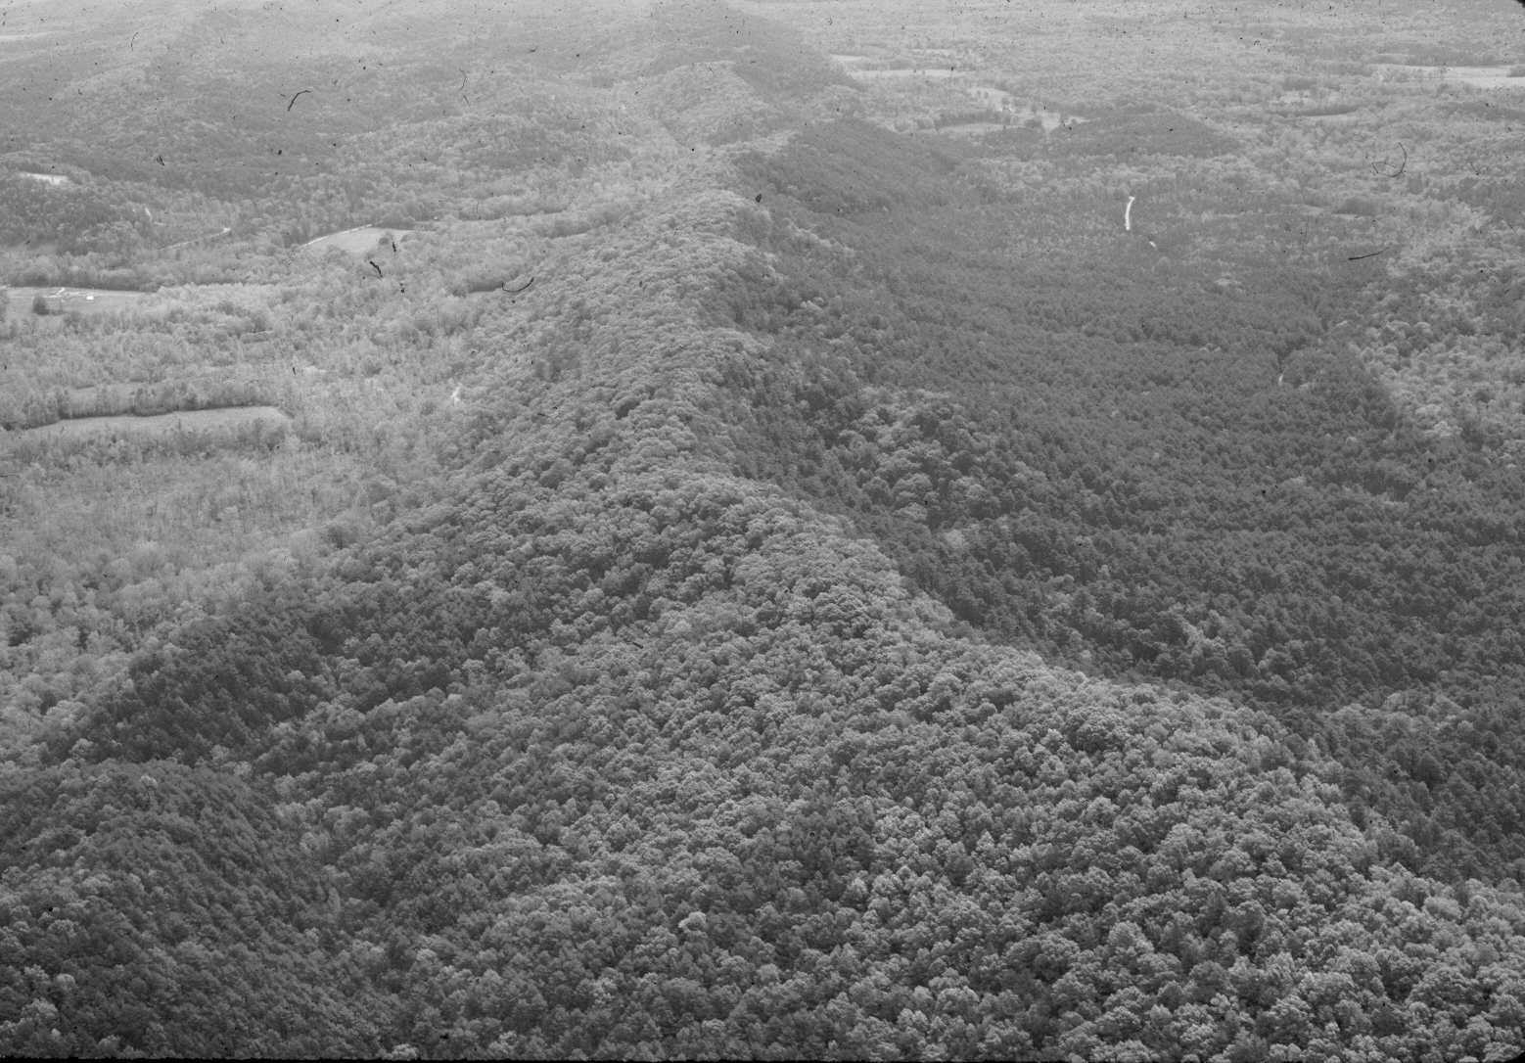
N
Notes:
In the early 1990s, biologists on the Ouachita National Forest successfully amended the forest plan to include a large area of shortleaf-dominated slopes as an RCW restoration area. Research from these management efforts on woodpecker responses, as well as other birds and mammals, insects and plants, provided an incentive for others to initiate projects on other National Forests and state lands within the Highlands.
The re-introduction of historic fire regimes coupled with forest thinnings propagated a rarely seen native herbaceous plant response on forest floors characteristic of pre-settlement writings and survey records.

Slide 4
Woodland Systems
Are fire-maintained forested communities
Have an open canopy of trees
Groundcover of grasses, forbs, legumes, sedges
Lack a woody midstory and understory
Were once common in the Interior Highlands
Three SLP types in IH:
Shortleaf Pine - Bluestem
Shortleaf Pine - Dry Mesic Oak
Shortleaf Pine – Dry Oak
Notes:
So, what are we talking about when we say “restored conditions”?
The western range of Shortleaf and pine-oak was historically transitional from the treeless western prairies and our records depict landscapes of open canopies and herbaceous understories. Fire was the primary disturbance for thousands of years.
Up to 70% of the Highlands was a combination of prairies, woodlands, savannas, barrens and glades. And only 30%, what we would consider to be forests. Nowadays, after 100 years of fire suppression these historic condition are rare and so are many the fire-adapted SGCN.

Slide 5
Canopy BA* Ave DBH
Savanna: < 30% 10-40 > 14”
Woodlands: 40-70% 50-70 > 8”
Forests: > 70% > 70 NA
* dependent upon average DBH and crown types of overstory species, use of Gingrich-type table required.
Notes:
Although this attempt of mine is arguable at best….I think we should, as a group, distinguish between these conditions and provide some basic definitions for the various terms we use.
So, a Savanna, in our realm is a prairie with a few trees, a woodlands is an open forest with a herbaceous ground cover (two-layers) and a forest is multi-layered woody stems.
So, with help from ecologists, researchers and practitioners, we came up with a Gingrich-type table (stocking) for managers to have forest metrics that define the openess of the desired overstories, midstories and understories, and be able to use normal measurements to accomplish it.

Slide 6
Restoration Sites
in the Western Range
Notes:
Now, let’s take a look at some of our restoration projects that depict partner efforts at more of a landscape scale.

Slide 7
Western Range
Shortleaf pine coverage by density
USFS Pine/Bluestem Landscape
Notes:
If you look at the coverage of shortleaf in our region you can see it is most prominent in the Ouachitas and areas of southern Missouri.
This map gives all of you a better look at the Interior Highlands as it relates to the western range of SLP.
One of the best known and successful projects in our area is the “pine-bluestem” area of the Ouachita NF designated in gold.

Slide 8
254,000 acre Management Area on the Ouachita National Forest: approx. 130,000 acres in stages of restoration.
Notes:
To date, approximately 130,000 acres of this project is in some degree of being restored. Restoration is a process that involves repetitive treatments (namely rx burns) by which to reach historic conditions.
The species richness of the floral response usually continues to increase as repetitive actions take place.

Slide 9
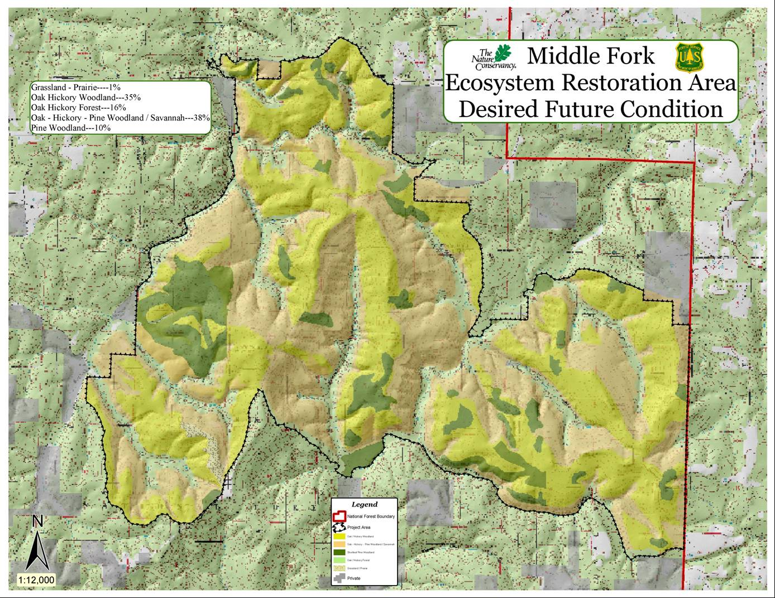
Notes:
This was one of the first demonstration areas on the Ozark-St. Francis National Forest. It was a collaboration between the USFS and TNC. It involved a total of 60,000 acres of woodland restoration management on multiple Ranger Districts back the mid 90s.

Slide 10
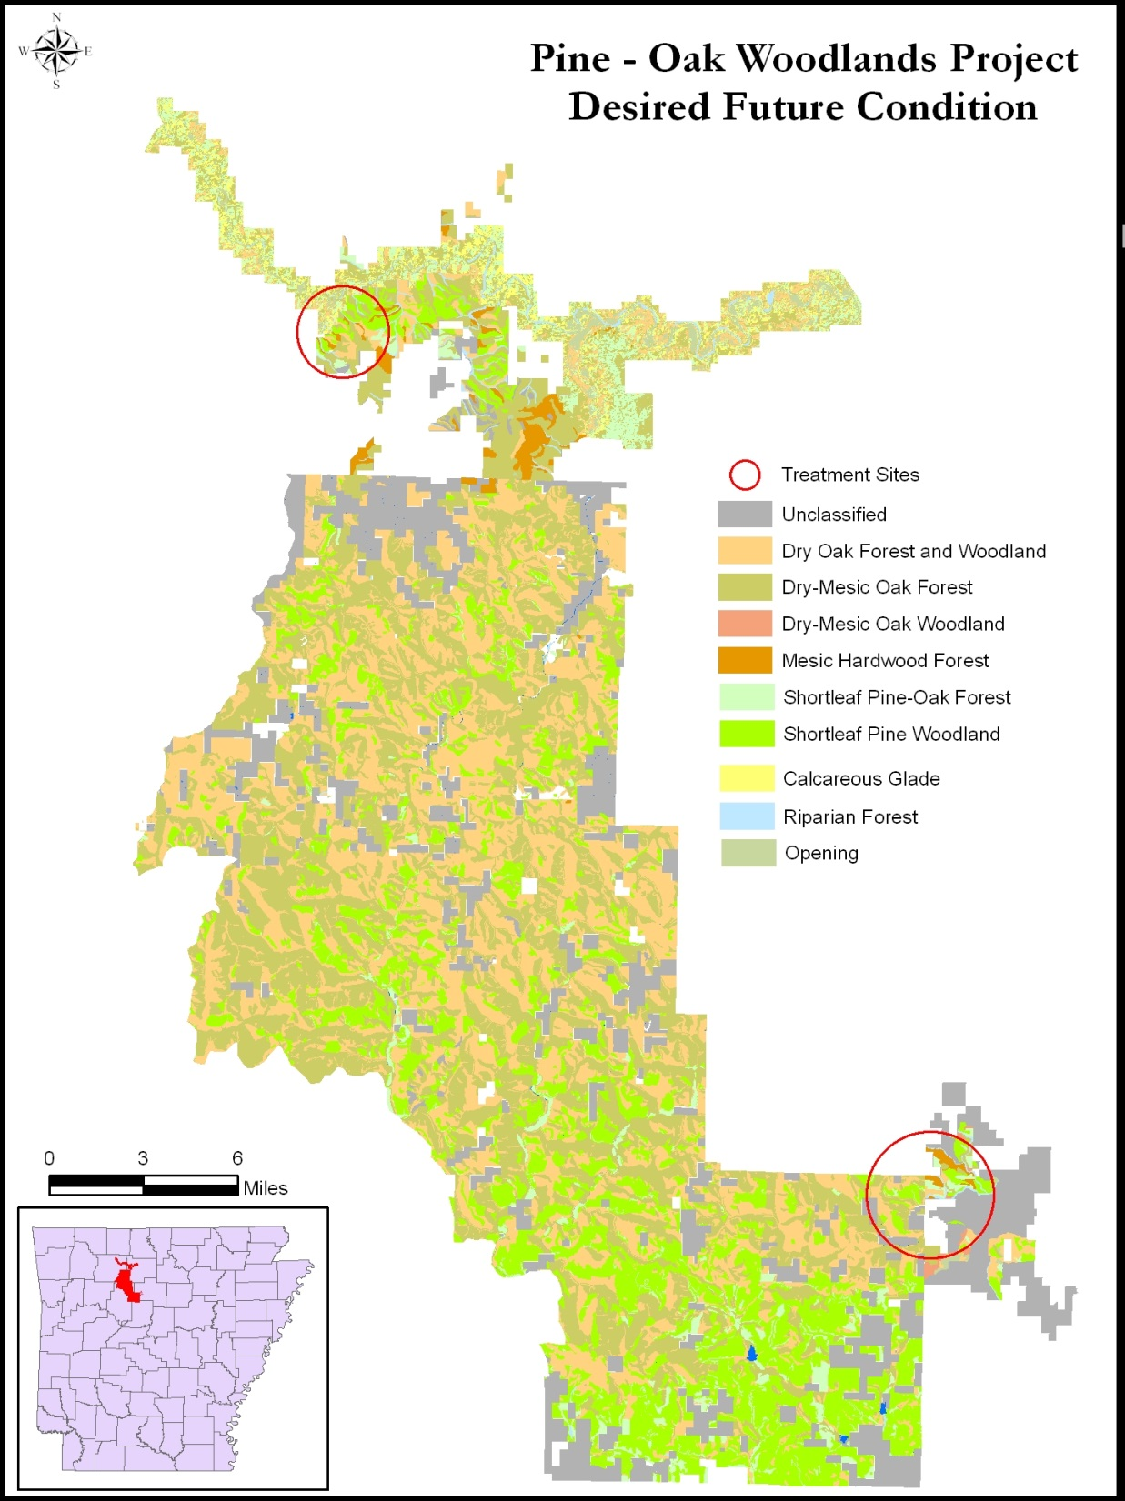
AR/MO
DDCF GRANT
Arkansas Project Area
Includes: (portions of)
Buffalo National River
Gene Rush WMA
Ozark National Forest
Gulf Mountain WMA
Middle Fork Restoration
Project Area:
320,000 acres
Notes:
Then around 2004, the Doris Duke Charitable Foundation provided a grant opportunity to two states that would work together towards putting conservation strategies on-the-ground as outlined in their individual Wildlife Action Plans. MO made the initial move and invited AR to join in with them. This was an important step in our teamwork history and we began to think in broader terms, like the Interior Highlands.
On the AR side, we developed a large-scale project area in the Ozark/Boston Mtns which included portions of the Buffalo NR, Gene Rush and Gulf Mtn. state-owned WMAs, and portions of the eastern Ozark NF totaling 320,000 acre landscape. This map depicts the Desired Future Conditions on these public lands delineating where we wish to restore woodlands and savanna conditions and rejuvenate the glade communities.
The advantage we had for a competitive grant was that each ownership has a comprehensive plan and/or habitat prescriptions that detail these future desired conditions. Each agency was already funding these types of restoration treatments and our state match makes our proposal very attractive to other grant opportunities.

Slide 11
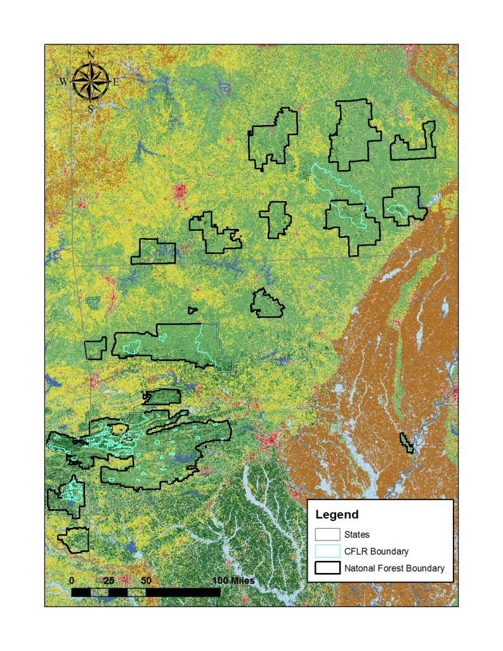
Mark Twain National Forest
Ozark – St. Francis National Forest
Ouachita National Forest
Notes:
And in 2011-12, as a part of the national (CLFRP) Collaborative Forest Landscape Restoration program, all three of the National Forests within the Shortleaf Pine western range benefited from the approval of their plans. (Turquoise polygons)
That guarantees 10 years of funding for the prescribed management. We are making use of that through leveraging partner resources in matching dollars and through potential stewardship contracts.
We’re pretty excited about all of these projects going on in our region and that’s not to mention work on other state lands (Game & Fish, Heritage tracts, state parks, etc,).

Slide 12
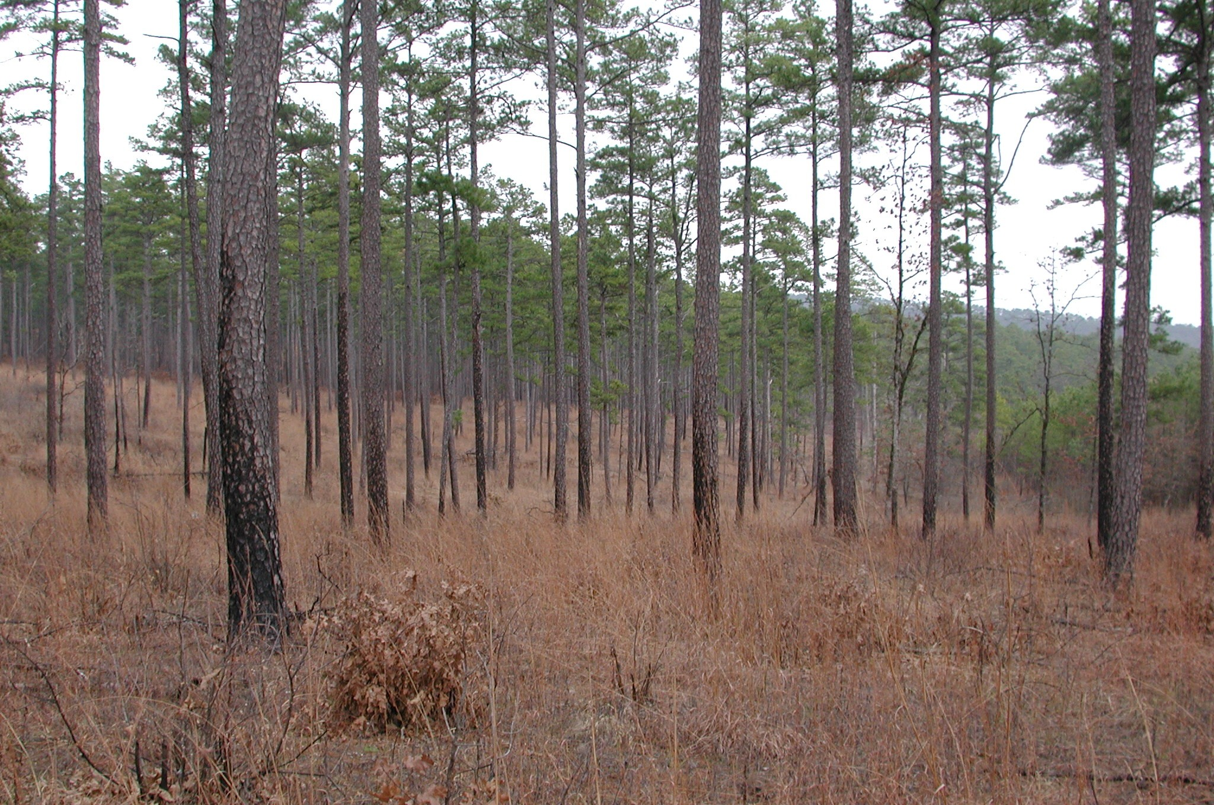
Notes:
Some the results speak for themselves.
A portion of the Pine-Bluestem area.

Slide 13
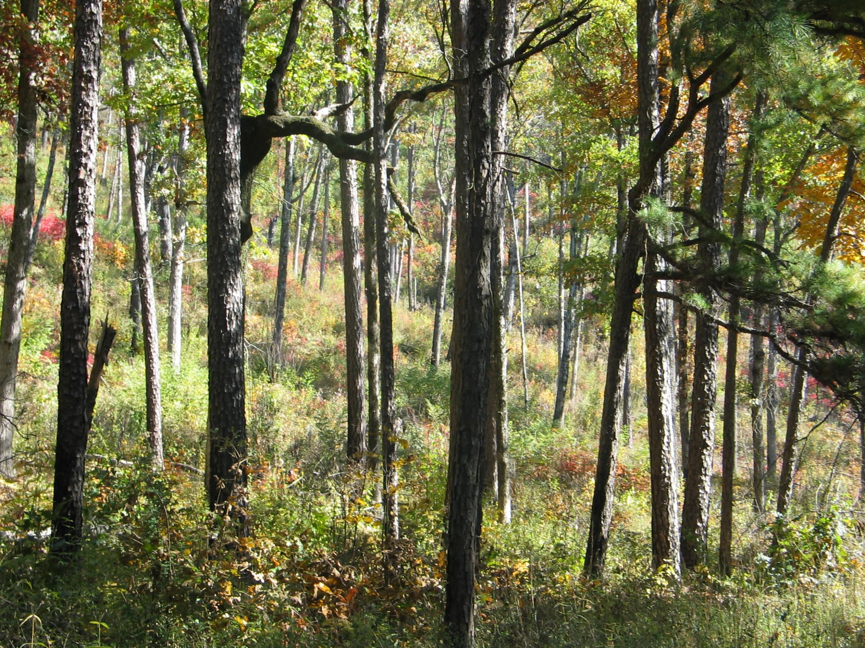
Notes:
This is the Hess’s Knob area of the Ozark National Forest.
The herbaceous plant community was probably over
150 species of after 11 years.
Our state Plant Ecologist, Theo witsell has identified 17 species of native legumes. 4 or 5 native lespedezas. A smorgasbord of perennial fruits, seeds, nuts and tall cover.

Slide 14
Lessons Learned
Notes:
1st and foremost if your considering a site land use history and pre-settlement fire histories are very important.
Some sites were so abused in the past through over-grazing, sheet erosion and intense wildfires, that the native plant seed source has been eliminated or depleted

Slide 15
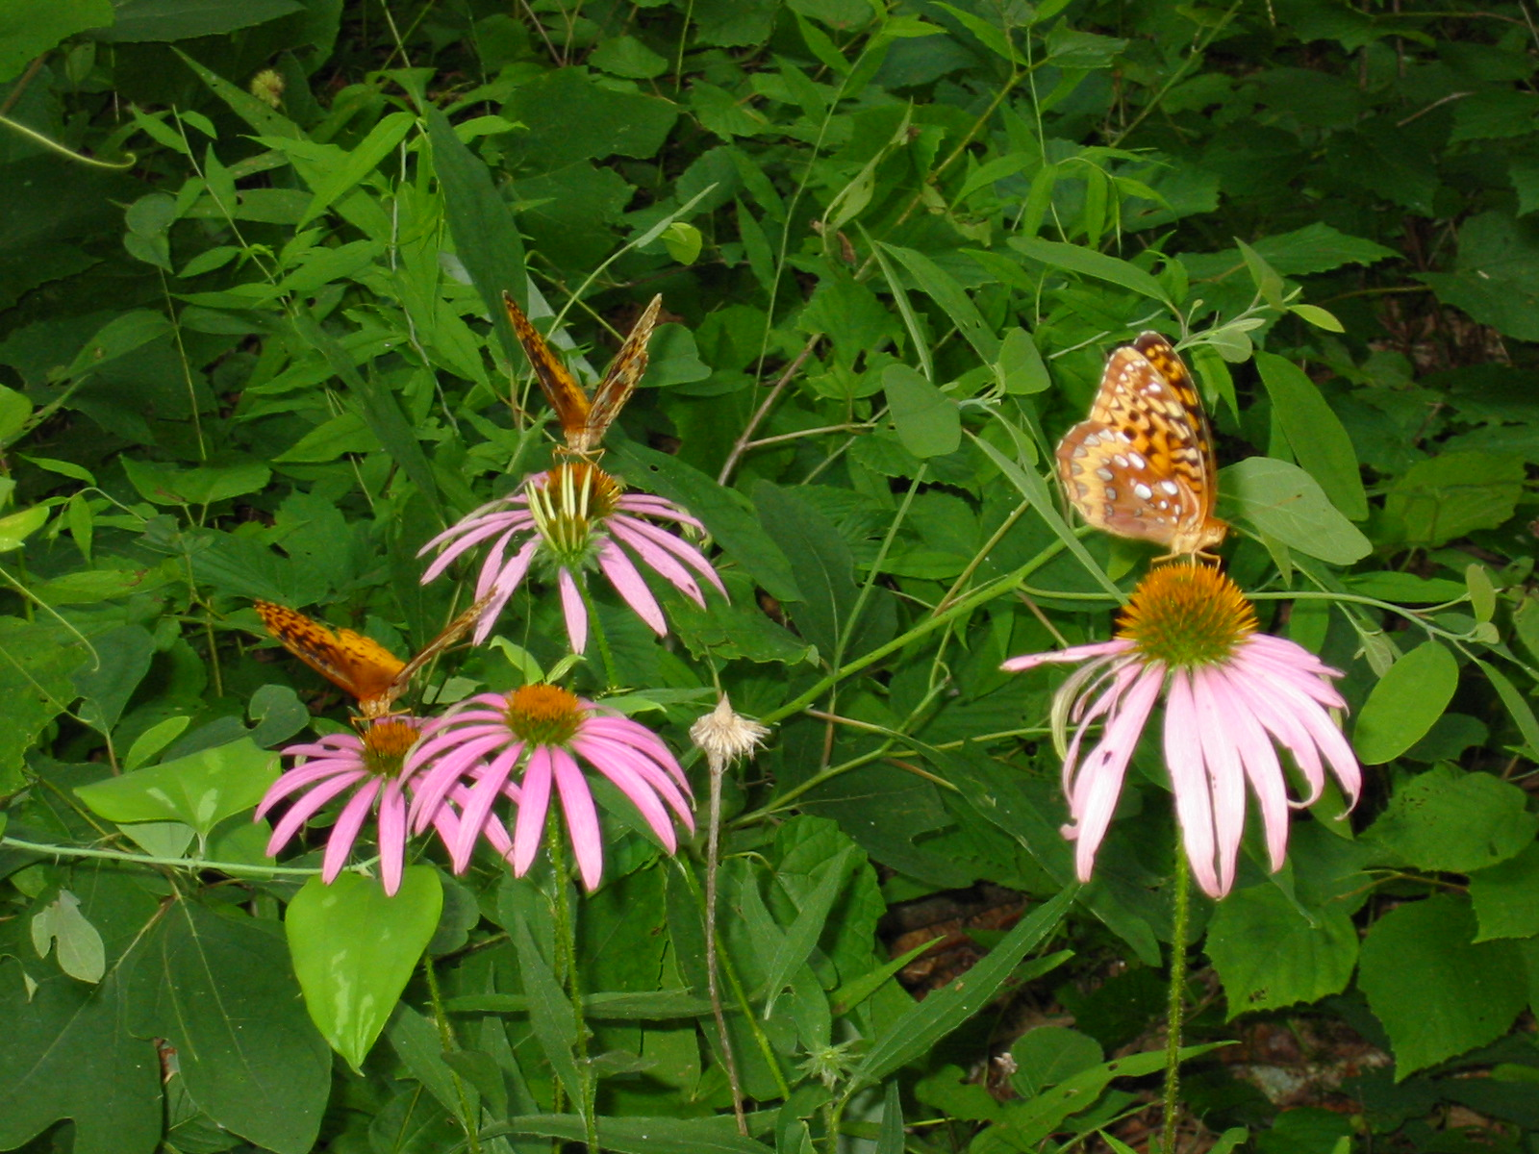
Lessons Learned
John Andre
Notes:
Therefore, one should check ahead beforehand, to see if there’s signs of an intact seed source. Investigate roadside ditches, tree gaps in burned forests to maybe see if there’s remnants of native plants.
MO chose to do floristic quality index surveys to help prioritize areas that offered a better bet of restoring. So, with limited staff and funding, knowing where not to work is important. We’ve developed a list of 5-10 species as indicators of site restorability that our staffs can identify prior to work.

Slide 16
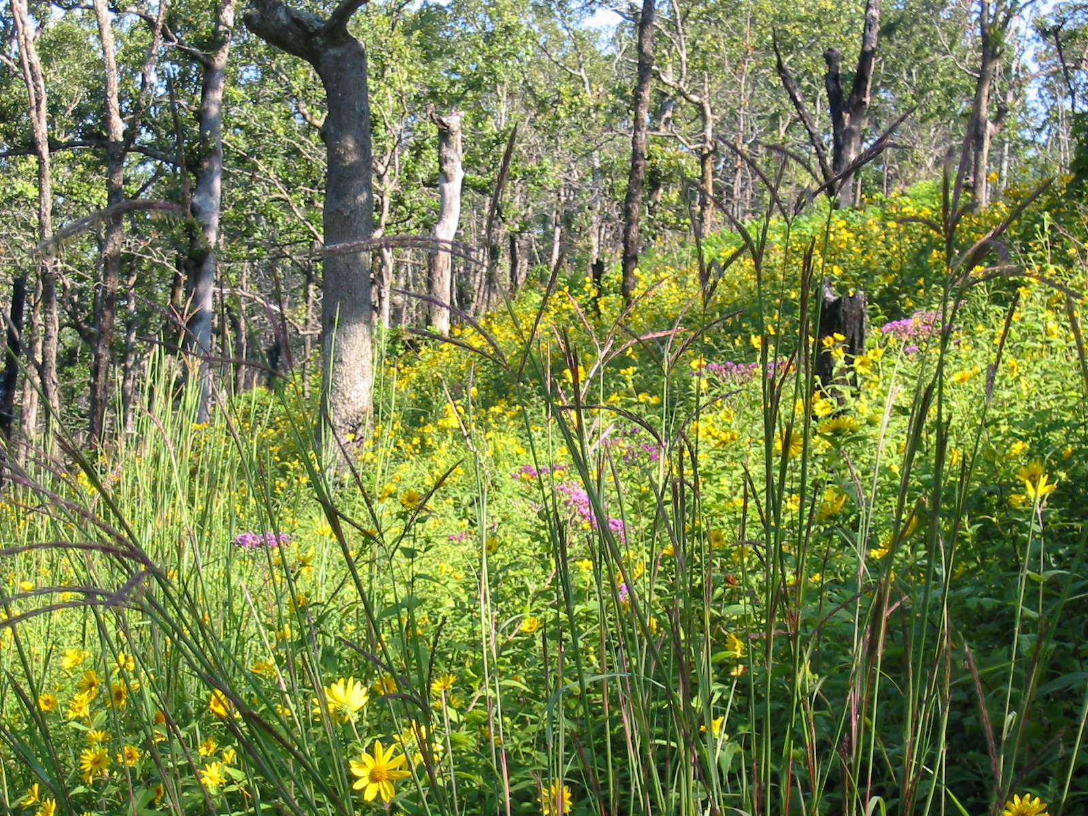
John Andre
Notes:
Some older sites (>11 years of management) have incredible plant diversity, some over 150 species, like in this post oak savanna. One site in particular has a plant list over 250 and growing on one of our WMAs.

Slide 17
Lessons Learned
Is the site most likely restorable?
In restoration, we should limit burning without thinning.
No sunlight…fewer plants.
During restoration phase, do not miss a 3-year burn window
if there’s anyway to help it.
It’s not hard to change a natural pine stand to an oak-dominated stand. It’s magic!
Notes:
Explain using slide

Slide 18
Lessons Learned
Merchantability of forest products drives our ability to afford future treatments so,
1) you need to have enough stocking to afford next thinning.
2) unless there’s a band saw mill around you can’t sell trees over 20” dbh.
And you should plan to lose 10 BA/ac. from overstory mortality with increased fire.
Managers, watch out for falling for “recipes”. Do not thin too much too early!
Notes:
Explain using slide

Slide 19
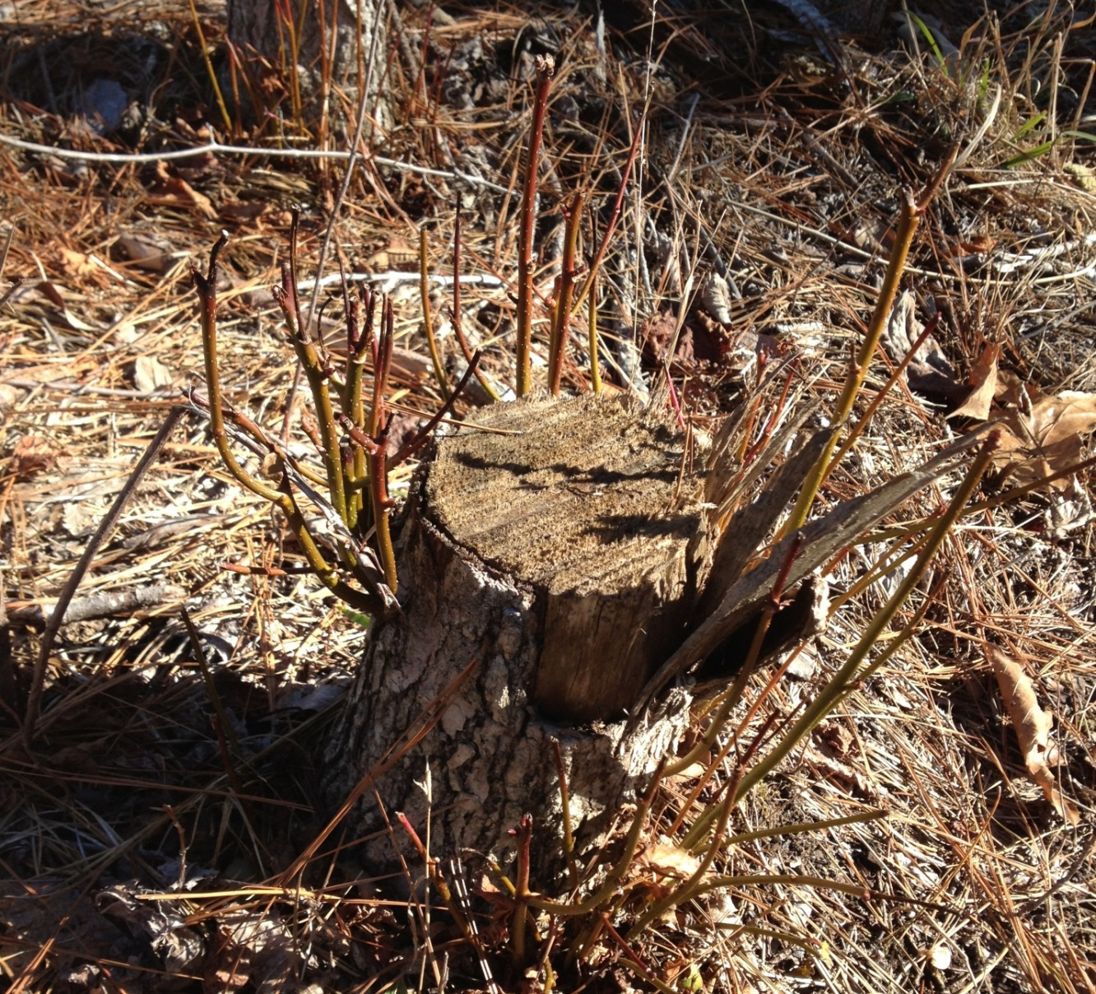
Lessons Learned
Afford the chemical
Notes:
Go ahead and afford the chemical.
We’re trying to grow grasses and forbs, not hardwood brush!
Therefore, the midstories and understory hardwoods need to be very limited.

Slide 20
The Restoration Prescription (for mature SLP stands)
Use dormant-season burns to reduce the litter layer.
2) Use herbicides on all non-merchantable, midstory and understory woody growth (<8”).
3) Burn again while fuel (injected stems) is not yet available, reducing intensity.
Notes:
So should you suspect your site is redeemable, our management prescription to restore shortleaf woodland conditions goes something like this: (it’s site specific through)
1) Use dormant-season burns to reduce the litter layer
2) Use herbicides on all non-merchantable, midstory and understory woody growth. (7” and down)
3) Try burning again while injected stems (fuel) is not yet available, standing dead.

Slide 21
The Restoration Prescription (for mature SLP stands)
4) Mark the necessary overstory reduction and all remaining midstory stems (you can save a few).
5) Conduct harvest, preferably whole-tree logging to reduce on-site slash.
6) Try to stay on 3-year burn rotation during restoration phase.
Notes:
4) Mark the necessary overstory reduction % and all remaining midstory stems. You can save a few.
Conduct harvest, preferably whole-tree logging to remove on-site slash.
6) Try your best to stay on 3-year burn rotation.

Slide 22
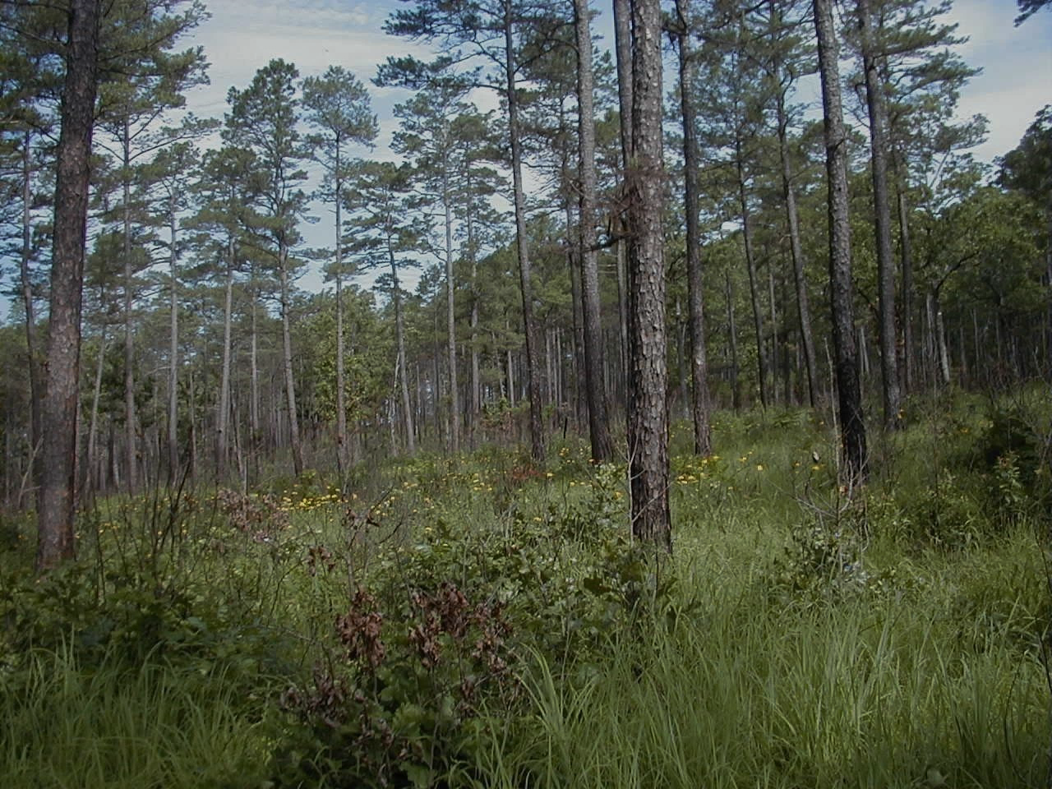
Desired Future Conditions
Notes:
So, lets move on to explain our work on DFCs
for restored sites in the Interior Highlands.
This involved, heavily, the experience of multiple individuals in the region who had a hand in restoring SLP communities as well as forest and plant ecologists that understood the missing component we were seeking to restore.
I also suggest a strong presence of those who understand fire effects and have hands on training in conducting burns.

Slide 23
Team Developed Desired Future Conditions for Three Systems:
Pine-bluestem: Shortleaf pine communities in which warm season grasses/forbs are prominent on dissected plains.
Dry-Mesic Pine-Oak: Shortleaf pine mixed with oak species (either can be dominant) on more deeply dissected hills, even on upper north-facing slopes.
Dry Pine-Oak: SLP mixed with oak species on steep, south-facing upper slopes and ridge tops.
(Incorporates 7 NatureServe Community Types)
Notes:
My experience is that when a group of knowledgeable people come up with a management idea like this, its also incumbent upon them to offer the necessary training or step it down into terms managers can identify with.
For example, we combined the 7 NatureServe types into three (3) more general types.
I’ll go over this quickly because you have the tables of forest metrics as part of the Initiatives Plan.
Remember, we are recommending these for restoring ecological conditions in shortleaf-dominated stands. More work is necessary to improve those for mixed stands.

Slide 24
Variables addressed in Regard to Desired Future Conditions
Available Sunlight:
Canopy Cover % 2) Midstory % 3) Understory %
Basal Area and Tree Density (surrogates)
Desired herbaceous ground cover %
Disturbance Regimes (Consider frequency, intensity, and seasonality)
Notes:
These are the forest structural indices we believe are the most important when trying to release a historic herbaceous plant community under an open overstory.

Slide 25
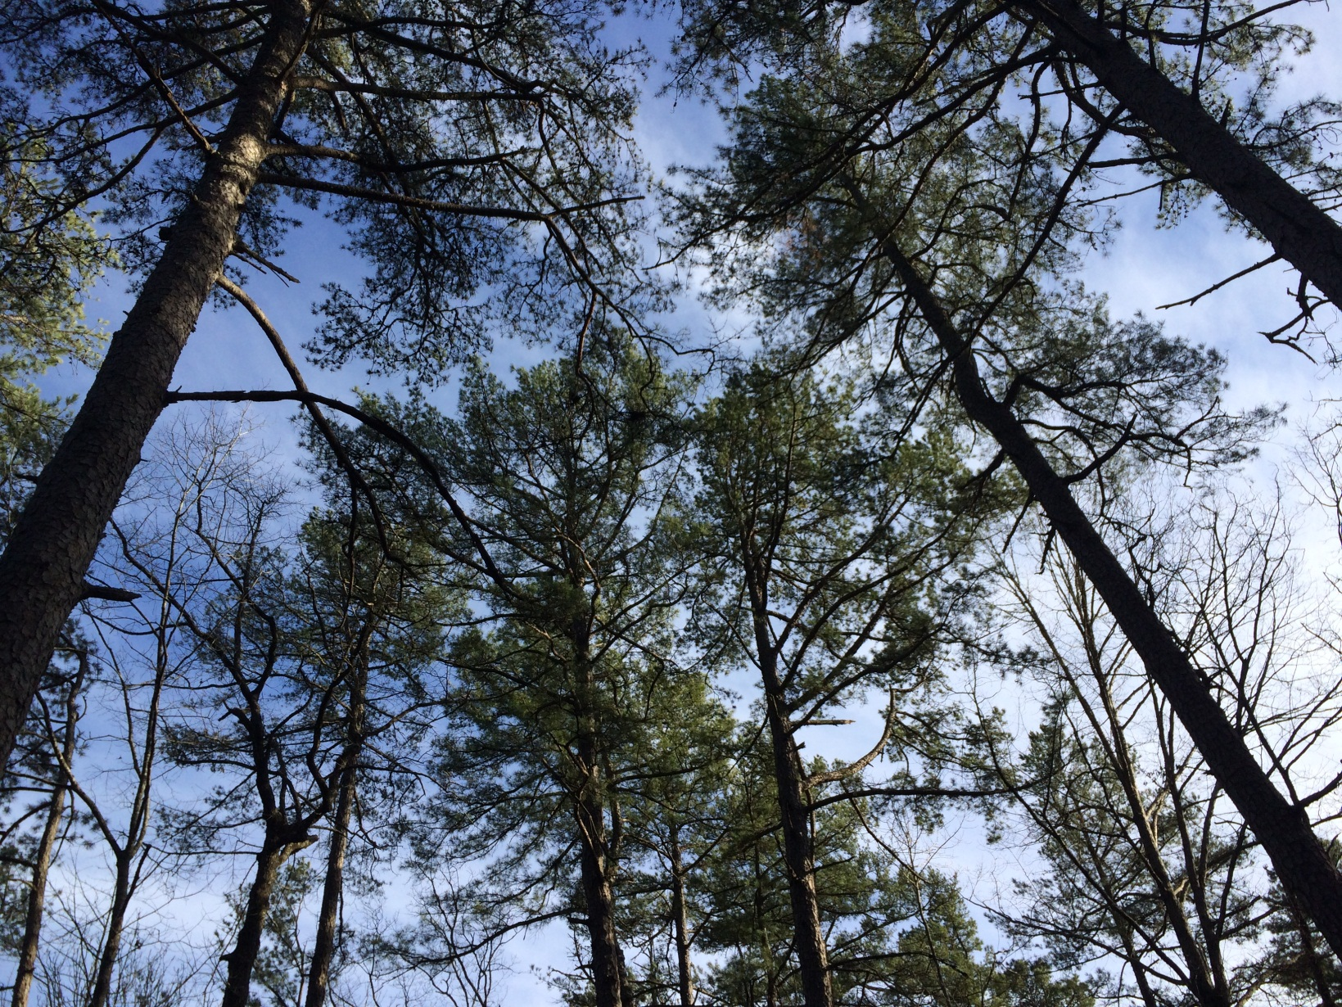
Estimate canopy closure
Notes:
Therefore, in order to develop the recommended metrics for use by foresters and other trained managers, it was necessary to first develop a data set of DBH to crown radius ratios of forest-grown, mature Shortleaf stems.

Slide 26
Desired future conditions for Shortleaf Pine forests based on available growing space was adapted from Rogers (1983)
 | Percent Canopy Closure for forest grown Shortleaf Pine Stands
 | 10% |  | 20% |  | 25% |  | 30% |  | 40% |  | 50% |  | 60% |  | 70% |  | 80% |  | 90% |  | 100%
DBH | #/ac | BA | #/ac | BA | #/ac | BA | #/ac | BA | #/ac | BA | #/ac | BA | #/ac | BA | #/ac | BA | #/ac | BA | #/ac | BA | #/ac | BA
10 | 30 | 16 | 59 | 32 | 74 | 40 | 89 | 49 | 119 | 65 | 148 | 81 | 178 | 97 | 208 | 113 | 237 | 129 | 267 | 146 | 297 | 162
12 | 14 | 11 | 28 | 22 | 35 | 28 | 42 | 33 | 57 | 44 | 71 | 56 | 85 | 67 | 99 | 78 | 113 | 89 | 127 | 100 | 142 | 111
14 | 10 | 11 | 21 | 22 | 26 | 27 | 31 | 33 | 41 | 44 | 51 | 55 | 62 | 66 | 72 | 77 | 82 | 88 | 92 | 99 | 103 | 110
16 | 9 | 12 | 17 | 24 | 22 | 30 | 26 | 36 | 35 | 49 | 44 | 61 | 52 | 73 | 61 | 85 | 70 | 97 | 78 | 109 | 87 | 122
18 | 7 | 12 | 14 | 25 | 17 | 31 | 21 | 37 | 28 | 49 | 35 | 62 | 42 | 74 | 49 | 86 | 56 | 99 | 63 | 111 | 70 | 123
20 | 7 | 15 | 14 | 30 | 17 | 37 | 20 | 45 | 27 | 59 | 34 | 74 | 41 | 89 | 48 | 104 | 55 | 119 | 61 | 134 | 68 | 149
22 | 6 | 17 | 13 | 34 | 16 | 42 | 19 | 51 | 26 | 68 | 32 | 84 | 38 | 101 | 45 | 118 | 51 | 135 | 58 | 152 | 64 | 169
24 | 4 | 14 | 9 | 28 | 11 | 35 | 13 | 42 | 18 | 57 | 22 | 71 | 27 | 85 | 31 | 99 | 36 | 113 | 40 | 127 | 45 | 141
Range for Pine-Bluestem Woodland
(for 16” average stand DBH)
Range for SLP-Dry Oak Woodland
(for 16” average stand DBH)
Range for SLP-Dry Mesic Oak Woodland
(for 16” average stand DBH)
Rogers, R. 1983. Guides for Thinning Shortleaf Pine. Pp. 217-225. In: Jones, Earle P., [Editor] 1983. Proceedings of the Second Biennial Southern Silvicultural Research Station Conference, Atlanta, Georgia, November 4-5, 1982. Gen Tech Rep SE-24. Asheville, NC: U.S. Department of Agriculture, Forest Service, Southeastern Forest Experiment Station. 526p.
Notes:
This data allowed us to develop this “Gingrich-type” table
to show the relationship between basal area and trees per acre under a given canopy closure. You’ll find this table in the appendix of the Initiative Plan.
As you see we’ve highlighted a 16” dbh stand to demonstrate it’s use under a 50% canopy = 44 trees/acre and about 60 BA.
In my opinion, we should probably follow up this work for mixed stands, developing more data for the contribution various percentages of oak crowns in pine-oak and oak pine communities.

Slide 27
Overview of Range of Variables
Community Type | Canopy Closure (%) | Basal Area* (ft²/ac) | Trees Per Acre* | Midstory Density (%) | Understory Cover (%) | Ground Layer Cover (%)
Shortleaf Pine-Bluestem | 30-60 | 35-70 | 26-52 | <10 | <10 | 80-100
Shortleaf Pine-Dry Mesic Oak Woodland | 50-80 | 60-95 | 44-70 | <30 | <30 | 50-80
Shortleaf Pine-Dry Oak | 30-50 | 35-60 | 26-44 | 15 | 20-80 North <30 South | 40-60
*Calculated Based on an average DBH of 16”, will vary with average stand DBH see table 1 A
Desired age and structural characteristics for canopy, mid- and under-story seral stages, and ground flora:
Disturbance Regimes (Consider frequency, intensity, and seasonality)
Notes:
So, you can see that our Desired Conditions are very dependent upon the amount of light allowed to penetrate through both the overstory and midstory in order to obtain a significant herbaceous ground layer that restores a historic two-layered stand condition.
This table and the discussions of the team in arriving at these parameters are included in the Appendix.

Slide 28
Effects of Restoration
Notes:
So, now let’s take a look at some of the research and monitoring that’s taken place regarding how thinning and burning our projects has impacted plants and animals.

Slide 29
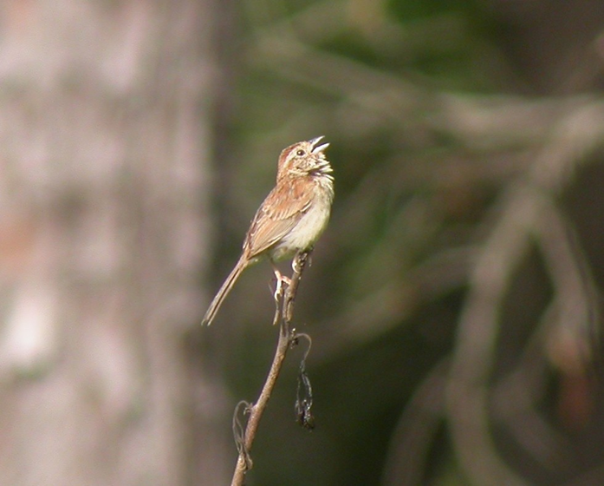
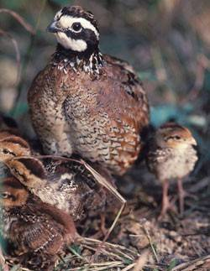
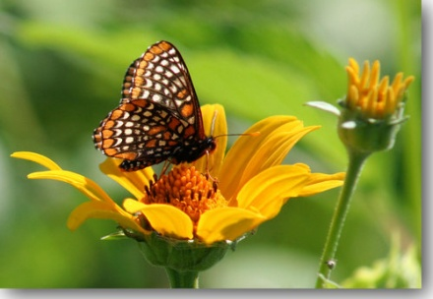
Effects of Restoration
Notes:
Research and monitoring for the last twenty years, has shown some interesting results, some expected and some surprises.
Like this Baltimore Checker Spot butterfly showing up on sites outside of it’s known range on Gene Rush WMA.
There was a remnant of Bobwhites on the that portion of the Ouachitas prior to restoration but they sure seemed to like restoration because their numbers have noticeably increased.
Bobwhites: 19 times their frequency in restored as found in untreated controls.

Slide 30
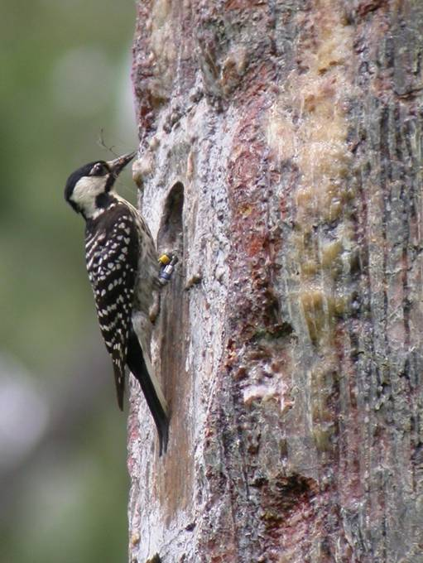
Shortleaf Pine-Bluestem Restoration – Environmental Effects
Notes:
How about RCW responses, since it was the initial reason for the Ouachita NF restoration?
Work started in 1994-95, you can see what happened after that.

Slide 31
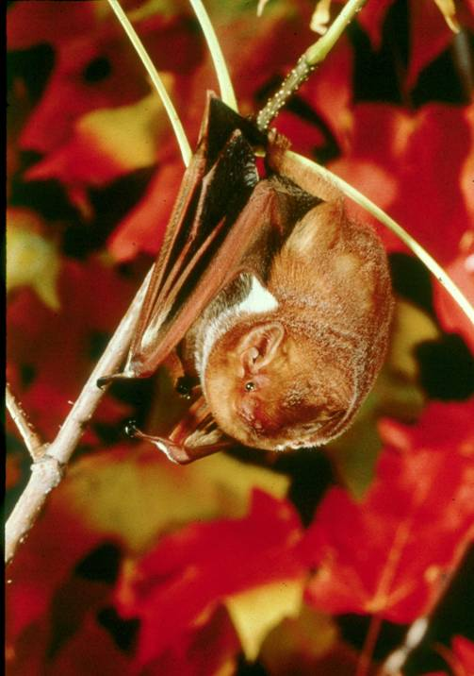
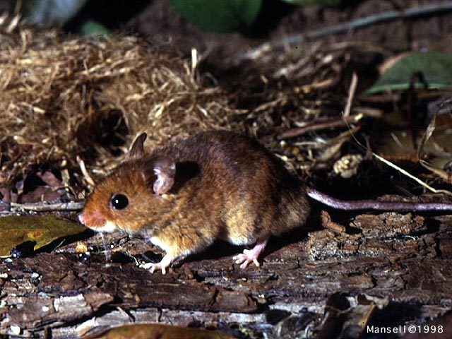
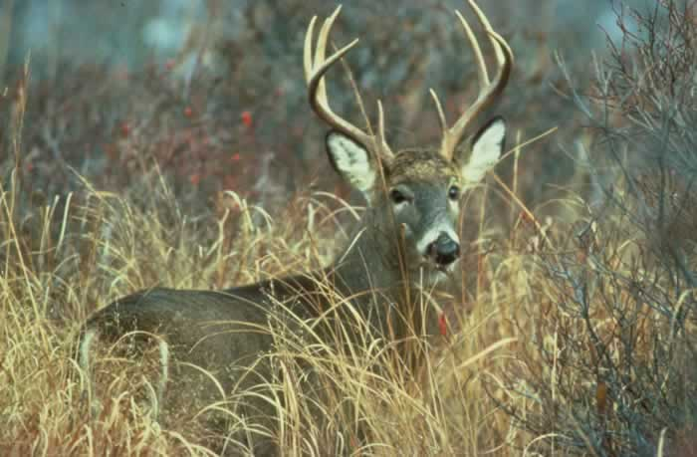
Shortleaf Pine-Bluestem Restoration – Environmental Effects
On butterfly fauna (Thill et al. 2004)
- Numbers of adult butterflies were lowest in the untreated controls and were highest in treated stands the first year after burning
On bats (Perry et al. 2007)
- Big brown, Evening, Northern long-eared, Eastern red, and Seminole bats preferred to roost in thinned and burned mature stands
On small mammals (Masters et al. 1998)
- Abundance and diversity increased in restored stands.
On deer forage (Masters et al. 1996)
- A seven-fold increase in preferred forage in restored stands as compared to untreated controls.
Notes:
These and 15 years of timber rattlesnake research by Dr. Steve Bupre, U of A.
He told me a few years back that indeed, body weights in his snakes are up and that’s a positive sign to him.

Slide 32
Outreach to
Private Landowners
Notes:
Our more recent endeavors regarding SLP restoration have been led by George Rheinhardt who, submitted a project under the Two Chiefs decision, which prioritized private landowners within the shortleaf range and 10 mile corridor to be eligible for cost incentives to manage their pine forests.

Slide 33
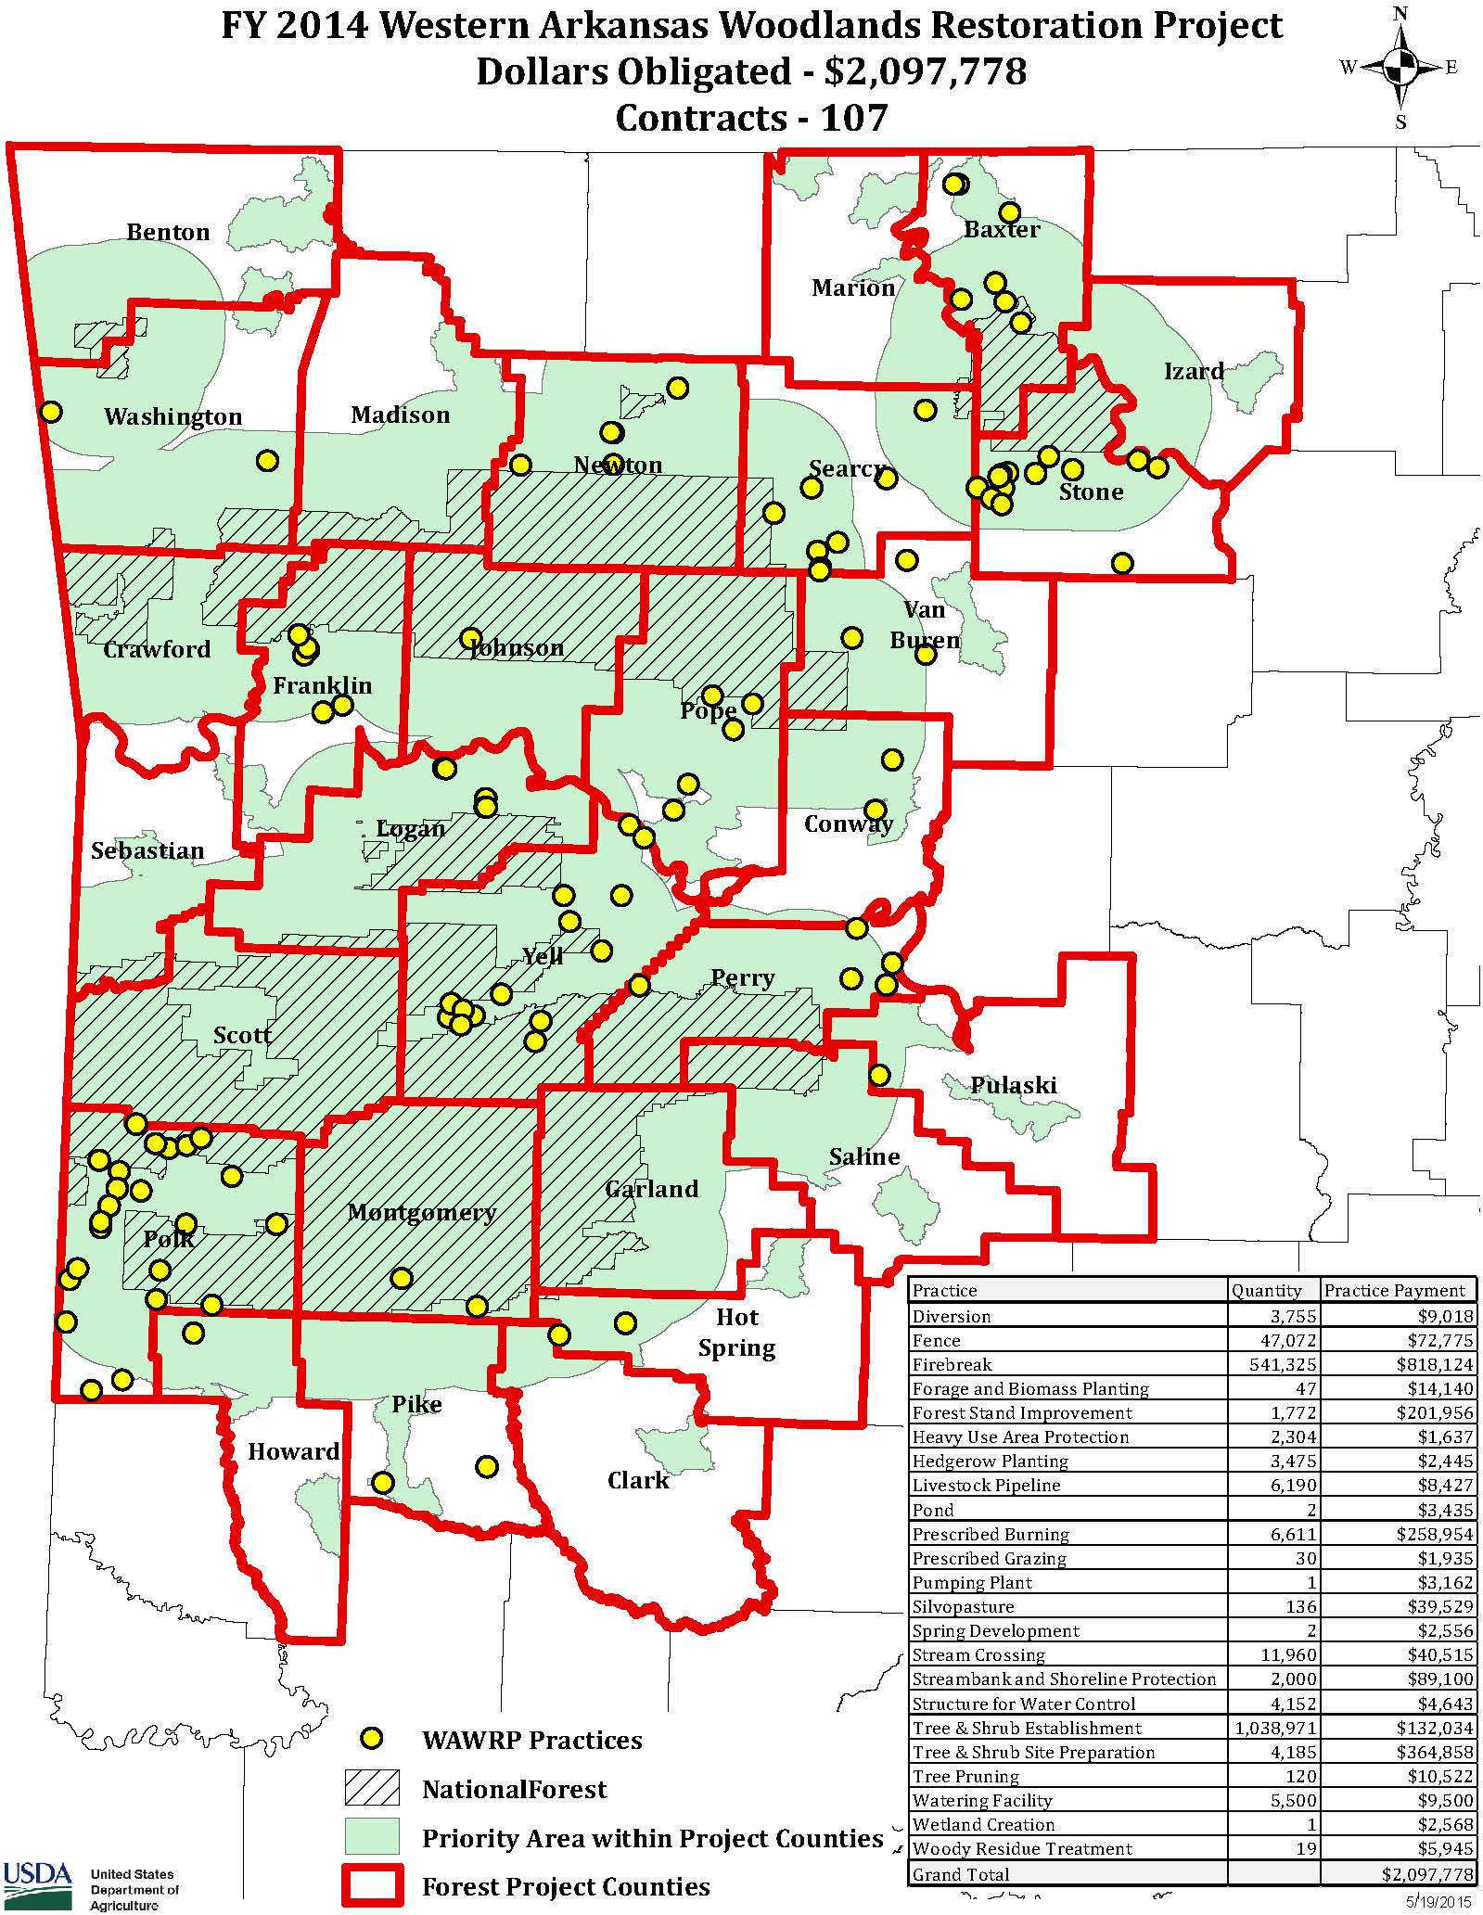
WAWRP
FY 2014 FUNDING
Ouachita and Ozark National Forests
$1.3 million
NRCS
$2.1 million
Notes:
This map depicts this project showing the counties of northern and western Arkansas and the 10 mile border around federal properties where landowners could enroll. Brillant idea!
The small circles are the private lands that signed-up for assistance.

Slide 34
Two Chief’s Projects
2015
Public lands of AR/MO
Shortleaf pine coverage
Priority Buffers for PLs
Notes:
In the second year of the Two Chiefs program, both AR and MO had similar programs involving private shortleaf forests adjacent or closely adjacent to federal lands.
So available funds could be prioritized to landowners that 1) had extant shortleaf forests and 2) that were adjacent to or in AR, within the 10 mile border of federal lands.
Note: The gold border which forms the PL polygon within the 10 mile border.

Slide 35
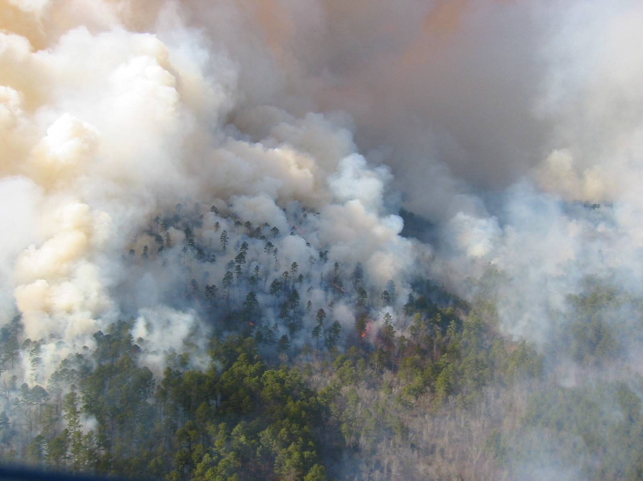
Questions?
Notes:
So, that about does it for what has been going on as far as Shortleaf Pine in the Western range. I would be glad to try and answer a question or two if we have any time left.
Thanks so much.

