Slide 1
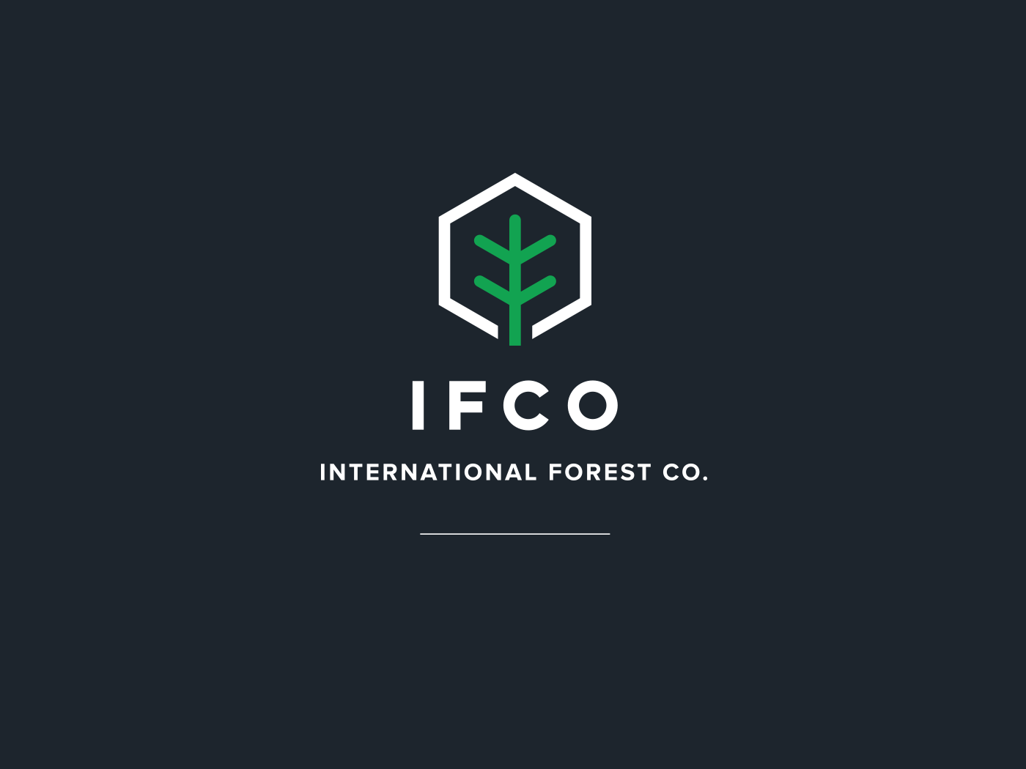
3rd Biennial Shortleaf Pine Conference
The Return of An American Forest Legacy
“Shortleaf Seedling Production and Quality Seedlings”
W

Slide 2
Who is IFCO?
Oldest and Largest Producer of Containerized Seedlings
  32 years of container seedling growing experience
  Over 84 million seedlings grown in 2015
  Longleaf, Loblolly, Slash, Shortleaf and Virginia Pine
  Wiregrass and other native species

Slide 3

The Decision Pyramid©
Silviculture
Soil
Climate
Market
Genetics

Slide 4
Research Cooperatives
  NC State Tree Improvement Program (Genetic Improvement)
  NCSU/ VA Tech Forest Productivity Cooperative (Silviculture)
  Western Gulf Forest Tree Improvement (Genetic Improvement)
  University of Georgia – PMRC (Silviculture)
  Auburn Southern Forestry Nursery Cooperative (Nursery)
  Forest Pest Management Coop (Pest Management)
  U. of FL-Cooperative Forest Genetics Research Program (CFGRP)

Slide 5

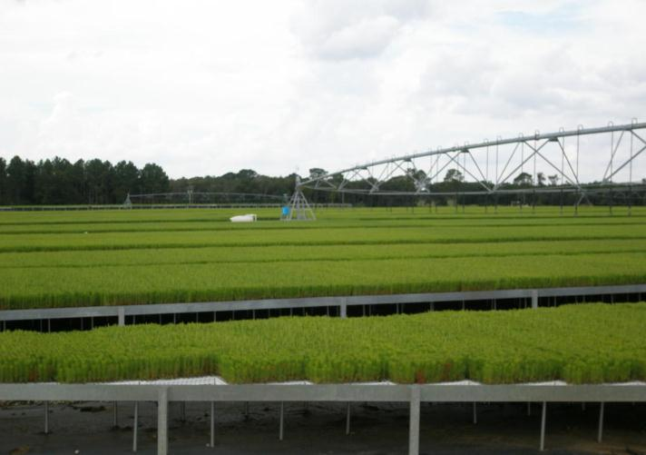
Container Nursery

Slide 6
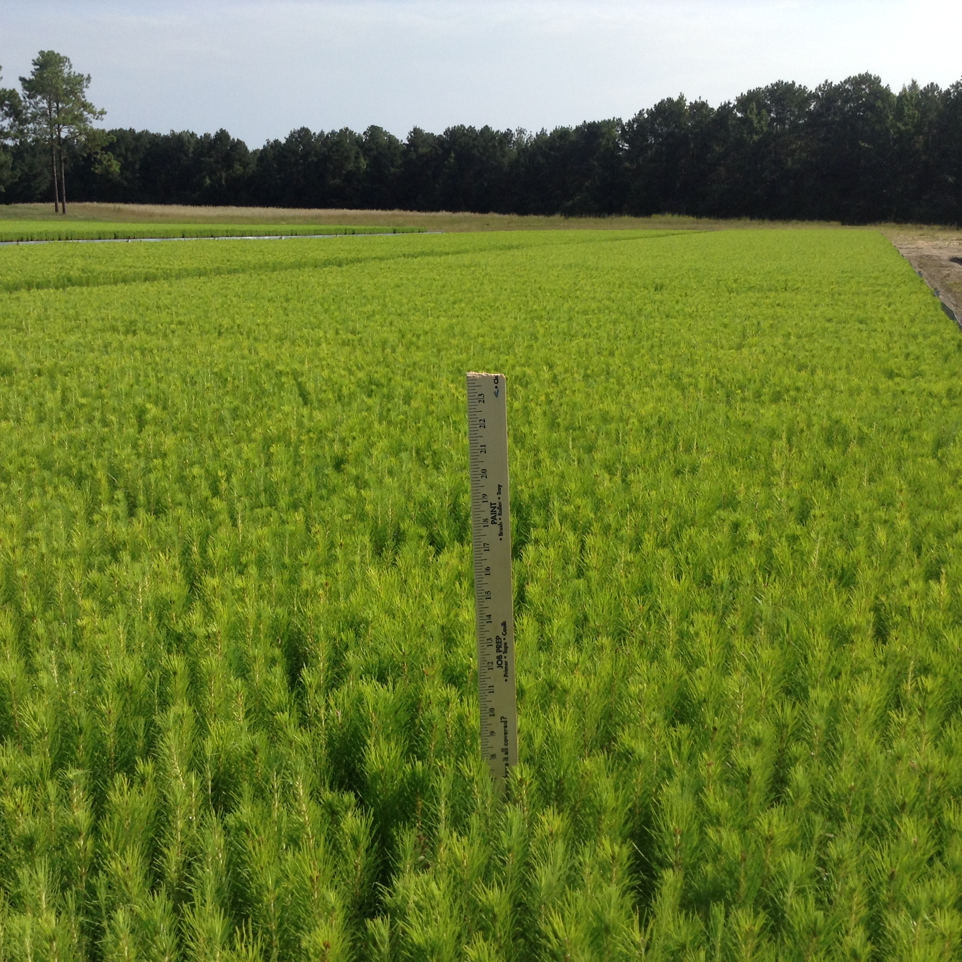
Shortleaf Production in Late Summer

Slide 7
Shortleaf Production Numbers
South wide

Slide 9
The observed rapid increase in container seedling production is being driven by:
High survival potential
Wide planting window permitting late summer to early spring plantings
Increased growth
Lowering of initial trees planted to optimize sawtimber production or create wildlife habitat
Efficient way to deploy higher cost genetic selections

Slide 10
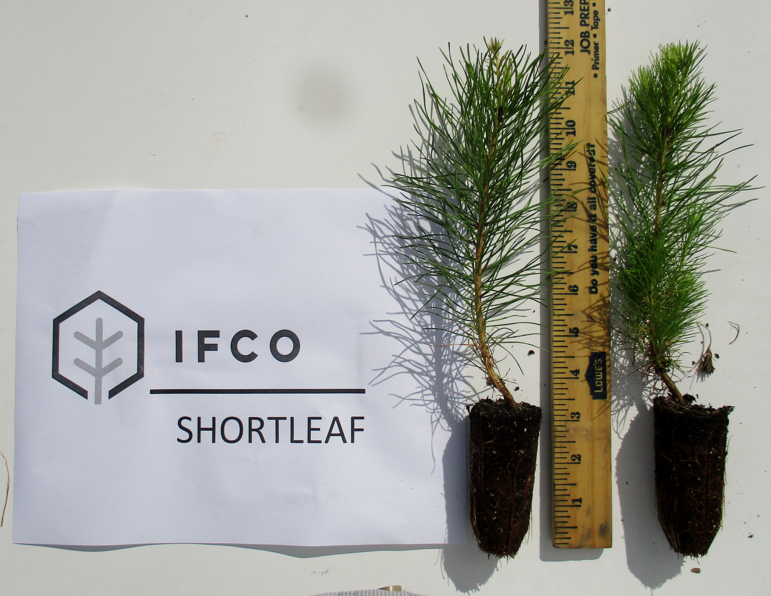
Concept of a target seedling
Height of 10-12 inches
Root Collar Diameter of 4.0 MM or greater
Root shoot ratio of .40 or greater by dry weight.
Firm root system with
Root volume of 5.5 cubic inches or better

Slide 11
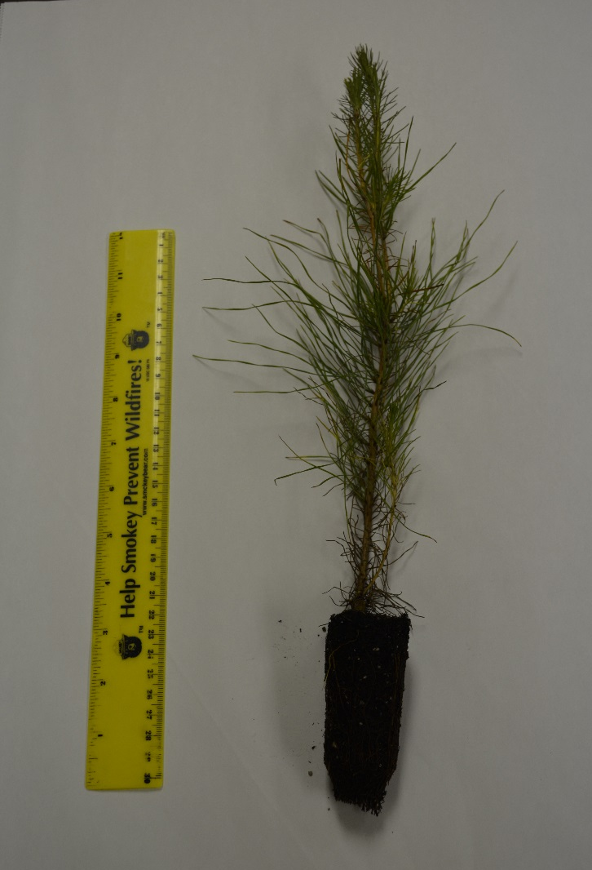
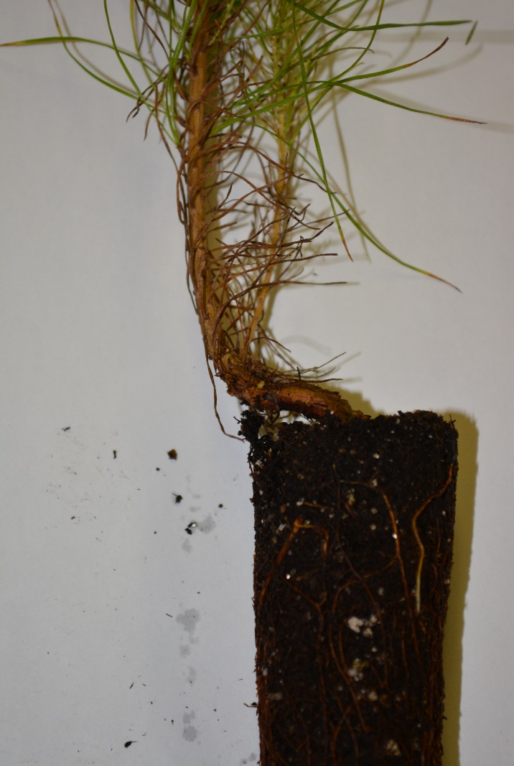
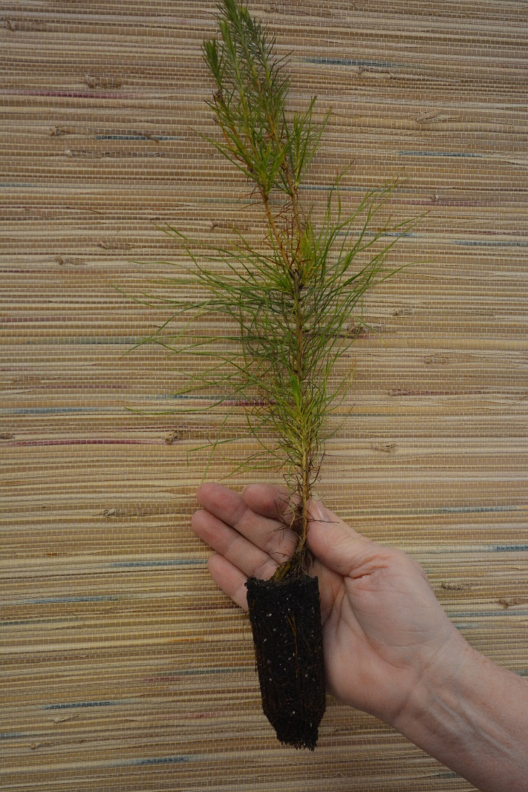
Shortleaf Pine Seedlings

Slide 12
Container Sizes and Quality Specifications
Common standards
Growing Density 120S 49 per square foot, 3.4 in. length, 1.6 in. diameter.
Growing Density 135 53 per square foot, 5.0 in. length, 1.6 in. diameter.
Growing Density 128 51.5 per square foot 4.75 in. length 1.5 diameter.
Seedlings per box 300
Culls No more than 5 per box
No presence of pests Seedlings insect & disease free
Packing liner Boxes contain a 1 mil plastic liner
Fully developed roots containing mycorrhizae that hold together

Slide 13
Average No. of Roots and Root Weight including tap root after 5 months
Container | Av. Total Number of Roots | Total Root Weights
Bareroot | 20 | 3.5
Container A | 64 | 6.1
IFCO 128 | 82 | 7.7
Container B | 82 | 5.3
Container C | 71 | 6.3

Slide 14
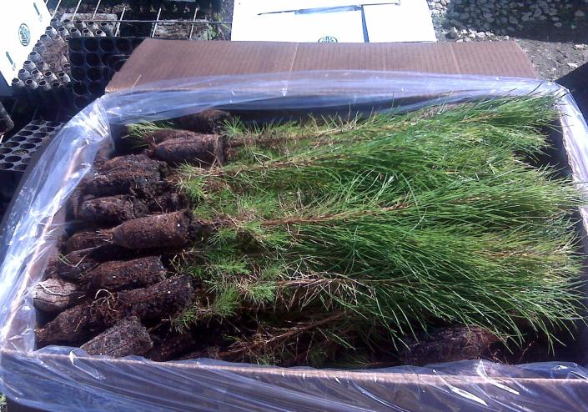
Packaged Seedlings

Slide 15
IFCO Seed Sources
All Seedlings are from Improved Seed Orchards and limited OP families
Seed Sources Available
  Virginia
  North Carolina
  Georgia
  Arkansas
  Texas
International Forest Company
28

Slide 16
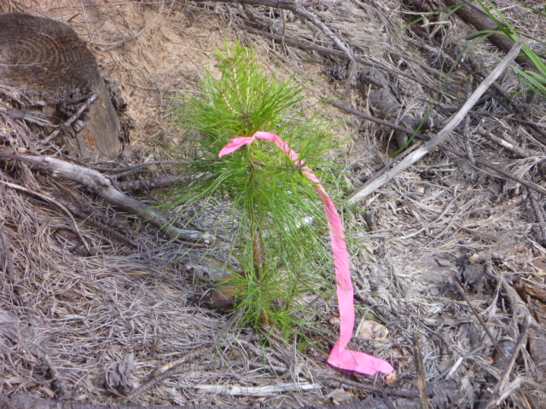
One Year Old- but

Slide 17
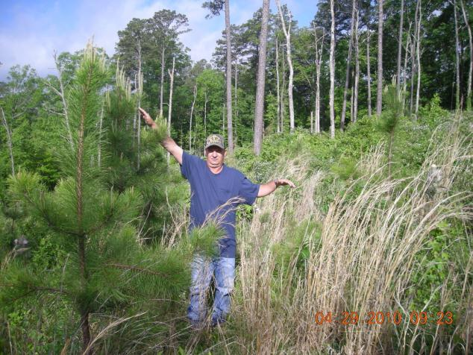
Example from the Field
3 year-old Containerized Planting - USFS
International Forest Company
30

Slide 18
Prices
Price/Acre
Shortleaf Container Improved $72.50
Bareroot Improved $30.00
Based on 500 trees per acre.

Slide 19
Keys to Be Successful
Order seedlings by Jan. 31 to have seedlings for the planting season next fall or winter.
Know and keep up with the seed source you plant.
Plant seedlings early and deep to insure good survival.
Do your chemical site preparation in June through early August.
PLANNING IS ESSENTIAL!

Slide 20
