Slide 1
Underplanted Shortleaf Pine Seedling Survival and Growth in the North Carolina Piedmont
David K. Schnake¹, Scott D. Roberts², John D. Kushla², Ian A. Munn²
¹North Carolina Department of Agriculture and Consumer Services, Research Stations Division
²College of Forest Resources, Department of Forestry, Mississippi State University

Slide 2
Introduction
Shortleaf acreage is declining in North Carolina
Regeneration-focused management is needed to balance the proportion of seedlings to overstory trees

Slide 3
Shortleaf pine can grow very well in parts of North Carolina

Slide 4
We need to consider changing landowner values and new management constraints when developing regeneration plans

Slide 5
Underplanting might be a suitable option for some landowners where:
Shortleaf underplanted beneath a hardwood overstory
Visual impacts of forest management are a concern
Overstory retention is desired or required
Notes:
Underplanting is an alternative regeneration method that might be appropriate in the Central and Southern Appalachian Piedmont. The concept is quite simple: You leave some overstory trees and then artificially regenerate beneath them. In addition to lessening the visual impact of regenerating a forest stand, the overstory trees can add some structural diversity to the site and, depending on how many were left, add some of the sheltering effects associated with a shelterwood. Artificially regenerating beneath the overstory gives the forester control over stock type, density, and the timing of establishment.
The shelterwood method may therefore be an appropriate option in areas where the visual impacts of forest management are a concern, overstory retention is otherwise desired or required, and the landowner wants some control over what is being established and when it will take place.

Slide 6
Past Underplanting Research
Inverse relationship between overstory density and seedling growth
Guldin, J. M. & Heath, G. (2001). Underplanting shortleaf pine seedlings beneath a residual hardwood stand in the Ouachita Mountains: results after seven growing seasons.
Jensen, J. & Gwaze, D. (2007). Underplanting shortleaf pine at Coldwater Conservation Area in Missouri.
Jensen, J., Smith, C., Johanson, M., & Gwaze, D., (2007). Underplanting shortleaf pine in the Missouri Ozarks.
Kabrick, J. M., Dey, D. C., Shifley, S. R., & Villwock, J. L. (2011). Early survival and growth of planted shortleaf pine seedlings as a function of initial size and overstory stocking.
Notes:
A few studies have investigated underplanting shortleaf pine beneath residual hardwood overstories. The general take-away from these studies is that there is an inverse relationship between overstory density and the growth of the underplanting seedlings. The studies also looked at survival and there were either no significant differences between treatments or a similar inverse relationship between survival and overstory density.

Slide 7
Objectives
Evaluate the effectiveness of underplanting as a method of establishing a shortleaf pine component in mixed stands in the Central Appalachian Piedmont
Evaluate the impact of overstory density on survival and growth of underplanted seedlings on a North Carolina Piedmont site.
Evaluate differences in survival and growth between containerized and bareroot shortleaf pine planting stock.
Notes:
Our primary objective with the study is to evaluate the effectiveness of underplanting as a method of establishing a shortleaf pine component in the pine-hardwood or hardwood-pine mixtures in the Southern Appalachian Piedmont. Our specific objectives include:
Evaluate differences in survival and growth between containerized and bareroot shortleaf pine planting stock.
Evaluate the impact of overstory stocking and canopy coverage on survival and growth of underplanted seedlings on a North Carolina Piedmont site.
We’ve basically combined aspects of the four previous underplanting studies and implemented it in North Carolina. We’ve added some complexity by using several different stock types.

Slide 8
Methods Study Site
Study site prior to harvest
NCDA&CS Umstead Research Station. Durham County, NC.
Mixed Hardwood-Pine
Abandoned agricultural land
Soils: silt loam and sandy loam
Annual precipitation: 45.2 inches
Elevation: 440 – 480 ft.
Notes:
The study site we have selected is located in the Piedmont of North Carolina. The site was a typical hardwood-pine mixed stand on abandoned agricultural land. The site is basically a ridge that runs north to south with moderate yet easily defined eastern and western and southern aspects. Two soil types were present: Lingum silt loam on the upper portions of the ridge and Helena sandy loam on the lower slopes. The site is best described as a rocky ridge with shallow soils. The average rainfall received in this portion of the State is on the low end of the Piedmont average. At a whopping 440 to 480 feet, it is one of the higher points in the county. Geologically, this site is on the Triassic Basin sandwiched between the Carolina Slate Belt to the west and the Releigh-belt to the east.

Slide 9
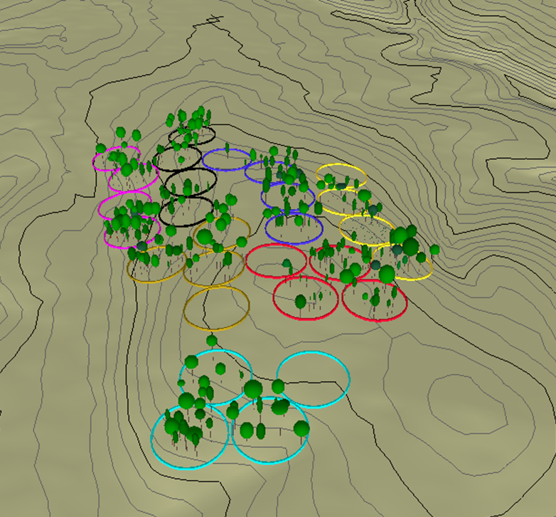
Methods Experimental Design
Four residual overstory basal area treatment levels: BA 0, BA 15, BA 30, BA 45
1/3-acre circular treatment plots
1/10-acre seedling measurement plot positioned at plot center
Seven replicated blocks of each residual BA treatment
Three stock types
N
Graphic generated with EnVision software developed by Robert J. McGaughey, USDA Forest Service Pacific Northwest Research Station

Slide 10
Methods Stock Type
Three shortleaf pine stock types are being analyzed
Containerized with a small plug (NCSP)
1-0
1.6 x 3.5 depth plug
NC seed source
Bareroot (VABR)
1-0
VA seed source
Containerized with a large plug (NCLP)
1-0
1.5 x 4.75 depth plug
NC seed source

Slide 11
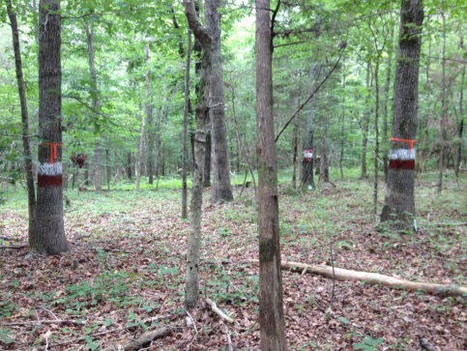
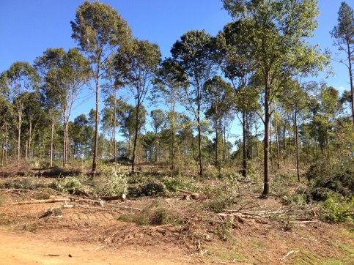
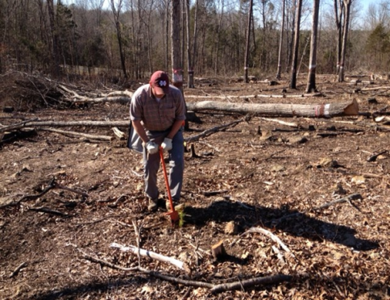
Methods Implementation
Marked the leave trees within each plot to ensure uniform overstory distribution and comparable average diameters
Harvested to targeted residual basal areas in August and September, 2012.
Planted and recorded initial sizes in January/February, 2013.
Recorded survival, seedling height, and seedling groundline diameter following first and second growing seasons

Slide 12
Results – Year One Survival
Stock type and residual basal area had significant effects on first year survival

Slide 13
Results – Year Two Groundline Diameter Growth
Residual basal area and stock type had significant effects on groundline diameter growth after two growing seasons

Slide 14
Results – Year Two Height Growth
Residual basal area and stock type had significant effects on height growth after two growing seasons

Slide 15
Discussion - Survival
Residual overstory basal area had a significant effect on survival
Containerized stock had significantly better survival that than the bareroot stock
Attributed to the harsh microclimate in BA 0 plots and dense herbaceous competition
The bareroot and containerized seedlings with small plugs had poor survival in the BA 0 plots
Attributed to the more intact root systems of the containerized stock and possibly seed source.
Differences between the two containerized stock are attributed to more area for root development in the large plug and depth.
Notes:
Our analysis showed that treatment had a significant effect on the survival of the bareroot seedlings and the containerized stock with the small plug size. Survival was worst in the clearcut plots and then gradually improved with increasing basal area. We attribute this to two things: First, we basically created a gradient of harshness under the different levels of overstory with the clearcut or BA0 plots being the harshest with regard to microclimate. Additionally, there was intense herbaceous competition within the BA 0 plots. We theorize that the bareroot and small-plugged containerized stock struggled to survive in such a harsh environment with so much competition.
We also noticed that there were no significant differences in survival by treatment for the containerized stock with large plugs. As with the other stock types, survival was lowest in the BA0 plots but not significantly so. We theorize that the higher root volume associated with the larger containerized seedling plugs improved those seedlings' ability to survive.
When we looked harder at the interaction between stock type and treatment we noticed that the containerized stock with large plugs had significantly better survival than the containerized stock with smaller plugs in the BA0 plots. Again, we attribute this to the higher root volume associated with the larger plug.

Slide 16
Discussion - Growth
Heights and groundline diameters were largest in plots with no/low residual overstory density
Containerized stock generally had larger heights and groundline diameters after two growing seasons
Again attributed to the more intact root systems associated with the containerized seedlings, depth and area for root development between the two container sizes, and possibly seed source.
Inverse relationship between overstory density and seedling size

Slide 17
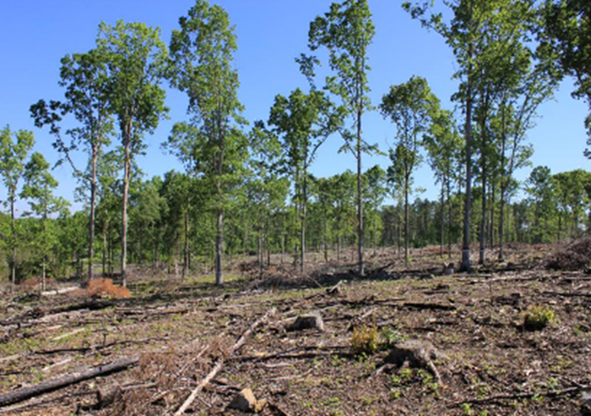
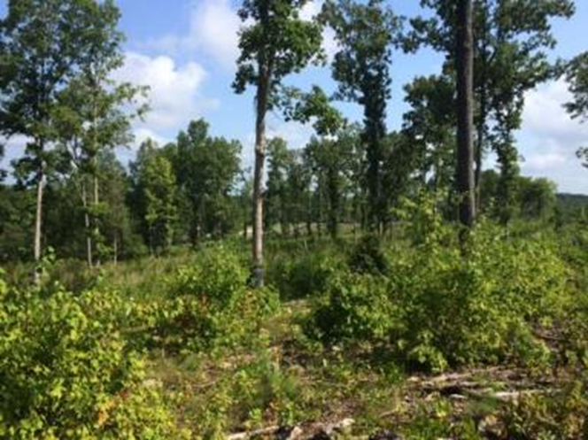
Management Implications
Underplanting shortleaf pine seedling beneath a residual hardwood overstory appears to be a suitable method of establishing shortleaf pine.
The suppression of competing vegetation and sheltering provided by low levels of overstory basal area may improve early survival without negatively impacting growth.

Slide 18
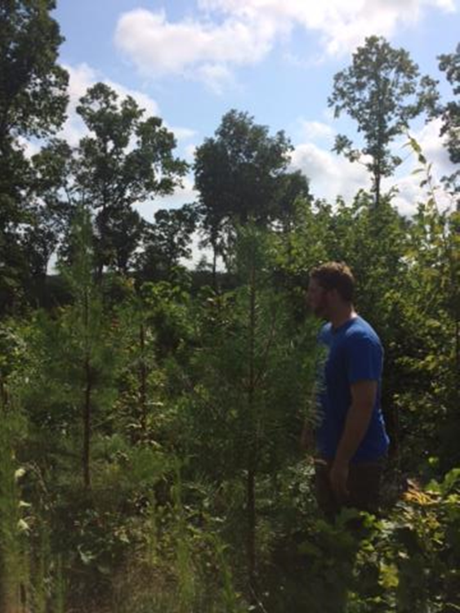
Management Implications
Containerized stock outperformed bareroot stock on this harsh Piedmont site.
Both containerized sources, which are currently available to landowners, performed very well.
If the site allows, planting containerized seedlings with larger and deeper plugs may increase seedling survival and growth on harsh sites.

Slide 19
Questions
David K. Schnake
(217) 855-2927
David.schnake@ncagr.gov

Slide 20
References
Bailey, R. G. (1995). Description of the Ecoregions of the United States. Washington, D.C: USDA Forest Service. Retrieved from http://www.fs.fed.us/land/ecosysmgmt/index.html
Conservancy, T. N. (2005). The Piedmont Ecoregion: A Plan for Biodiversity Conservation - Draft Implementation Document. (J. Dunscomb, M. Bucher, J. Prince, & R. Sutter, Eds.). The Nature Conservancy.
Guldin, J. M. (2007). Restoration and Management of Shortleaf Pine in Pure and Mixed Stands - Science, Empirical Observation, and the Wishful Application of Generalities. In J. Kabrick, D. Dey, & D. Gwaze (Eds.), Shortleaf Pine Restoration and Ecology in the Ozarks: Proceedings of a Symposium. General Technical Report NR-P-15 (pp. 47–58). Newton Square, PA: USDA Forest Service, Northern Research Station.
Guldin, J. M., & Heath, G. (2001). Underplanting Shortleaf Pine Seedlings Beneath a Residual Hardwood Stand in the Ouachita Mountains: Results after Seven Growing Seasons. Research Note SRS-09. Asheville, NC: USDA Forest Service Southeastern Forest Experiment Station. Retrieved from http://www.srs.fs.usda.gov/pubs/viewpub.php?index=2742
Jensen, J., & Gwaze, D. (2007). Underplanting Shortleaf Pine at Coldwater Conservation Area in Missouri. In J. Kabrick, D. Dey, & D. Gwaze (Eds.), Shortleaf Pine Restoration and Ecology in the Ozarks: Proceedings of a Symposium. General Technical Report NR-P-15 (pp. 117–118). Newton Square, PA: USDA Forest Service, Northern Research Station.
Jensen, J., Smith, C., Johanson, M., & Gwaze, D. (2007). Underplanting Shortleaf Pine in the Missouri Ozarks. In J. Kabrick, D. Dey, & D. Gwaze (Eds.), Shortleaf Pine Restoration and Ecology in the Ozarks: Proceedings of a Symposium. General Technical Report NR-P-15 (pp. 112–116). Newton Square, PA: USDA Forest Service, Northern Research Station.
Kabrick, J., Dey, D., Shifley, S. R., & Villwock, J. L. (2011). Early survival and growth of planted shortleaf pine seedlings as a function of initial size and overstory stocking. In S. Fei, J. M. Lhotka, J. W. Stringer, K. W. Gottschalk, & G. W. Miller (Eds.), Proceedings of the 17th Central Hardwood Forest Conference. GRT-NRS-P-78 (Vol. 78, pp. 277–286). Newton Square, PA: USDA Forest Service, Northern Research Station. Retrieved from http://www.nrs.fs.fed.us/pubs/gtr/gtr-p-78papers/29kabrickp78.pdf
Lawson, E. R. (1990). Silvics of North America Volume 1 : Conifers. (R. M. Burns & B. H. Honkala, Eds.)Silvics of North America Volume 1 Conifers (Vol. 1, pp. 630–652). Washington, D.C: USDA Forest Service. Retrieved from http://www.na.fs.fed.us/spfo/pubs/silvics_manual/table_of_contents.htm

