Slide 1
Where We Are Now -- Successes and Challenges to Restoring Shortleaf Pine in North Carolina
Bill Pickens
NC Forest Service
3rd Biennial Shortleaf Pine Conference.
September 24, 2015
Knoxville, TN

Slide 2
Shortleaf is losing ground … & numbers
Notes:
62 % loss in acres 1990 – 2002
54.6 million trees lost (1984 -1990)
106.8 million trees lost (1990 – 2002
BA declined by 47% (1990-2002)

Slide 3
75% is > 40 years old
Notes:
Perhaps a bigger concern is the shift towards older stands. Posing the question where will the next shortleaf forest come from

Slide 4
FIA Shortleaf Plots

Slide 5
Successes - Outreach
Sponsored 4 Shortleaf focused workshops
NCSAF Meeting June 2005
NCSU Forestry Outreach Teleconference January 2006
Shortleaf Pine Restoration Conference Sept. 2010
Shortleaf 101 Workshop May 2015
Shortleaf in the Appalachians July 2015
7 presentations from 2011 – 2015
Consulting Forester, Landowners, Forestry Guild, NCFS Foresters, Fire Council

Slide 6
Successes - Management
Increases in Acres planted
Increases in Seedling demand
Increases in Acres burned
Priority in Cost-Share funding

Slide 7
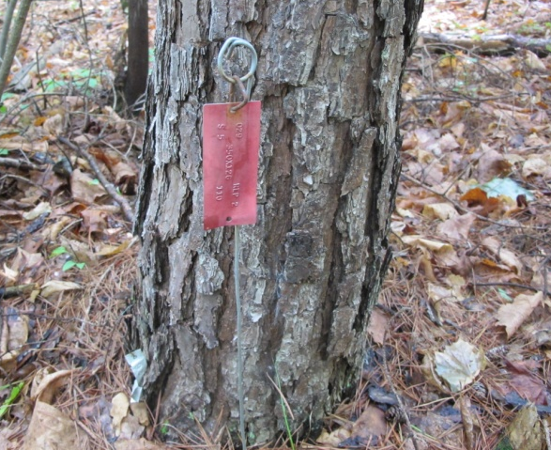
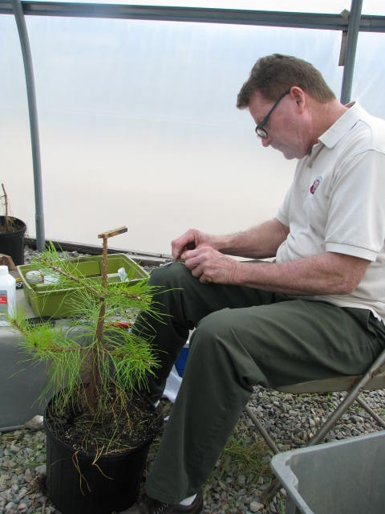
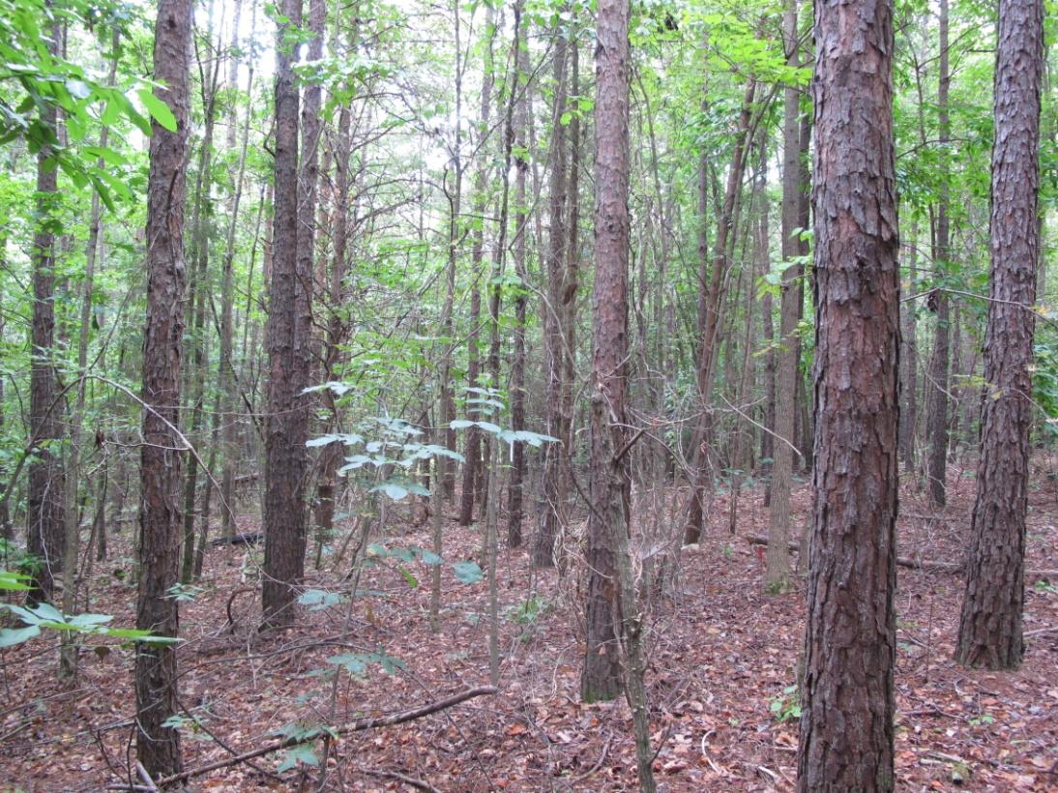
Successes – Tree Improvement
Established a New 2nd Generation Shortleaf Orchard
Scion material from Tennessee and USFS
Re-measured progeny tests established 25 – 30 years ago
Best Growers were the best on all sites
Survival , height = no differences in Piedmont or Mountain

Slide 8
Successes – SL Website

Slide 9
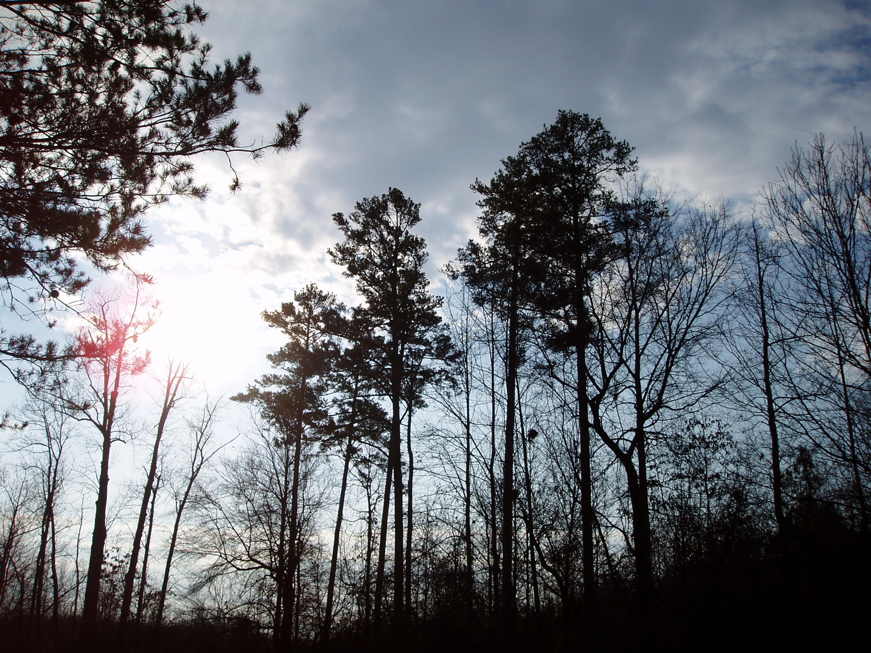
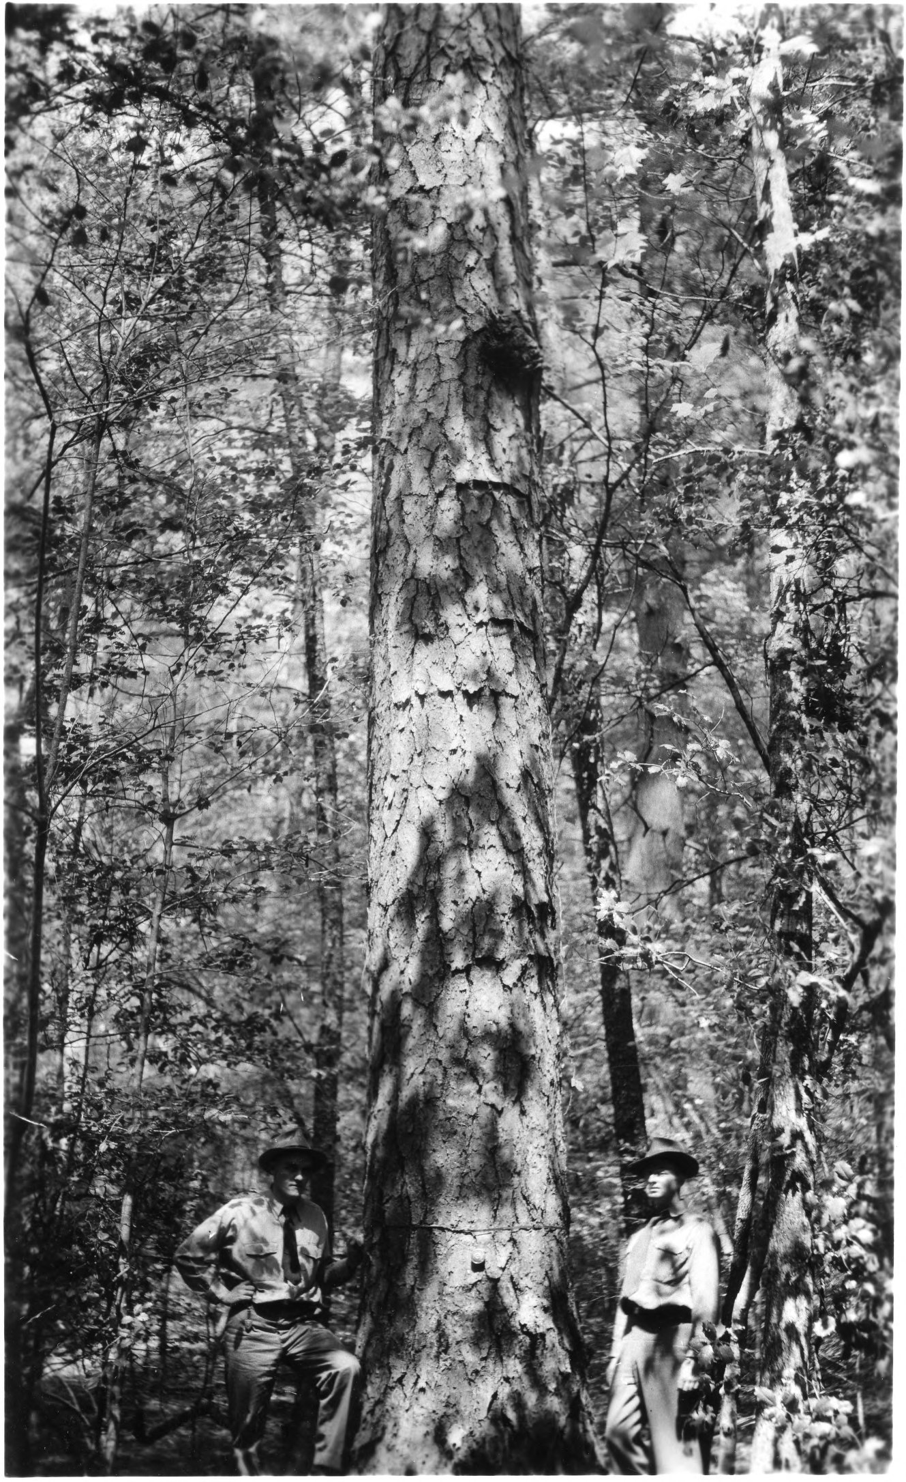
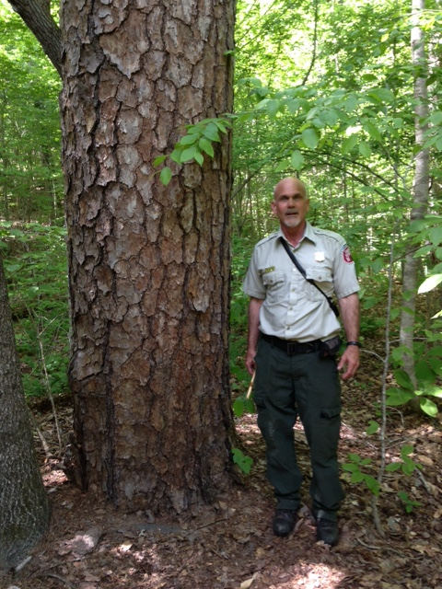

Slide 10
Mattoon 1915

Slide 12
Naturally occurred …..
Dry Oak—Hickory Forest
Dry-Mesic Oak—Hickory Forest,
Dry Basic Oak—Hickory Forest
Dry-Mesic Basic Oak—Hickory Forest,
Piedmont Monadnock Forest
Xeric Hardpan Forest (all subtypes),
Dry Piedmont Longleaf Pine Forest
Notes:
Shortleaf pine occurs/occurred naturally in most of the drier Piedmont communities:
Dry Oak—Hickory Forest, Dry-Mesic Oak—Hickory Forest, Dry Basic Oak—Hickory Forest, Dry-Mesic Basic Oak—Hickory Forest, Piedmont Monadnock Forest (mainly in the Pine Subtype), Xeric Hardpan Forest (all subtypes), and Dry Piedmont Longleaf Pine Forest. It could also be in Piedmont Acidic Glade, Piedmont Basic Glade, Granitic Flatrock, or Piedmont Cliff. It was probably also present in the Coastal Plain in the oak-hickory forests, though loblolly would have been present there as well. It would be in at least some Mesic Pine Savannas and Pine/Scrub Oak Sandhill – Mesic Transition Subtype. In the mountains, it is present in Low Mountain Pine Forest, Southern Mountain Pine—Oak Forest, and to some degree in the Low Dry Subtype of Montane Oak—Hickory Forest.

Slide 13
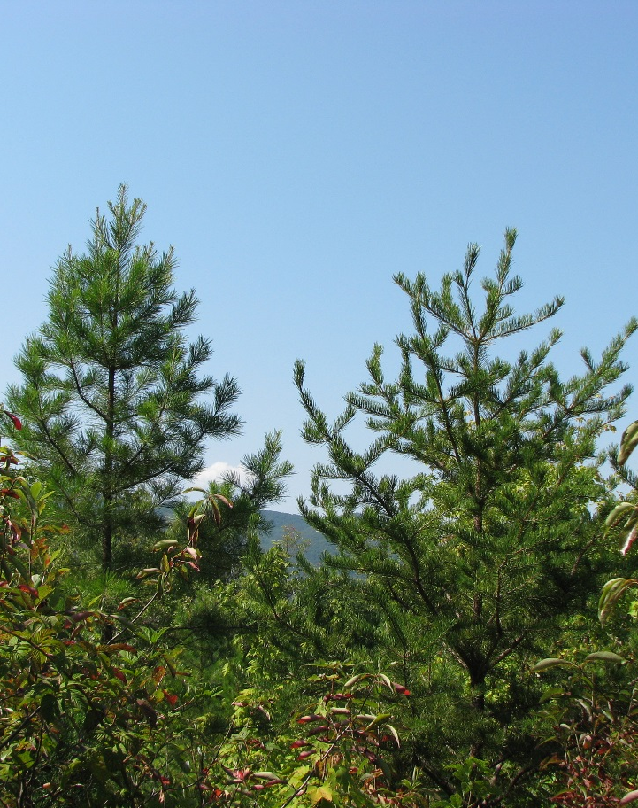
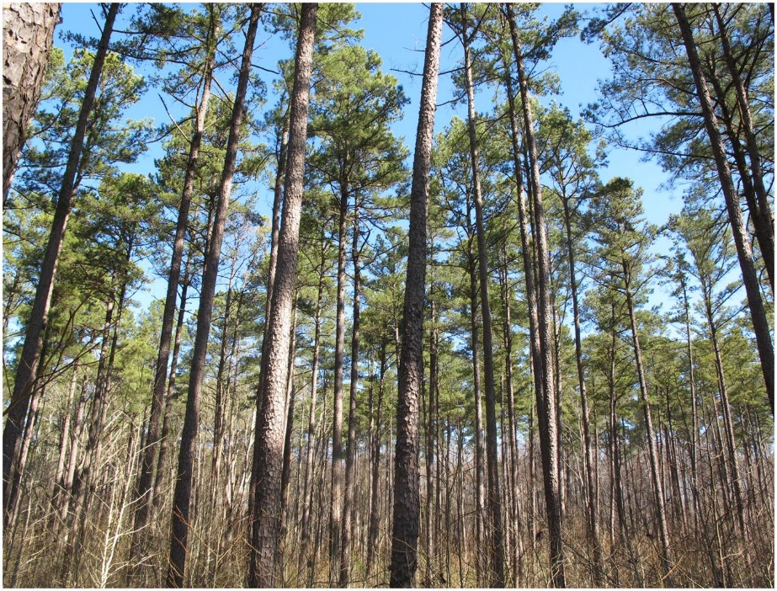
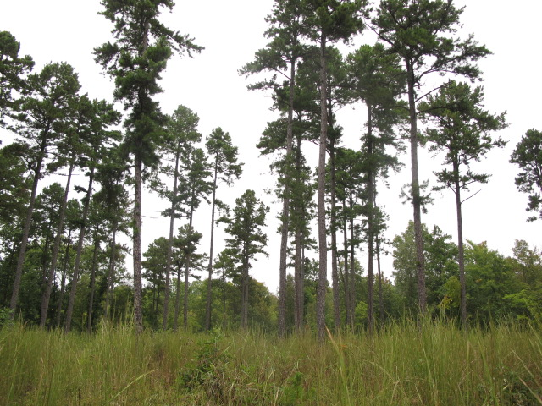
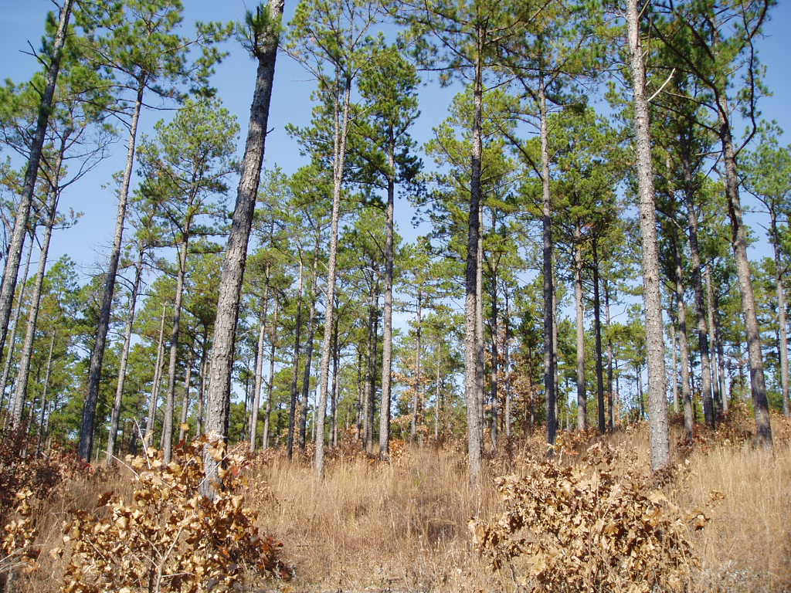
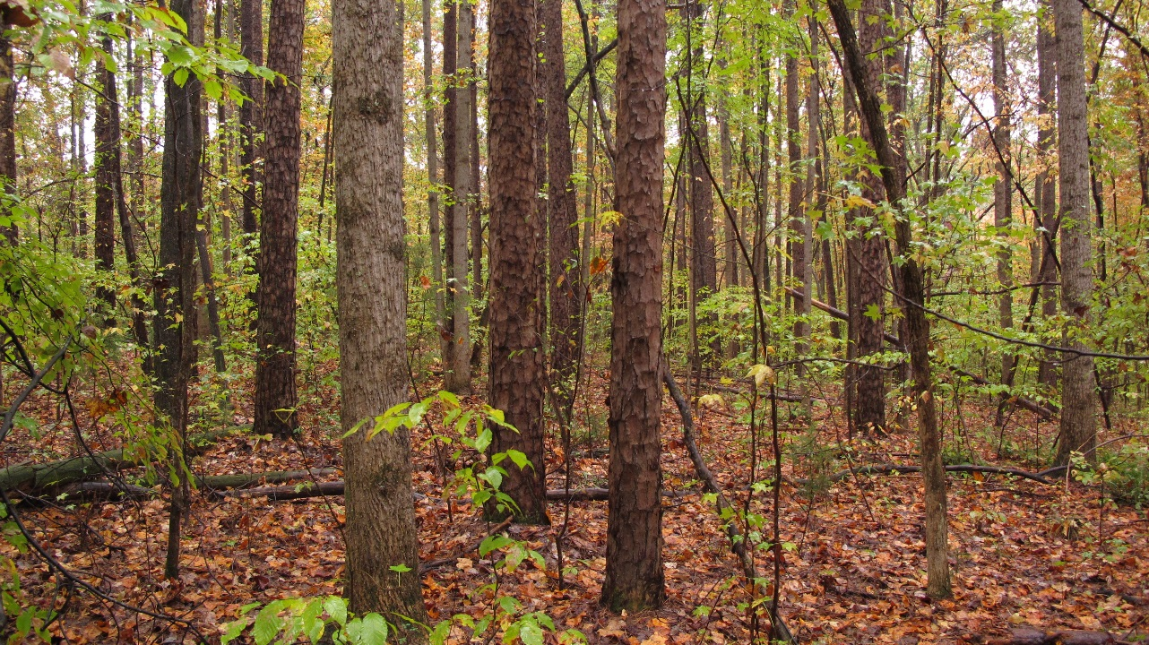
Strategies for Restoration What do we want our Shortleaf Forests to Look Like?

Slide 14
Strategies for Restoration What do we want our Shortleaf Forests to Look Like?
The forest now compared to what it was
Timber production or ecological restoration
Savannas, mixed pine-oak, plantations

Slide 15
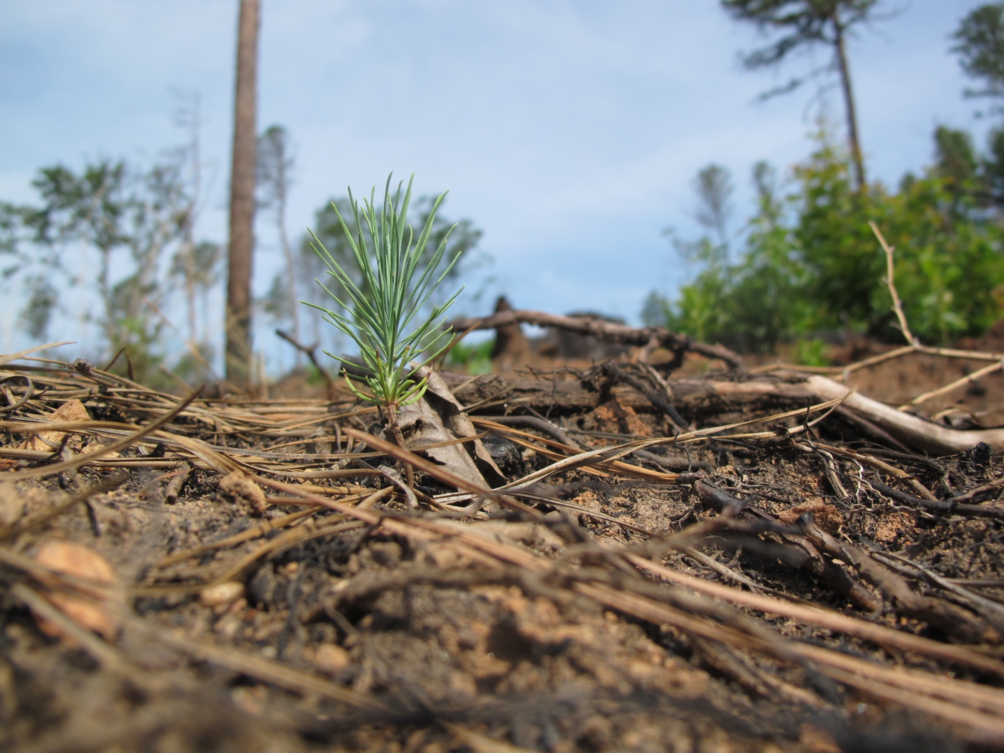
Strategies to Restoration: Select for success
Select the Right Sites
What about Littleleaf
Mixed stands

Slide 16
Strategies to Restoration: Grow the Next Forest
Artificial Regeneration
Adequate Site Prep
Quality Seedlings
Mixed stands-Match Species

Slide 17
Strategies to Restoration: Grow the Next Forest
Natural Regeneration
Target Existing Stands
Adequate Site Prep

Slide 18
Lessons Learned There is a lot of:
Competition
Growing space
Funds
Interest
Interest

Slide 19
Lessons Learned There is a lot of:
Gaps in Knowledge and Experience
Gaps in Research
Real and perceived bias
SPB Risk
Littleleaf Disease Risk
Growth
Site Suitability

Slide 20
Lessons Learned
Smoke Management Concerns
Shortleaf takes time to establish
Natural regeneration has not been dependable
SL is not fire proof
A lot of Shortleaf does not sprout after top-kill

Slide 21
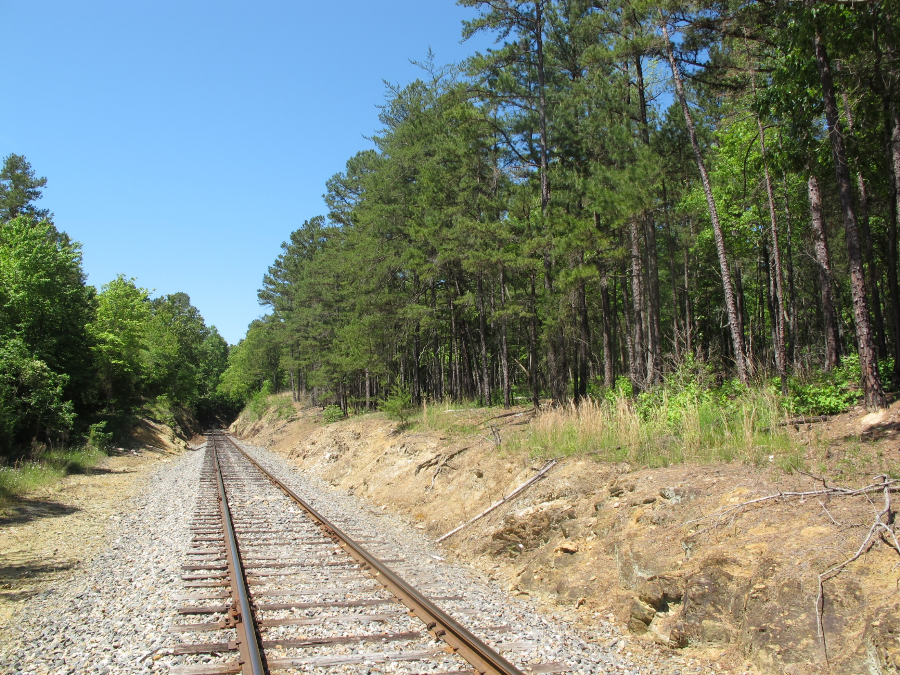
What’s Down the Tracks?
An upland species without production capacity of loblolly nor the ecological capacity of longleaf……
“It seems unremarkable and therefore is expendable” Dr Gary Blank , NCSU

Slide 22
“Shortleaf is the New Longleaf”
Include Private Landowners
Make an Economic argument to Complement an Ecological one
Be “Honest Brokers” of Information
SL is an option
Find a Hook
Cultural, ecological, history
Educate and Demonstrate
Be Patient

Slide 23
Questions???.... or Comments
bill.pickens@ncagr.gov
919-553-6178 x233

